Slide 1
8) Granularity
Computation / Communication Ratio:
In parallel computing, granularity is a qualitative measure of the ratio of computation to communication.
Periods of computation are typically separated from periods of communication by synchronization events.
Fine grain parallelism
Coarse grain parallelism

Slide 2
Fine-grain Parallelism
Relatively small amounts of computational work are done between communication events
Low computation to communication ratio
Facilitates load balancing
Implies high communication overhead and less opportunity for performance enhancement
If granularity is too fine it is possible that the overhead required for communications and synchronization between tasks takes longer than the computation.

Slide 3
Coarse-grain Parallelism
Relatively large amounts of computational work are done between communication/synchronization events
High computation to communication ratio
Implies more opportunity for performance increase
Harder to load balance efficiently

Slide 4
Which is Best?
The most efficient granularity is dependent on the algorithm and the hardware environment in which it runs.
In most cases the overhead associated with communications and synchronization is high relative to execution speed so it is advantageous to have coarse granularity.
Fine-grain parallelism can help reduce overheads due to load imbalance.

Slide 5
9) I/O The bad news
I/O operations are generally regarded as inhibitors to parallelism
Parallel I/O systems are immature or not available for all platforms
In an environment where all tasks see the same filespace, write operations will result in file overwriting
Read operations will be affected by the fileserver's ability to handle multiple read requests at the same time
I/O that must be conducted over the network (NFS, non-local) can cause severe bottlenecks

Slide 6
The good News
Some parallel file systems are available. For example:
GPFS: General Parallel File System for AIX (IBM)
Lustre: for Linux clusters (Cluster File Systems, Inc.)
PVFS/PVFS2: Parallel Virtual File System for Linux clusters (Clemson/Argonne/Ohio State/others)
PanFS: Panasas ActiveScale File System for Linux clusters (Panasas, Inc.)
HP SFS: HP StorageWorks Scalable File Share. Lustre based parallel file system (Global File System for Linux) product from HP
The parallel I/O programming interface specification for MPI has been available since 1996 as part of MPI-2. Vendor and "free" implementations are now commonly available.

Slide 7
Some Options
If you have access to a parallel file system, investigate using it. If you don't, keep reading...
Rule #1: Reduce overall I/O as much as possible
Confine I/O to specific serial portions of the job, and then use parallel communications to distribute data to parallel tasks. For example, Task 1 could read an input file and then communicate required data to other tasks. Likewise, Task 1 could perform write operation after receiving required data from all other tasks.
For distributed memory systems with shared filespace, perform I/O in local, non-shared filespace. For example, each processor may have /tmp filespace which can used. This is usually much more efficient than performing I/O over the network to one's home directory.
Create unique filenames for each tasks' input/output file(s)

Slide 8
Amdahl's Law
10) Limits and Costs of Parallel Programming
Amdahl's Law states that potential program speedup is defined by the fraction of code (P) that can be parallelized:
1
speedup = --------
1 - P
If none of the code can be parallelized, P = 0 and the speedup = 1 (no speedup). If all of the code is parallelized, P = 1 and the speedup is infinite (in theory).
If 50% of the code can be parallelized, maximum speedup = 2, meaning the code will run twice as fast.

Slide 9
Amdahl's Law
Introducing the number of processors performing the parallel fraction of work, the relationship can be modeled by
where P = parallel fraction, N = number of processors and S = serial fraction
1
speedup = ------------
P + S
---
N

Slide 10
Amdahl's Law
It soon becomes obvious that there are limits to the scalability of parallelism. For example, at
P = .50, .90 and .99 (50%, 90% and 99% of the code is parallelizable)
speedup
-----------------------------------
N P = .50 P = .90 P = .99
----- ------- ------- -------
10 1.82 5.26 9.17
100 1.98 9.17 50.25
1000 1.99 9.91 90.99
10000 1.99 9.91 99.02

Slide 11
Amdahl's Law
However, certain problems demonstrate increased performance by increasing the problem size. For example:
2D Grid Calculations 85 seconds 85%
Serial fraction 15 seconds 15%
We can increase the problem size by doubling the grid dimensions and halving the time step. This results in four times the number of grid points and twice the number of time steps. The timings then look like:
2D Grid Calculations 680 seconds 97.84%
Serial fraction 15 seconds 2.16%
Problems that increase the percentage of parallel time with their size are more scalable than problems with a fixed percentage of parallel time.

Slide 12
Complexity
In general, parallel applications are much more complex than corresponding serial applications, perhaps an order of magnitude. Not only do you have multiple instruction streams executing at the same time, but you also have data flowing between them.
The costs of complexity are measured in programmer time in virtually every aspect of the software development cycle:
Design
Coding
Debugging
Tuning
Maintenance
Adhering to "good" software development practices is essential when when working with parallel applications - especially if somebody besides you will have to work with the software.

Slide 13
Portability
Thanks to standardization in several APIs, such as MPI, POSIX threads, HPF and OpenMP, portability issues with parallel programs are not as serious as in years past. However...
All of the usual portability issues associated with serial programs apply to parallel programs. For example, if you use vendor "enhancements" to Fortran, C or C++, portability will be a problem.
Even though standards exist for several APIs, implementations will differ in a number of details, sometimes to the point of requiring code modifications in order to effect portability.
Operating systems can play a key role in code portability issues.
Hardware architectures are characteristically highly variable and can affect portability.

Slide 14
Resource Requirements
The primary intent of parallel programming is to decrease execution wall clock time, however in order to accomplish this, more CPU time is required. For example, a parallel code that runs in 1 hour on 8 processors actually uses 8 hours of CPU time.
The amount of memory required can be greater for parallel codes than serial codes, due to the need to replicate data and for overheads associated with parallel support libraries and subsystems.
For short running parallel programs, there can actually be a decrease in performance compared to a similar serial implementation. The overhead costs associated with setting up the parallel environment, task creation, communications and task termination can comprise a significant portion of the total execution time for short runs.

Slide 15
Scalability
The ability of a parallel program's performance to scale is a result of a number of interrelated factors. Simply adding more machines is rarely the answer.
The algorithm may have inherent limits to scalability. At some point, adding more resources causes performance to decrease. Most parallel solutions demonstrate this characteristic at some point.
Hardware factors play a significant role in scalability. Examples:
Memory-cpu bus bandwidth on an SMP machine
Communications network bandwidth
Amount of memory available on any given machine or set of machines
Processor clock speed
Parallel support libraries and subsystems software can limit scalability independent of your application.

Slide 16
11) Performance Analysis and Tuning
As with debugging, monitoring and analyzing parallel program execution is significantly more of a challenge than for serial programs.
A number of parallel tools for execution monitoring and program analysis are available.
Some are quite useful; some are cross-platform also.
One starting point: Performance Analysis Tools Tutorial
Work remains to be done, particularly in the area of scalability.

Slide 17
Parallel Examples

Slide 18
Agenda
Array Processing
PI Calculation
Simple Heat Equation
1-D Wave Equation

Slide 19
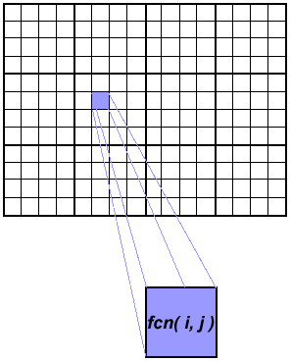
Array Processing
This example demonstrates calculations on 2-dimensional array elements, with the computation on each array element being independent from other array elements.
The serial program calculates one element at a time in sequential order.
Serial code could be of the form:
do j = 1,n
do i = 1,n
a(i,j) = fcn(i,j)
end do
end do
The calculation of elements is independent of one another - leads to an embarrassingly parallel situation.
The problem should be computationally intensive.

Slide 20
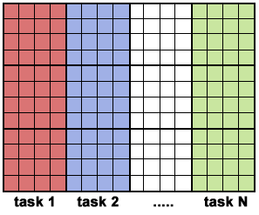
Array Processing Solution 1
Arrays elements are distributed so that each processor owns a portion of an array (subarray).
Independent calculation of array elements insures there is no need for communication between tasks.
Distribution scheme is chosen by other criteria, e.g. unit stride (stride of 1) through the subarrays. Unit stride maximizes cache/memory usage.
Since it is desirable to have unit stride through the subarrays, the choice of a distribution scheme depends on the programming language. See the Block - Cyclic Distributions Diagram for the options.
After the array is distributed, each task executes the portion of the loop corresponding to the data it owns.
For example, with Fortran block distribution:
do j = mystart, myend
do i = 1,n
a(i,j) = fcn(i,j)
end do
end do
Notice that only the outer loop variables are different from the serial solution.

Slide 21
Array Processing Solution 1 - One possible implementation
Implement as SPMD model.
Master process initializes array, sends info to worker processes and receives results.
Worker process receives info, performs its share of computation and sends results to master.
Using the Fortran storage scheme, perform block distribution of the array.
Pseudo code solution: red highlights changes for parallelism.

Slide 22
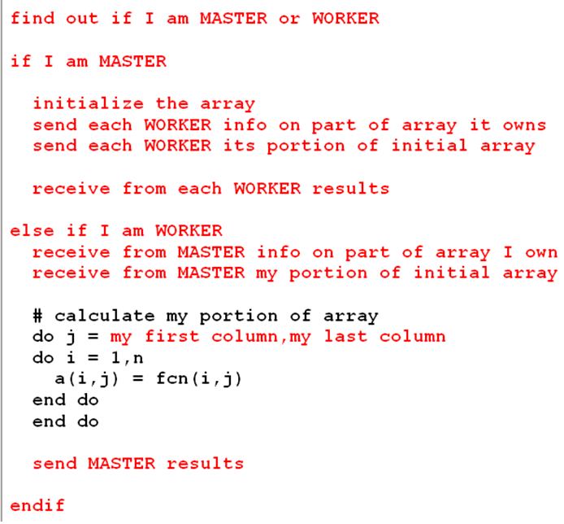
Array Processing Solution 1 - One possible implementation

Slide 23
Array Processing Solution 2: Pool of Tasks
The previous array solution demonstrated static load balancing:
Each task has a fixed amount of work to do
May be significant idle time for faster or more lightly loaded processors - slowest tasks determines overall performance.
Static load balancing is not usually a major concern if all tasks are performing the same amount of work on identical machines.
If you have a load balance problem (some tasks work faster than others), you may benefit by using a "pool of tasks" scheme.

Slide 24
Array Processing Solution 2- Pool of Tasks Scheme
Two processes are employed
Master Process:
Holds pool of tasks for worker processes to do
Sends worker a task when requested
Collects results from workers
Worker Process: repeatedly does the following
Gets task from master process
Performs computation
Sends results to master
Worker processes do not know before runtime which portion of array they will handle or how many tasks they will perform.
Dynamic load balancing occurs at run time: the faster tasks will get more work to do.
Pseudo code solution: red highlights changes for parallelism.

Slide 25
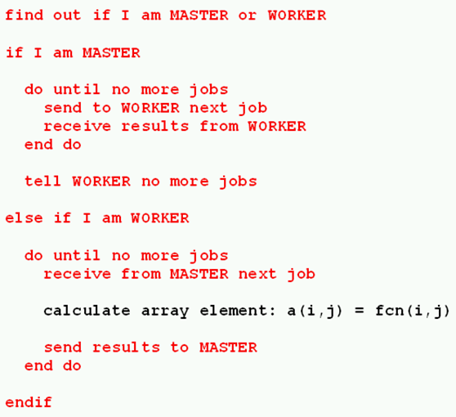
Array Processing Solution 2 Pool of Tasks Scheme

Slide 26
Pi Calculation
The value of PI can be calculated in a number of ways. Consider the following method of approximating PI
Inscribe a circle in a square
Randomly generate points in the square
Determine the number of points in the square that are also in the circle
Let r be the number of points in the circle divided by the number of points in the square
PI ~ 4 r
Note that the more points generated, the better the approximation

Slide 27
Discussion
In the above pool of tasks example, each task calculated an individual array element as a job. The computation to communication ratio is finely granular.
Finely granular solutions incur more communication overhead in order to reduce task idle time.
A more optimal solution might be to distribute more work with each job. The "right" amount of work is problem dependent.

Slide 28
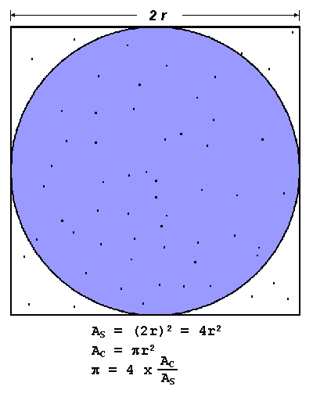
Algorithm
npoints = 10000
circle_count = 0
do j = 1,npoints
generate 2 random numbers between 0 and 1
xcoordinate = random1 ; ycoordinate = random2
if (xcoordinate, ycoordinate) inside circle then circle_count = circle_count + 1
end do
PI = 4.0*circle_count/npoints
Note that most of the time in running this program would be spent executing the loop
Leads to an embarrassingly parallel solution
- Computationally intensive
- Minimal communication
- Minimal I/O

Slide 29
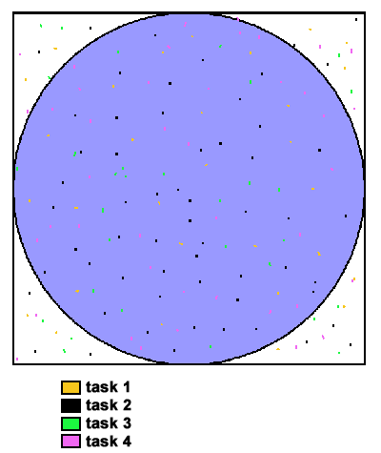
PI Calculation - Parallel Solution
Parallel strategy: break the loop into portions that can be executed by the tasks.
For the task of approximating PI:
Each task executes its portion of the loop a number of times.
Each task can do its work without requiring any information from the other tasks (there are no data dependencies).
Uses the SPMD model. One task acts as master and collects the results.
Pseudo code solution: red highlights changes for parallelism.

Slide 30
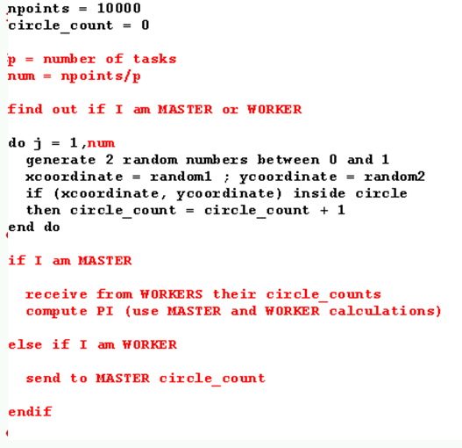
PI Calculation - Parallel Solution

Slide 31
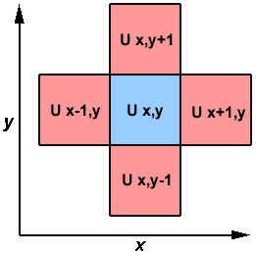
Simple Heat Equation
Most problems in parallel computing require communication among the tasks. A number of common problems require communication with "neighbor" tasks.
The heat equation describes the temperature change over time, given initial temperature distribution and boundary conditions.
A finite differencing scheme is employed
to solve the heat equation numerically
on a square region.
The initial temperature is zero on the boundaries and high in the middle.
The boundary temperature is held at zero.
For the fully explicit problem, a time stepping algorithm is used. The elements of a 2-dimensional array represent the temperature at points on the square. `

Slide 32
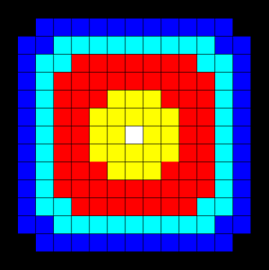
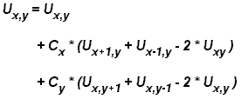
Simple Heat Equation
The calculation of an element is
dependent upon neighbor element values.
A serial program would contain code like:

Slide 33
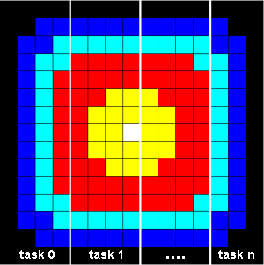
Parallel Solution 1
Implement as an SPMD model
The entire array is partitioned and distributed as subarrays to all tasks. Each task owns a portion of the total array.
Determine data dependencies
interior elements belonging to a task are independent of other tasks
border elements are dependent upon a neighbor task's data, necessitating communication.
Master process sends initial info to workers, checks for convergence and collects results
Worker process calculates solution, communicating as necessary with neighbor processes
Pseudo code solution: red highlights changes for parallelism.

Slide 34
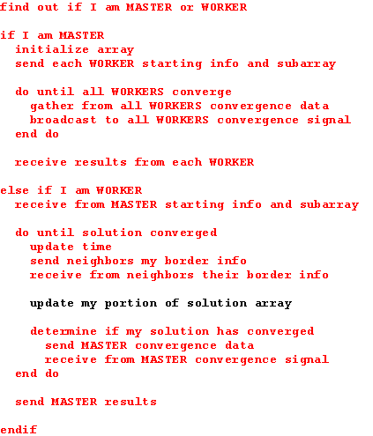
Parallel Solution 1

Slide 35
Parallel Solution 2 Overlapping Communication and Computation
In the previous solution, it was assumed that blocking communications were used by the worker tasks. Blocking communications wait for the communication process to complete before continuing to the next program instruction.
In the previous solution, neighbor tasks communicated border data, then each process updated its portion of the array.
Computing times can often be reduced by using non-blocking communication. Non-blocking communications allow work to be performed while communication is in progress.
Each task could update the interior of its part of the solution array while the communication of border data is occurring, and update its border after communication has completed.
Pseudo code for the second solution: red highlights changes for non-blocking communications.

Slide 36
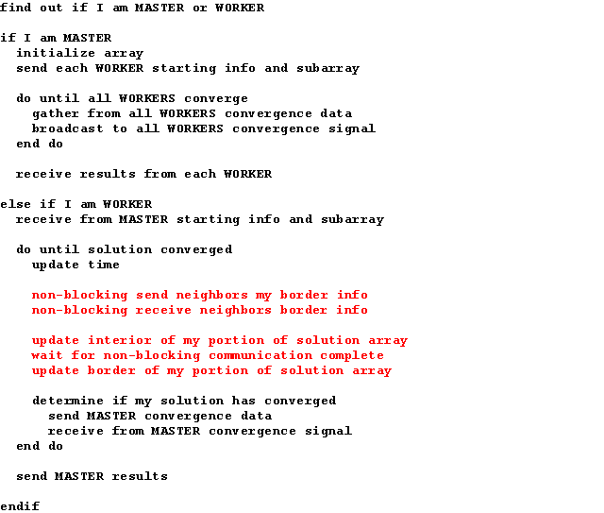
Parallel Solution 2-Overlapping Communication and Computation

Slide 37
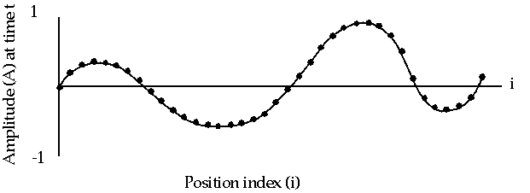
1-D Wave Equation
In this example, the amplitude along a uniform, vibrating string is calculated after a specified amount of time has elapsed.
The calculation involves:
the amplitude on the y axis
i as the position index along the x axis
node points imposed along the string
update of the amplitude at discrete time steps.

Slide 38
1-D Wave Equation
The equation to be solved is the one-dimensional wave equation:
where c is a constant
Note that amplitude will depend on previous timesteps (t, t-1) and neighboring points (i-1, i+1). Data dependence will mean that a parallel solution will involve communications.

Slide 39
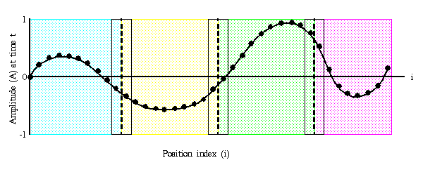
1-D Wave Equation Parallel Solution
Implement as an SPMD model
The entire amplitude array is partitioned and distributed as subarrays to all tasks. Each task owns a portion of the total array.
Load balancing: all points require equal work, so the points should be divided equally
A block decomposition would have the work partitioned into the number of tasks as chunks, allowing each task to own mostly contiguous data points.
Communication need only occur on data borders. The larger the block size the less the communication.

Slide 40
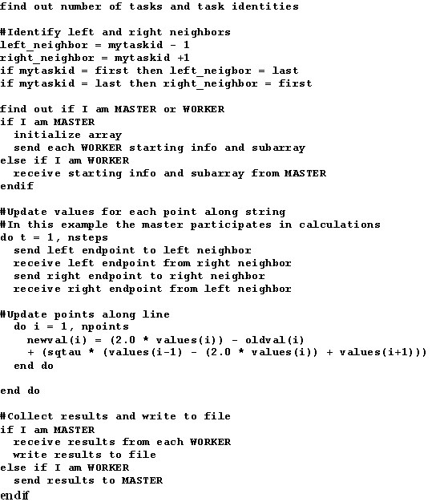
1-D Wave Equation Parallel Solution

