Slide 1
Types of Concurrent Events
There are 3 types of concurrent events:-
Parallel Event or Synchronous Event :-
(Type of concurrency is parallelism)
It may occur in multiple resources during the same interval time.
Example
Array/Vector Processors
CU
PE
PE
PE
Based on ALU

Slide 2
2. Simultaneous Event or Asynchronous
Event :-
(Type of concurrency is simultaneity )
It may occur in multiple resources during the
same interval time.
Example
Multiprocessing System
3. Pipelined Event or Overlapped Event :-
It may occur in overlapped spans.
Example
Pipelined Processor

Slide 3
THE STATE OF COMPUTING System Performance
Machine Capability and Program Behaviour
Peak Performance
Turnaround time
Cycle Time, Clock Rate and Cycles Per Instruction (CPI)
Performance Factors
  Instruction Count, Average CPI, Cycle Time, Memory Cycle Time and No. of memory cycles
System Attributes
  Instruction Set Architecture, Compiler Technology, Processor Implementation and control, Cache and Memory Hierarchy
MIPS Rate, FLOPS and Throughput Rate
Programming Environments – Implicit and Explicit Parallelism

Slide 4
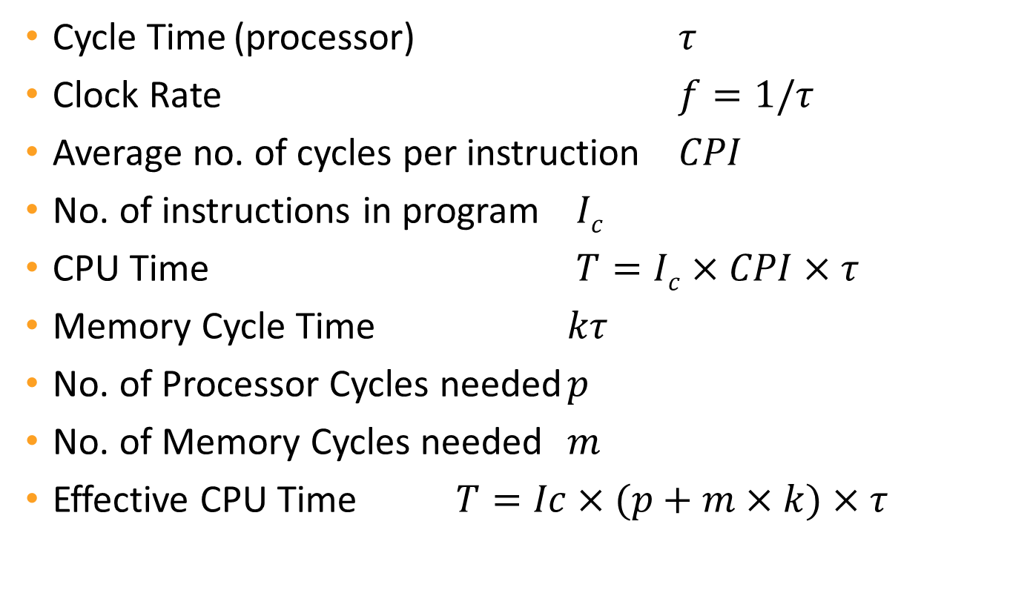
THE STATE OF COMPUTING
System Attributes to Performance
Cycle Time (processor) $τ$
Clock Rate $f=1/τ$
Average no. of cycles per instruction $CPI$
No. of instructions in program $Ic$
CPU Time $T=Ic×CPI×τ$
Memory Cycle Time $kτ$
No. of Processor Cycles needed $p$
No. of Memory Cycles needed $m$
Effective CPU Time $T=Ic×(p+m×k)×τ$

Slide 5

THE STATE OF COMPUTING
System Attributes to Performance
MIPS Rate
$τ=\frac{Ic}{T×106}=\frac{f}{CPI×106}=\frac{f×Ic}{C×106}$
Throughput Rate
$Wp=\frac{MIPS×106}{Ic}=\frac{f}{CPI×Ic}$

Slide 6
System Attributes versus Performance Factors
The ideal performance of a computer system requires a perfect match between machine capability and program behavior.
Machine capability can be enhanced with better hardware technology, however program behavior is difficult to predict due to its dependence on application and run-time conditions.
Below are the fundamental factors for projecting the performance of a computer.
1) Efficiency is measured as:-
Efficiency = Time / Speed + Accuracy

Slide 7
2.Clock Rate :- CPU is driven by a clock of constant cycle time (τ).
τ = 1/ f (ns)
3. CPI :- (Cycles per instruction)
As different instructions acquire different cycles to execute, CPI will be taken as an average value for a given instruction set and a given program mix.

Slide 8
3. Execution Time :- Let I_{c} be Instruction Count or total number of instructions in the program. So
Execution Time = ?
T = I_{c} × CPI × τ
Now,
CPI = Instruction Cycle = Processor Cycles +
Memory Cycles
∴ Instruction cycle = p + m × k
where
m = number of memory references

Slide 9
P = number of processor cycles
k = latency factor (how much the memory
is slow w.r.t to CPU)
Now let C be Total number of cycles required to execute a program.
So, C = ?
C = I_{c} × CPI
And the time to execute a program will be
T = C × τ

Slide 10
4. MIPS Rate :-
MIPS rate =
MIPS=
5. Throughput Rate:- Number of programs executed per unit time. W = ?
I_{c}
T
×
10
6
Clock frequency
CPI x10
6
W = 1 / T
OR
W = MIPS × 10
I_{c}
6

Slide 11
Numerical:- A benchmark program is executed on a 40MHz processor. The benchmark program has the following statistics.
Instruction Type
Arithmetic
Branch
Load/Store
Floating Point
Instruction Count
45000
32000
15000
8000
Clock Cycle Count
1
2
2
2
Calculate average CPI,MIPS rate & execution for the above benchmark program.

Slide 12
Average CPI = C
I_{c}
C = Total # cycles to execute a whole program
I_{c} Total Instruction
= 45000 ×1 + 32000×2 + 15000×2 + 8000×2
45000 + 32000 + 15000 + 8000
= 155000
100000
CPI = 1.55
Execution Time = C / f

Slide 13
6
T = 155000 / 40 × 10
T = 0.155 / 40
T = 3.875 ms
MIPS rate = I_{c} / T × 10
MIPS rate = 25.8
6

Slide 14
System Attributes | Performance Factors
 | I_{c} | CPI
 |  | p | m | k | τ
Instruction-set Architecture
Compiler Technology
CPU Implementation & Technology
Memory Hierarchy

Slide 15
Practice Problems :-
A benchmark program containing 234,000 instructions is executed on a processor having a cycle time of 0.15ns. The statistics of the program is given below.
Each memory reference requires 3 CPU cycles to complete. Calculate MIPS rate & throughput for the program.
Instruction Type
Arithmetic
Branch
Load/Store
Instruction
Mix
58 %
33 %
9 %
Processor Cycles
2
3
3
Memory
Cycles
2
1
2

Slide 16
Programmatic Levels of Parallel Processing
Parallel Processing can be challenged in 4
programmatic levels:-
Job / Program Level
2. Task / Procedure Level
3. Interinstruction Level
4. Intrainstruction Level

Slide 17
1. Job / Program Level :-
It requires the development of parallel processable algorithms. The implementation of parallel algorithms depends on the efficient allocation of limited hardware and software resources to multiple programs being used to solve a large computational problem.
Example: Weather forecasting , medical consulting , oil exploration etc.

Slide 18
2. Task / Procedure Level :-
It is conducted among procedure/tasks within the same program. This involves the decomposition of the program into multiple tasks.
( for simultaneous execution )
3. Interinstruction Level :-
Interinstruction level is to exploit concurrency among multiple instructions so that they can be executed simultaneously. Data dependency analysis is often performed to reveal parallellism amoung instructions.

Slide 19
Vectorization may be desired for scalar operations within DO loops.
4. Intrainstruction Level :-
Intrainstruction level exploits faster and concurrent operations within each instruction e.g. use of carry look ahead and carry save address instead of ripple carry address.

Slide 20
Key Points :-
Hardware role decrease from high to low levels whereas software role increases from low to high levels.
As highest job level is conducted algorithmically, lowest level is implemented directly by hardware means.
The trade-off between hardware and software approaches to solve a problem is always a very controversial issue.

Slide 21
4. As hardware cost declines and software
cost increases , more and more hardware
method are replacing the conventional
software approaches.
Conclusion :-
Parallel Processing is a combined field of studies which requires a broad knowledge of and experience with all aspects of algorithms, languages, hardware, software, performance evaluation and computing alternatives.

Slide 22
Parallel Processing in Uniprocessor Systems
A number of parallel processing mechanisms have been developed in uniprocessor computers. We identify them in six categories which are described below.
1. Multiplicity of Functional Units :-
Different ALU functions can be distributed to
multiple & specialized functional units which
can operate in parallel.

Slide 23
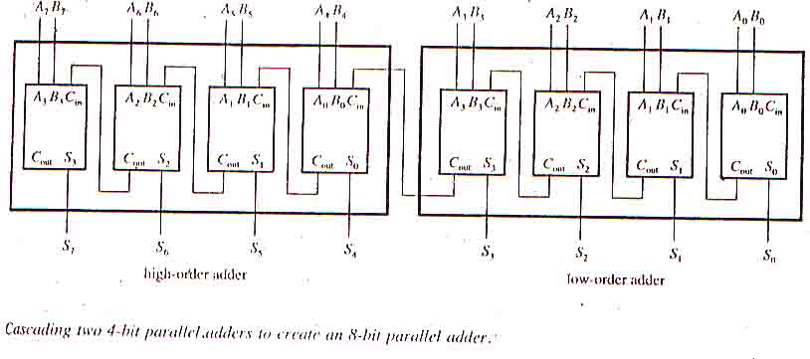
2. Parallelism & Pipelining within the CPU :-
Use of carry-lookahead & carry-save address
instead of ripple-carry adders.
Cascade two 4-bit parallel adders to create an 8-bit parallel adder.

Slide 24
Ripple-carry Adder :-
At each stage the sum bit is not valid until
after the carry bits in all the preceding stages are valid.
No of bits is directly proportional to the time required for valid addition.
Problem :- The time required to generate each carryout bit in the 8-bit parallel adder is 24ns. Once all inputs to an adder are valid, there is a delay of 32ns until the output sum bit is valid. What is the maximum number of additions per second that the adder can perform?

Slide 25
1 addition = 7 × 24 + 32
= 200ns
Additions / sec = 1 / 200
= 0.5 × 10 × 10
= 5 × 10
= 5 million additions / sec
-3
9
6

Slide 26
Practice Problem
Assuming the 32ns delay in producing a valid sum bit in the 8-bit parallel adder. What maximum delay in generating a carry out bit is allowed if the adder must be capable of performing 10 additions per second.
7

Slide 27
3. Overlapping CPU & I/O Operations :-
DMA is conducted on a cycle-stealing basis.
CDC-6600 has 10 I/O processors of I/O multiprocessing.
Simultaneous I/O operations & CPU computations can be achieved using separate I/O controllers, channels.
4. Use of hierarchical Memory System :-
A hierarchal memory system can be used to close up the speed gap between the CPU &

Slide 28
main memory because CPU is 1000 times faster than memory access.
5. Balancing of Subsystem Bandwidth :-
Consider the relation
t_{m}< t_{m} < t_{d}
Bandwidth of a System :-
Bandwidth of a system is defined as the number of operations performed per unit time.
Bandwidth of a memory :-
The memory bandwidth is the number of words

Slide 29
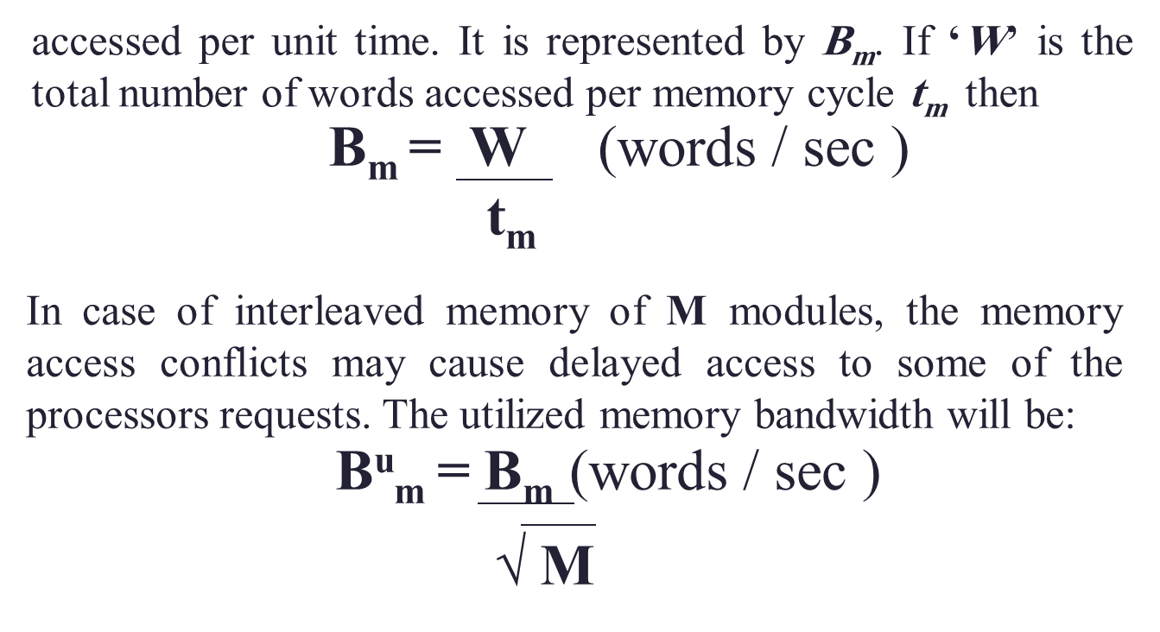
Processor Bandwidth :-
B_{p} :- maximum CPU computation rate.
B_{p} :- utilized processor bandwidth or the no. of
u

Slide 30
output results per second.
u
B_{p} = R_{w} (word result)
T_{p}
R_{w} :- no of word results.
T_{p} :- Total CPU time to generate R_{w} results.
B_{d} :- Bandwidth of devices. (which is assumed
as provided by the vendor).
The following relationships have been observed between the bandwidths of the major subsystems in a high performance uniprocessor.
B_{m} ≥
u
B_{p} ≥
u
B_{d}
B_{m} ≥
B_{p} ≥

Slide 31
Due to the unbalanced speeds we need to match the processing power of the three subsystem, we need to match the processing power of the three subsystems.
Two major approaches are described below :-
Bandwidth balancing b/w CPU & memory :-
Using fast cache having access time t_{c} = t_{p}.
2. Bandwidth balancing b/w memory & I/O :-
Intelligent disk controllers can be used to filter
out irrelevant data off the tracks. Buffering can
be performed by I/O channels.

Slide 32
6a. Multiprogramming :-
As we know that some computer programs are CPU bound & some are I/O bound.Whenever a
Process P1 is tied up with I/O operations.The system scheduler can switch the CPU to process P2.This allows simultaneous execution
of several programs in the system.This interleaving of CPU & I/O operations among
several programs is called multiprogramming, so the total execution time is reduced.

Slide 33
6b. Time sharing :-
In multiprogramming, sometimes a high priority program may occupy the CPU for too long to
allow others to share. This problem can be overcome by using a time-sharing operating
system.The concept extends from multiprogram –ming by assigning fixed or variable time slices to multiple programs. In other words, equal
opportunities are given to all programs competing for the use of CPU.
Time sharing is particularly effective when applied to a computer system connected to many interactive terminals.

