Slide 1
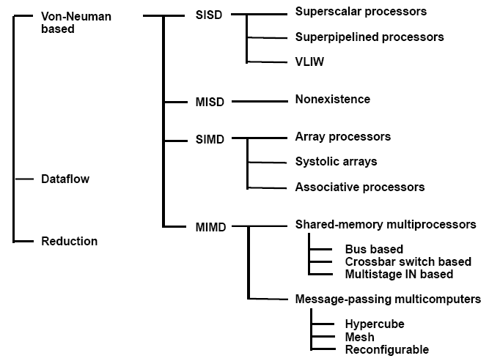
COMPUTER ARCHITECTURES FOR PARALLEL ROCESSING

Slide 2
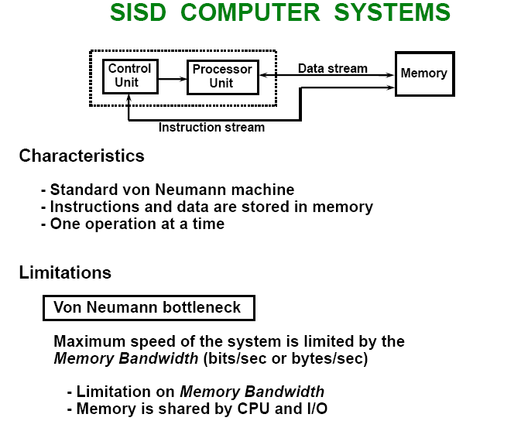

Slide 3
SISD PERFORMANCE IMPROVEMENTS
• Multiprogramming
• Spooling
• Multifunction processor
• Pipelining
• Exploiting instruction-level parallelism
- Superscalar
- Superpipelining
- VLIW (Very Long Instruction Word)

Slide 4
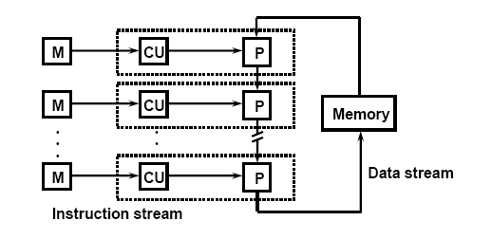
MISD COMPUTER SYSTEMS
Characteristics
- There is no computer at present that can be classified as MISD

Slide 5
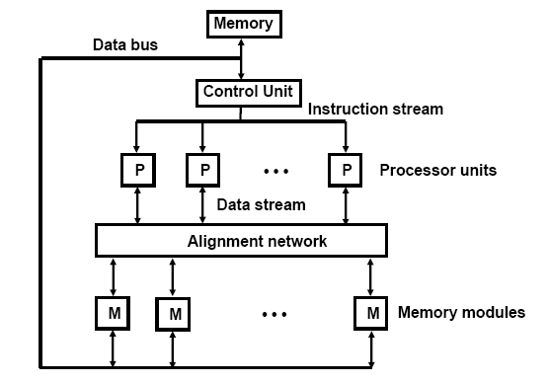
SIMD COMPUTER SYSTEMS
Characteristics –
Only one copy of the program exists
- A single controller executes one instruction at a time

Slide 6
TYPES OF SIMD COMPUTERS
Array Processors
The control unit broadcasts instructions to all PEs, and all active PEs execute the same instructions
ILLIAC IV, GF-11, Connection Machine, DAP, MPP
Systolic Arrays
- Regular arrangement of a large number of very simple processors constructed on VLSI circuits
CMU Warp, Purdue CHiP
Associative Processors
Content addressing
- Data transformation operations over many sets of arguments with a single instruction
- STARAN, PEPE

Slide 7
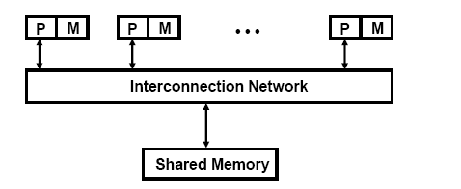
MIMD COMPUTER SYSTEMS
Characteristics
- Multiple processing units
- Execution of multiple instructions on multiple data
Types of MIMD computer systems
- Shared memory multiprocessors
- Message-passing multicomputers

Slide 8
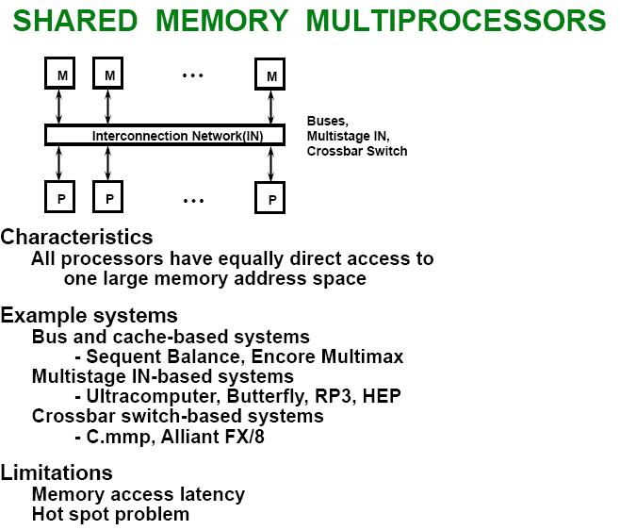

Slide 9
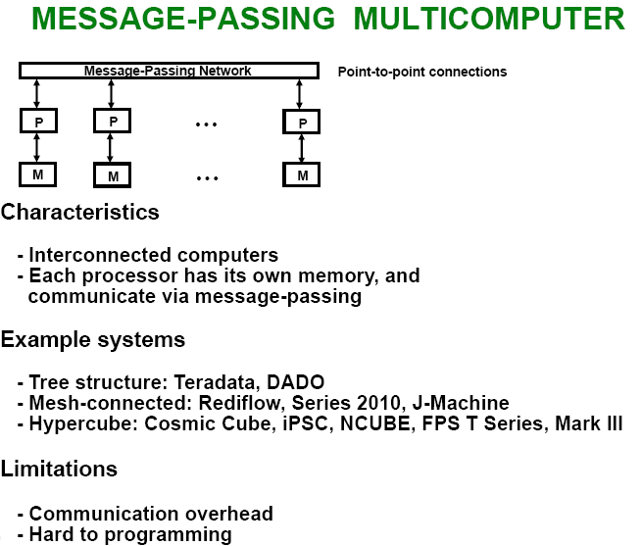

Slide 10
Pipeline and Vector Processing
Parallel Processing
  Simultaneous data processing tasks for the purpose of increasing the computational speed
  Perform concurrent data processing to achieve faster execution time
  Multiple Functional Unit : Separate the execution unit into eight functional units operating in parallel
=
Pipelining
  Pipelining
  Decomposing a sequential process into suboperations
    Each subprocess is executed in a special dedicated segment concurrently

Slide 12
  Pipelining:
  Multiply and add operation : ( for i = 1, 2, …, 7 )
    3-Suboperation Segment
      1) : Input Ai and Bi
      2) : Multiply and input Ci
      3) : Add Ci
    Content of registers in pipeline example :
  General considerations
    4 segment pipeline :
      S : Combinational circuit for Suboperation
      R : Register(intermediate results between the segments)
    Space-time diagram :
    Show segment utilization as a function of time
    Task : T1, T2, T3,…, T6
      Total operation performed going through all the segment

Slide 13
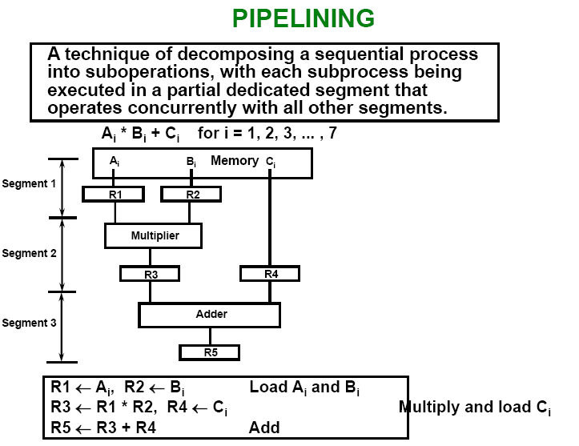

Slide 14
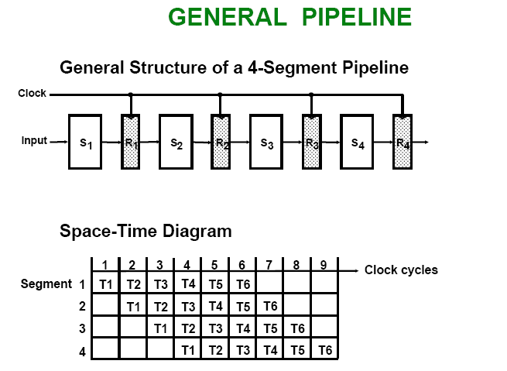

Slide 15
  Speedup S : Nonpipeline / Pipeline
    S = n • t_{n} / ( k + n - 1 ) • t_{p} = 6 • 6 t_{n} / ( 4 + 6 - 1 ) • t_{p} = 36 t_{n} / 9 t_{n} = 4
      n : task number ( 6 )
      t_{n} : time to complete each task in nonpipeline ( 6 cycle times = 6 t_{p})
      t_{p} : clock cycle time ( 1 clock cycle )
      k : segment number ( 4 )
    If n→ ∞ S = t_{n} / t_{p}
    task
    nonpipeline ( t_{n} ) = pipeline ( k • t_{p} )
    S = t_{n} / t_{p} = k • t_{p} / t_{p} = k
    k (segment )
Pipeline = 9 clock cycles
k + n - 1 ≈ n

Slide 16
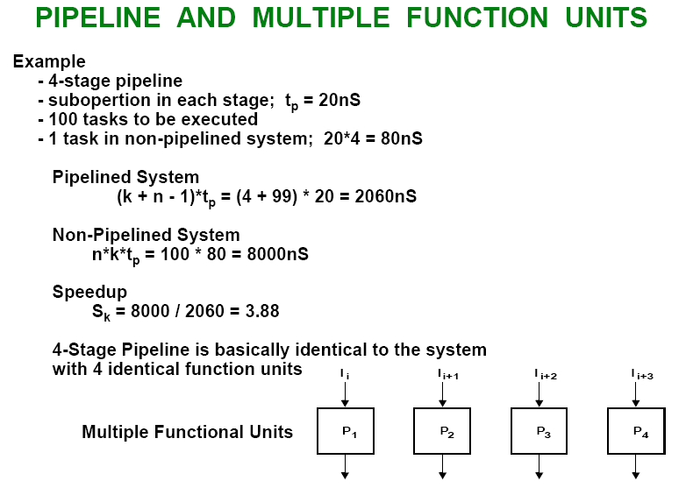

Slide 17
Static Arithmetic Pipelines
Most arithmetic pipelines performs fixed functions.
  Due to performance of a fixed function, it is also called unifunctional pipeline
ALUs performs fixed-point using integer unit
Floating-point operations is performed using a separate unit (coprocessor)
All arithmetic operations can be performed using basic add and shift operations
Arithmetic and logical shifts can be performed with shift registers
Addition can be done using carry propagation adder (CPA) or carry save adder (CSA)

Slide 18
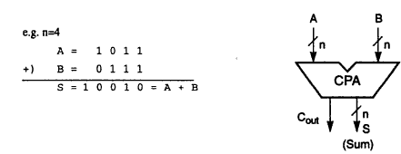
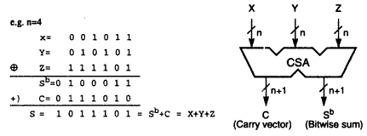
Arithmetic Pipeline Design

Slide 19
Arithmetic Pipeline
  Floating-point Adder Pipeline Example :
  Add / Subtract two normalized floating-point binary number
      X = A x 2ª = 0.9504 x 10³
      Y = B x 2^{b} = 0.8200 x 10²
    4 segments suboperations
      1) Compare exponents by subtraction :
      3 - 2 = 1
        X = 0.9504 x 10³
        Y = 0.8200 x 10²
      2) Align mantissas
        X = 0.9504 x 10³
        Y = 0.08200 x 10³
      3) Add mantissas
        Z = 1.0324 x 10³
      4) Normalize result
        Z = 0.1324 x 10⁴

Slide 20
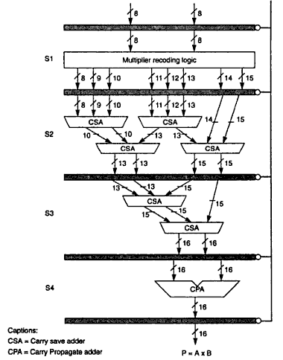
Multiply Pipeline Design
CSA and CPA are used at different
stages to design pipeline for fixed
point multiplication
Example: multiplication of two 8-bit
numbers, producing a 16-bit result
  S1: generates eight partial products
  S2: two levels of CSAs taking eight
  numbers and producing four
  S3: two CSAs convert four numbers
  into two numbers
  S4: one CPA takes two numbers
  and result into one number

Slide 21
3-4 Instruction Pipeline
  Instruction Cycle
    1) Fetch the instruction from memory
    2) Decode the instruction
    3) Calculate the effective address
    4) Fetch the operands from memory
    5) Execute the instruction
    6) Store the result in the proper place
  Example : Four-segment Instruction pipeline
    Four-segment CPU pipeline :
      1) FI : Instruction Fetch
      2) DA : Decode Instruction & calculate EA
      3) FO : Operand Fetch
      4) EX : Execution

Slide 22
      Instruction 3 Branch
No Branch
Branch

