Slide 1
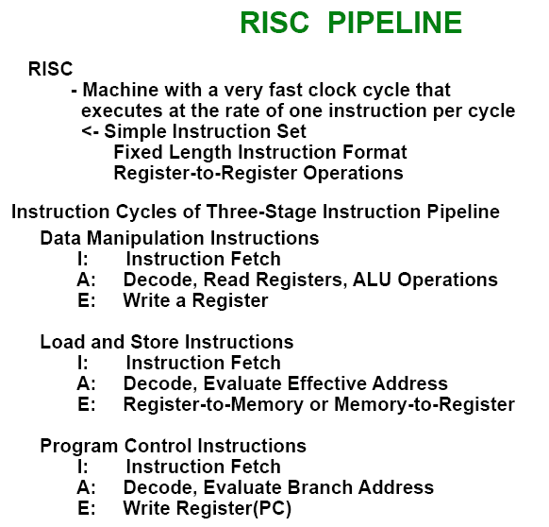

Slide 2
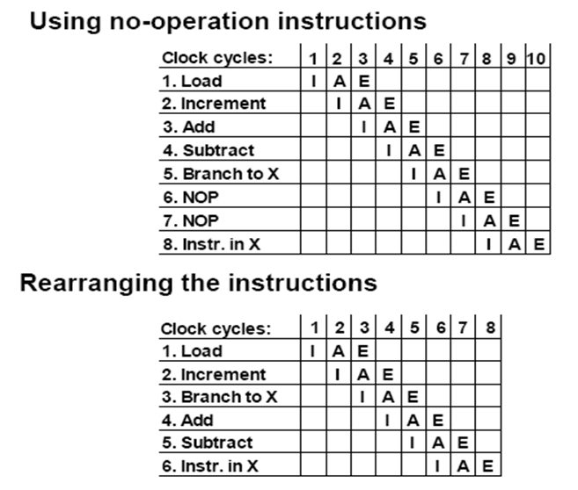
Compiler analyzes the instructions before and after the branch and rearranges the program sequence by inserting useful instructions in the delay steps

Slide 3
  Pipeline Conflicts : 3 major difficulties
    1) Resource conflicts
      memory access by two segments at the same time
    2) Data dependency
      when an instruction depend on the result of a previous instruction, but this result is not yet available
    3) Branch difficulties
      branch and other instruction (interrupt, ret, ..) that change the value of PC
  Data Dependency
    Hardware
      Hardware Interlock
        previous instruction Hardware Delay
      Operand Forwarding
        previous instruction, register
        Software
      Delayed Load
        previous instruction No-operation instruction
  Handling of Branch Instructions
    Prefetch target instruction
      Conditional branch:- branch target instruction ( instruction (

Slide 4
    Prefetch Target Instruction
      –Fetch instructions in both streams, branch not taken and branch taken
      –Both are saved until branch is executed. Then, select the right instruction stream and discard the wrong stream
    Branch Target Buffer(BTB; Associative Memory)
      –Entry: Addr of previously executed branches;
      Target instruction and the next few instructions
      –When fetching an instruction, search BTB.
      –If found, fetch the instruction stream in BTB;
      –If not, new stream is fetched and update BTB
    Loop Buffer (High Speed Register file)
      – Storage of entire loop that allows to execute a
      loop without accessing memory
    Branch Prediction
      –Guessing the branch condition, and fetch
      an instruction stream based on the guess.
      Correct guess eliminates the branch penalty
    Delayed Branch
      –Compiler detects the branch and rearranges the
      instruction sequence by inserting useful instructions
      that keep the pipeline busy in the presence of a
      branch instruction

Slide 5
Mechanisms for Instruction Pipelining
Goal: Achieve maximum parallelism in pipeline by smoothening the instruction flow and minimizing the idle cycles
Mechanisms:-
  Prefetch Buffers
  Multiple Functional Units
  Internal Data Forwarding
  Hazard Avoidance

Slide 6
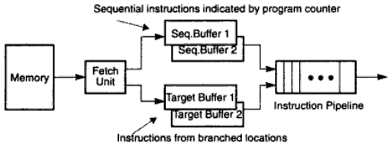
Prefetch Buffers
Used to match the instruction fetch rate to the pipeline consumption rate
In a single memory access, a block of consecutive instructions are fetched into a prefetch buffer
Three types of prefetch buffers:-
  Sequential buffers, used to store sequential instructions
  Target buffers, used to store branch target instructions
  Loop buffer, used to store loop instructions

Slide 7
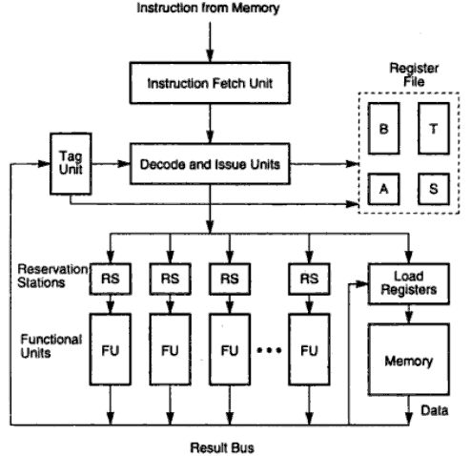
Multiple Functional Units
At times, a specific pipeline stage becomes the bottleneck
Identified by large number of checks
in a row in reservation table
To resolve dependencies,
we use reservation stations
Each RS is uniquely identified
with a tag monitored by tag
unit (Register Tagging)
Helps in conflict resolution
and serving as buffer

Slide 8
Multifunctional Arithmetic Pipeline
Multifunctional arithmetic pipeline perform many functions
Types of multifunctional pipelines:-
  Static pipeline
    Performs single function at a given time, another function at some other time
  Dynamic pipeline
    Performs multiple functions at the same time
    Care needs to be taken in sharing the pipeline

Slide 9
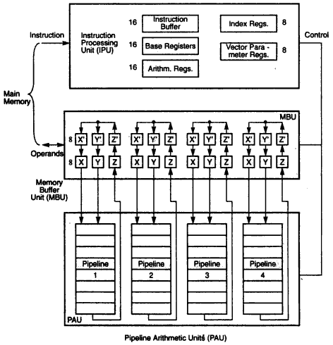
Static Multifunctional Pipeline
Example: Advanced Scientific Computer
Key features:-
  Four pipeline arithmetic units
  Large number of working registers in the processor which
  controls operations of memory
  buffer units and arithmetic units
  IPU handles fetching and
  decoding of instructions

Slide 10
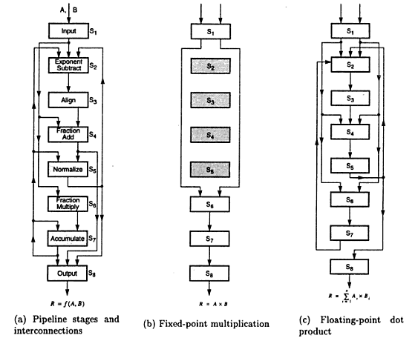
Pipeline Interconnections
Example: Advanced
Scientific Computer
Arithmetic pipeline has
eight stages
It is an example of static
multifunctional pipeline
With change in inter-
connections, different
functions (fixed-point and
floating point) can be
performed

Slide 11
Performance Considerations
The execution time T of a program that has a dynamic instruction count N is given by:
where S is the average number of clock cycles it takes to fetch and execute one instruction, and R is the clock rate.
Instruction throughput is defined as the number of instructions executed per second.

Slide 12
Overview
An n-stage pipeline has the potential to increase the throughput by n times.
However, the only real measure of performance is the total execution time of a program.
Higher instruction throughput will not necessarily lead to higher performance.
Two questions regarding pipelining
How much of this potential increase in instruction throughput can be realized in practice?
What is good value of n?

Slide 13
“Iron Law” of Processor Performance
Time = Instructions Cycles Time
Program Program * Instruction * Cycle
Instructions per program depends on source code, compiler technology, and ISA
Cycles per instructions (CPI) depends upon the ISA and the microarchitecture
Time per cycle depends upon the microarchitecture and the base technology
Microarchitecture | CPI | cycle time
Microcoded | >1 | short
Single-cycle unpipelined | 1 | long
Pipelined | 1 | short

Slide 14
CPI Examples
Microcoded machine
Time
7 cycles
5 cycles
10 cycles
Inst 1
Inst 2
Inst 3
3 instructions, 22 cycles, CPI=7.33
Unpipelined machine
Inst 1
Inst 2
Inst 3
3 instructions, 3 cycles, CPI=1
Pipelined machine
Inst 1
3 instructions, 3 cycles, CPI=1
Inst 2
Inst 3

Slide 15

Technology Assumptions
A small amount of very fast memory (caches)
backed up by a large, slower memory
Fast ALU (at least for integers)
Multiported Register files (slower!)
A 5-stage pipeline will be the focus of our detailed design
- some commercial designs have over 30 pipeline stages to do an integer add!

Slide 16
Speed Up Equation for Pipelining
For simple RISC pipeline, CPI = 1:

Slide 17
Example…
Machine A: Dual ported memory (“Harvard Architecture”)
Machine B: Single ported memory, but its pipelined implementation has a 1.05 times faster clock rate
Ideal CPI = 1 for both
Loads are 40% of instructions executed
SpeedUp_{A} = Pipe. Depth/(1 + 0) x (clock_{unpipe}/clock_{pipe})
= Pipeline Depth
SpeedUp_{B} = Pipe. Depth/(1 + 0.4 x 1) x (clock_{unpipe}/(clock_{unpipe} / 1.05)
= (Pipe. Depth/1.4) x 1.05
= 0.75 x Pipe. Depth
SpeedUp_{A} / SpeedUp_{B} = Pipe. Depth/(0.75 x Pipe. Depth) = 1.33
Machine A is 1.33 times faster

Slide 18
Designing a Pipelined Processor
What do we need to do to pipeline the process ?
Instruction
Fetch
Instr. Decode
Reg. Fetch
Execute
Addr. Calc
Memory
Access
Write
Back
Next PC
MUX
Next SEQ PC
Adder
4
Zero?
RS1
Reg File
Address
RS2
MUX
Memory
Inst
ALU
Data
Memory
RD
MUX
L
M
D
MUX
Sign
Extend
Imm
WB Data

Slide 19
5 Steps of MIPS/DLX Datapath
Instruction
Fetch
Instr. Decode
Reg. Fetch
Execute
Addr. Calc
Memory
Access
Write
Back
Next PC
IF/ID
ID/EX
EX/MEM
MUX
MEM/WB
Next SEQ PC
Next SEQ PC
Adder
4
Zero?
RS1
Reg File
Address
MUX
Memory
RS2
ALU
Data
Memory
MUX
MUX
Sign
Extend
Imm
WB Data
RD
RD
RD
Data stationary control
  local decode for each instruction phase / pipeline stage

Slide 20
Graphically Representing Pipelines
Can help with answering questions like:
  how many cycles does it take to execute this code?
  what is the ALU doing during cycle 4?
  use this representation to help understand datapaths

Slide 21
Visualizing Pipelining
Time (clock cycles)
Cycle 1
Cycle 2
Cycle 3
Cycle 4
Cycle 5
Cycle 6
Cycle 7
I
n
s
t
r.
O
r
d
e
r
Ifetch
Reg
ALU
DMem
Reg
Ifetch
Reg
ALU
DMem
Reg
Ifetch
Reg
ALU
DMem
Reg
Ifetch
Reg
ALU
DMem
Reg

Slide 22
Conventional Pipelined Execution Representation
Time
IFetch
Dcd
Exec
Mem
WB
IFetch
Dcd
Exec
Mem
WB
IFetch
Dcd
Exec
Mem
WB
IFetch
Dcd
Exec
Mem
WB
IFetch
Dcd
Exec
Mem
WB
Program Flow
IFetch
Dcd
Exec
Mem
WB

Slide 23
Single Cycle, Multiple Cycle, vs. Pipeline
Cycle 1
Cycle 2
Clk
Single Cycle Implementation:
Load
Store
Waste
Cycle 1
Cycle 2
Cycle 3
Cycle 4
Cycle 5
Cycle 6
Cycle 7
Cycle 8
Cycle 9
Cycle 10
Clk
Multiple Cycle Implementation:
Load
Store
R-type
Ifetch
Reg
Exec
Mem
Wr
Ifetch
Reg
Exec
Mem
Ifetch
Pipeline Implementation:
Load
Ifetch
Reg
Exec
Mem
Wr
Store
Ifetch
Reg
Exec
Mem
Wr
R-type
Ifetch
Reg
Exec
Mem
Wr
Notes:
Here are the timing diagrams showing the differences between the single cycle, multiple cycle, and pipeline implementations.
For example, in the pipeline implementation, we can finish executing the Load, Store, and R-type instruction sequence in seven cycles.
In the multiple clock cycle implementation, however, we cannot start executing the store until Cycle 6 because we must wait for the load instruction to complete.
Similarly, we cannot start the execution of the R-type instruction until the store instruction has completed its execution in Cycle 9.
In the Single Cycle implementation, the cycle time is set to accommodate the longest instruction, the Load instruction.
Consequently, the cycle time for the Single Cycle implementation can be five times longer than the multiple cycle implementation.
But may be more importantly, since the cycle time has to be long enough for the load instruction, it is too long for the store instruction so the last part of the cycle here is wasted.

Slide 24
Vector Processing
  Science and Engineering Applications
    Long-range weather forecasting, Petroleum explorations, Seismic data analysis, Medical diagnosis, Aerodynamics and space flight simulations, Artificial intelligence and expert systems, Mapping the human genome, Image processing
  Vector Operations
    Arithmetic operations on large arrays of numbers
    Conventional scalar processor
      Machine language
    Vector processor
      Single vector instruction
Initialize I = 0
20 Read A(I)
Read B(I)
Store C(I) = A(I) + B(I)
Increment I = I + 1
If I ≤ 100 go to 20
Continue
      Fortran language
DO 20 I = 1, 100
20 C(I) = A(I) + B(I)
C(1:100) = A(1:100) + B(1:100)

Slide 25
  Vector Instruction Format :
  ADD A B C 100
  Matrix Multiplication
    3 x 3 matrices multiplication : n² = 9 inner product
      : inner product 9
    Cumulative multiply-add operation : n³ = 27 multiply-add
      : multiply-add
      9 X 3 multiply-add = 27
① ② ③
① ② ③
C₁₁= 0

Slide 26
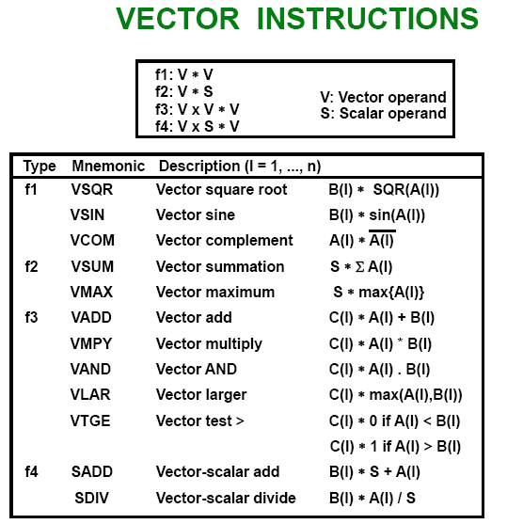

Slide 27
  Pipeline for calculating an inner product :
    Floating point multiplier pipeline : 4 segment
    Floating point adder pipeline : 4 segment
      after 1st clock input
      after 8th clock input
      Four section summation
      after 4th clock input
A₁B₁
A₄B₄ A₃B₃ A₂B₂ A₁B₁
      after 9th, 10th, 11th ,...
A₈B₈ A₇B₇ A₆B₆ A₅B₅ A₄B₄ A₃B₃ A₂B₂ A₁B₁
A₈B₈ A₇B₇ A₆B₆ A₅B₅ A₄B₄ A₃B₃ A₂B₂ A₁B₁
, , , ⑩ ⑨

Slide 28
  Memory Interleaving :
    Simultaneous access to memory from two or more source using one memory bus system
    Address Interleaving Different sets of addresses are assigned to different memory modules

Slide 29
  Supercomputer
    Supercomputer = Vector Instruction + Pipelined floating-point arithmetic
    Performance Evaluation Index
      MIPS : Million Instruction Per Second
      FLOPS : Floating-point Operation Per Second
        megaflops : 10⁶, gigaflops : 10⁹
    Cray supercomputer : Cray Research
      Clay-1 : 80 megaflops, 4 million 64 bit words memory
      Clay-2 : 12 times more powerful than the clay-1
    VP supercomputer : Fujitsu
      VP-200 : 300 megaflops, 32 million memory, 83 vector instruction, 195 scalar instruction
      VP-2600 : 5 gigaflops

Slide 30
Array Processors
  Performs computations on large arrays of data
  Array Processing
    Attached array processor :
      Auxiliary processor attached to a general purpose computer .It is designed as a peripheral for a conventional host computer.
      Its purpose is to enhance the performance of the computer by providing vector processing.
      It achieves high performance by means of parallel processing with multiple functional units.

Slide 31
    SIMD array processor :
      Computer with multiple processing units operating It is processor which consists of multiple processing unit operating in parallel.
      The processing units are synchronized to perform the same task under control of common control unit. Each processor elements(PE) includes an ALU , a floating point arithmetic unit and working register.in parallel

