Slide 1
High Performance Computing

Slide 2
Recap
SMP
Clustering

Slide 3
Today’s topics
NUMA (Non-Uniform Memory Access)
Cache Coherence

Slide 4
Nonuniform Memory Access (NUMA)
UMA: Uniform memory access
All processors have access to all parts of memory
Using load & store
Access time to all regions of memory is the same
Access time to memory for different processors same
As used by SMP
Nonuniform memory access
All processors have access to all parts of memory
Using load & store
Access time of processor differs depending on region of memory
Different processors access different regions of memory at different speeds
Cache coherent NUMA
Cache coherence is maintained among the caches of the various processors
Significantly different from SMP and clusters

Slide 5
Motivation
SMP has practical limit to number of processors
Bus traffic limits to between 16 and 64 processors
In clusters each node has own memory
Apps do not see large global memory
Coherence maintained by software not hardware
NUMA retains SMP flavour while giving large scale multiprocessing
e.g. Silicon Graphics Origin NUMA 1024 MIPS R10000 processors
Objective is to maintain transparent system wide memory while permitting multiprocessor nodes, each with own bus or internal interconnection system

Slide 6
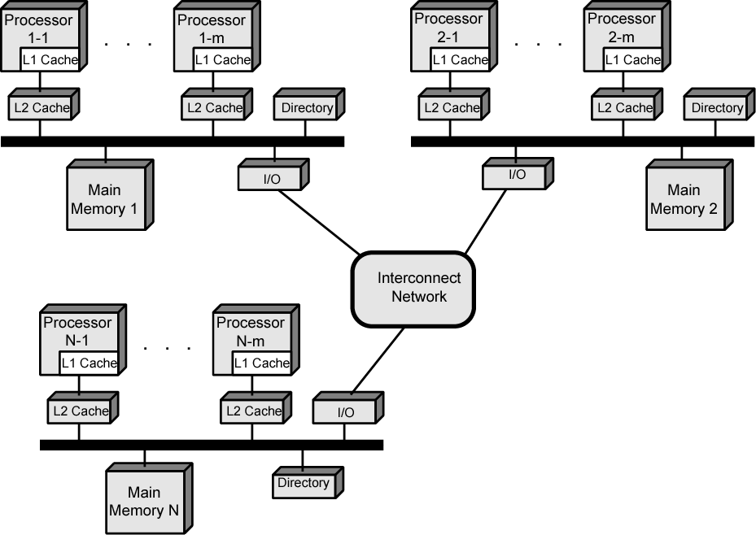
CC-NUMA Organization

Slide 7
CC-NUMA Operation
Each processor has own L1 and L2 cache
Each node has own main memory
Nodes connected by some networking facility
Each processor sees single addressable memory space
Memory request order:
L1 cache (local to processor)
L2 cache (local to processor)
Main memory (local to node)
Remote memory
Delivered to requesting (local to processor) cache
Automatic and transparent

Slide 8
Cache Coherence
Node 1 directory keeps note that node 2 has copy of data
If data modified in cache, this is broadcast to other nodes
Local directories monitor and purge local cache if necessary
Local directory monitors changes to local data in remote caches and marks memory invalid until writeback
Local directory forces writeback if memory location requested by another processor

Slide 9
NUMA Pros & Cons
Effective performance at higher levels of parallelism than SMP
No major software changes
Performance can breakdown if too much access to remote memory
Can be avoided by:
L1 & L2 cache design reducing all memory access
Need good temporal locality of software
Good spatial locality of software
Virtual memory management moving pages to nodes that are using them most
Not transparent
Page allocation, process allocation and load balancing changes needed
Availability?

Slide 10
Cache Coherence
In SMP or NUMA, multiple copies of cache
Each copy may have a different value of data item
Maintain Coherency
How?

Slide 11
Cache Coherence: Two Approaches
Write back: Update Main memory once cache is flushed.
Write through: Write is updated to cache as well as to the main memory.

Slide 12
Implementations
Software Solutions:
Compile time decision
Conservative
Inefficient cache utilization
Hardware Solutions:
Runtime decision
More effective

Slide 13
Hardware based solution
Directory Protocol
Snoopy Protocol

Slide 14
Directory
Centralized Controller
Individual cache controller makes a request
Centralized controller checks and issues command
Updates information

Slide 15
Directory
Write
Processor requests exclusive writes
Controller sends message
Invalidates
Read
Issues command to the processor
Holding Processor
Writes back to MM
Read permitted

Slide 16
Directory
Disadvantage
Centralized Controller
Bottleneck
Advantage
Useful in large –scale system

Slide 17
Snoopy Protocol
Update operation announced
All Cache controllers snoop
Bus architecture
Careful
Increased Bus Traffic

Slide 18
Snoopy Protocol
Two approaches
Write Invalidate
One write
Multiple readers
Exclusive: Writer invalidates others entries
Write Update
Multiple writers
All writes are updated

Slide 19
Write Invalidate
The MESI Protocol : P4 processor
Data cache: Two status bits, 4 states
Modified
Exclusive
Shared
Invalid
See Table

