Slide 1

Structural Design of Highway
Third Stage
Lecture 7
Lecture. Dr. Rana Amir Yousif
Highway and Transportation Engineering
Al-Mustansiriyah University
2017

Slide 2
References:
1. Nicholas J. Garber and Lester A. Hoel.”Traffic and Highway Engineering”, Fourth Edition.
2.Yoder; E. J. and M. W. Witczak, “Principles of Pavement Design”, A Wiley- Interscience Publication, John Wiley & Sons Inc., U.S.A., 1975.
3. Yaug H. Huang, “Pavement Analysis and Design”, Prentic Hall Inc., U.S.A., 1993.
4.“AASHTO Guide for Design of Pavement Structures 1993”, AASHTO, American Association of State Highway and Transportation Officials, U.S.A., 1993.
5. Oglesby Clarkson H., “Highway Engineering”, John Wiley & Sons Inc., U.S.A.,1975.

Slide 3
2- Resistance Value (R-Value) ASTM D2844
The Resistance Value (R-value) is a test value, which measures the ability of a soil to resist lateral flow due to vertically applied load. This test Developed by California Division of Highways in 1940s,
Measures frictional resistance of granular material to deformation
Uses the Hveem Stabilometer
Tests material in a saturated condition (worst case scenario)
At the completion of the expansion test, the specimen is put into a flexible sleeve and placed in the stabilometer as shown in the figure. Vertical pressure is applied gradually on the specimen at a speed of 0.05 in./min until a pressure of 160 lb/in.2 is attained. The corresponding horizontal pressure is immediately recorded.

Slide 5

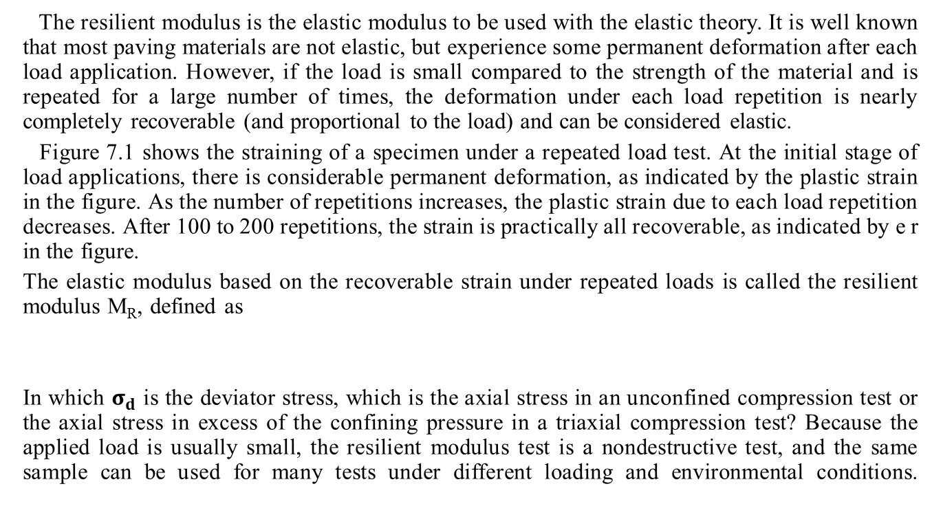
3. RESILIENT MODULUS
The resilient modulus is the elastic modulus to be used with the elastic theory. It is well known that most paving materials are not elastic, but experience some permanent deformation after each load application. However, if the load is small compared to the strength of the material and is repeated for a large number of times, the deformation under each load repetition is nearly completely recoverable (and proportional to the load) and can be considered elastic.
Figure 7.1 shows the straining of a specimen under a repeated load test. At the initial stage of load applications, there is considerable permanent deformation, as indicated by the plastic strain in the figure. As the number of repetitions increases, the plastic strain due to each load repetition decreases. After 100 to 200 repetitions, the strain is practically all recoverable, as indicated by e r in the figure.
The elastic modulus based on the recoverable strain under repeated loads is called the resilient modulus M_{R}, defined as
In which $σ_{d}$ is the deviator stress, which is the axial stress in an unconfined compression test or the axial stress in excess of the confining pressure in a triaxial compression test? Because the applied load is usually small, the resilient modulus test is a nondestructive test, and the same sample can be used for many tests under different loading and environmental conditions.
M_{R} =$\frac{σ_{d}}{€_{r}}$ (7.1)

Slide 6
FIGURE 7 .1 (Strains under repeated loads)

Slide 7
3.1 Loading Waveform
The type and duration of loading used in the repeated load test should simulate that actually occurring in the field. When a wheel load is at a considerable distance from a given point in the pavement, the stress at that point is zero. When the load is directly above the given point, the stress at the point is maximum. It is therefor reasonable to assume the stress pulse to be a haversine or triangular loading, the duration of which depends on the vehicle speed and the depth of the point below the pavement surface.
Barksdale (1971) investigated the vertical stress pulses at different points in flexible pavements. The stress pulse can be approximated by a haversine or a triangular function, as shown in Figure 7 .2. After considering the inertial and viscous effects based on the vertical stress pulses measured in the AASHO Road Test, the stress pulse time can be related to the vehicle speed and depth, as shown in Figure 7 .3 . Because of these effects, the loading time is not inversely proportional to the vehicle speed .
Brown (1973) derived the loading time for a bituminous layer as a function of vehicle speed and layer thickness. The loading time is based on the average pulse time for stresses in the vertical and horizontal directions at various depths in the bituminous layer. For thicker layers, his loading times are slightly smaller than those obtained by Barksdale.
FIGURE 7.2 Equivalent haversine and triangular pulse.

Slide 8
FIGURE 7. 3 Vertical stress pulse time under haversine or triangular loading

Slide 9
(1 in . = 25 .4 mm . 1 mph = 1 .6 km/h) . (After Barksdale (1971) . )
McLean (1974) determined the loading time for an equivalent square wave vertical pulse, as shown in Figure 7 .4, on which the Barksdale's results for 30 mph (48 km/h) triangular loading are superimposed for comparison. It can be seen that the pulse time based on the square wave is shorter than that based on the triangular wave, which is as expected.
FIGURE 7.4 Vertical stress pulse time under square wave form
(1 in . = 25 .4 mm, 1 mph = 1.6 km/h) . (After McLean (1974))

Slide 10
Example :
Repeated load compression tests are employed to determine the resilient moduli of the surface, base , and subbase materials in a flexible pavement, as shown in Figure 7 .5 . The points at the midheight of each layer are used to determine the stress pulse times. If the vehicle speed is 40 mph (64 km/h), what should be the load durations of haversine and square wave loadings for each material?
FIGURE 7.5 Example 7 .1 (1 in . =25 .4 mm) .

Slide 11
Resilient modulus test can be conducted on all types of pavement materials ranging from cohesive to stabilized materials. The test is conducted in a triaxial device equipped for repetitive load conditions.
Measures “stiffness” of the material under repeated load.
Determines the load carrying capacity of the material.
Used for HMA as well as unbound materials
Uses a repeated load triaxial test.
Used in most modern methods of pavement design.

Slide 12
Elastic modulus:
Is sometimes called Young’s modulus, An elastic modulus (E) can be determined for any solid material and represents a constant ratio of stress and strain (a stiffness): E = stress/ strain A material is elastic if it is able to return to its original shape or size immediately after being stretched or squeezed. The modulus of elasticity for a material is basically the slope of its stress-strain plot within the elastic range (as shown in Figure 1).
It is important to remember that a measure of a material’s modulus of elasticity is not a measure of strength. Strength is the stress needed to break or rupture a material, whereas elasticity is a measure of how well a material returns to its original shape and size.

