Slide 1

Structural Design of Highway
Third Stage
Lecture 6
Lecture. Dr. Rana Amir Yousif
Highway and Transportation Engineering
Al-Mustansiriyah University
2017

Slide 2
References:
1. Nicholas J. Garber and Lester A. Hoel.”Traffic and Highway Engineering”, Fourth Edition.
2.Yoder; E. J. and M. W. Witczak, “Principles of Pavement Design”, A Wiley- Interscience Publication, John Wiley & Sons Inc., U.S.A., 1975.
3. Yaug H. Huang, “Pavement Analysis and Design”, Prentic Hall Inc., U.S.A., 1993.
4.“AASHTO Guide for Design of Pavement Structures 1993”, AASHTO, American Association of State Highway and Transportation Officials, U.S.A., 1993.
5. Oglesby Clarkson H., “Highway Engineering”, John Wiley & Sons Inc., U.S.A.,1975.

Slide 3
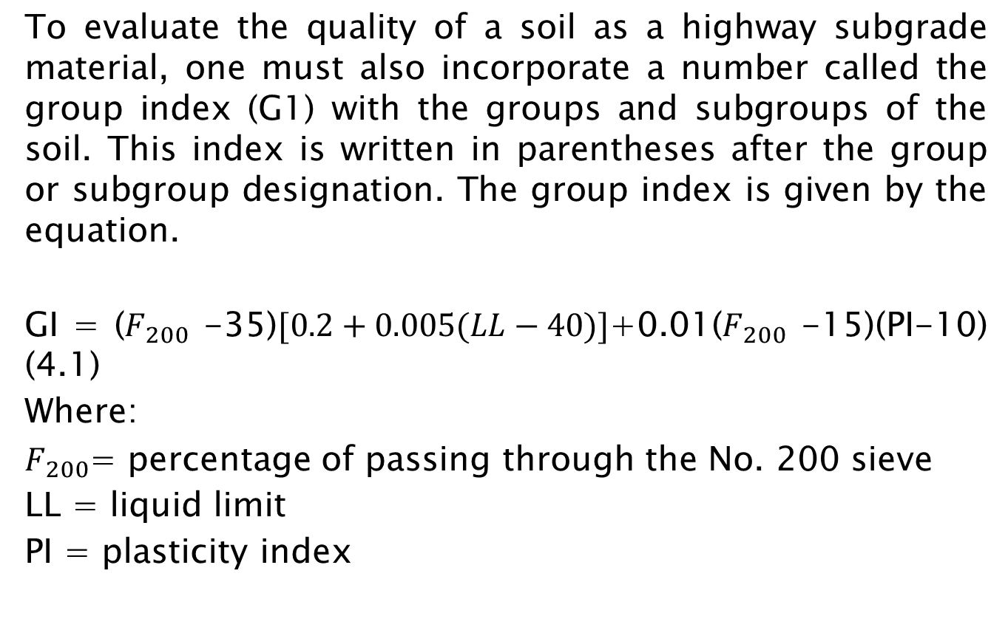
To evaluate the quality of a soil as a highway subgrade material, one must also incorporate a number called the group index (G1) with the groups and subgroups of the soil. This index is written in parentheses after the group or subgroup designation. The group index is given by the equation.
GI = ($F_{200}$ -35)$[0.2+0.005(LL−40)]$+0.01($F_{200}$ -15)(PI-10) (4.1)
Where:
$F_{200}$= percentage of passing through the No. 200 sieve
LL = liquid limit
PI = plasticity index

Slide 5
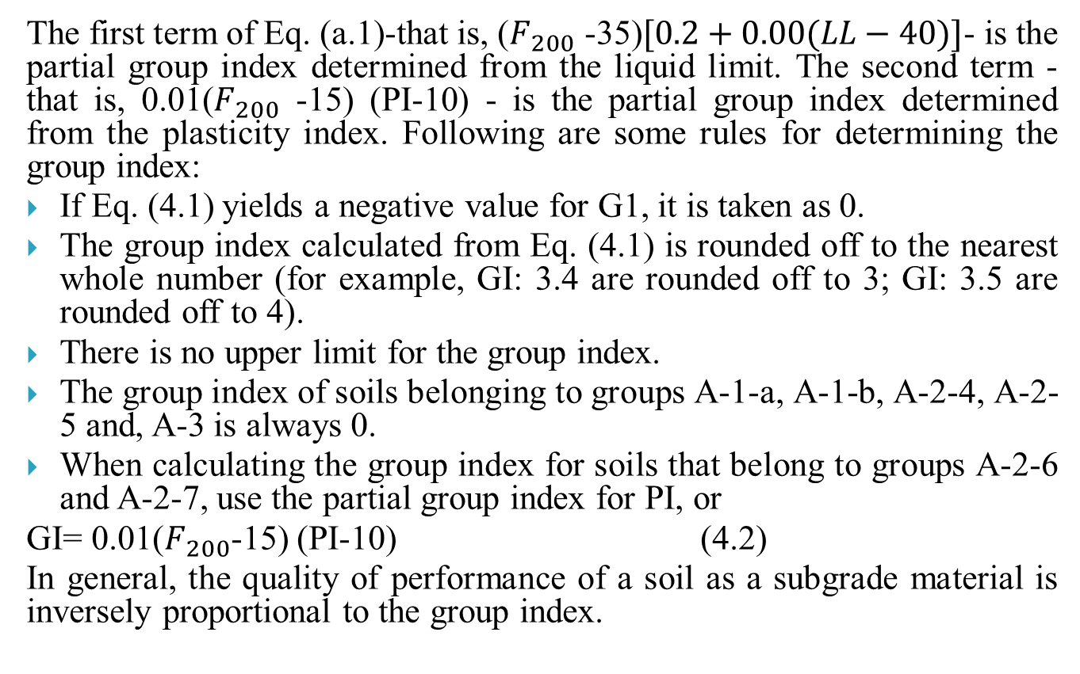
The first term of Eq. (a.1)-that is, ($F_{200}$ -35)$[0.2+0.00(LL−40)]$- is the partial group index determined from the liquid limit. The second term - that is, 0.01($F_{200}$ -15) (PI-10) - is the partial group index determined from the plasticity index. Following are some rules for determining the group index:
If Eq. (4.1) yields a negative value for G1, it is taken as 0.
The group index calculated from Eq. (4.1) is rounded off to the nearest whole number (for example, GI: 3.4 are rounded off to 3; GI: 3.5 are rounded off to 4).
There is no upper limit for the group index.
The group index of soils belonging to groups A-1-a, A-1-b, A-2-4, A-2-5 and, A-3 is always 0.
When calculating the group index for soils that belong to groups A-2-6 and A-2-7, use the partial group index for PI, or
GI= 0.01($F_{200}$-15) (PI-10) (4.2)
In general, the quality of performance of a soil as a subgrade material is inversely proportional to the group index.

Slide 6
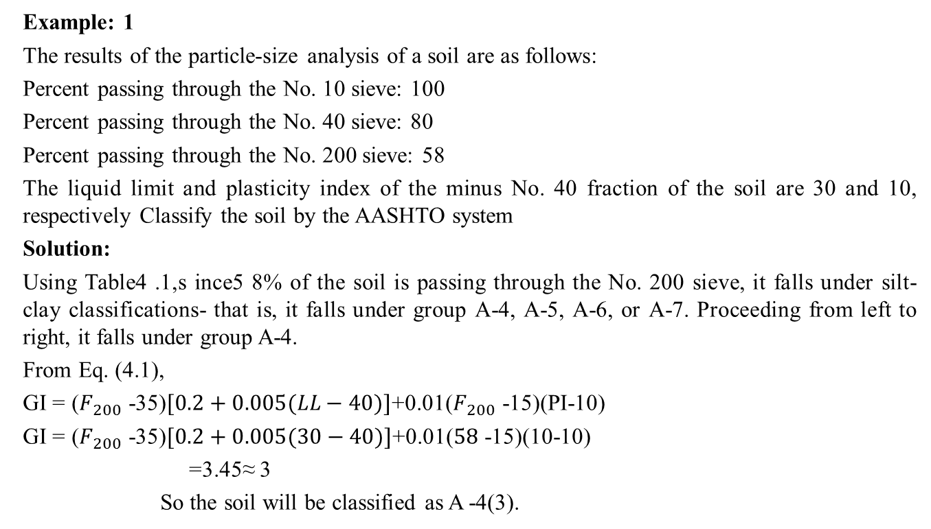
Example: 1
The results of the particle-size analysis of a soil are as follows:
Percent passing through the No. 10 sieve: 100
Percent passing through the No. 40 sieve: 80
Percent passing through the No. 200 sieve: 58
The liquid limit and plasticity index of the minus No. 40 fraction of the soil are 30 and 10, respectively Classify the soil by the AASHTO system
Solution:
Using Table4 .1,s ince5 8% of the soil is passing through the No. 200 sieve, it falls under silt-clay classifications- that is, it falls under group A-4, A-5, A-6, or A-7. Proceeding from left to right, it falls under group A-4.
From Eq. (4.1),
GI = ($F_{200}$ -35)$[0.2+0.005(LL−40)]$+0.01($F_{200}$ -15)(PI-10)
GI = ($F_{200}$ -35)$[0.2+0.005(30−40)]$+0.01($58$ -15)(10-10)
=3.45≈ 3
So the soil will be classified as A -4(3).

Slide 7
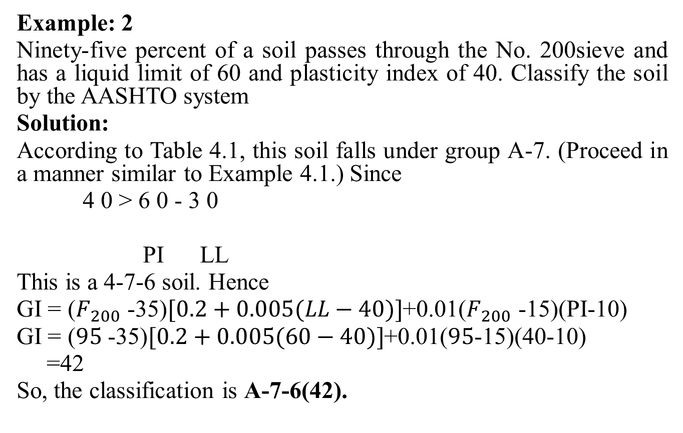
Example: 2
Ninety-five percent of a soil passes through the No. 200sieve and has a liquid limit of 60 and plasticity index of 40. Classify the soil by the AASHTO system
Solution:
According to Table 4.1, this soil falls under group A-7. (Proceed in a manner similar to Example 4.1.) Since
4 0 > 6 0 - 3 0
PI LL
This is a 4-7-6 soil. Hence
GI = ($F_{200}$ -35)$[0.2+0.005(LL−40)]$+0.01($F_{200}$ -15)(PI-10)
GI = ($95$ -35)$[0.2+0.005(60−40)]$+0.01($95$-15)(40-10)
=42
So, the classification is A-7-6(42).

Slide 8
LOAD DISTRIBUTION CONCEPTSOIL
The load (from a vehicle) is transferred to the pavement through loadbearing axles and pressurized tires. The resulting pressure or stress on the pavement, at any depth, is dependent on many factors, such as total load, the number of axles and tires, and the condition of the tires.
The stress on the surface of the pavement gets distributed in an inverted V form from the surface downward. In other words, the stress intensity decreases along the depth of the pavement.

Slide 9
Figure: Concept of Distribution of Stress in the Inverted Form.

Slide 10
SPECIAL TESTS FOR PAVEMENT DESIGN
1- California Bearing Ratio (CBR) Test
This test is commonly known as the CBR test and involves the determination of the load-deformation curve of the soil in the laboratory using the standard CBR testing. The test is conducted on samples of soil compacted to required standards and immersed in water for four days, during which time the samples are loaded with a surcharge that simulate the estimated weight of pavement material the soil will support. The objective of the test is to determine the relative strength of a soil with respect to crushed rock, which is considered an excellent coarse base material. This is obtained by conducting a penetration test on the samples still carrying the simulated load and using a standard CBR equipment. The CBR is defined as the penetration resistance of a subgrade soil relative to a standard crushed rock.

Slide 11
The unit load for 0.1 piston in standard crushed rock is usually taken as 1000 lb/in2, which gives the CBR as
Load a piston (area = 3 in²) at a constant rate (0.05 in/min)
Record Load every 0.1 in penetration
Total penetration not to exceed 0.5 in.
Draw Load-Penetration Curve.

