Slide 1

Structural Design of Highway
Third Stage
Lecture 4
Lecture. Dr. Rana Amir Yousif
Highway and Transportation Engineering
Al-Mustansiriyah University
2017

Slide 2
References:
1. Nicholas J. Garber and Lester A. Hoel.”Traffic and Highway Engineering”, Fourth Edition.
2.Yoder; E. J. and M. W. Witczak, “Principles of Pavement Design”, A Wiley- Interscience Publication, John Wiley & Sons Inc., U.S.A., 1975.
3. Yaug H. Huang, “Pavement Analysis and Design”, Prentic Hall Inc., U.S.A., 1993.
4.“AASHTO Guide for Design of Pavement Structures 1993”, AASHTO, American Association of State Highway and Transportation Officials, U.S.A., 1993.
5. Oglesby Clarkson H., “Highway Engineering”, John Wiley & Sons Inc., U.S.A.,1975.

Slide 3
COMPACTION EQUIPMENT
The desired level of compaction is best achieved by matching the soil type with its proper compaction method. Other factors must be considered as well, such as compaction specs and job site conditions.
Cohesive soils—clay is cohesive; its particles stick together.* Therefore, a machine with a high impact force is required to ram the soil and force the air out, arranging the particles. A rammer is the best choice or a pad-foot vibratory roller if higher production is needed. *The particles must be sheared to compact.
Granular soils—since granular soils are not cohesive and the particles require a shaking or vibratory action to move them; vibratory plates (forward travel) are the best choice.

Slide 4
COHESIVE SOILS
MTX70 Rammer
P33/24 HHMR ROLLER

Slide 5
RX15010CI ROLLER

Slide 6
GRANULAR SOILS
MVC-88 Vibratory Plate
MVH-306 Reversible Plate

Slide 7
AR-13H Ride-on Vibratory Roller

Slide 8
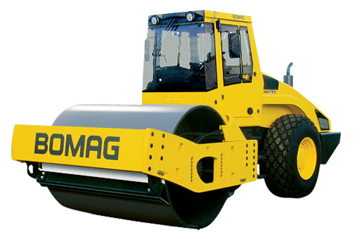
Field Compaction Equipment
Compaction equipment used in the field can be divided to the following types:
Rollers are used for field compaction and apply either a vibrating force or an impact force on the soil. The type of roller used for any particular job depends on the type of soil to be compacted.
• A smooth wheel or drum roller applies contact pressure of up to 55 lb/in.2 over 100 percent of the soil area in contact with the wheel. This type of roller is generally used for finish rolling of subgrade material and can be used for all types of soil material except rocky soils.
Smooth Wheel or Drum Roller

Slide 9
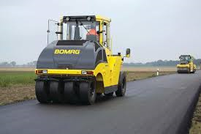
The rubber-tired roller is another type of contact roller, consisting of a heavily loaded wagon with rows of 3 to 6 tires placed close to each other.
The pressure in the tires may be up to 100 lb/in2. They are used for both granular and cohesive materials.
Rubber-Tired Roller

Slide 10
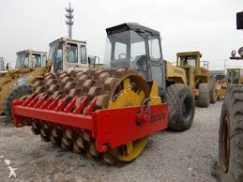
Sheep foot roller, this roller has a drum wheel that can be filled with water. The drum wheel has several protrusions, which may be round or rectangular in shape. Contact pressures ranging from 200 to 1000 lb/in2 can be obtained from sheep foot rollers, depending on the size of the drum and whether or not it is filled with water. The sheep foot roller is used mainly for cohesive soils.
Sheep Foot Roller

Slide 11
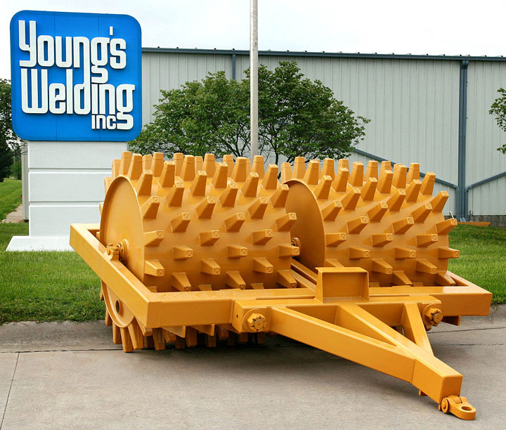
Tamping foot rollers are similar to sheep foot rollers in that they also have protrusions that are used to obtain high contact pressures, ranging from 200 to 1200 lb/in.2. The feet of the tamping foot rollers are specially hinged to obtain a kneading action while compacting the soil. As with sheep foot rollers, tamping foot rollers compact from the bottom of the soil layer.
Tamping Foot Rollers

