Slide 1

Structural Design of Highway
Third Stage
Lecture1
Lecture. Dr. Rana Amir Yousif
Highway and Transportation Engineering
Al-Mustansiriyah University
2017

Slide 2
References:
1. Nicholas J. Garber and Lester A. Hoel.”Traffic and Highway Engineering”, Fourth Edition.
2.Yoder; E. J. and M. W. Witczak, “Principles of Pavement Design”, A Wiley- Interscience Publication, John Wiley & Sons Inc., U.S.A., 1975.
3. Yaug H. Huang, “Pavement Analysis and Design”, Prentic Hall Inc., U.S.A., 1993.
4.“AASHTO Guide for Design of Pavement Structures 1993”, AASHTO, American Association of State Highway and Transportation Officials, U.S.A., 1993.
5. Oglesby Clarkson H., “Highway Engineering”, John Wiley & Sons Inc., U.S.A.,1975.

Slide 3
Rigid Pavements:
A rigid pavement is constructed from cement concrete or reinforced concrete slabs. Grouted concrete roads are in the category of semi-rigid pavements.
The design of rigid pavement is based on providing a structural cement concrete slab of sufficient strength to resists the loads from traffic. The rigid pavement has rigidity and high modulus of elasticity to distribute the load over a relatively wide area of soil.

Slide 4
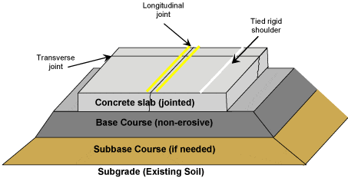
Fig: Rigid Pavement Cross-Section

Slide 5
Minor variations in subgrade strength have little influence on the structural capacity of a rigid pavement. In the design of a rigid pavement, the flexural strength of concrete is the major factor and not the strength of subgrade. Due to this property of pavement, when the subgrade deflects beneath the rigid pavement, the concrete slab is able to bridge over the localized failures and areas of inadequate support from subgrade because of slab action

Slide 7
Types of Rigid Pavements
Rigid pavements can be classified into four types:
Jointed plain concrete pavement (JPCP),
Jointed reinforced concrete pavement (JRCP),
Continuous reinforced concrete pavement (CRCP), and
Pre-stressed concrete pavement (PCP).

Slide 8
Jointed Plain Concrete Pavement: are plain cement concrete pavements constructed with closely spaced contraction joints. Dowel bars or aggregate interlocks are normally used for load transfer across joints. They normally have a joint spacing of 5 to 10m.
Jointed Reinforced Concrete Pavement: Although reinforcements do not improve the structural capacity significantly, they can drastically increase the joint spacing to 10 to 30m. Dowel bars are required for load transfer. Reinforcement's help to keep the slab together even after cracks.
Continuous Reinforced Concrete Pavement: Complete elimination of joints are achieved by reinforcement.

Slide 9
Failure criteria of rigid pavements
Traditionally fatigue cracking has been considered as the major, or only criterion for rigid pavement design. The allowable number of load repetitions to cause fatigue cracking depends on the stress ratio between flexural tensile stress and concrete modulus of rupture. Of late, pumping is identified as an important failure criterion.
Pumping is the ejection of soil slurry through the joints and cracks of cement concrete pavement, caused during the downward movement of slab under the heavy wheel loads. Other major types of distress in rigid pavements include faulting, spalling, and deterioration.

Slide 10
Difference between Flexible Pavements and Rigid Pavements:
 | Flexible Pavement | Rigid Pavement
1 | It consists of a series of layers with the highest quality materials at or near the surface of pavement. | It consists of one layer Portland cement concrete slab or relatively high flexural strength.
2 | It reflects the deformations of subgrade and subsequent layers on the surface. | It is able to bridge over localized failures and area of inadequate support
3 | Its stability depends upon the aggregate interlock, particle friction and cohesion. | Its structural strength is provided by the pavement slab itself by its beam action.
4 | Pavement design is greatly influenced by the subgrade strength. | Flexural strength of concrete is a major factor for design.
5 | It functions by a way of load distribution through the component layers | It distributes load over a wide area of subgrade because of its rigidity and high modulus of elasticity.
6 | Temperature variations due to change in atmospheric conditions do not produce stresses in flexible pavements. | Temperature changes induce heavy stresses in rigid pavements.
7 | Flexible pavements have self-healing properties due to heavier wheel loads are recoverable due to some extent. | Any excessive deformations occurring due to heavier wheel loads are not recoverable, i.e. settlements are permanent.

Slide 11
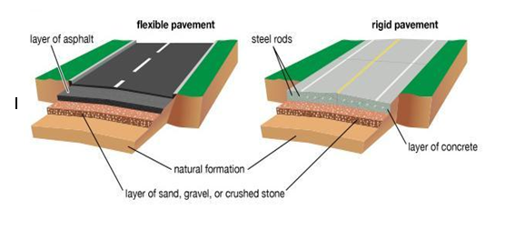

Slide 12
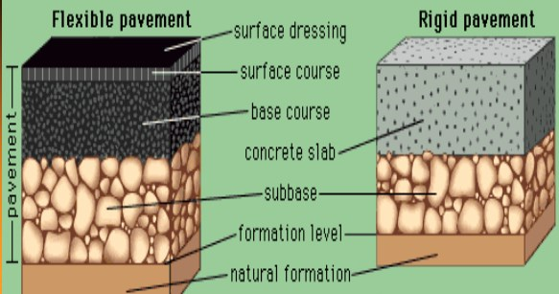

Slide 13
