Slide 1
Structural Design of Highway
Third Stage
Lecture1
Lecture. Dr. Rana Amir Yousif
Highway and Transportation Engineering
Al-Mustansiriyah University
2017

Slide 2
References:
1. Nicholas J. Garber and Lester A. Hoel.”Traffic and Highway Engineering”, Fourth Edition.
2.Yoder; E. J. and M. W. Witczak, “Principles of Pavement Design”, A Wiley- Interscience Publication, John Wiley & Sons Inc., U.S.A., 1975.
3. Yaug H. Huang, “Pavement Analysis and Design”, Prentic Hall Inc., U.S.A., 1993.
4.“AASHTO Guide for Design of Pavement Structures 1993”, AASHTO, American Association of State Highway and Transportation Officials, U.S.A., 1993.
5. Oglesby Clarkson H., “Highway Engineering”, John Wiley & Sons Inc., U.S.A.,1975.

Slide 3
Introduction to pavement design
Overview
A highway pavement is a structure consisting of superimposed layers of processed materials above the natural soil sub-grade, whose primary function is to distribute the applied vehicle loads to the sub-grade. The pavement structure should be able to provide a surface of acceptable riding quality, adequate skid resistance, favorable light reacting characteristics, and low noise pollution. The ultimate aim is to ensure that the transmitted stresses due to wheel load are sufficiently reduced, so that they will not exceed bearing capacity of the subgrade.
Two types of pavements are generally recognized as serving this purpose, namely flexible pavements and rigid pavements. This chapter gives an overview of pavement types, layers, and their functions, and pavement failures. Improper design of pavements leads to early failure of pavements affecting the riding quality

Slide 4
Requirements of a pavement
An ideal pavement should meet the following requirements:
Sufficient thickness to distribute the wheel load stresses to a safe value on the sub-grade soil.
Structurally strong to withstand all types of stresses imposed upon it, Adequate coefficient of friction to prevent skidding of vehicles, Smooth surface to provide comfort to road users even at high speed, Produce least noise from moving vehicles, Dust proof surface so that traffic safety is not impaired by reducing visibility Impervious surface, so that sub-grade soil is well protected, and Long design life with low maintenance cost.

Slide 5
TYPES OF PAVEMENT – FLEXIBLE AND RIGID PAVEMENT
The pavements can be classified based on the structural performance into two, flexible pavements and rigid pavements. In flexible pavements, wheel loads are transferred by grain-to-grain contact of the aggregate through the granular structure. The flexible pavement, having less flexural strength, acts like a flexible sheet (e.g. bituminous road). On the contrary, in rigid pavements, wheel loads are transferred to sub-grade soil by flexural strength of the pavement and the pavement acts like a rigid plate (e.g. cement concrete roads). In addition to these, composite pavements are also available.
A thin layer of flexible pavement over rigid pavement is an ideal pavement with most desirable characteristics. However, such pavements are rarely used in new construction because of high cost and complex analysis required.

Slide 6
Flexible Pavements:
Flexible pavement can be defined as the one consisting of a mixture of asphaltic or bituminous material and aggregates placed on a bed of compacted granular material of appropriate quality in layers over the subgrade. Water bound macadam roads and stabilized soil roads with or without asphaltic toppings are examples of flexible pavements.
The design of flexible pavement is based on the principle that for a load of any magnitude, the intensity of a load diminishes as the load is transmitted downwards from the surface by virtue of spreading over an increasingly larger area, by carrying it deep enough into the ground through successive layers of granular material.

Slide 7
Fig: Flexible Pavement Cross-section

Slide 8
Thus for flexible pavement, there can be grading in the quality of materials used, the materials with high degree of strength is used at or near the surface. Thus the strength of subgrade primarily influences the thickness of the flexible pavement.

Slide 10
Types of Flexible Pavements
The following types of construction have been used in flexible pavement:
Conventional layered flexible pavement,
Full - depth asphalt pavement, and
Contained rock asphalt mat (CRAM).

Slide 11
Typical layers of a flexible pavement
Typical layers of a conventional flexible pavement includes seal coat, surface course, tack coat, binder course, prime coat, base course, sub-base course, compacted sub-grade, and natural sub-grade.
Seal Coat: Seal coat is a thin surface treatment used to water-proof the surface and to provide skid resistance.
Tack Coat: Tack coat is a very light application of asphalt, usually asphalt emulsion diluted with water. It provides proper bonding between two layer of binder course and must be thin, uniformly cover the entire surface, and set very fast.

Slide 12
Prime Coat: Prime coat is an application of low viscous cutback bitumen to an absorbent surface like granular bases on which binder layer is placed. It provides bonding between two layers. Unlike tack coat, prime coat penetrates into the layer below, plugs the voids, and forms a water tight surface.
Surface course: is the layer directly in contact with traffic loads and generally contains superior quality materials. They are usually constructed with dense graded asphalt concrete (AC). The functions and requirements of this layer are:
It provides characteristics such as friction, smoothness, drainage, etc. Also it will prevent the entrance of excessive quantities of surface water into the underlying base, sub-base and sub-grade,
It must be tough to resist the distortion under traffic and provide a smooth and skid- resistant riding surface,
It must be water proof to protect the entire base and sub-grade from the weakening effect of water.

Slide 13
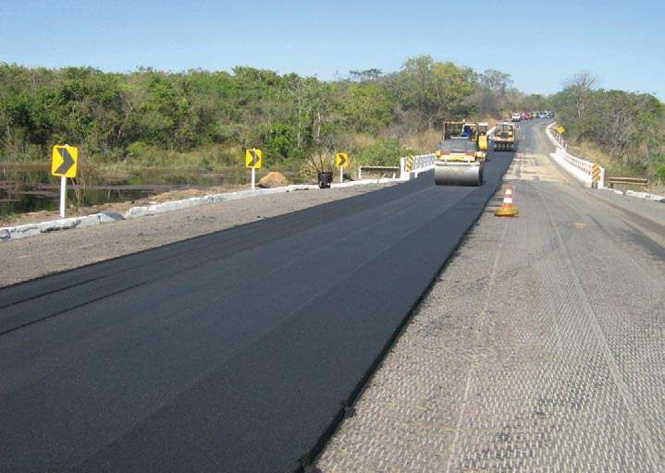
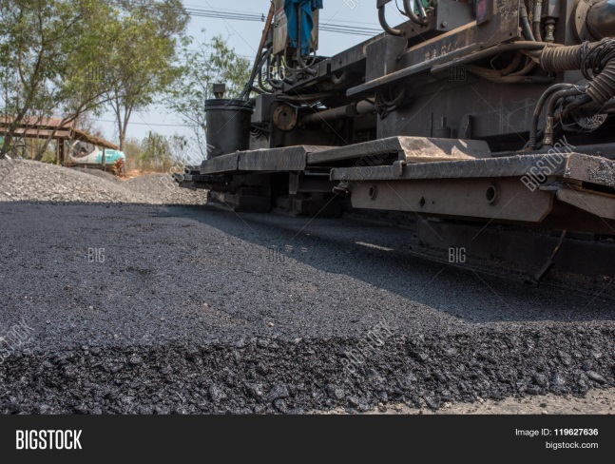
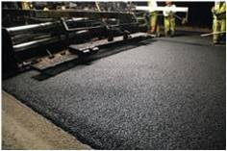

Slide 14
Binder course
This layer provides the bulk of the asphalt concrete structure. Its chief purpose is to distribute load to the base course the binder course generally consists of aggregates having less asphalt and doesn't require quality as high as the surface course, so replacing a part of the surface course by the binder course results in more economical design.
Base course
The base course is the layer of material immediately beneath the surface of binder course and it provides additional load distribution and contributes to the sub-surface drainage It may be composed of crushed stone, crushed slag, and other untreated or stabilized materials.

Slide 15
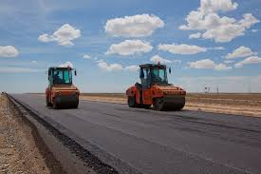
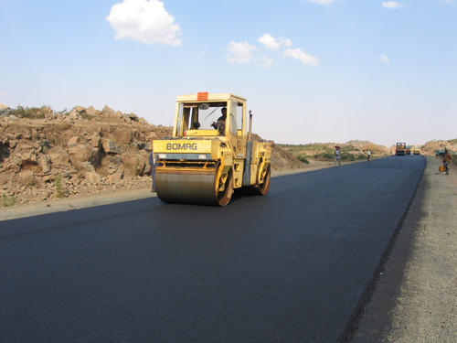
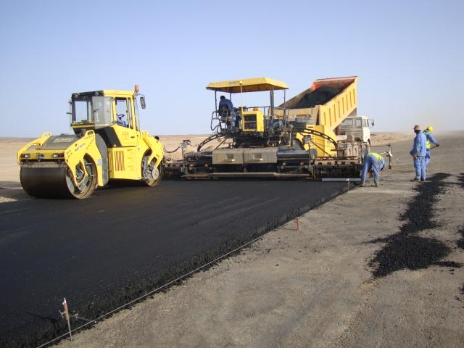

Slide 16
Sub-Base course
The sub-base course is the layer of material beneath the base course and the primary functions are to provide structural support, improve drainage, and reduce the intrusion of fines from the sub-grade in the pavement structure If the base course is open graded, then the sub-base course with more fines can serve as a filler between sub-grade and the base course A sub-base course is not always needed or used. For example, a pavement constructed over a high quality, stiff sub-grade may not need the additional features offered by a sub-base course. In such situations, sub-base course may not be provided.

Slide 17
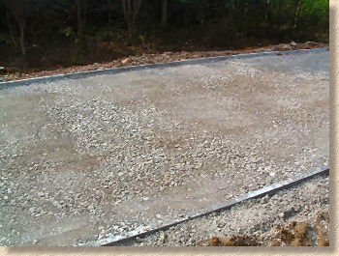

Slide 18
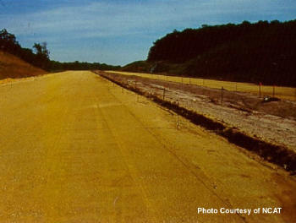
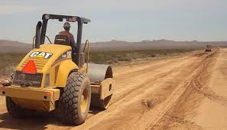
Sub-grade
The top soil or sub-grade is a layer of natural soil prepared to receive the stresses from the layers above. It is essential that at no time soil sub-grade is overstressed. It should be compacted to the desirable density, near the optimum moisture content.

Slide 19
Failure of flexible pavements
The major flexible pavement failures are fatigue cracking, rutting, and thermal cracking. The fatigue cracking of flexible pavement is due to horizontal tensile strain at the bottom of the asphaltic concrete. The failure criterion relates allowable number of load repetitions to tensile strain and this relation can be determined in the laboratory fatigue test on asphaltic concrete specimens. Rutting occurs only on flexible pavements as indicated by permanent deformation or rut depth along wheel load path. Two design methods have been used to control rutting: one to limit the vertical compressive strain on the top of subgrade and other to limit rutting to a tolerable amount (12 mm normally). Thermal cracking includes both low-temperature cracking and thermal fatigue cracking.

