Slide 1


Programming I/ First semester / Computer Fundamentals
Environmental Engineering Department
Lecture 1
What is Computer?
Computer is an advanced electronic device that takes raw data as input from the user and processes these data under the control of set of instructions (called program) and gives the result (output) and saves output for the future use. It can process both numerical and non-numerical (arithmetic and logical) calculations.
A computer has four functions:
a. accepts data Input
b. processes data Processing
c. produces output Output
d. stores results Storage
Input (Data):
Input is the raw information entered into a computer from the input devices. It is the collection of letters, numbers, images etc.
Process:
Process is the operation of data as per given instruction. It is totally internal process of the computer system.
Output:
Output is the processed data given by computer after data processing. Output is also called as Result. We can save these results in the storage devices for the future use.
Computer System
All of the components of a computer system can be summarized with the simple equations.

Slide 2
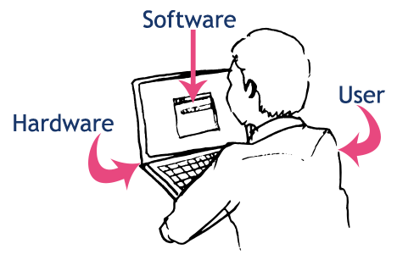
Programming I/ First semester / Computer Fundamentals
Environmental Engineering Department
COMPUTER SYSTEM = HARDWARE + SOFTWARE+ USER
Hardware = Internal Devices + Peripheral Devices
All physical parts of the computer (or everything that we can touch) are known as Hardware.
Software = Programs
Software gives "intelligence" to the computer.
USER = Person, who operates computer.

Slide 3
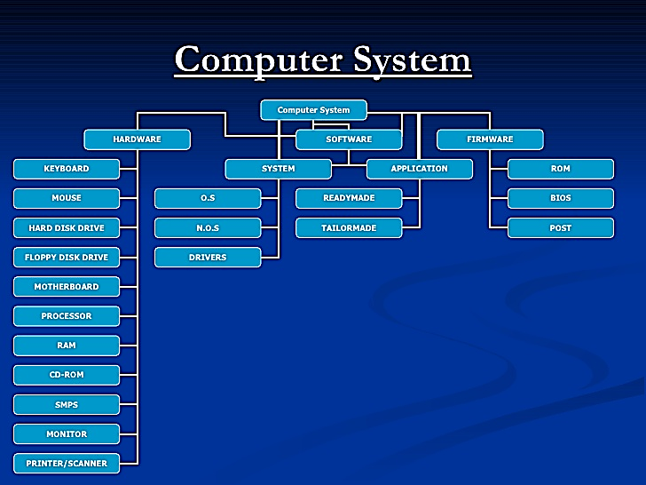
Programming I/ First semester / Computer Fundamentals
Environmental Engineering Department

Slide 4
Programming I/ First semester / Computer Fundamentals
Environmental Engineering Department
Major parts of the Computer
Input Devices

Slide 5
Programming I/ First semester / Computer Fundamentals
Environmental Engineering Department
Processor
CENTRAL PROCESSING UNIT (CPU)
The main unit inside the computer is the CPU. This unit is responsible for all events inside the computer. It controls all internal and external devices, performs arithmetic and logic operations. The CPU (Central Processing Unit) is the device that interprets and executes instructions.

Slide 6
Programming I/ First semester / Computer Fundamentals
Environmental Engineering Department
Output Devices

Slide 7
Programming I/ First semester / Computer Fundamentals
Environmental Engineering Department
Storage Devices
1. Primary memory (main memory)
A. RAM (Random Access Memory/Read-Write Memory)
B. ROM (Read-only-memory)
2. Secondary memory (storage devices)
A. Hard Disk (Local Disk)
B. Optical Disks: CD-R, CD-RW, DVD-R, DVD-RW
C. Pen Drive
D. Zip Drive
E. Floppy Disks
F. Memory Cards
G. External Hard Disk

Slide 8
Programming I/ First semester / Computer Fundamentals
Environmental Engineering Department

Slide 9
Programming I/ First semester / Computer Fundamentals
Environmental Engineering Department
Peripheral Devices

Slide 10
Programming I/ First semester / Computer Fundamentals
Environmental Engineering Department
Internal Components

Slide 11
Programming I/ First semester / Computer Fundamentals
Environmental Engineering Department
Lecture 2
Software
Software, simply are the computer programs. The instructions given to the computer in the form of a program is called Software. Software is the set of programs, which are used for different purposes. All the programs used in computer to perform specific task is called Software.
Types of software
1. System software:
a) Operating System Software
DOS, Windows XP, Windows Vista, Unix/Linux, MAC/OS X etc.
b) Utility Software
  Windows Explorer (File/Folder Management), Windows Media Player, Anti-Virus Utilities, Disk Defragmentation, Disk Clean, BackUp, WinZip, WinRAR etc…
2. Application software:
a) Package Software
  Ms. Office 2003, Ms. Office 2007, Macromedia (Dreamweaver, Flash, Freehand), Adobe (PageMaker, PhotoShop)
b) Tailored or Custom Software
SAGE (Accounting), Galileo/Worldspan (Travel) etc.

Slide 12
Programming I/ First semester / Computer Fundamentals
Environmental Engineering Department
3. Computer Languages & Scripting:
a) Low Level Language
  i) Machine Level Language
  ii) Assembly Language
  Machine language: These language instructions are directly executed by CPU
  Assembly language: The endeavor of giving machine language instructions a name structure that means bit strings of instructions of machine language are given name here
  High Level Language: The user friendly language ...more natural language than assembly language.
  Assembler is needed to convert assembly language into machine language
Complier is needed to convert high level to machine language
b) High Level Language
COBOL (COmmon Business Oriented Language), FORTRAN (FORmula TRANslation), BASIC (Beginner's All-purpose Symbolic Instruction Code), C, C++ etc. are the examples of High Level Language.

Slide 13
Programming I/ First semester / Computer Fundamentals
Environmental Engineering Department
Lecture 3
Basic Computer Literacy
Quiz One
1. Which one is not an output device?
  o Printer
  o Monitor
  o Keyboard
  o Modem
2. Which one works as an output and input device?
  o Modem
  o Scanner
  o Mouse
  o Monitor
3. All computers must have:
  o Word processing software
  o An operating system
  o A printer attached
  o A virus checking program
4. The brain of the computer is called:
  o Random Access Memory or RAM
  o Central Processing Unit or CPU
  o Read Only Memory or ROM
  o BIOS
8. The resolution of a printer is measured in:
o Megabits
o Hz
o Dots per inch (DPI)
o Inches (diagonal)
9. Windows and Macintosh computers:
o Are both manufactured by Motorola
o Both use Intel microprocessors
o Use the same operating system
o Are not compatible
10. A computer port is used to:
o Communicate with other computer peripherals
o Download files from the web
o Communicate with all hard drives
o Connect computers together
5. An operating system is:
  o Integrated software
  o CD-ROM software
  o Application software
  o System software
6. Software is:
  o A computer program
  o A set of instructions
  o All of the above
  o Only in operating systems
7. One MB is equal to:
  o The amount of RAM in every computer
  o 1 billion bytes
  o 1024KB
  o 1 thousand bytes

Slide 14
Programming I/ First semester / Computer Fundamentals
Environmental Engineering Department
4. The part of the computer that processes the information is the (1 point)
o floppy disk
o CD-ROM drive
o monitor
o microprocessor
5. Which of these is not an example of an input device? (1 point)
o keyboard
o mouse
o hard drive
o scanner
6. Windows is (1 point)
o a kind of operating system.
o a graphics display device.
o a monitor display system.
o a video game.
Lecture 4
Quiz Two
1. CPU means (1 point)
  o Central Processing Unit
  o Controlled Program Utilization
  o Computer Programming Unit
  o Computerized Processing Unit
2. Computers use a special code for representing letters and numbers, known as the (1 point)
o processing code
  binary code
o CRX code
o integrated code
3. The main circuit board in the computer that connects the parts of the computer is the (1 point)
o hard drive
o motherboard
o fatherboard
o main board

Slide 15
Programming I/ First semester / Computer Fundamentals
Environmental Engineering Department
Lecture 5
The Binary Number System
The number system that you are familiar with, that you use every day, is the decimal number system, also commonly referred to as the base-10 system. When you perform computations such as 3 + 2 = 5, or 21 – 7 = 14, you are using the decimal number system. This system, which you likely learned in first or second grade, is ingrained into your subconscious; it’s the natural way that you think about numbers. Of course it is not just you: It is the way that everyone thinks—and has always thought—about numbers and arithmetic. Evidence exists that Egyptians were using a decimal number system five thousand years ago. The Roman numeral system, predominant for hundreds of years, was also a decimal number system (though organized differently from the Arabic base-10 number system that we are most familiar with). Indeed, base-10 systems, in one form or another, have been the most widely used number systems ever since civilization started counting.
In dealing with the inner workings of a computer, though, you are going to have to learn to think in a different number system, the binary number system, also referred to as the base-2 system.Before considering why we might want to use a different number system, let’s first consider: Why do we use base-10? The simple answer: We have 10 fingers. Before the days of calculators and computers, we counted on our hands (many of us still do!).

Slide 16
Programming I/ First semester / Computer Fundamentals
Environmental Engineering Department
Consider a child counting a pile of pennies. He would begin: “One, two, three, …, eight, nine.” Upon reaching nine, the next penny counted makes the total one single group of ten pennies. He then keeps counting: “One group of ten pennies… two groups of ten pennies… three groups of ten pennies … eight groups of ten pennies … nine groups of ten pennies…” Upon reaching nine groups of ten pennies plus nine additional pennies, the next penny counted makes the total thus far: one single group of one hundred pennies. Upon completing the task, the child might find that he has three groups of one hundred pennies, five groups of ten pennies, and two pennies left over: 352 pennies.
More formally, the base-10 system is a positional system, where the rightmost digit is the ones position (the number of ones), the next digit to the left is the tens position (the number of groups of 10), the next digit to the left is the hundreds position (the number of groups of 100), and so forth. The base-10 number system has 10 distinct symbols, or digits (0, 1, 2, 3,…8, 9). In decimal notation, we write a number as a string of symbols, where each symbol is one of these ten digits, and to interpret a decimal number, we multiply each digit by the power of 10 associated with that digit’s position.
For example, consider the decimal number: 6349. This number is:

Slide 17
Programming I/ First semester / Computer Fundamentals
Environmental Engineering Department
Consider: Computers are built from transistors, and an individual transistor can only be ON or OFF (two options). Similarly, data storage devices can be optical or magnetic. Optical storage devices store data in a specific location by controlling whether light is reflected off that location or is not reflected off that location (two options). Likewise, magnetic storage devices store data in a specific location by
magnetizing the particles in that location with a specific orientation. We can have the north magnetic pole pointing in one direction, or the opposite direction (two options).
Computers can most readily use two symbols, and therefore a base-2 system, or binary number system, is most appropriate. The base-10 number system has 10 distinct symbols: 0, 1, 2, 3, 4, 5, 6, 7, 8 and 9. The base-2 system has exactly two symbols: 0 and 1. The base-10 symbols are termed digits. The base-2 symbols are termed binary digits, or bits for short. All base-10 numbers are built as strings of digits (such as 6349). All binary numbers are built as strings of bits (such as 1101). Just as we would say that the decimal number 12890 has five digits, we would say that the binary number 11001 is a five-bit number. The point: All data in a computer is represented in binary. The pictures of your last vacation stored on your hard drive—it’s all bits. The YouTube video of the cat falling off the chair that you saw this morning—bits. Your Facebook page—bits. The tweet you sent—bits. The email from your professor telling you to spend less time on vacation, browsing YouTube, updating your Facebook page and sending tweets—that’s bits too. Everything is bits.
To understand how computers work, you have to speak the language. And the language of computers is the binary number system.

Slide 18
Programming I/ First semester / Computer Fundamentals
Environmental Engineering Department
Converting a Binary Number to a Decimal Number
To convert a binary number to a decimal number, we simply write the binary number as a sum of powers of 2. For example, to convert the binary number 1011 to a decimal number, we note that the rightmost position is the ones position and the bit value in this position is a 1. So, this rightmost bit has the decimal value of . The next position to the left is the twos position, and the bit value in this position is also a 1. So, this next bit has the decimal value of . The next position to the left is the fours position, and the bit value in this position is a 0. The leftmost position is the eights position, and the bit value in this position is a 1. So, this leftmost bit has the decimal value of . Thus:

Slide 19
Programming I/ First semester / Computer Fundamentals
Environmental Engineering Department
Lecture 6
The algorithmic foundations of computer science
What is an algorithm?
An algorithm is a
well-ordered collection of
unambiguous and
effectively computable operations that, when executed,
produces a result and
halts in a finite amount of time.
The question that must be answered is:
Does the computing entity understand what the operation is to do?
This implies that the knowledge of the computing entity must be considered.
For example, is the following ambiguous?
Make the pie crusts.

Slide 20
Programming I/ First semester / Computer Fundamentals
Environmental Engineering Department
To an experienced cook,
Make the pie crusts.
is not ambiguous.
But, an less experienced cook may need:
Take 1 1/3 cups of flour.
Sift the flour.
Mix the sifted flour with 1/2 cup of butter and 1/4 cup of water to make dough.
Roll the dough into two 9-inch pie crusts.
or even more detail!

Slide 21
Programming I/ First semester / Computer Fundamentals
Environmental Engineering Department
For this example we are interested in the square root of 55
Find the two integers between which √55 lies
  Do this by starting at 0 and continuing up through the integers until you find an integer whose square is less than 55 and the next integer has a square larger than 55
Find the first estimate by averaging the two integers
Divided 55 by the estimate. Compute it to one more place than you want in the final answer
Average the estimate and the result of step 3
Repeat steps 3 and 4 until the tenth digit does not change
Example of a Dry run
L1 Declare two variables , first num second num
L2 Initialise both variables to 0
L3 first num = 0 second num = 0
L4 Ask user to enter first number
L5 Assign user input to first num variable
L6 Ask user to enter second number
L7 Assign user input to second num variable
L8 Add first num to second num
L9 Print result
Do a Dry run for this program assuming the user enters 17 for first number and 24 for the second

Slide 22
Programming I/ First semester / Computer Fundamentals
Environmental Engineering Department
Lecture 7
Relational Operators
Give examples
< less than
> greater than
<= Less than or equal to a<=b
>= greater than or equal c>=d
== equals
!= not equals 5!=6
Boolean expression – TRUE or FALSE
If then Else statements
If <TEST>
<STATEMENT 1 >
Else
<STATEMENT 2 >
<

Slide 23
Programming I/ First semester / Computer Fundamentals
Environmental Engineering Department

Slide 24
Programming I/ First semester / Computer Fundamentals
Environmental Engineering Department

