Slide 1

SHREE SA’D VIDYA MANDAL INSTITUTE OF TECHNOLOGY
DEPARTMENT OF CIVIL ENGINEERING

Slide 2
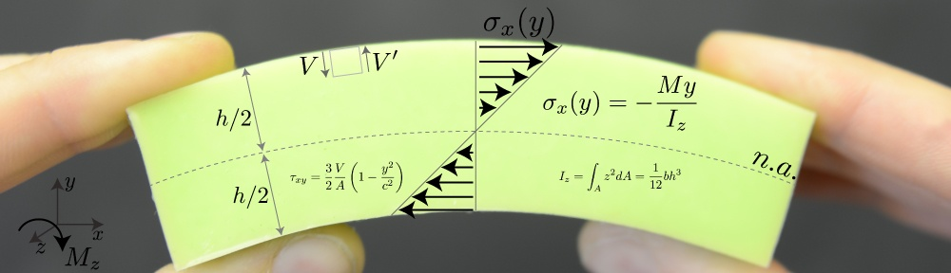
Subject:-Mechanics Of Solids
    Topic:-Shear stresses on beam

Slide 3
Presented by:-
Name
Arvindsai
Dhaval Chavda
Fahim Patel
Navazhushen Patel
Enrollment no.
130454106002
130454106001
140453106005
140453106008

Slide 4
Topics To Be Covered
Shear Force
Shear Stresses In Beams
Horizontal Shear Stress
Derivation Of Formula
Shear Stress Distribution Diagram
Numericals

Slide 5
Shear force
Any force which tries to shear-off the member, is termed as shear force.
Shear force is an unbalanced force, parallel to the cross-section, mostly vertical, but not always, either the right or left of the section.

Slide 6
Shear Stresses
To resist the shear force, the element will develop the resisting stresses, Which is known as Shear Stresses(τ).
τ= =
Shear force
S
Cross sectional area
A

Slide 7
Example:-
For the given figure if we want to calculate the τ..
Then it will be
Let shear force be S
∴τ=S/(bxd)
S
d
b

Slide 8
Shear Stresses In Beams
Shear stresses are usually maximum at the neutral axis of a beam (always if the thickness is constant or if thickness at neutral axis is minimum for the cross section, such as for I-beam or T-beam ), but zero at the top and bottom of the cross section as normal stresses are max/min.
NA
NA
NA

Slide 9

When a beam is subjected to a loading, both bending moments, M, and shear forces, V, act on the cross section. Let us consider a beam of rectangular cross section. We can reasonably assume that the shear stresses τ act parallel to the shear force V.
b
h
V
O
z
n
m
v

Slide 10
Shear stresses on one side of an element are accompanied by shear stresses of equal magnitude acting on perpendicular faces of an element. Thus, there will be horizontal shear stresses between horizontal layers of the beam, as well as, Vertical shear stresses on the vertical cross section.
n
m

Slide 11
Horizontal Shear Stress
Horizontal shear stress occurs due to the variation in bending moment along the length of beam.
Let us assume two sections PP' and QQ', which are 'dx' distance apart, carrying bending moment and shear forces 'M and S' and 'M+ ∆M and S+ ∆S‘ respectively as shown in Fig.

Slide 12
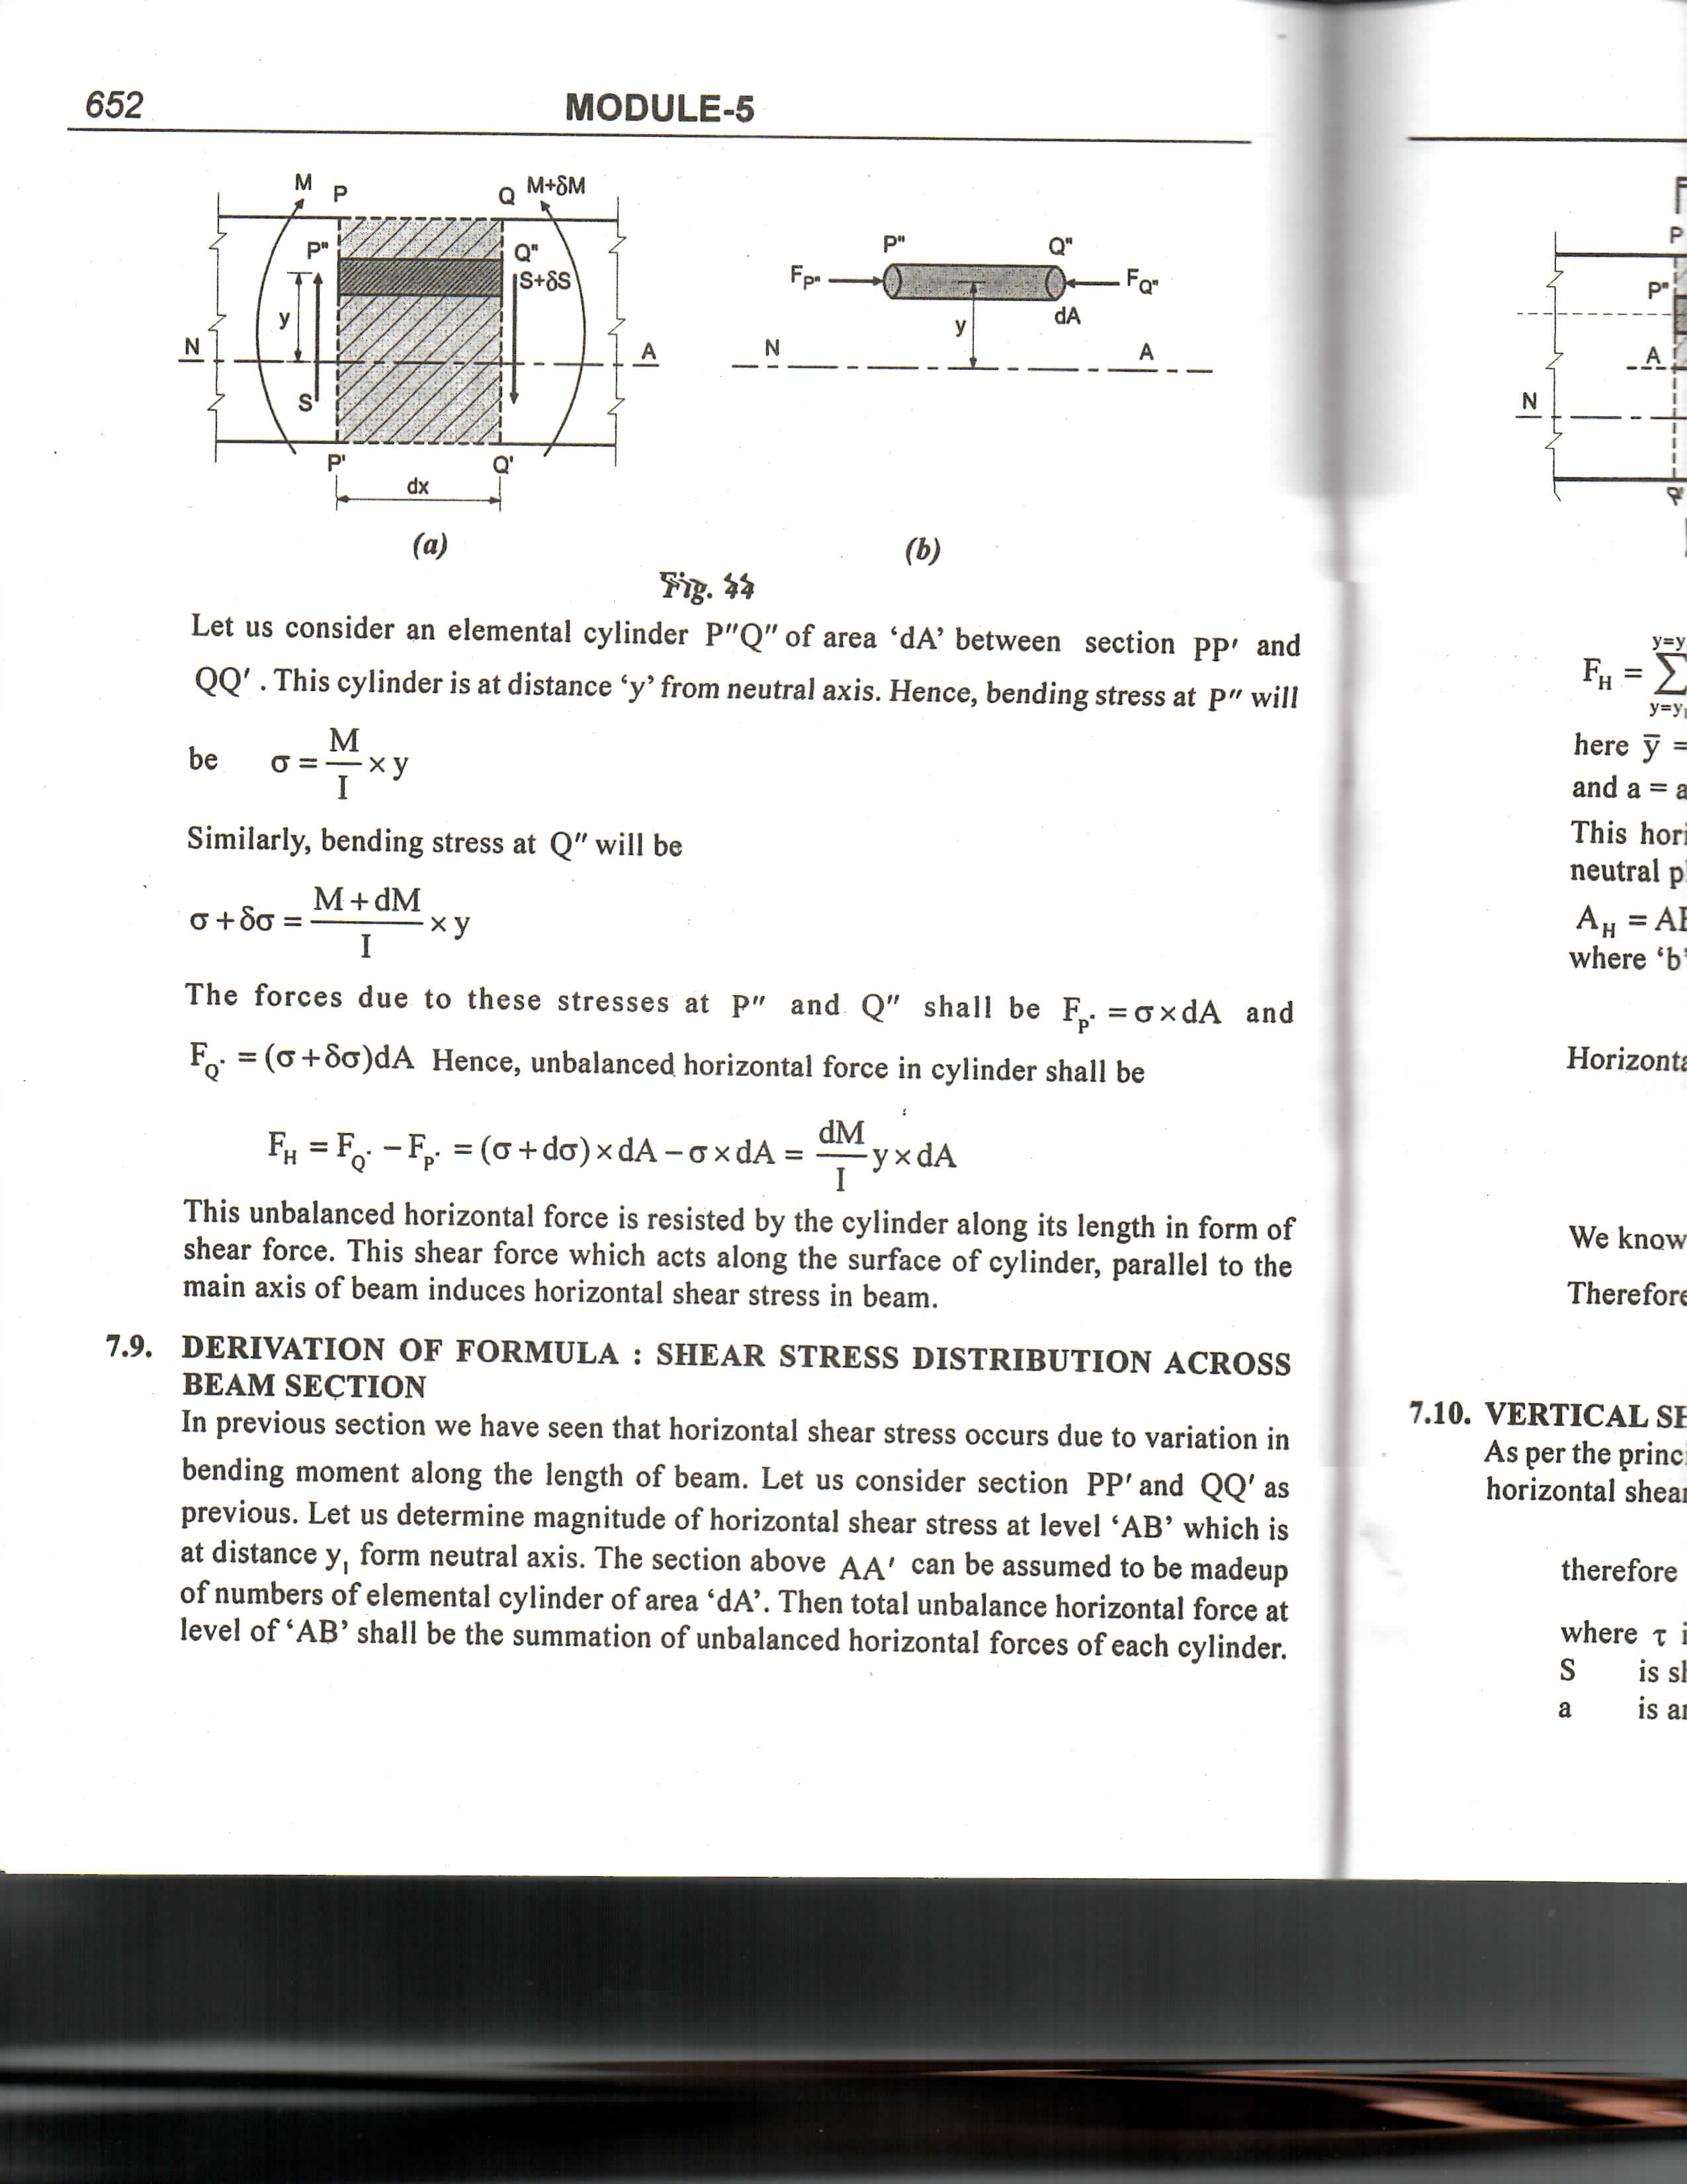
Let us consider an elemental cylinder P"Q" of area 'dA' between section PP' and QQ' . This cylinder is at distance 'y' from neutral axis.

Slide 14
This unbalanced horizontal force is resisted by the cylinder along its length in form of shear force. This shear force which acts along the surface of cylinder, parallel to the main axis of beam induces horizontal shear stress in beam.

Slide 15
DERIVATION OF FORMULA: SHEAR STRESS DISTRIBUTION ACROSS BEAM SECTION
Let us consider section PP' and QQ' as previous.
Let us determine magnitude of horizontal shear stress at level 'AB' which is at distance YI form neutral axis.
The section above AA' can be assumed to be made up of numbers of elemental cylinder of area 'dA'. Then total unbalance horizontal force at level of' AS' shall be the summation of unbalanced horizontal forces of each cylinder.

Slide 16
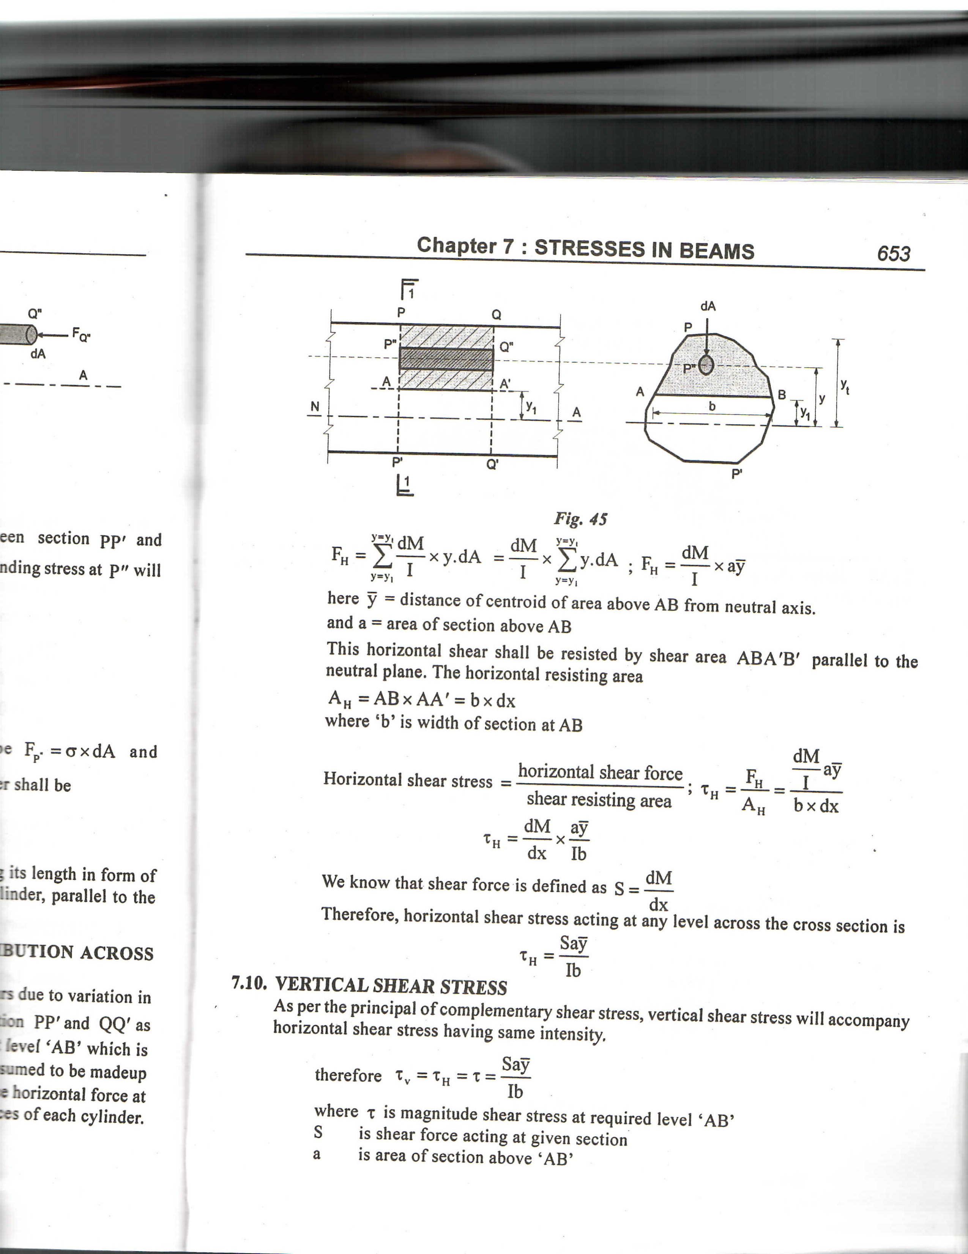

Slide 17
Here, y = distance of centroid of area above AB from neutral axis, And a= area of section above AB.
This horizontal shear shall be resisted by shear area ABA'B‘ parallel to the Neutral plane. The horizontal resisting area here distance of centroid of area above AB from neutral axis and a=area of section above AB.
Ah = AB x AA’=b x dx
where ‘b’is width of section at AB.

Slide 18
We know that shear force is defined as S=dM/dx
Therefore, horizontal shear stress acting at any level across the cross sections.
TH= Say / Ib

Slide 19
SHEAR STRESS DISTRIBUTION DIAGRAM
1.Rectangular section
τmax
NA
2.Circular section
τmax
NA

Slide 20
3.Triangular section
τ
h/2
τmax
NA
τavg
4.Hollow circular section
τmax
NA

Slide 21
5.Hollow Rectangular section
τmax
NA
6. “I” section
τmax
NA

Slide 22
7. “C” section
τmax
NA
8. “+” section
τmax
NA

Slide 23
9. “H” section
τmax
NA
10. “T” section
τmax
NA

Slide 24
Numericals

Slide 25
Rectangular section sum
Example-1: Two wooden pieces of a section 100mm X100mm glued to gather to for m a beam cross section 100mm wide and 200mm deep. If the allowable shear stress at glued joint is 0.3 N/mm² what is the shear force the section can carry ?

Slide 26
wooden piece
100mm
100mm
100mm

Slide 27
Circular section sum
Example-2: A circular a beam of 100mm Diameter is subjected to a Shear force of 12kN, calculate The value of maximum shear Stress and draw the variation of shear stress along the Depth of the beam.

Slide 29
D =100mm
NA

Slide 30
I section sum
Example-3: A rolled steel joist of I section overall 300 mm deep X 100mm wide has flange and web of 10 mm thickness. If permissible shear stress is limited to 100N/mm², find the value of uniformly distributed load the section can carry over a simply supported span of 6m.
Sketch the shear stress distribution across the section giving value at the point of maximum shear force.

Slide 31
100mm
10mm
10
300mm
NA

Slide 34
Triangular section sum
Example-4: A beam of triangular section having base width 150mm and height 200mm is subjected to a shear force of 20kN the value of maximum shear stress and draw shear stress distribution diagram.

Slide 36
τmax=2N/mm²
h/2
200mm
2/3.h
NA
τavg=1.33N/mm²
150mm

Slide 37
Cross section sum
Example-5: FIG Shows a beam cross section subjected to shearing force of 200kN. Determine the shearing stress at neutral axis and at a-a level. Sketch the shear stress distribution across the section.
100mm
100mm
100mm
50mm
X
100mm
50mm
100mm
50mm

Slide 40
15.48N/mm²
100mm
100mm
100mm
50mm
X
NA
100mm
50mm
5.03N/mm²
100mm
50mm
3.09N/mm²

Slide 41
Inverted T section sum
Example-6: Shows the cross section of a beam which is subjected to a vertical shearing force of 12kN.find the ratio the maximum shear stress to the mean shear stress.
20mm
60mm
20mm
60mm

Slide 44
τmax=11.29MPA
20mm
60mm
NA
20mm
τavg=5 MPA
τmin =2.21 MPA

Slide 45
L section sum
Example-7: An L section 10mm X 2mm show in the fig. is subjected to a shear force F. Find the value Of shear force F if max. shear stress developed is 5N/mm^{2.}

Slide 47
10mm
2mm
3.23mm
10mm
2mm

Slide 49
Tee section sum
Example-8: A beam is having and subjected to load as shown in fig. Draw shear stress distribution diagram across the section at point of maximum shear force, indication value at all important points.
100kN
A
B
3m
3m

Slide 50
200
100
200
100
25
300

Slide 53
τmin=0.367N/mm²
100
200
200
τavg=1.84N/mm²
100
25
NA
300
τmax=1.85N/mm²

Slide 54
I section sum
Example-9: Find the shear stress at the junction of the flange and web of an I section shown in fig. If it is subjected to a shear force of 20 kN.
100mm
20mm
200mm
20
100mm

Slide 56
100mm
20mm
200mm
NA
20
100mm

Slide 57
Rectangular section sum
Example-10: A 50mm x l00mm in depth rectangular section of a beam is s/s at the ends with 2m span the beam is loaded with 20 kN point load at o.5m from R.H.S. Calculate the maximum shearing stress in the beam.
20kN
A
B
0.5m
2.0m
RA
RB

Slide 59
50mm
τmax=4.5N/mm²
100mm
NA

Slide 60


