Slide 1
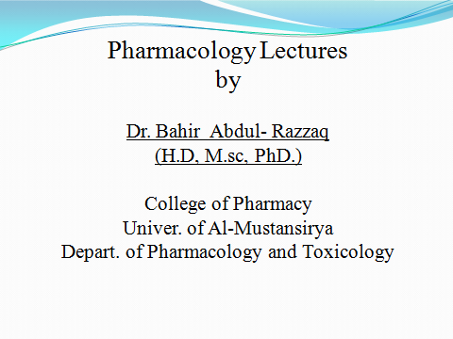

Slide 2
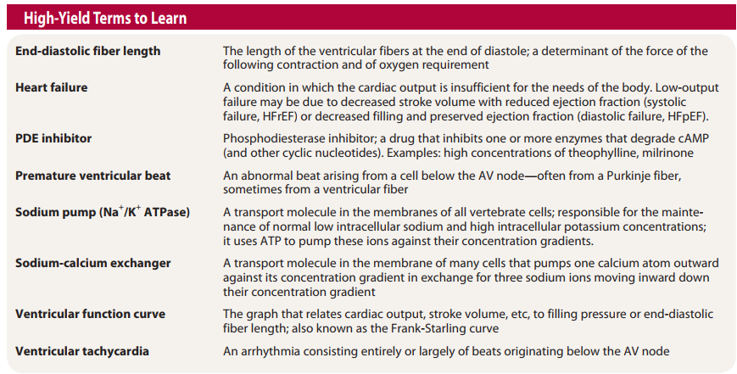

Slide 3
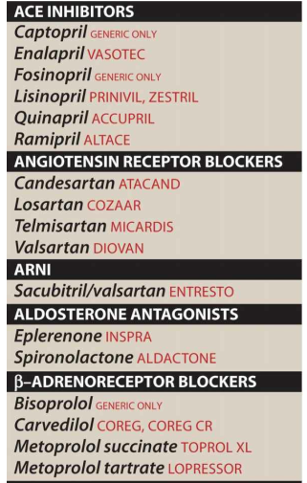

Slide 4
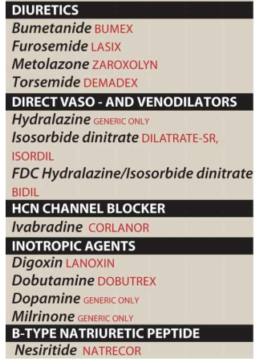

Slide 5


Slide 6
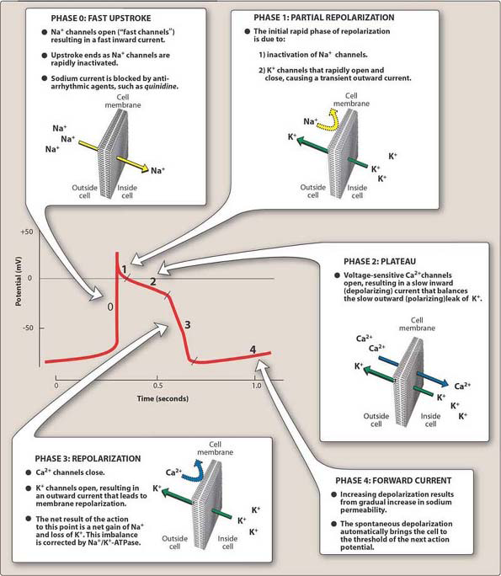

Slide 7
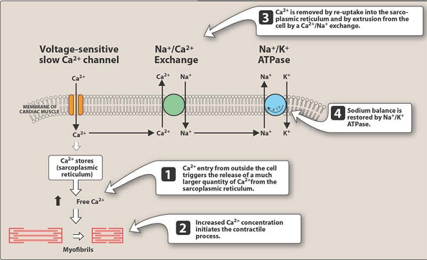

Slide 8
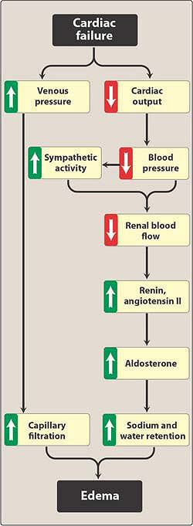

Slide 9
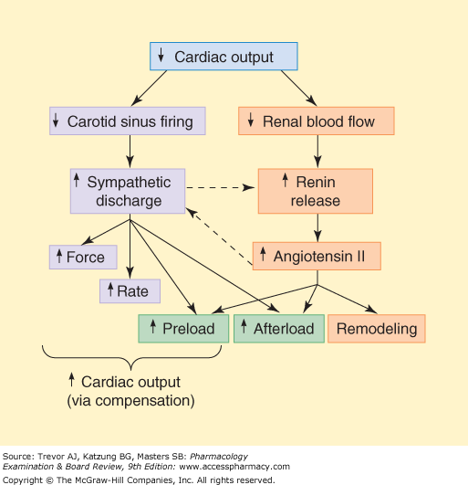

Slide 10
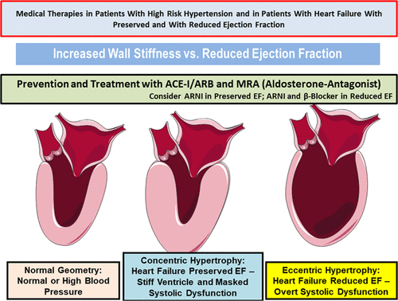

Slide 11
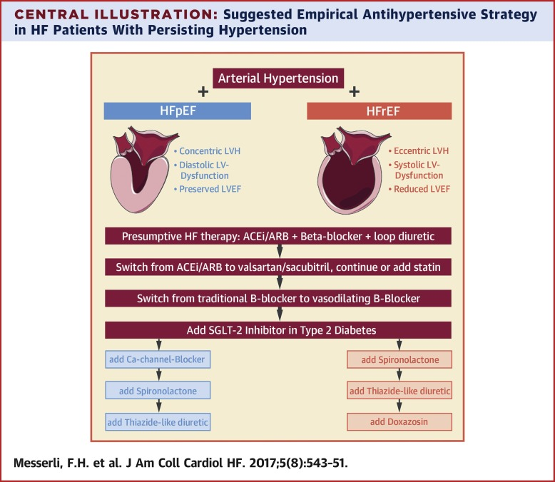

Slide 12
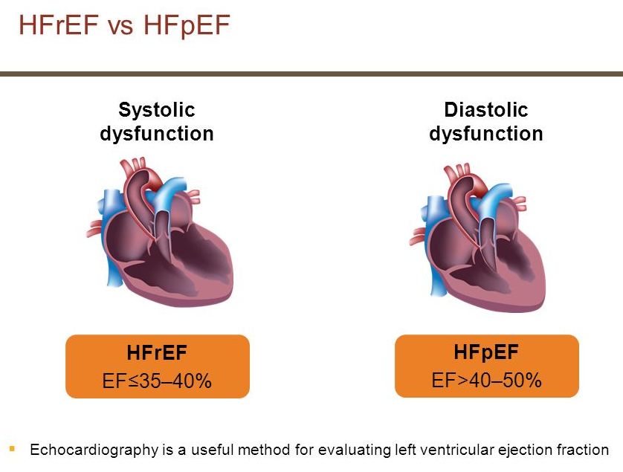

Slide 13
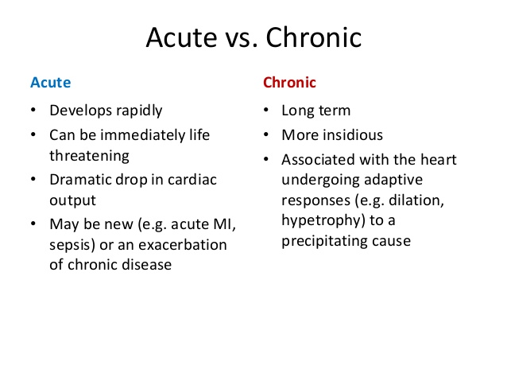

Slide 14
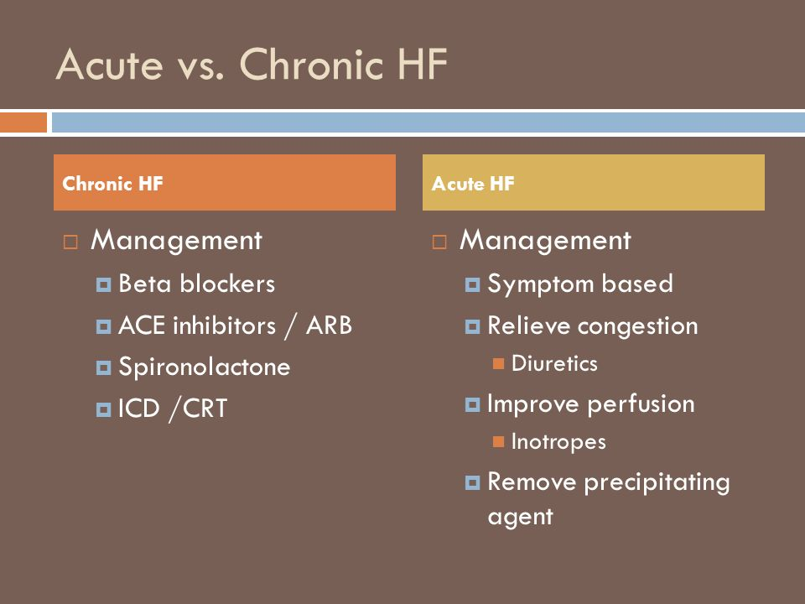

Slide 15
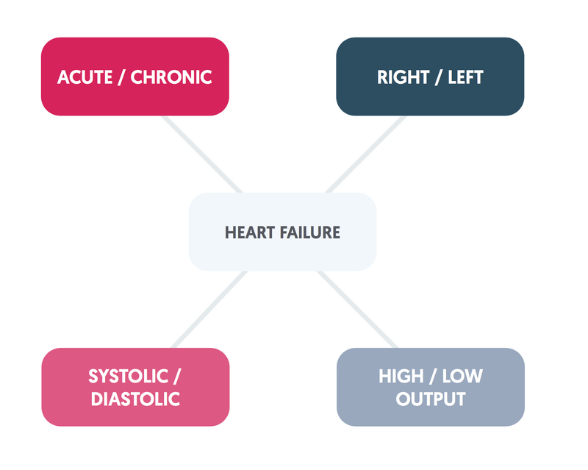

Slide 16


Slide 17
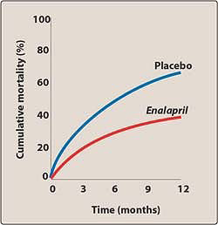

Slide 18
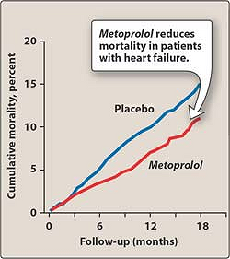

Slide 19
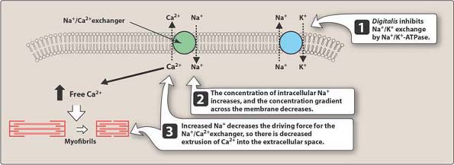

Slide 20
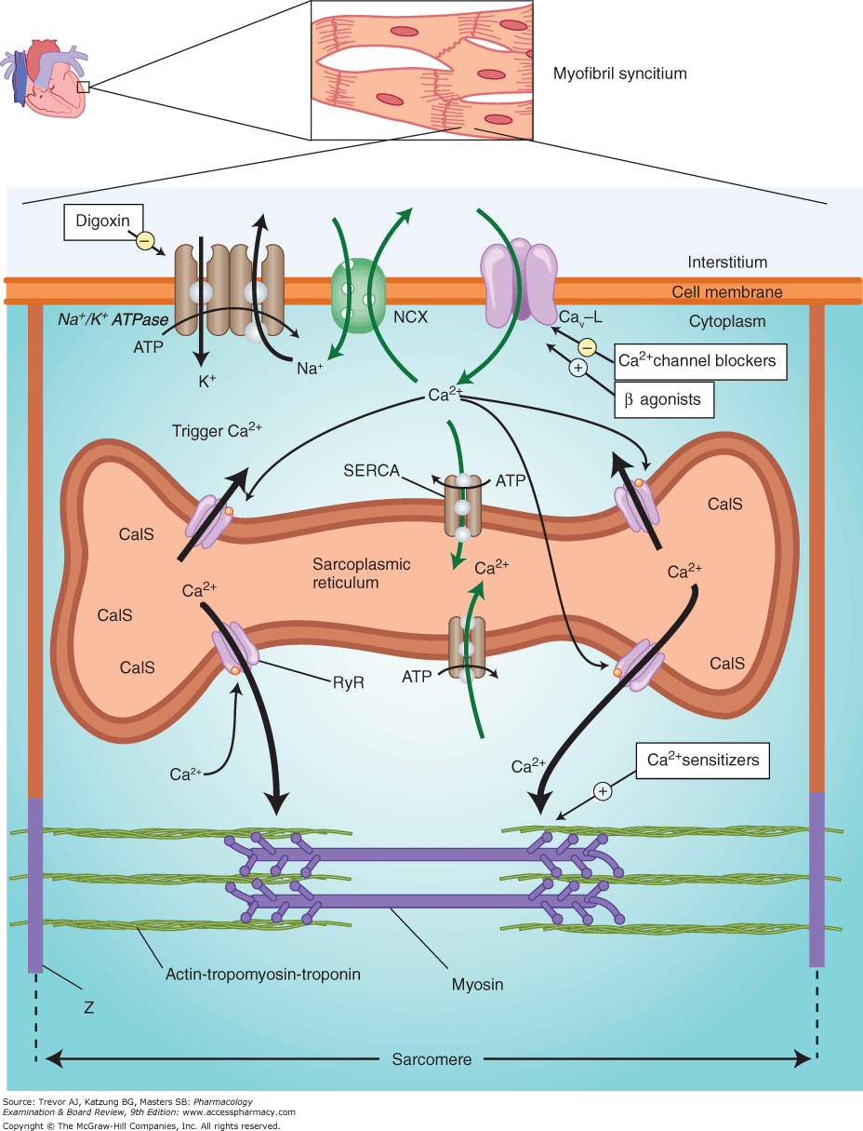

Slide 21
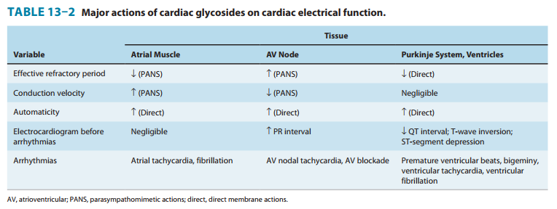

Slide 22
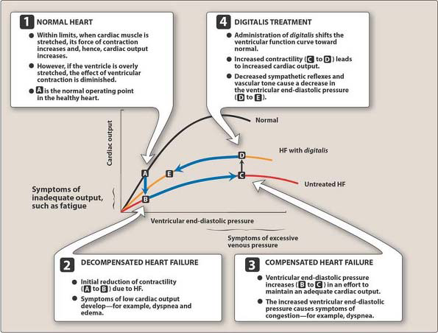

Slide 23
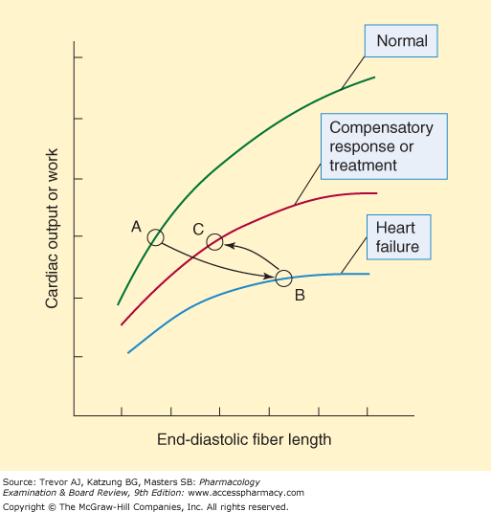

Slide 24
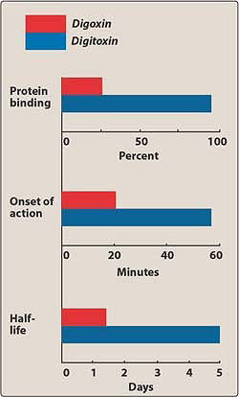

Slide 25
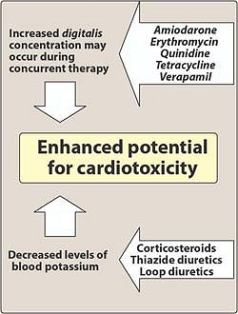

Slide 26
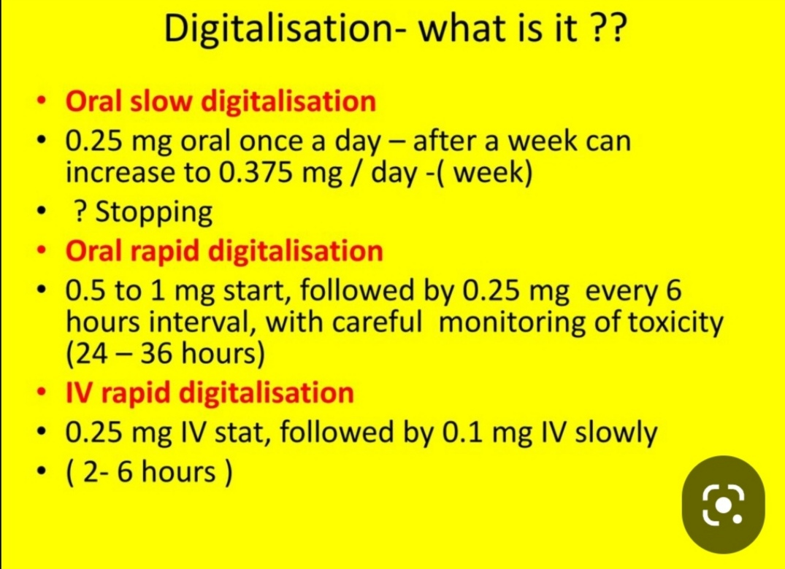

Slide 27
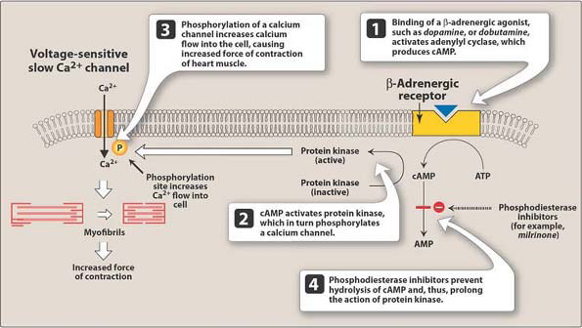

Slide 28
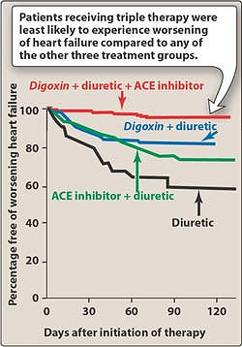

Slide 29
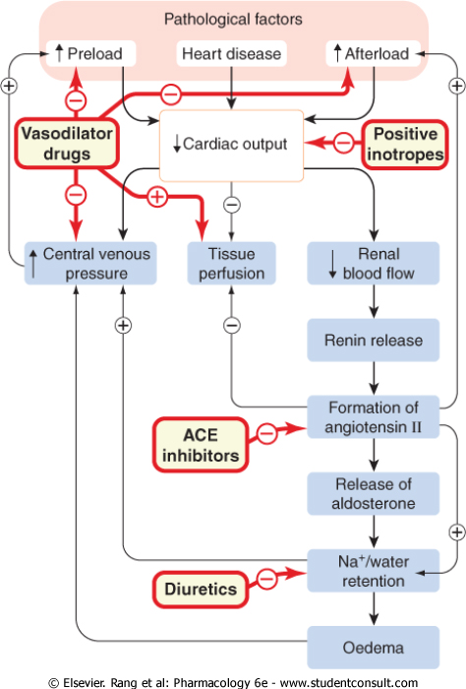

Slide 30


Slide 31
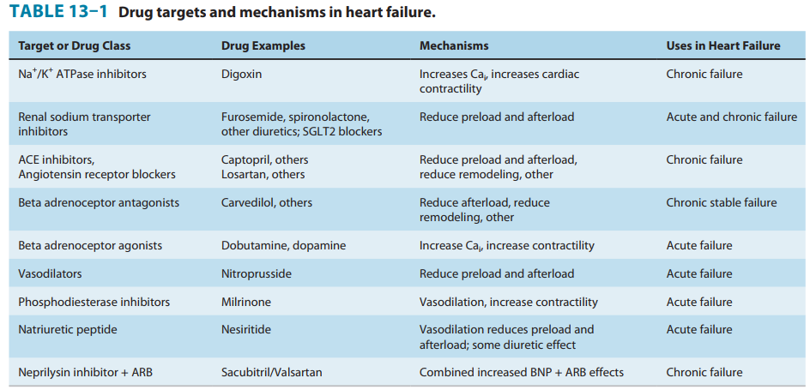

Slide 32
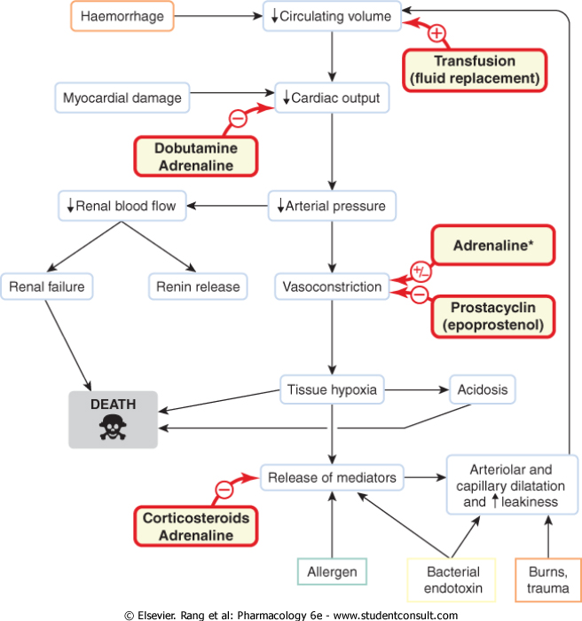

Slide 33
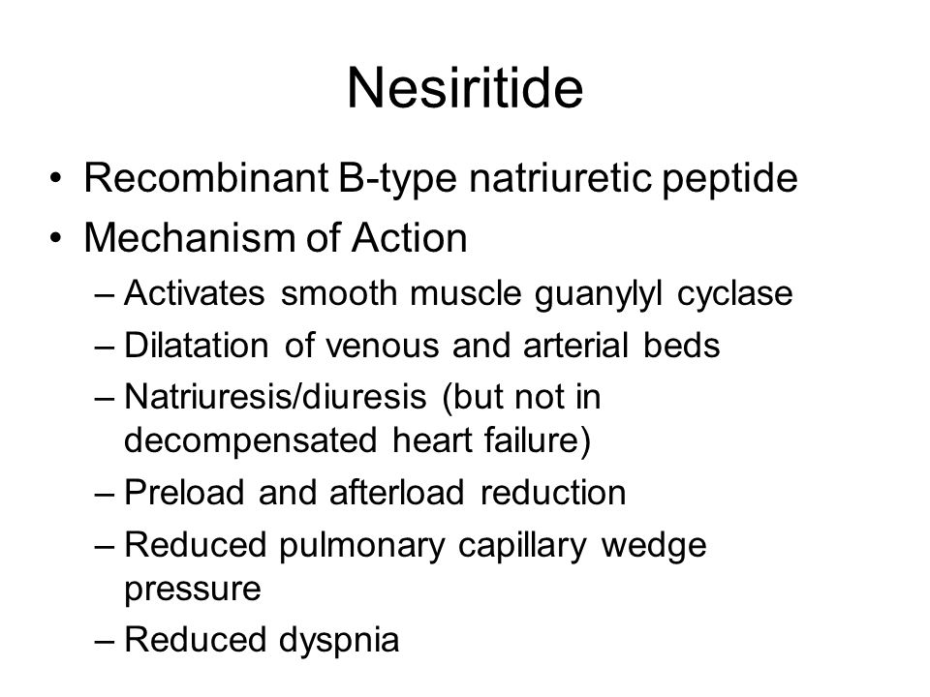

Slide 34
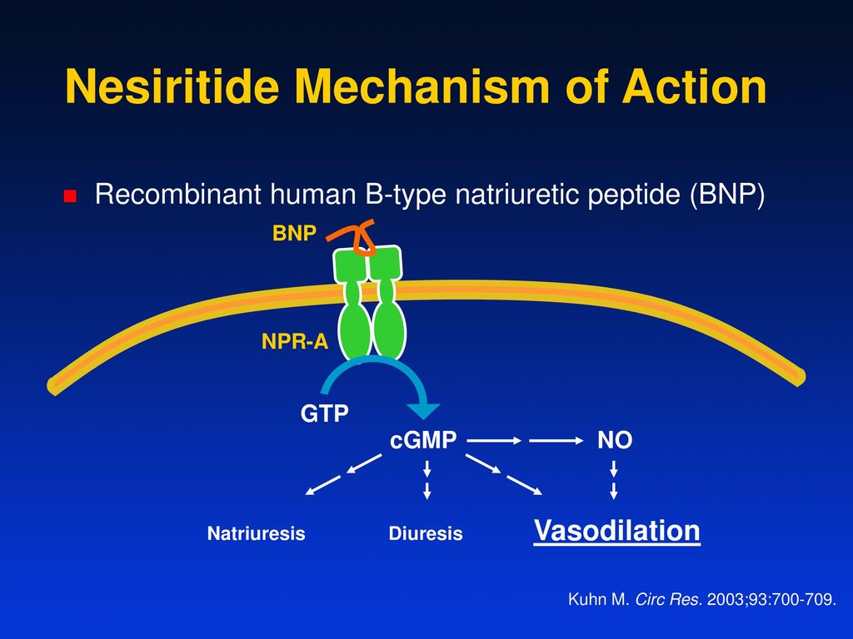

Slide 35
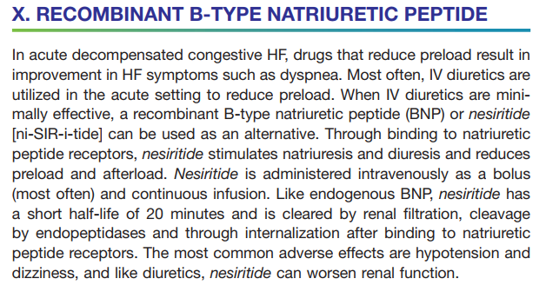

Slide 36
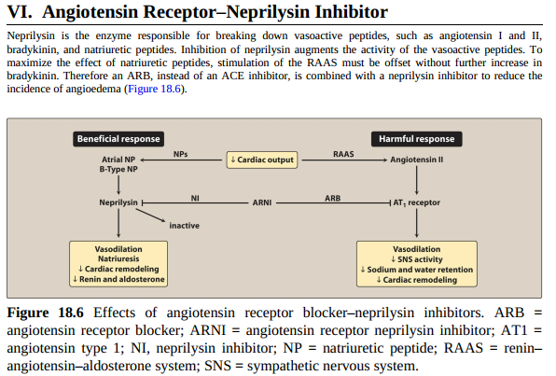

Slide 37
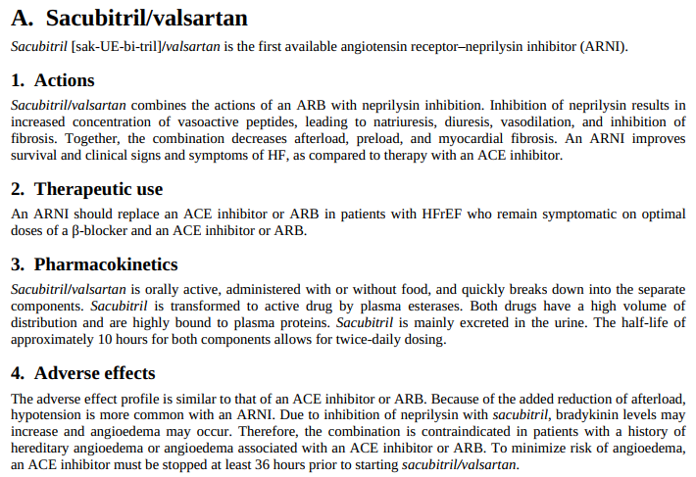

Slide 38
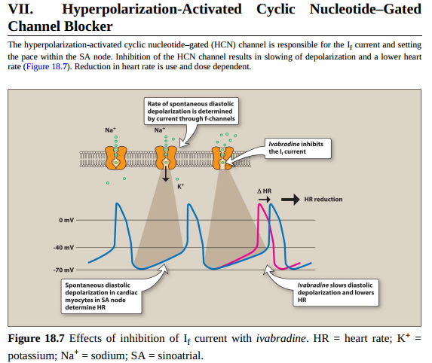

Slide 39
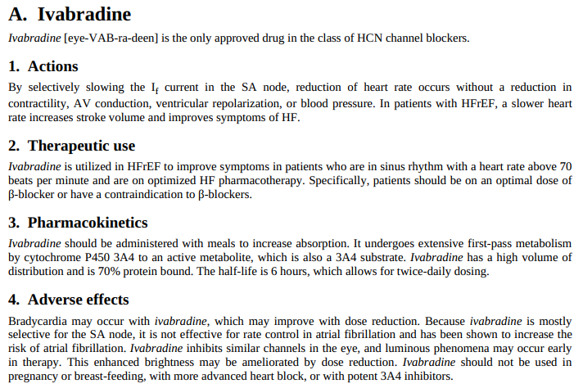

Slide 40
Checklist
When you complete this chapter, you should be able to:
Describe the strategies and list the major drug groups used in the treatment of acute heart failure and chronic failure.
Describe the mechanism of action of digitalis and its major effects. Indicate why digitalis is no longer considered a first-line therapy for chronic heart failure.
Describe the nature and mechanism of digitalis's toxic effects on the heart.
List some positive inotropic drugs other than digitalis that have been used in heart failure.
Describe the beneficial effects of diuretics, vasodilators, ACE inhibitors, and other drugs that lack positive inotropic effects in heart failure.

Slide 41
Compensatory increases in heart rate and renin release that occur in heart failure may be alleviated by
which of the following drugs?
A. Milrinone.
B. Digoxin.
C. Dobutamine.
D. Enalapril.
E. Metoprolol.

Slide 42
