Slide 1
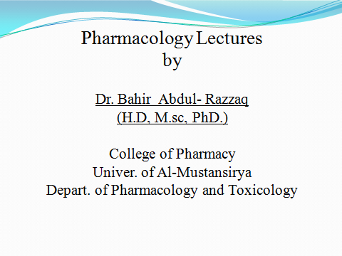

Slide 2
Physiology of Cardiac Tissues

Slide 3
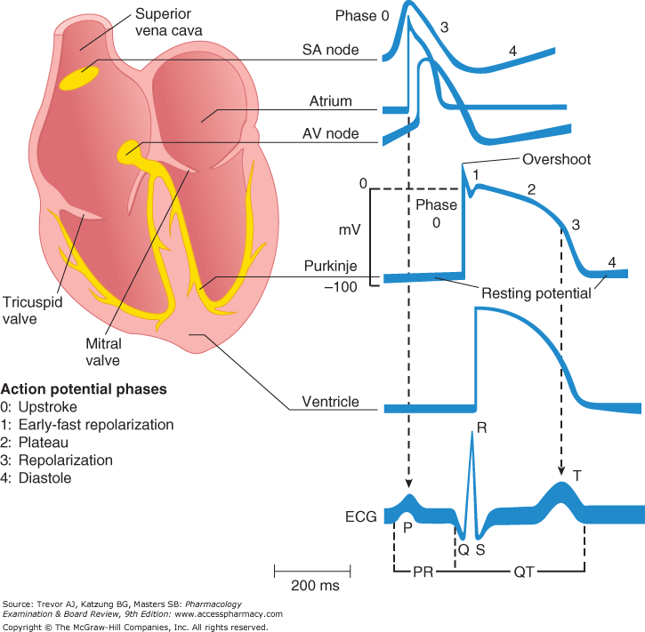

Slide 4
P- wave is generated by atrial depolarization
QRS by ventricular muscle depolarization
T- wave by ventricular repolarization.
PR interval is a measure of conduction time from atrium to ventricle through the (AV) node.
QRS duration indicates the time required for all of the ventricular cells to be activated (ie, the intraventricular conduction time).
QT interval reflects the duration of the ventricular action potential.

Slide 5
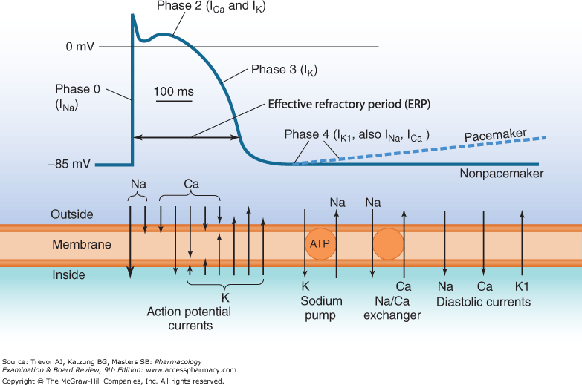

Slide 6
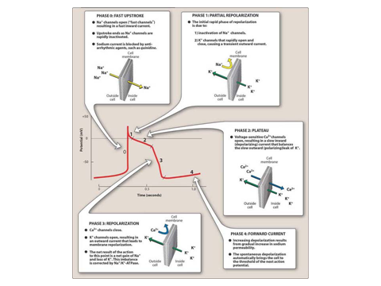

Slide 7
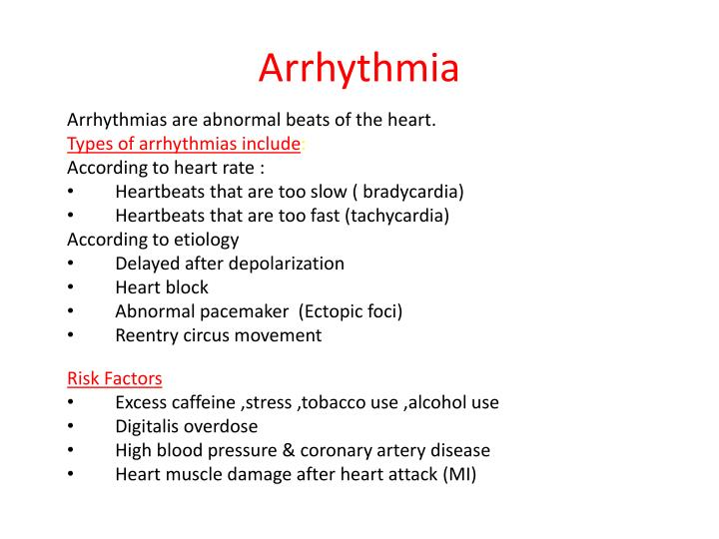

Slide 8
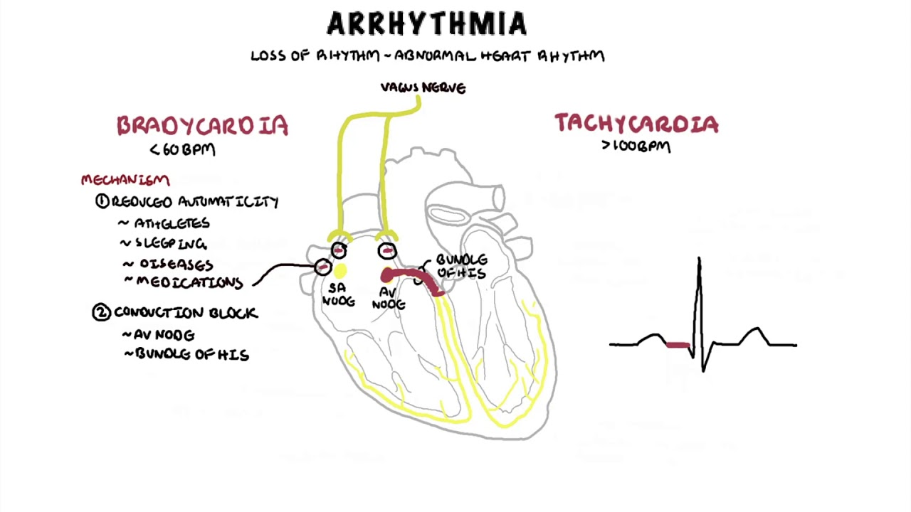

Slide 9
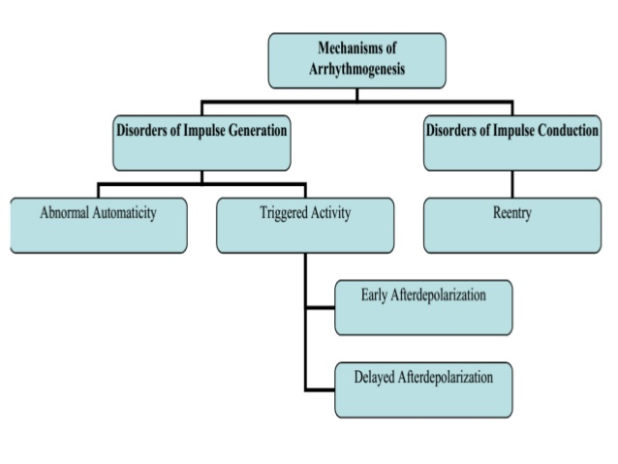

Slide 10
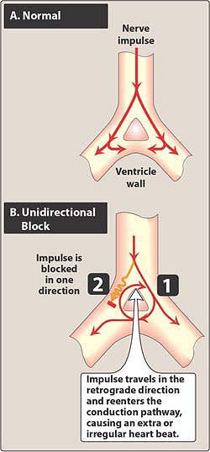

Slide 11
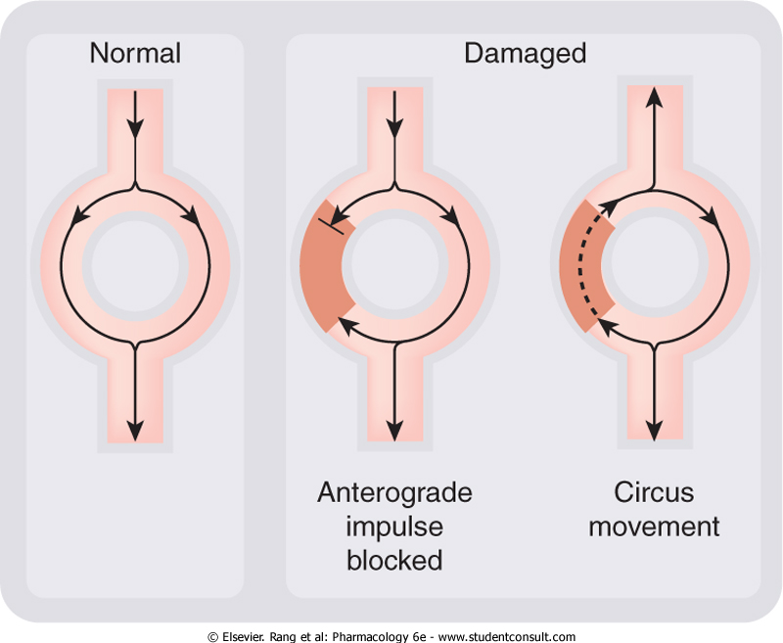

Slide 12
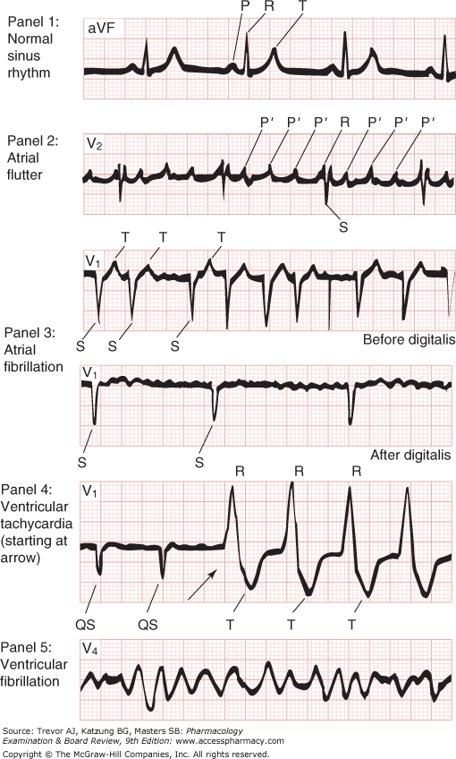

Slide 13
Torsade de point (TDP)
It is an acquired polymorphic ventricular tachycardia that exhibits distinct characteristics on the ECG. It was described by French physician in 1966. Prolongation of the QT interval can increase a person's risk of developing this abnormal heart rhythm, occurring in between 1% and 10% of patients who receive QT-prolonging antiarrhythmic drugs.

Slide 14
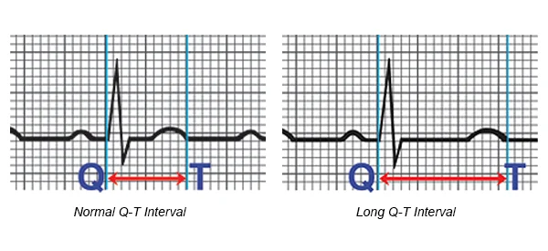
Congenital long QT- syndrome

Slide 15
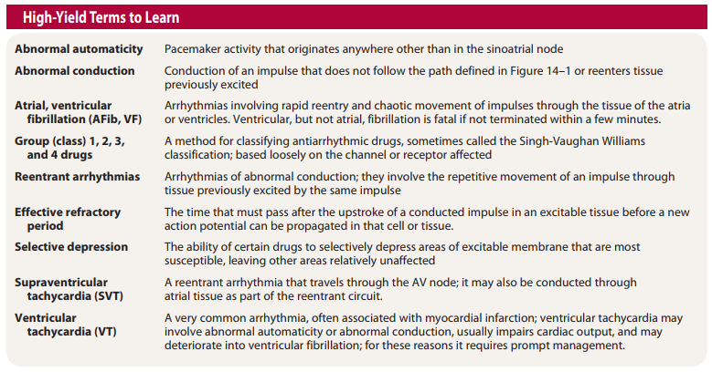

Slide 16
Anti-arrhythmic agents

Slide 17
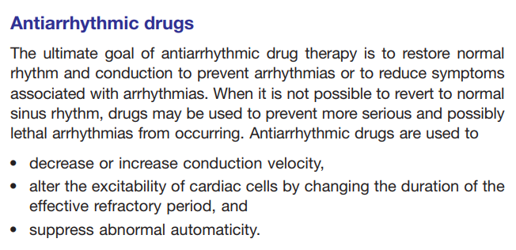

Slide 18
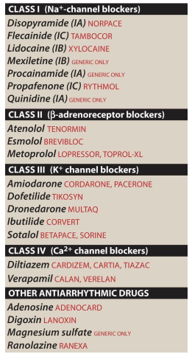

Slide 19
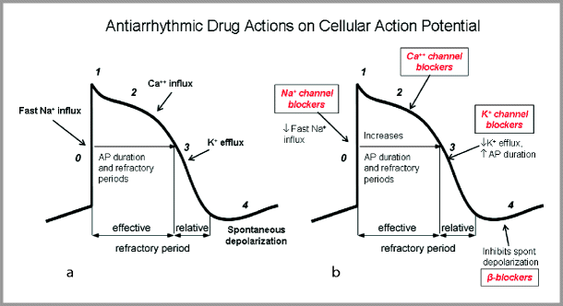
vaughan-williams classification of antiarrhythmic drugs

Slide 20
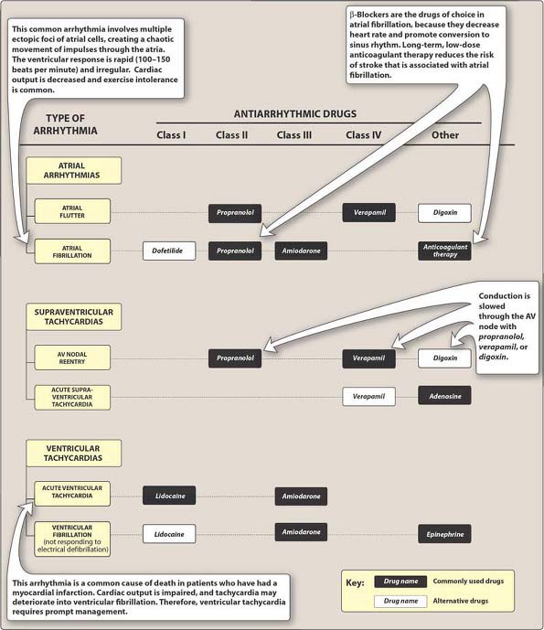

Slide 21
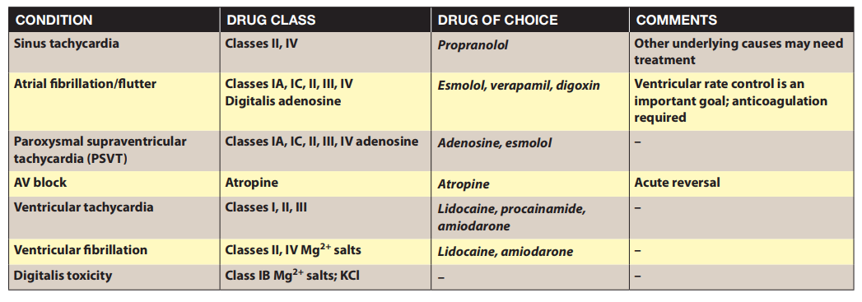

Slide 22
Sodium channel blockers

Slide 23
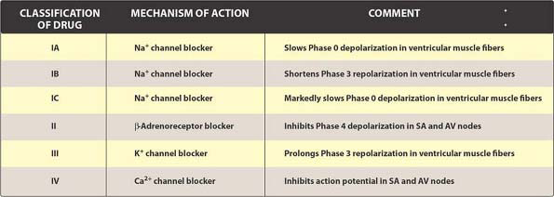

Slide 24
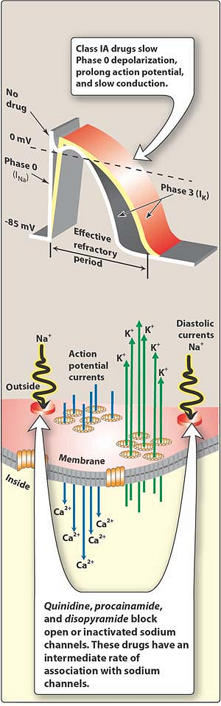

Slide 25
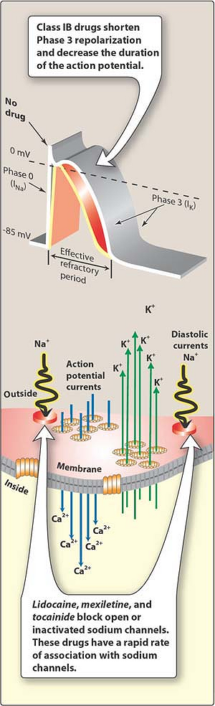

Slide 26
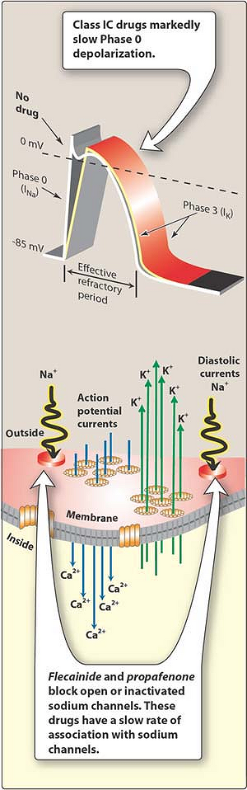

Slide 27
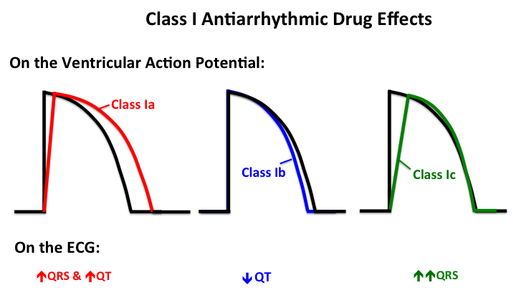

Slide 28
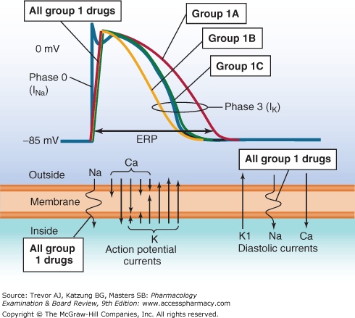

Slide 29
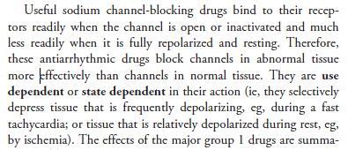
Na- Channel Blockers

Slide 30
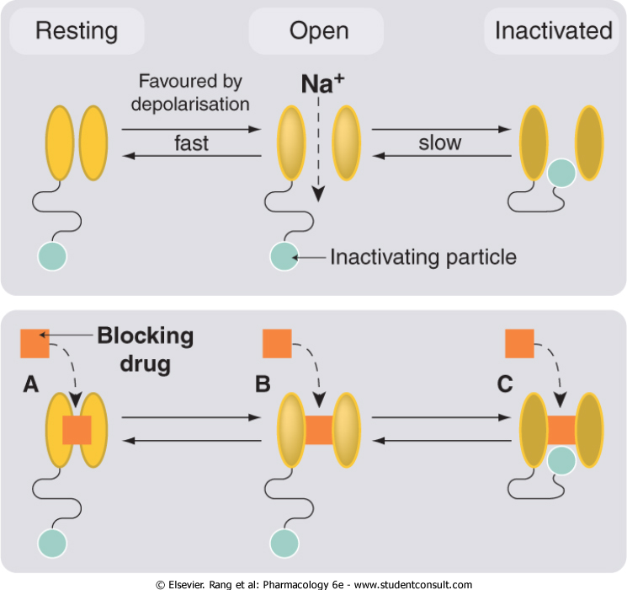

Slide 31
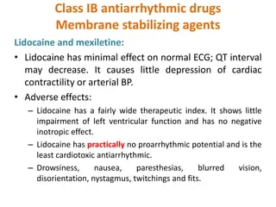

Slide 32
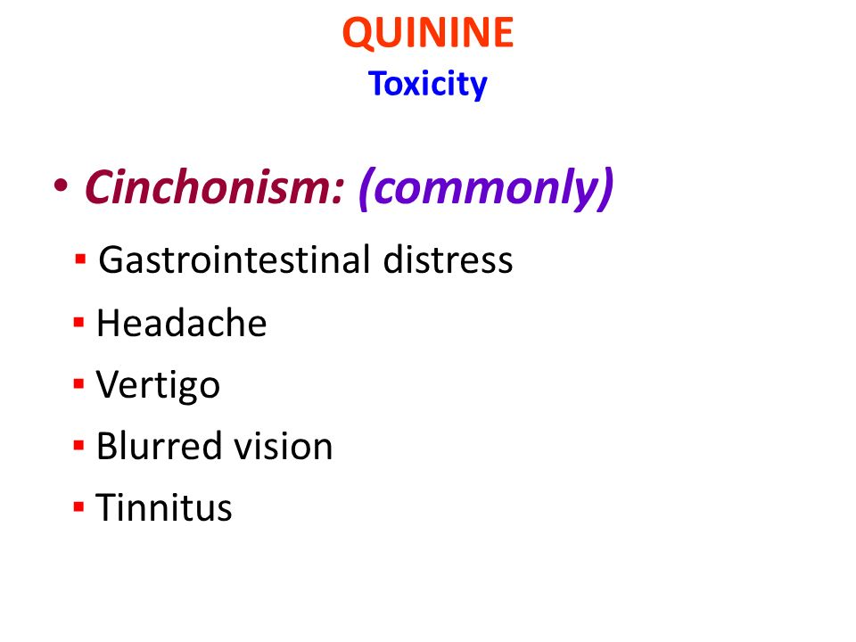

Slide 33
Beta- blockers

Slide 34
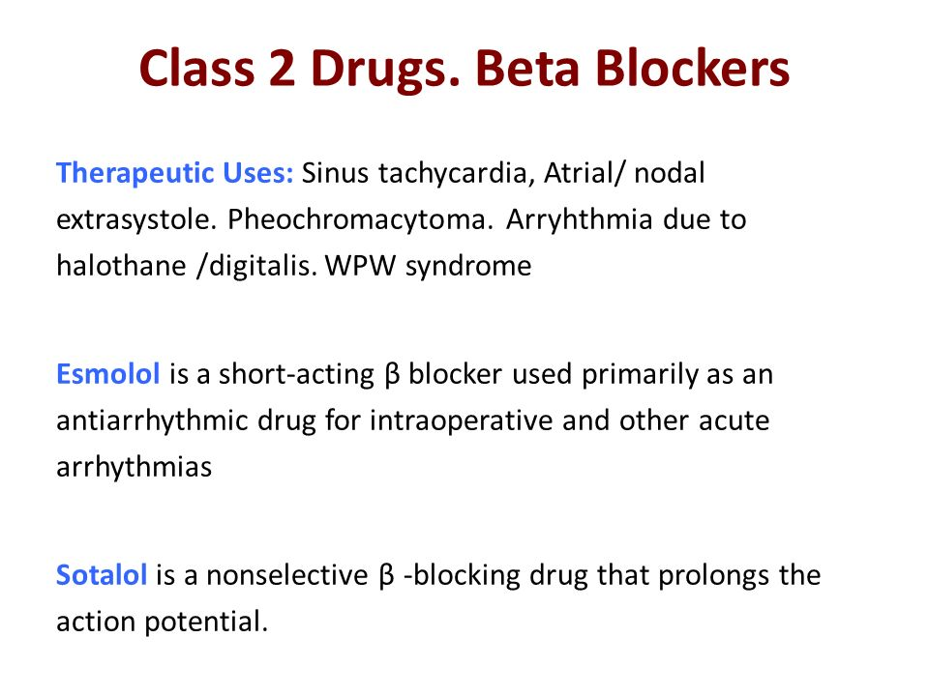

Slide 36
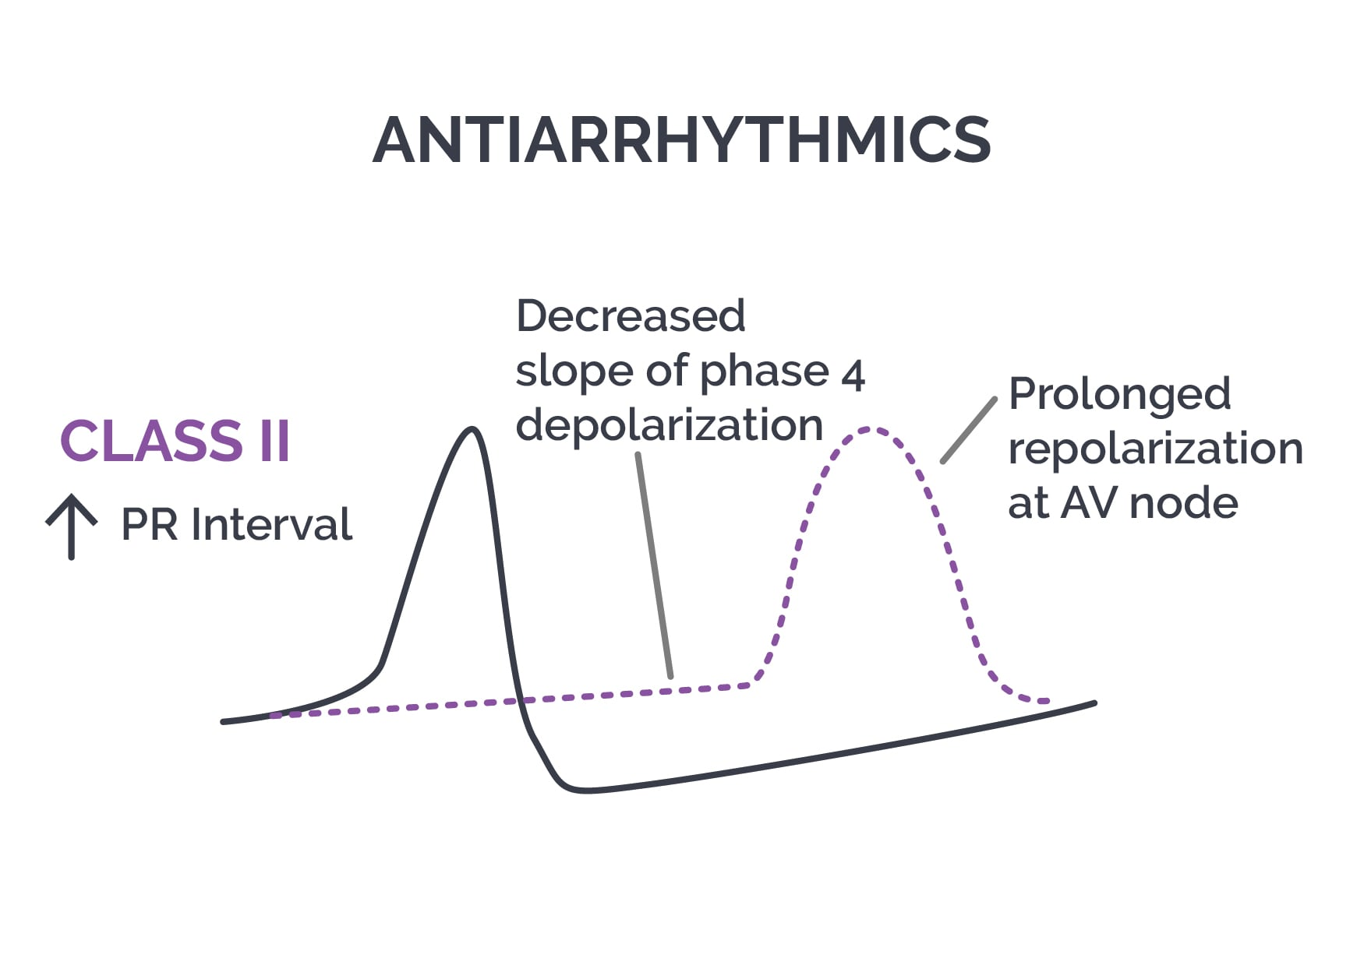

Slide 37
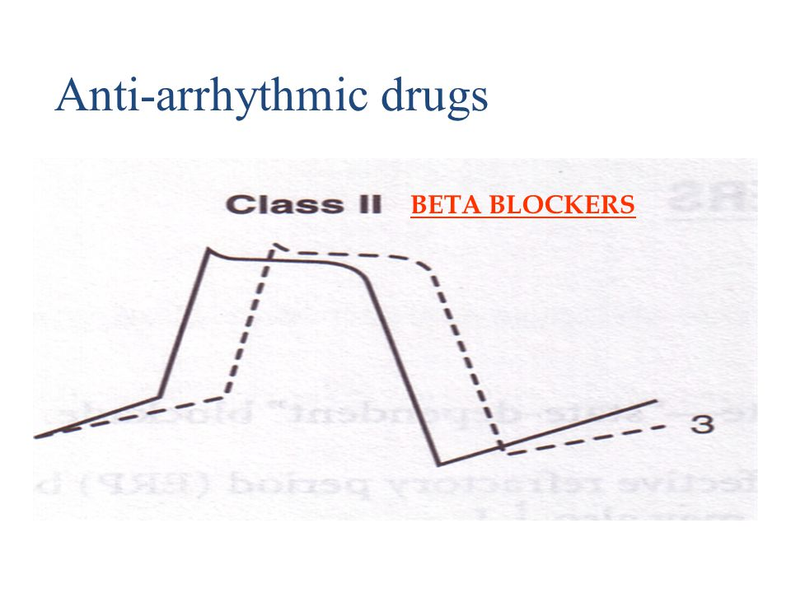

Slide 38
Potassium channel blockers

Slide 40
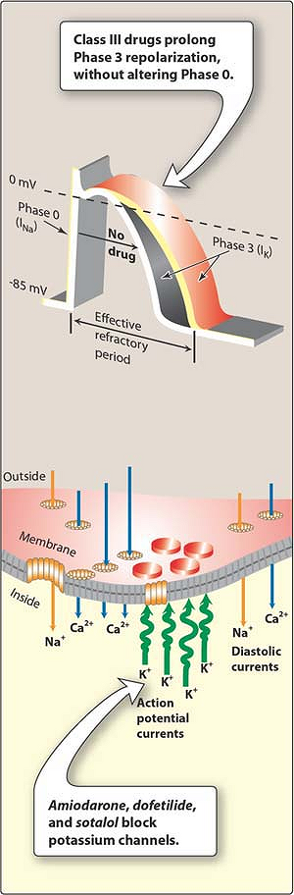

Slide 41
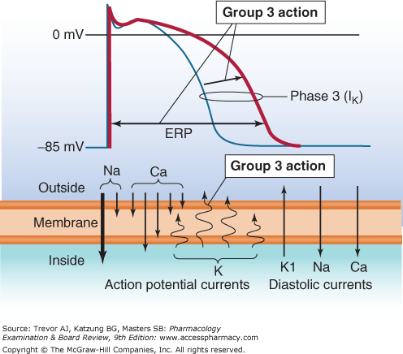

Slide 42
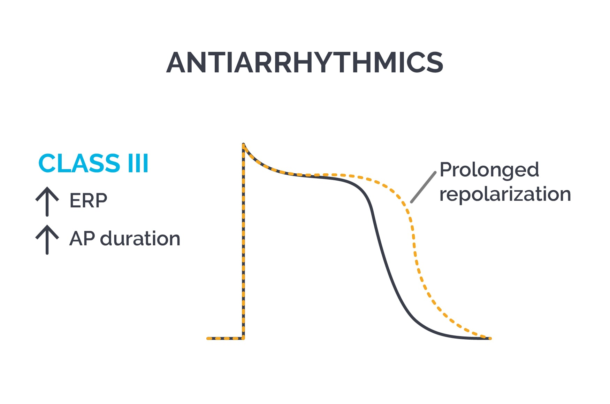

Slide 43
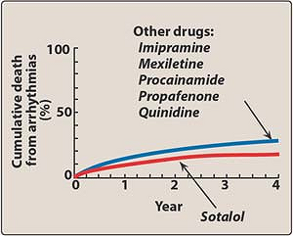

Slide 44
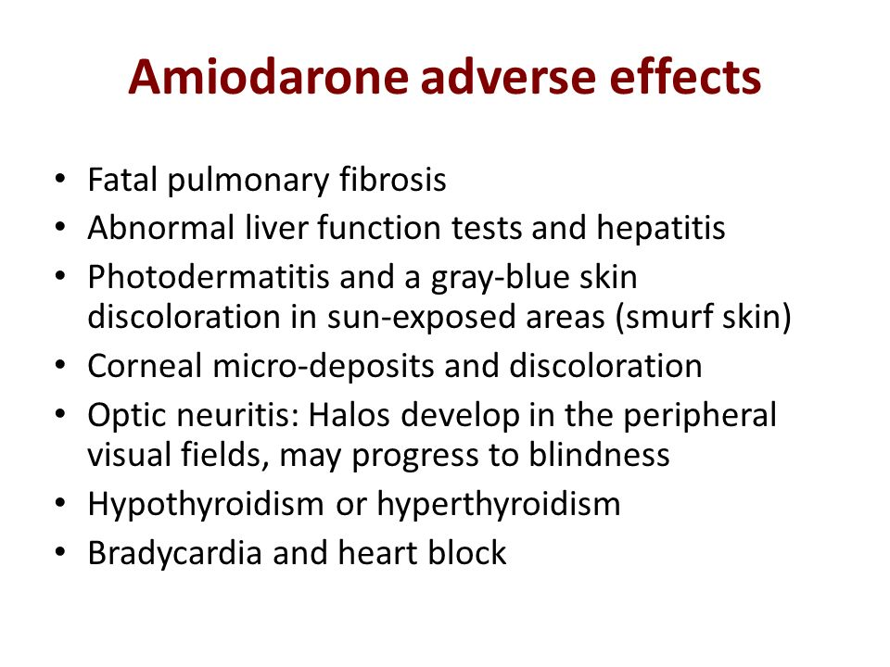

Slide 45
Calcium channel blockers

Slide 47
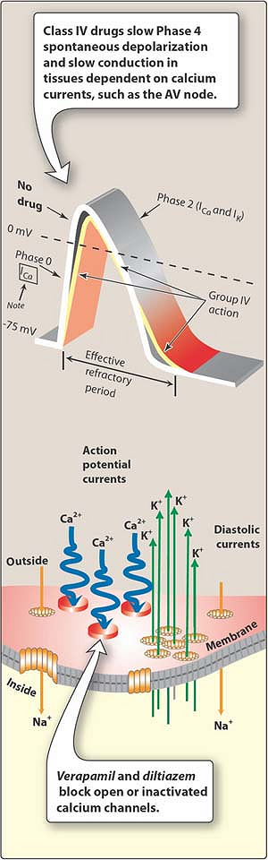

Slide 48
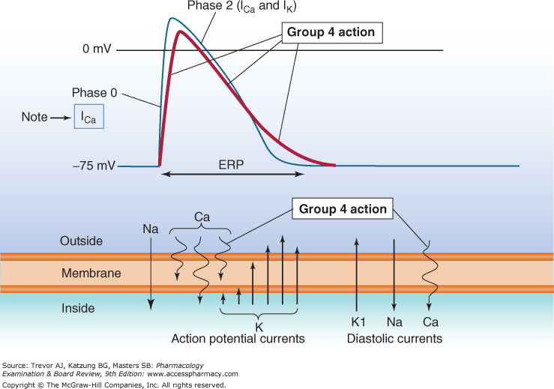

Slide 49
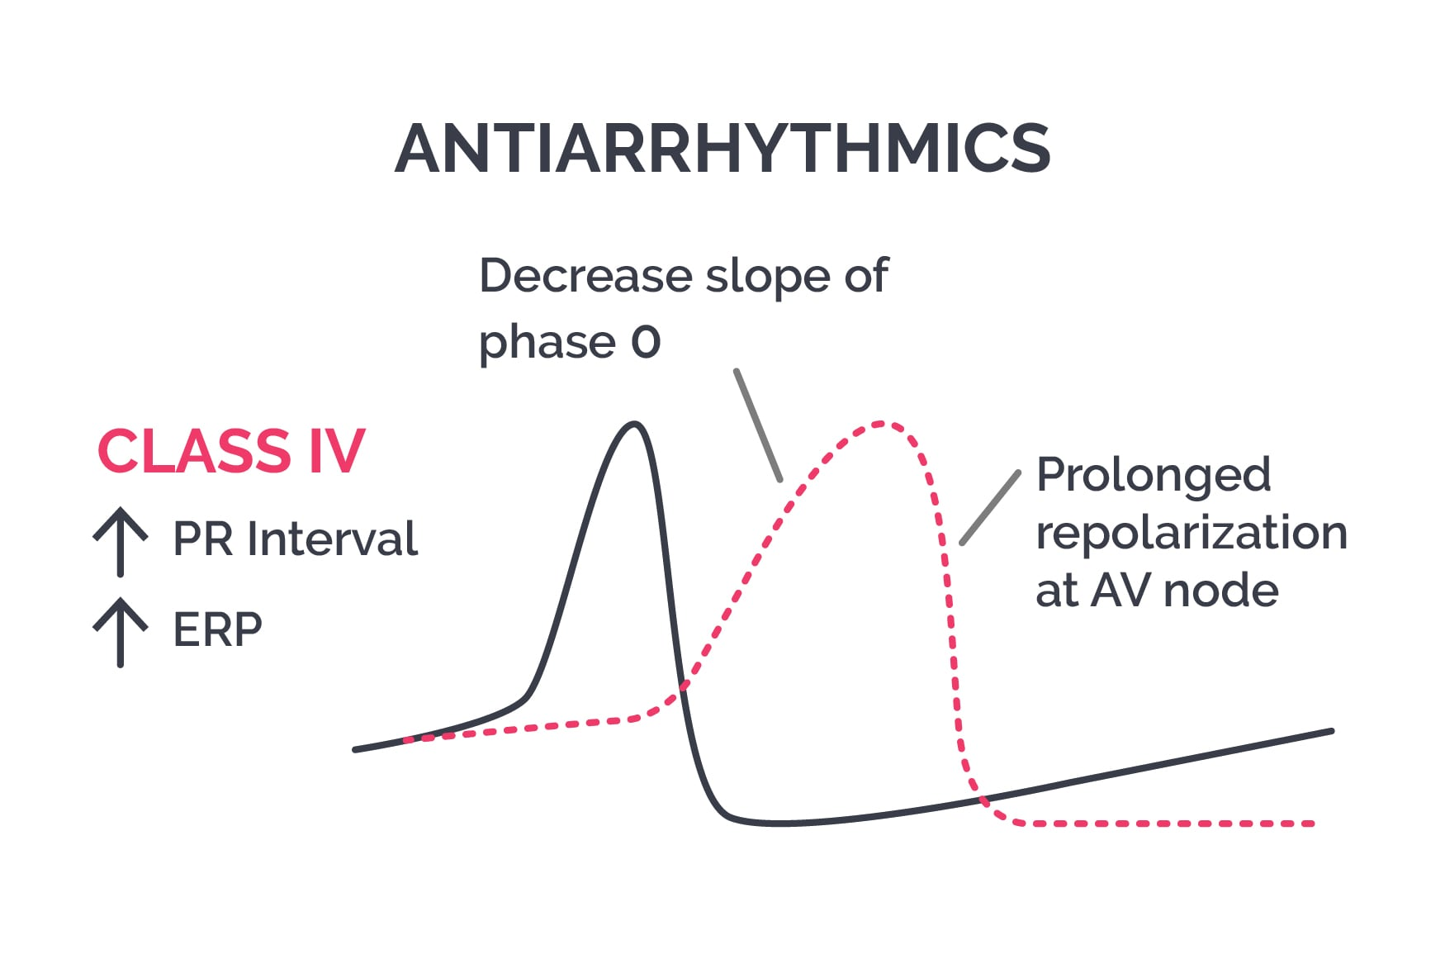

Slide 50
Mechanisms of anti-arrhythmic agents

Slide 51
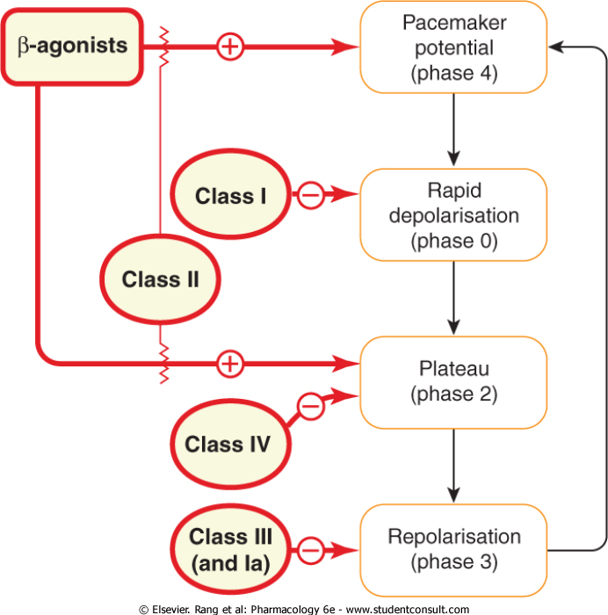

Slide 52
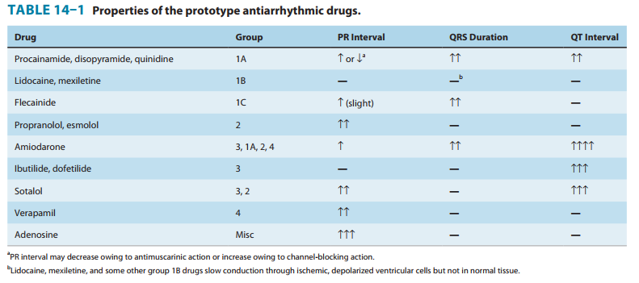

Slide 53
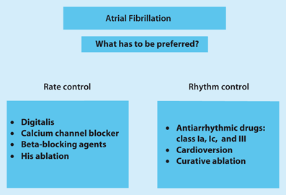

Slide 54
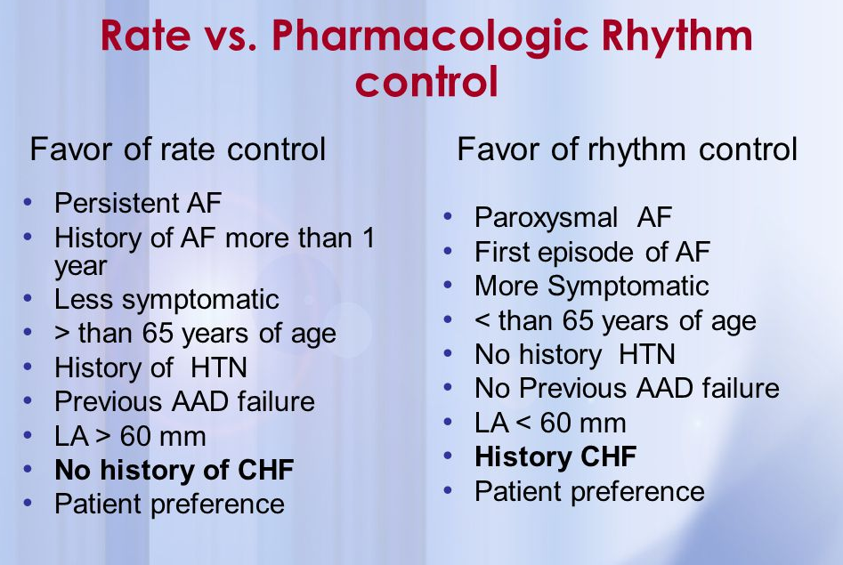

Slide 55
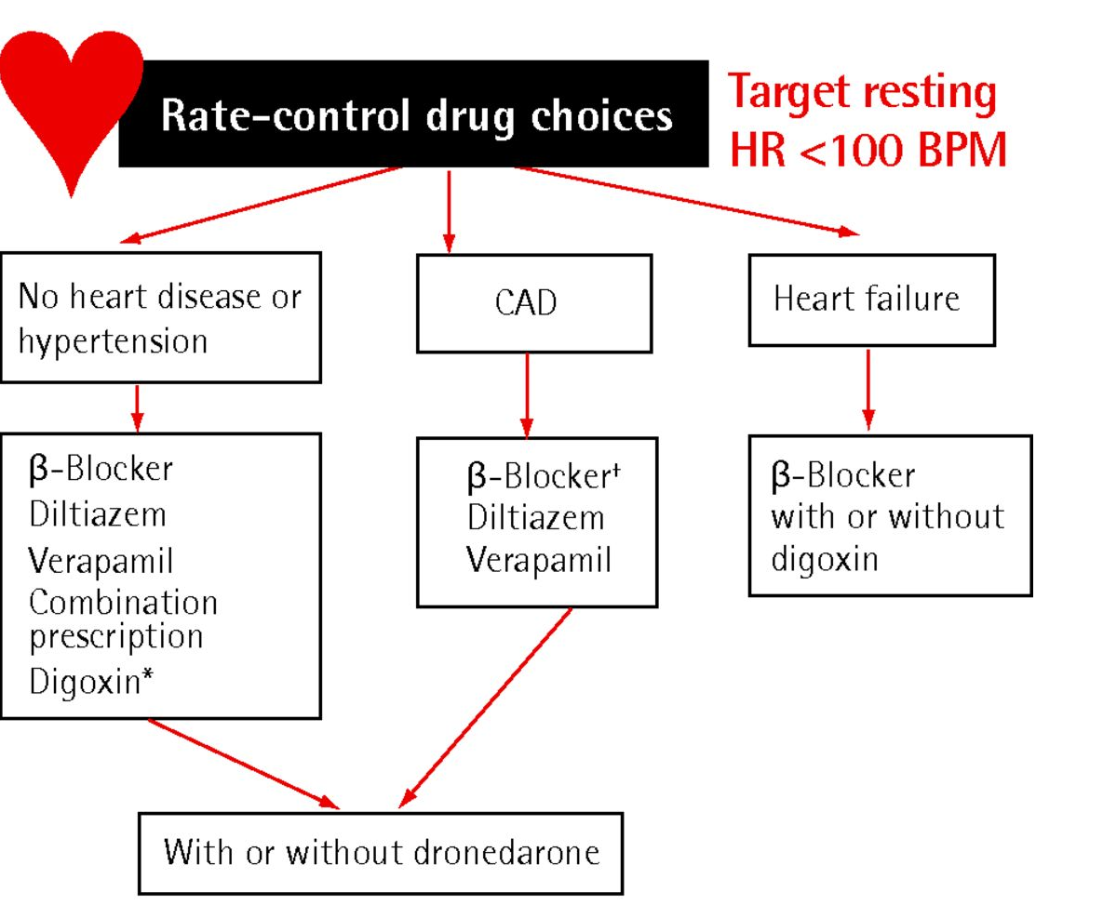

Slide 56
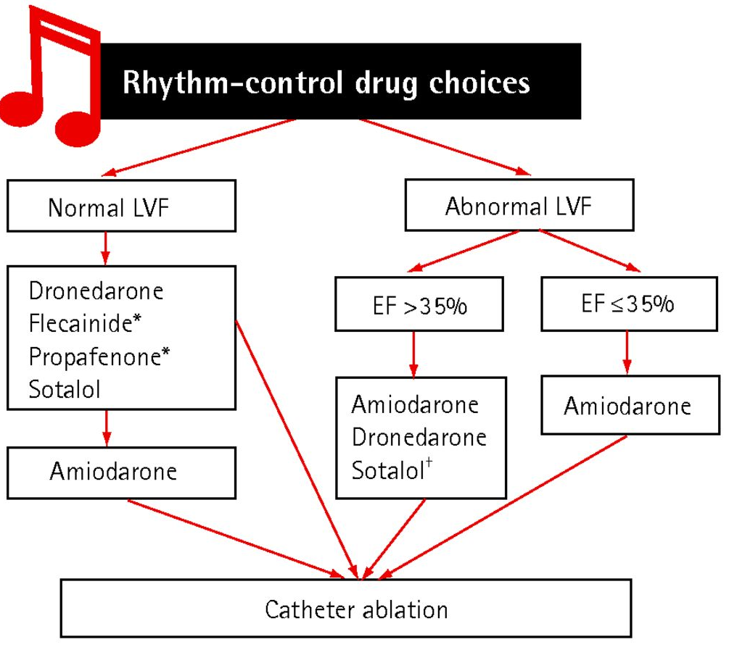

Slide 57
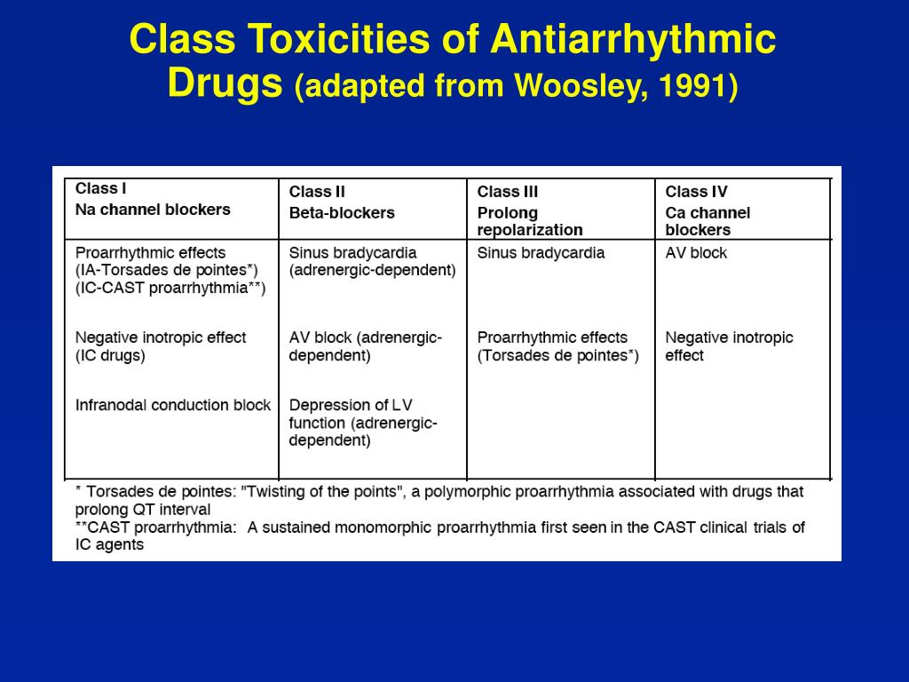

Slide 58
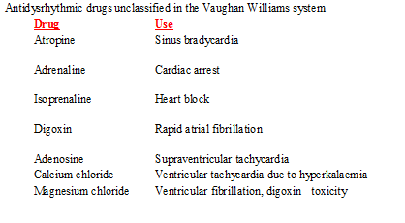
Unclassified (miscellaneous) anti-arrhythmic agents

Slide 59
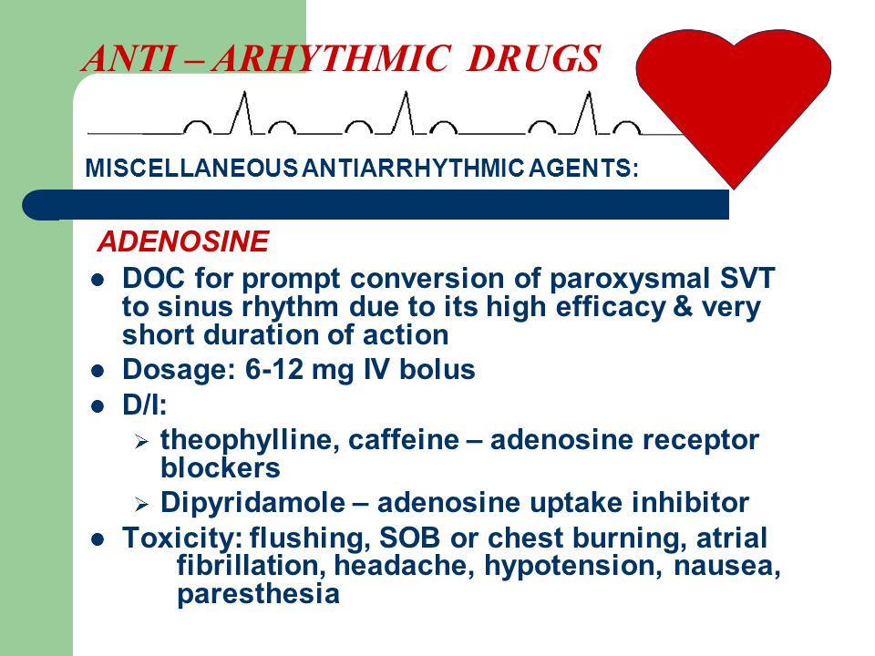

Slide 60
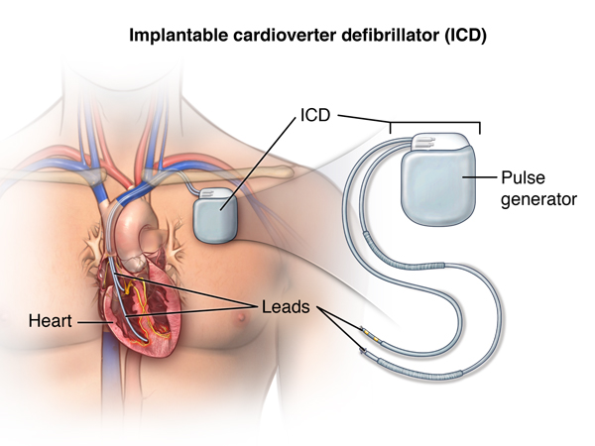

Slide 61
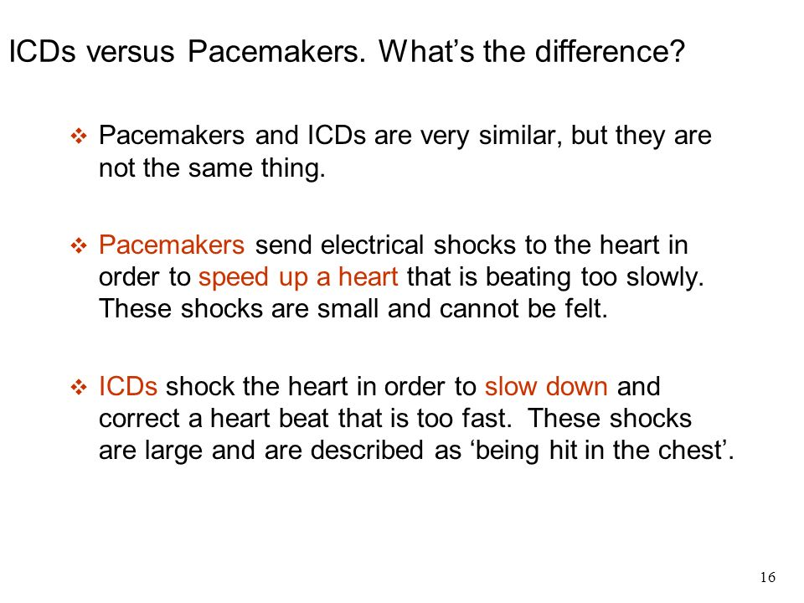

Slide 62
A 57-year-old man is being treated for an atrial arrhythmia. He complains of headache, dizziness, and tinnitus. Which one of the following antiarrhythmic drugs is the most likely cause?
A. Amiodarone.
B. Procainamide.
C. Propranolol.
D. Quinidine.
E. Verapamil.

