Slide 1
Presentation: Fundamentals of Digital Safety and Security

Slide 2
Introduction and Learning Objectives
Understanding Physical Safety issues in computing environments.
Exploring E-Safety and Data Protection Acts (DPA).
Identifying Data Security Threats and technical protection methods.

Slide 3
Physical Safety
Common Hazards and Prevention:
  Electrocution: Avoid liquids near equipment; use Residual Current Breakers (RCB).
  Fire Hazards: Do not overload sockets; ensure proper ventilation for cooling vents.
  Tripping Hazards: Use cable ducts to manage trailing wires and prefer wireless connectivity.
  Personal Injury: Use strong, stable desks to prevent heavy equipment from falling.

Slide 4
E-Safety and Data Protection
Data Protection Acts (DPA): Legislation designed to protect individual rights and prevent inaccurate data storage.
The 8 Principles of DPA: Data must be processed lawfully, for a specific purpose, kept accurate, secure, and not held longer than necessary.

Slide 5
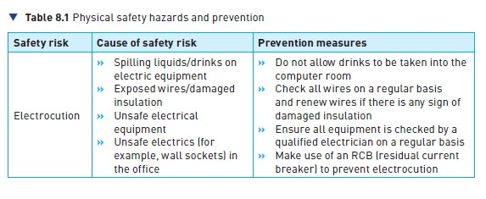
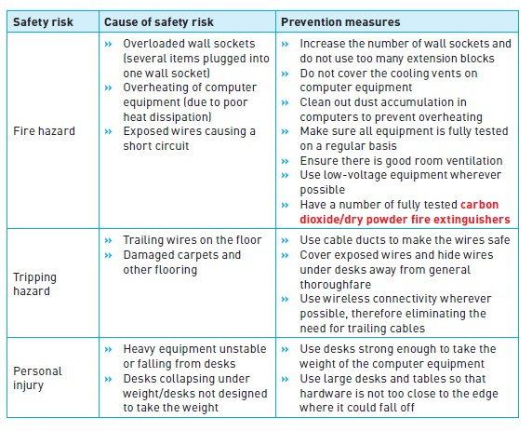

Slide 6
S4 E-Safety and Data Protection
Data Protection Acts (DPA): Legislation designed to protect individual rights and prevent inaccurate data storage.
The 8 Principles of DPA: Data must be processed lawfully, for a specific purpose, kept accurate, secure, and not held longer than necessary.

Slide 7
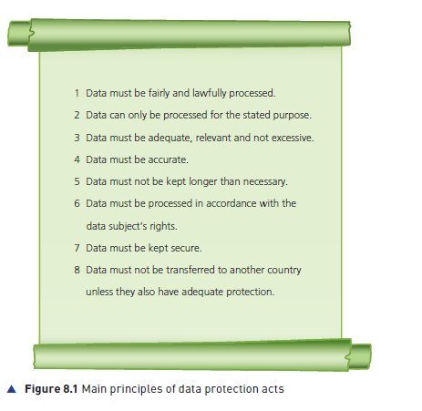

Slide 8
S5 Personal vs. Sensitive Data
Personal Data: Information that identifies a living person (e.g., Name, Address, IP address, ID number).
Sensitive Data: Requires extra protection (e.g., Ethnicity, medical history, religious beliefs, biometric data).

Slide 9
S6 Safe Internet and Email Practices
Web Browsing: Look for the HTTPS protocol and the green padlock symbol for secure connections.
Email Safety: Only open attachments from known sources; use Bcc for group emails to protect privacy.
Avoid Phishing: Do not click on suspicious hyperlinks within emails.
HTTPS (Hypertext Transfer Protocol Secure)

Slide 10
S7 Social Media and Online Gaming Risks
Social Media: Use privacy settings, block suspicious users, and avoid posting photos in school uniforms.
Online Gaming: Beware of Cyberbullying and Voice-masking technology used by predators to hide their identity.

Slide 11
S8 Data Security Threats
Hacking: Unauthorized access to a computer system.
Phishing Scams:
  Phishing: Fraudulent emails seeking personal info.
  Smishing: Phishing via SMS (text messages).
  Vishing: Phishing via voice calls or voicemail.
Pharming: Malicious code that redirects users to fake websites.

Slide 12
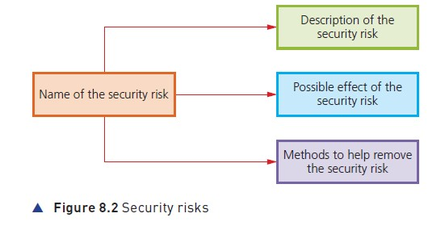
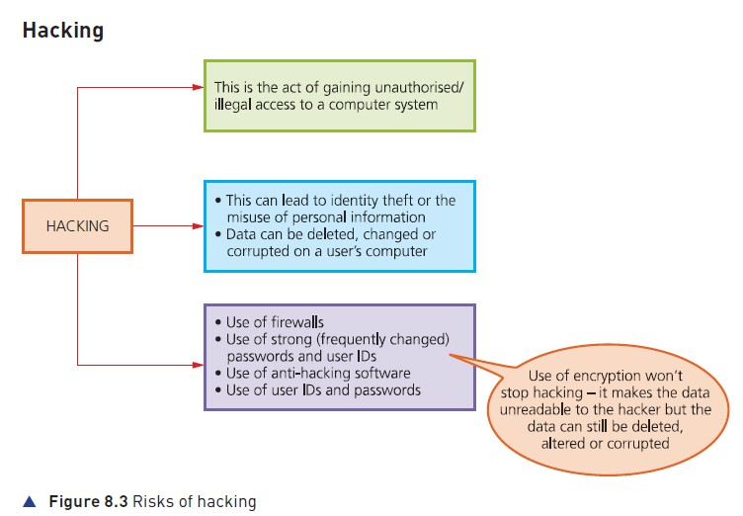

Slide 13
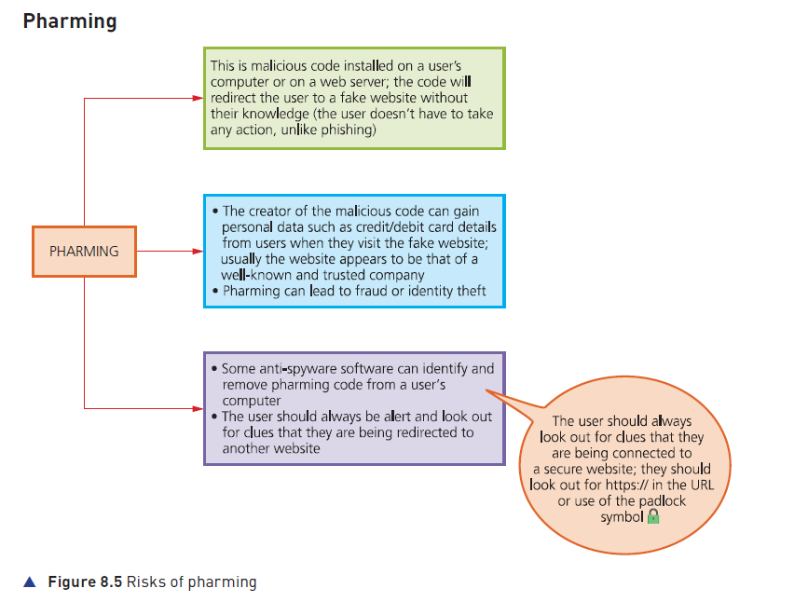
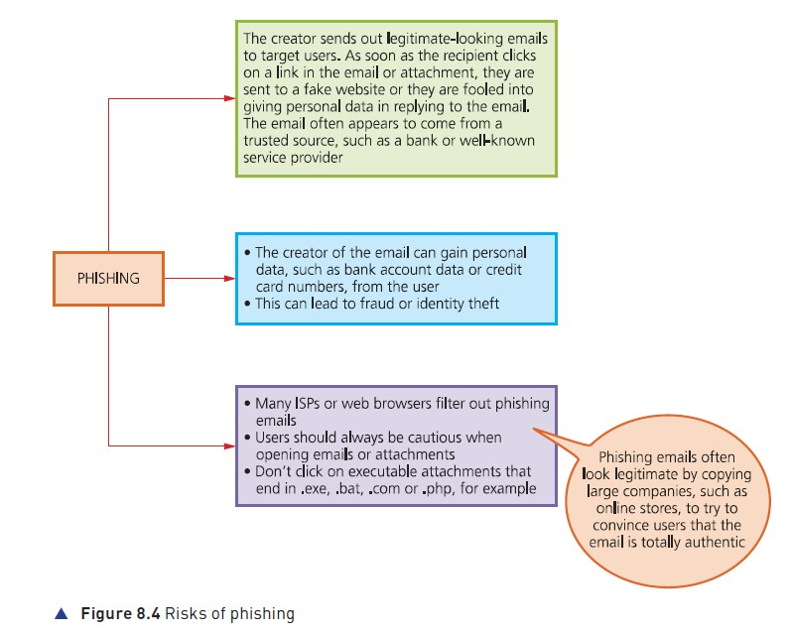

Slide 14
S9 Malware (Malicious Software)
Viruses: Programs that replicate and delete/corrupt files; they need a host program to run.
Worms: Stand-alone software that spreads across networks without user action.
Trojan Horses: Malicious software disguised as legitimate programs.
Ransomware: Programs that encrypt data and "hold it hostage" for a fee.

Slide 15
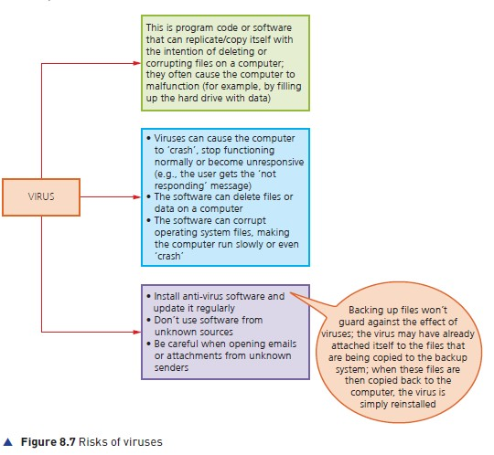
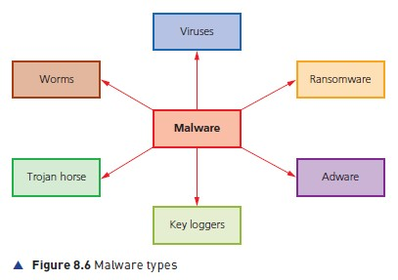

Slide 16
S10 Card Fraud and Theft
Shoulder Surfing: Observing someone entering their PIN at an ATM or POS terminal.
Card Cloning: Using Skimmers (for magnetic stripes) or Shimmers (for chip cards) to steal card data

Slide 17
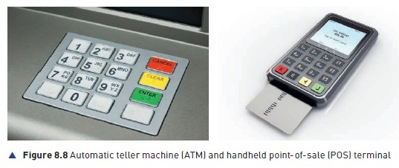

Slide 18
S11 Protection and Authentication
Biometrics: Using unique human features like Fingerprint scans, Face recognition, or Retina scans.
Firewalls: Hardware or software that filters network traffic based on specific criteria to block threats.
Encryption: Converting plain text into Cypher script to make data meaningless to hackers.

Slide 19
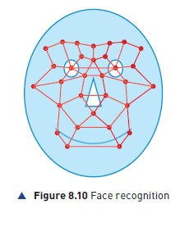
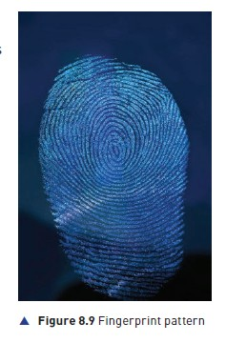

Slide 20
S12 Authentication and Secure Protocols
Two-Factor Authentication (2FA): Combines "something you know" (password) with "something you have" (mobile phone/OTP).
Secure Sockets Layer (SSL): A protocol that encrypts data between a web browser and a server.
Strong Passwords: Must include capital letters, numbers, and symbols (e.g., Sy12@#TT90)

Slide 21
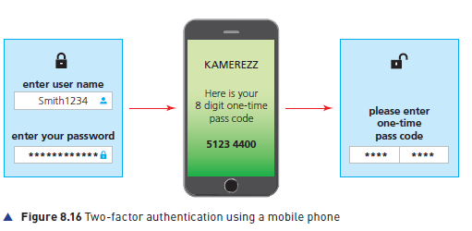

Slide 22
Conclusion and Summary
Regular Backups: The best defense against Ransomware.
Vigilance: Technical tools are only effective when combined with safe user behavior.
Stay Updated: Always keep anti-virus and anti-malware software current.

