Slide 1
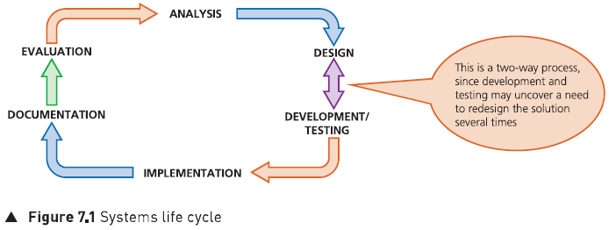
The Systems Life Cycle
Main Title: The Systems Life Cycle.
Subtitle: A systematic approach to analyzing, designing, and implementing new computer systems.

Slide 2
Why a New System?
Triggers for Change:
  Obsolete hardware: Current equipment cannot be repaired anymore.
  Legal changes: New laws or taxes requiring software overhaul.
  Technological advances: New hardware available to improve efficiency and reliability.
  Growth: Need to expand the company.
The Systems Analyst: The professional who oversees the entire upgrade process.

Slide 3
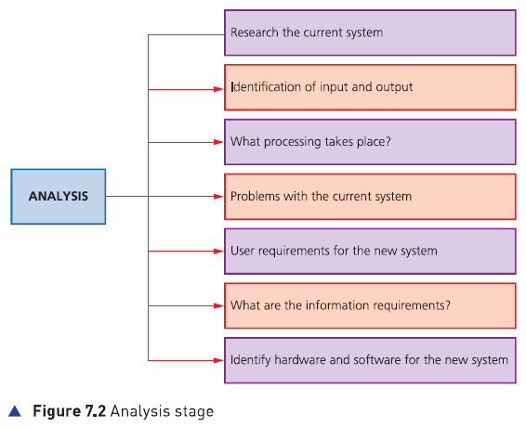
System Analysis

Slide 4
Stage 1 - Analysis
Researching the Current System:
  Observation: Watching personnel to see how the system works.
  Interviews: One-to-one Q&A sessions for deep insights.
  Questionnaires: Distributing forms to gather views from many users.
  Existing documents: Examining manuals and reports.
Key Output: Requirements Specification

Slide 5
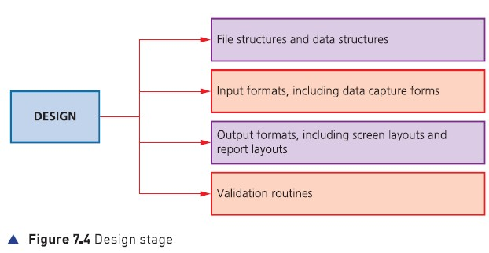
Stage 2 - Design: Data and Validation
File Structures: Defining Records, Fields, and the Primary Key
Data Types: Text, Alphanumeric, Numeric (Integer/Decimal), Boolean, and Date/Time.
Validation Routines: Rules to ensure data is sensible:
  Range check: Data within a specific limit.
  Length check: Specific number of characters.
  Format check: e.g., dd/mm/yyyy.

Slide 6
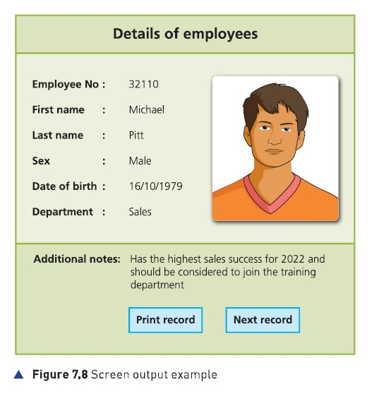
Design: Interfaces
Input Formats: Designing Data Capture Forms (paper or screen-based).
Output Formats:
  Screen Layouts: How information appears to the user.
  Report Layouts: Printed documents and database results.

Slide 7
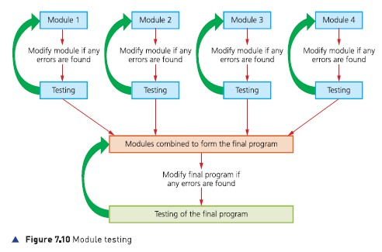
Development and Testing
Modular Form: Breaking the system into smaller "Modules" for easier development.
The Test Plan: Testing using three types of data:
  Normal data: Acceptable/valid data (e.g., month = 5).
  Extreme data: Data at the boundaries (e.g., month = 1 or 12).
  Abnormal data: Invalid data that should be rejected (e.g., month = 13 or "July").

Slide 8
Stage 4 - Implementation
Changeover Methods
Direct: Stop the old, start the new immediately (High risk).
  Parallel: Both systems run together for a period (Safe but expensive).
  Pilot: Implemented in one branch/office first (Low impact of failure).
  Phased: Introduced part by part (Gradual transition)

Slide 9
Stage 5 - Documentation
Technical Documentation: For programmers/analysts to maintain or repair the system (Includes: algorithms, file structures, hardware requirements).
User Documentation: For end-users to learn the software (Includes: tutorials, how to log in, FAQs).

Slide 10
Stage 6 - Evaluation
The Evaluation Process:
  Compare the new solution to the original requirements.
  Identify any limitations or necessary improvements.
  Gather feedback from users.
Outcome: Results may lead to updates in hardware or software, starting the cycle again.

Slide 11
Conclusion
A Continuous Cycle: The Systems Life Cycle is an ongoing process to ensure technology always meets business needs.
Final Review: Always check if the new solution is efficient, easy to use, and appropriate for the task.

