Slide 1
Computer Science
Networks & the effects of using them

Slide 2
What is a Network?
Definition: A system of two or more nodes (devices) interconnected via a transmission medium (guided or unguided) to share resources and data.
Essential elements of any network:
  End devices: Computers, printers, smartphones.
  Intermediate devices: Switches, routers, access points.
  Media: Copper wires, fiber optics, electromagnetic waves.
Benefits (economic & operational):
  Cost reduction (share printers/software).
  Increased reliability (backups).
  Scalability.
  Communication and collaboration.

Slide 3
Network Interface Card (NIC)
Full name: Network Interface Card (or network adapter).
Function: Converts data from parallel (inside computer) to serial (on the medium) and vice versa.

Slide 4
Network Interface Card (NIC)
Internal components of a NIC:
  Buffer memory.
  Microcontroller/processor.
  Connector (RJ45 for copper, antenna for wireless).
  Permanent memory storing the MAC address (burned-in).
Types: Wired (Ethernet), wireless (Wi-Fi), onboard (integrated), or external (USB).

Slide 5
MAC Address
Mathematical & logical definition: A globally unique identifier of 48 bits (6 bytes), used at the Data Link Layer (Layer 2 of OSI).
Format: 12 hexadecimal digits, grouped as 6 pairs separated by colons or hyphens.
Example : 00-1C-B3-4F-25-FF
Structure:
  First 24 bits (3 bytes): OUI (Organizationally Unique Identifier) assigned by IEEE to manufacturers (e.g., Apple, Intel).
  Last 24 bits (3 bytes): Unique serial number assigned by the manufacturer.

Slide 6
MAC Address
Properties:
  Static: Does not change unless the NIC is replaced (though MAC spoofing is possible).
  Physical: Used only within the local network (does not cross a router).
Importance: Essential for switching – switches use MAC address tables.

Slide 7
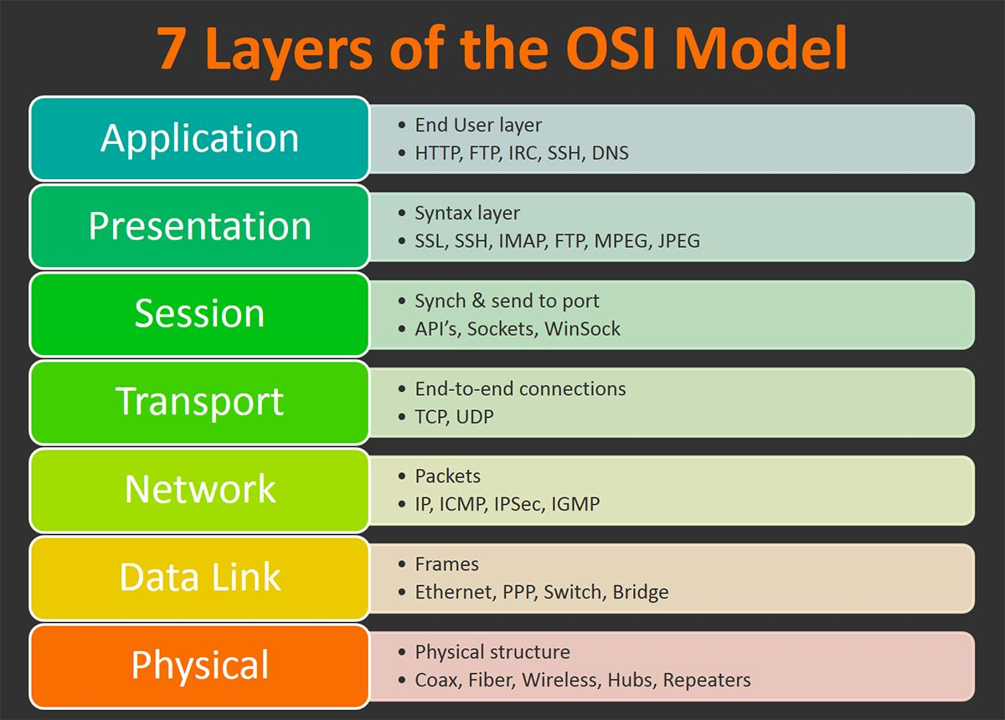

Slide 8
IP Address – IPv4 vs IPv6
Definition: A logical (non-permanent) identifier used at the Network Layer (Layer 3) to locate a device on a wide network (e.g., the internet).
IPv4 (32 bits):
Format: Four decimal numbers (0–255) separated by dots. Example: 192.168.1.1
Problem: Address exhaustion (only ~4.3 billion addresses).

Slide 9
IPv6 (128 bits)
Format: Eight groups of four hexadecimal digits separated by colons. Example: 2001:0db8:85a3:0000:0000:8a2e:0370:7334
Features: Vast address space (~340 undecillion), built-in security (IPsec), autoconfiguration (SLAAC)
Stateless Address Autoconfiguration
Internet Protocol Security

Slide 10
Key difference between MAC and IP:
Key difference between MAC and IP:
  MAC = identity (like a national ID number).
  IP = location address (like a postal address – changes when you move).

Slide 11
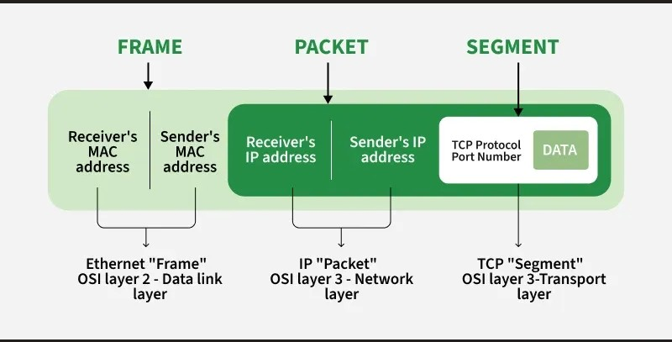
Data Packets
Why split data into packets?
  Efficient use of bandwidth.
  Avoids line monopolization (multiplexing).
  Only corrupted packets are retransmitted.

Slide 12
Data Packets
Packet structure:
  Header:
    Source IP address
    Destination IP address
    Sequence number (for reordering)
    Identification number (ties packets to original message)
    Time To Live (TTL) – prevents infinite looping
    Protocol type (TCP/UDP)
  Payload: The actual data fragment (part of a file, web page, etc.).
  Trailer (optional): Error-checking data (e.g., CRC).

