Slide 1
Computer Science

Slide 2
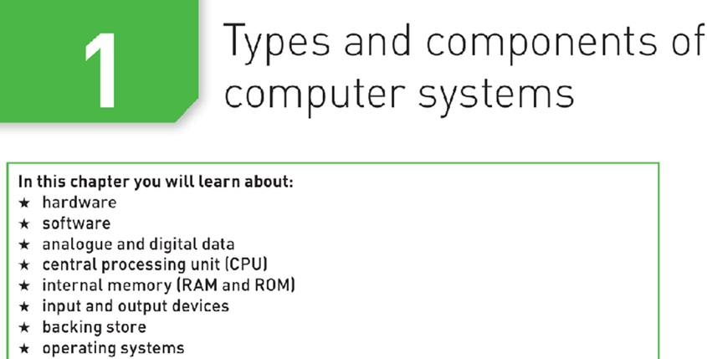

Slide 3
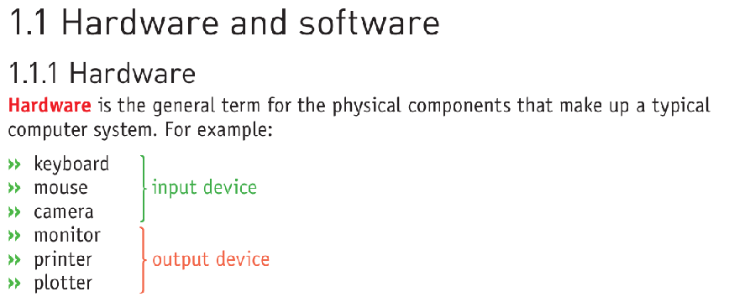

Slide 4



Slide 5
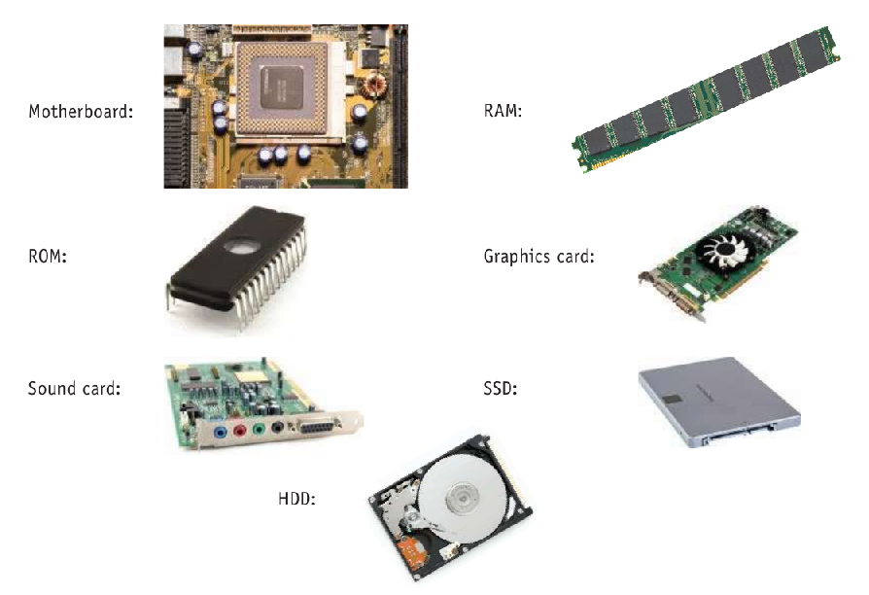

Slide 6
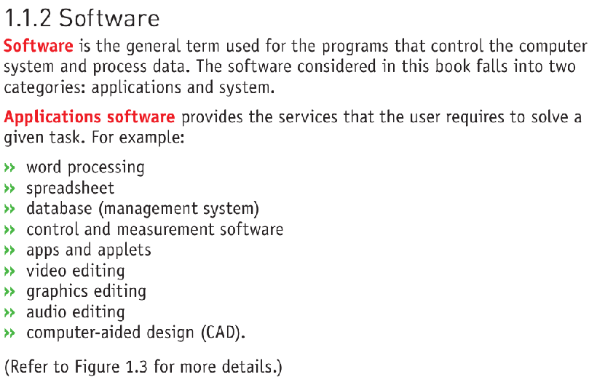

Slide 7


Slide 8
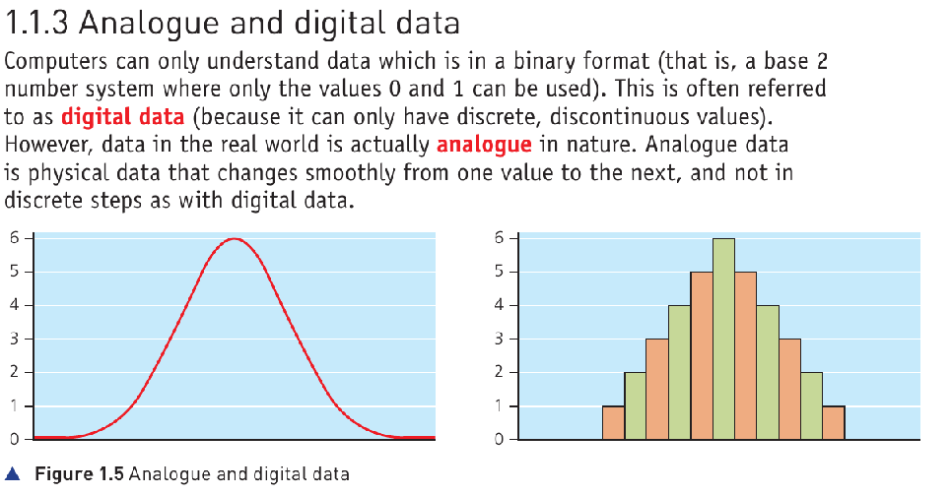


Slide 9

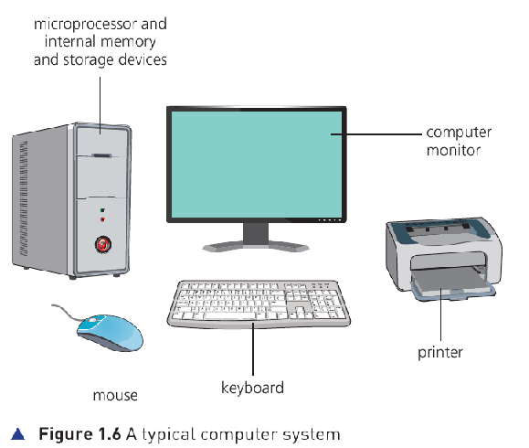

Slide 10
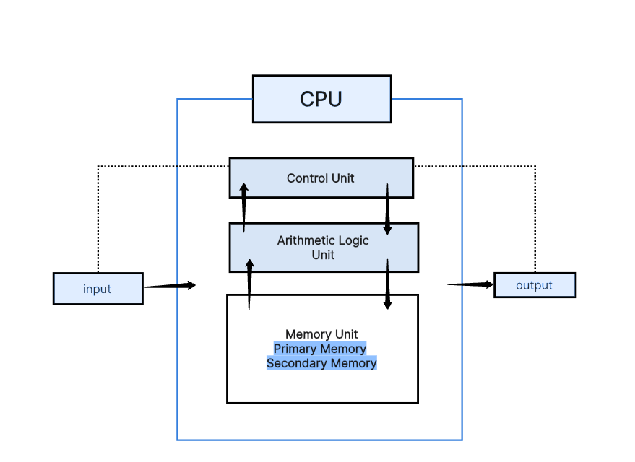
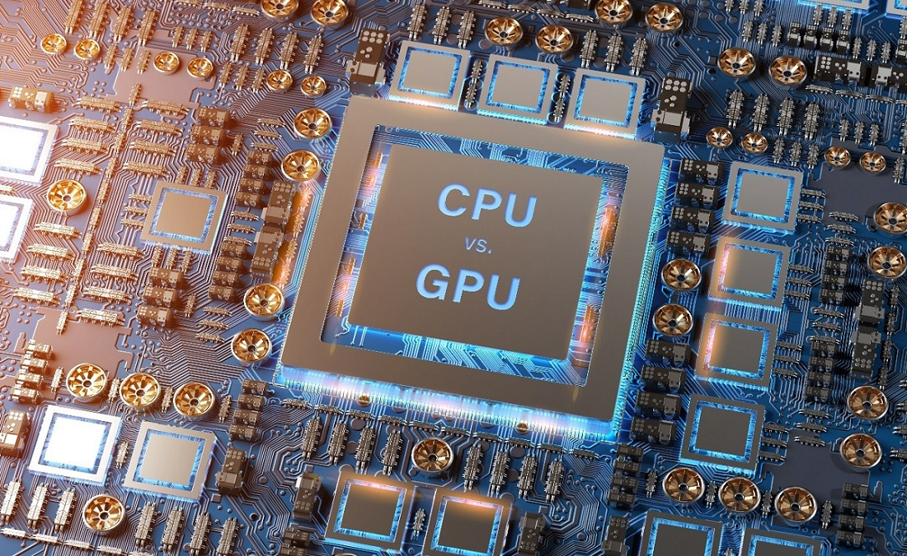
1.2.1 CPU
The central processing unit (CPU) is the part of the computer that interprets
and executes the commands from the computer hardware and software. It is
normally part of the computer motherboard.
The CPU/microprocessor is made up of a control unit, which controls the input and output devices; an arithmetic and logic unit (ALU), which carries out calculations and makes logical decisions, and small memory locations called registers.

Slide 11

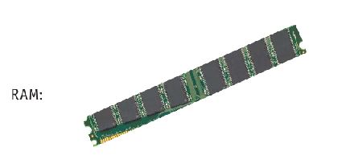

Slide 12

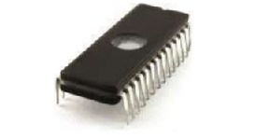

Slide 13
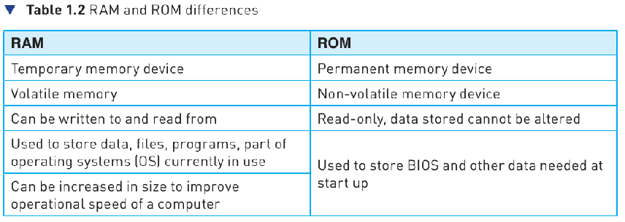

Slide 14
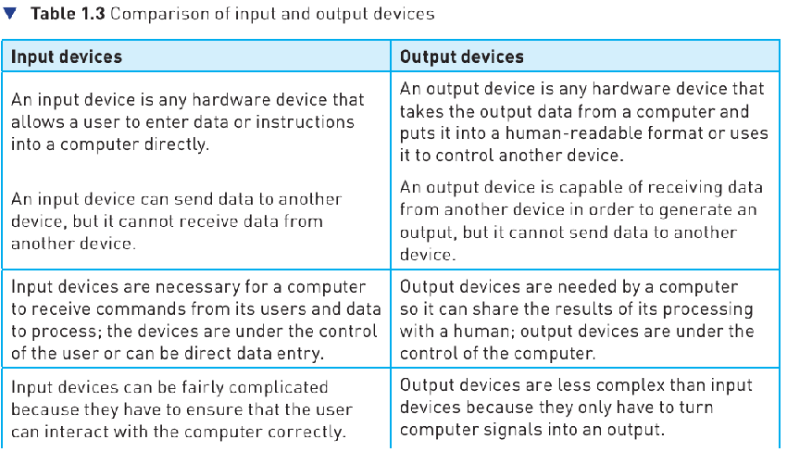

Slide 15



Slide 16
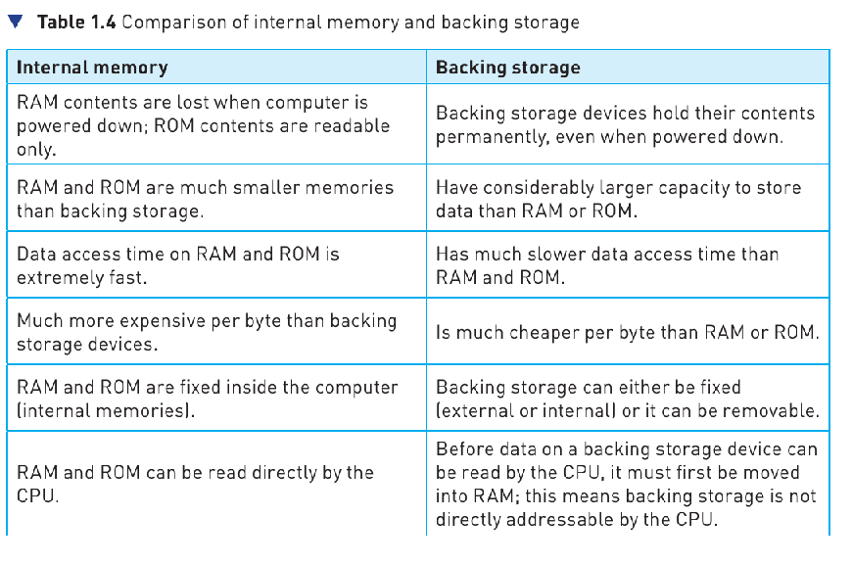

Slide 17
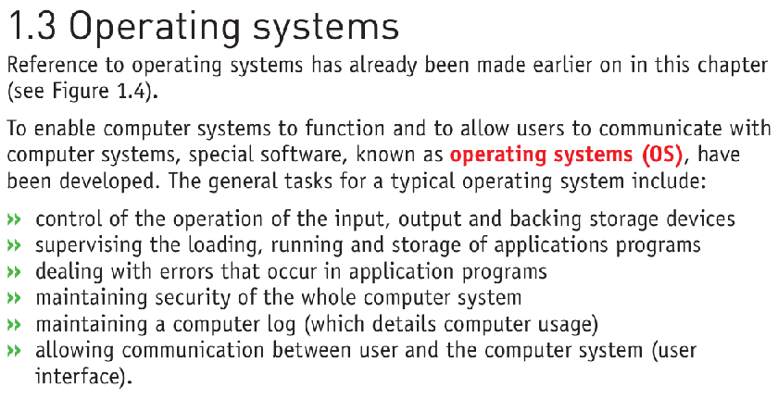

Slide 18
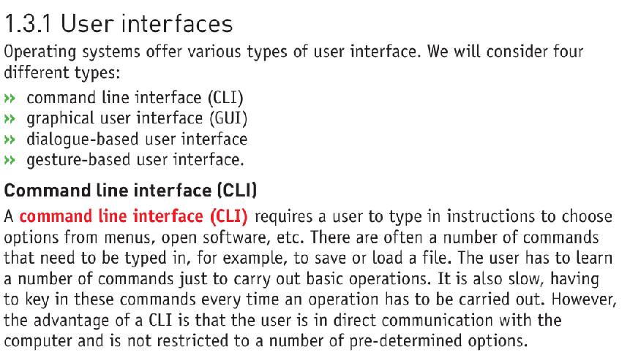

Slide 19




Slide 20
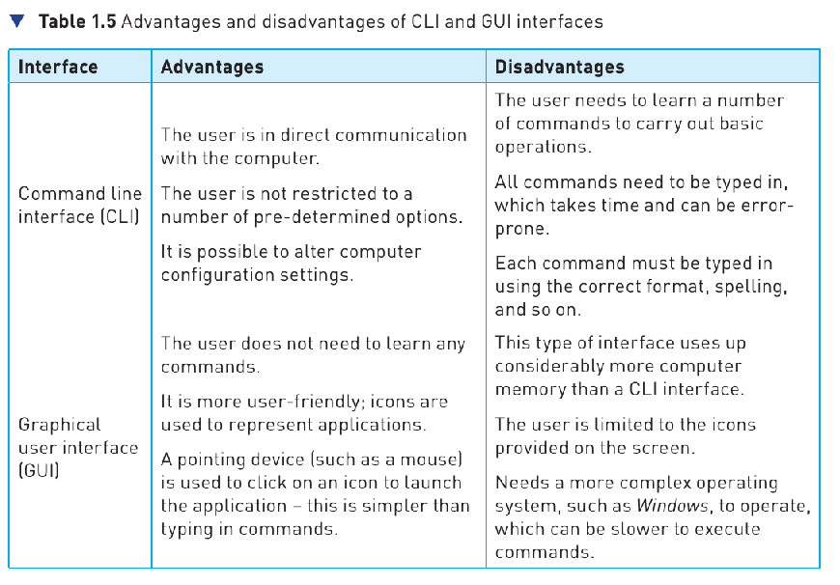

Slide 21

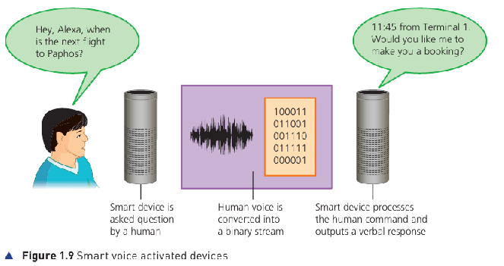

Slide 22
