Slide 1

Chapter 3
REFERENCE: APPLIED CLINICAL
PHARMACOKINETICS
Slideshow by: Assist. Prof. Dr. HADEEL DELMAN

Slide 2
DRUG DOSING IN SPECIAL
POPULATIONS

Slide 3
DRUG DOSING IN SPECIAL
POPULATIONS
RENAL DISEASE,
HEPATIC DISEASE,
HEART FAILURE,
OBESITY,
DRUG INTERACTIONS

Slide 4
RENAL DISEASE

Slide 5
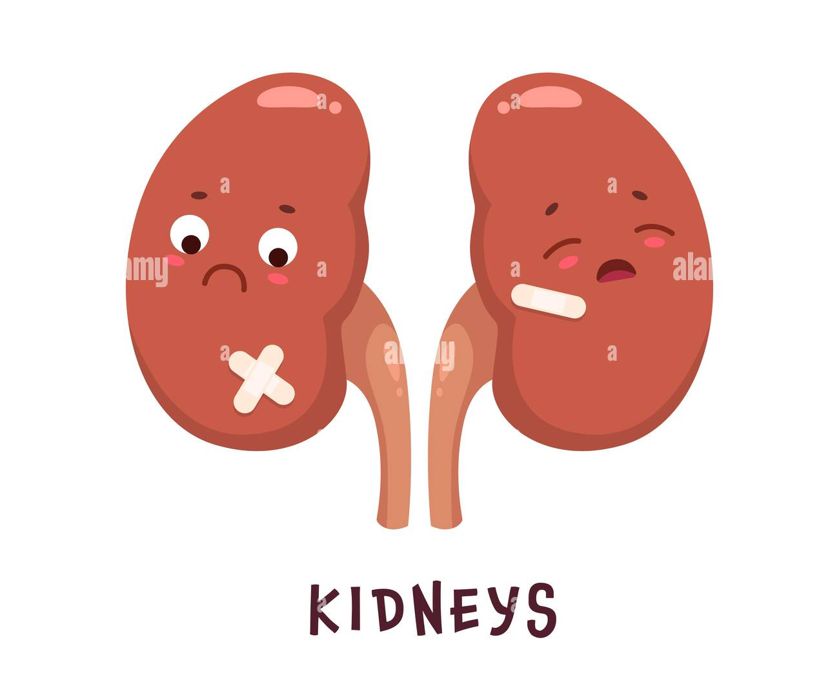
How we can measure renal function?

Slide 6
1. Glomerular Filtration Rate (GFR)
Groups need to follow renal function and GFR:
Neonates
Elderly
Acute and chronic renal failure

Slide 7
The equation that describes these various routes of renal elimination is:
fB is the free fraction of drug in the blood,
GFR is glomerular filtration rate,
RBF is renal blood flow,
Cl′sec is the intrinsic clearance for tubular secretion of unbound drug,
FR is the fraction reabsorbed

Slide 8
Practical Determination of
Glomerular filtration rate
Glomerular filtration rate can be determined practically by administration of special test compounds such as inulin or 125I-iothalamate.

Slide 9
Measurement of Glomerular filtration rate
Glomerular filtration rate can be estimated (calculated) using the modified Modification of Diet in Renal Disease (MDRD) equation:
Multiply by (0.742) if female, and (1.21) if African-American
GFR (in mL/min /1.73 m2) = 186 ⋅ SCr^{−1.154} ⋅ Age^{−0.203}

Slide 10
Example, the estimated GFR for a 53-year-old
African-American male with a SCr = 2.7 mg/dL
GFR = 186 ⋅ SCr^{−1.154} ⋅ Age^{−0.203}
GFR = 186 ⋅ (2.7 mg/dL) ^{−1.154} ⋅ (53 y) ^{−0.203} ⋅ 1.21
= 32 mL/min / 1.73 m²
Normal glomerular filtration rate of 80–120 mL/min

Slide 11
2. Measurement of Creatinine Clearance
Creatinine is a by-product of muscle metabolism that is primarily eliminated by glomerular filtration
Creatinine clearance rates can be measured by collecting urine for a specified period and collecting a blood sample for determination of serum creatinine at the midpoint of the concurrent urine collection time

Slide 12
Measurement of Creatinine Clearance
Method 1: CrCl measured from serum and urine
CrCl (in mL/min) = (UCr ⋅ Vurine) / (SCr ⋅ T)
UCr is the urine creatinine concentration in mg/dL,
Vurine is the volume of urine collected in mL,
SCr is the serum creatinine collected at the midpoint of the urine collection in mg/dL,
T is the time in minutes of the urine collection
most nephrologists use a 24-hour urine collection period

Slide 13
Example, a 24-hour urine was collected for a patient with the following results: UCr = 55 mg/dL, Vurine = 1000 mL, SCr = 1.0 mg/dL, T = 24 h. measure CrCl.
T = 24 h × 60 min/h = 1440 min
CrCl (in mL/min) = (UCr ⋅ Vurine) / (SCr ⋅ T)
= (55 mg/dL ⋅ 1000 mL) / (1.0 mg/dL ⋅ 1440 min)
= 38 mL/min.
Normal CrCl of 90–140 mL/min

Slide 14
Routine measurement of creatinine clearances in patients has been fraught with problems:
1- Incomplete urine collections,
2- Serum creatinine concentrations obtained at incorrect times, and
3- Collection time errors can produce erroneous measured creatinine clearance values.

Slide 15
Method 2: Estimate CrCl from serum creatinine only
Cockcroft and Gault method
Jelliffe and Jelliffe method
Salazar and Corcoran method

Slide 16
A/ Cockcroft and Gault method
For males, CrClest = [(140 − age) BW]/ (72 ⋅ SCr)
For females, CrClest = [0.85(140 − age)BW] / (72 ⋅ SCr)
CrClest is estimated creatinine clearance in mL/min,
age is in years,
BW is body weight in kg,
SCr is serum creatinine in mg/dL.
Patients ≥18 years old,
Actual weight within 30% of their ideal body weight
Stable serum creatinine concentrations

Slide 17
IBW measures
IBW males (in kg) = 50 + 2.3(Ht − 60)
IBW females (in kg) = 45 + 2.3(Ht − 60),
where Ht is height in inches

Slide 18
Example, a 55-year-old, 80-kg, 5-ft 11-in male has a serum creatinine equal to 1.9 mg/dL. Calculate the estimated creatinine clearance.
IBWmales = 50 + 2.3 (Ht − 60)
= 50 + 2.3(71 − 60)
= 75 kg (so the patient is within 30% of his ideal body weight
CrClest = [(140 − age)BW] / (72 ⋅ SCr)
= [(140 − 55 y)80 kg] / (72 ⋅ 1.9 mg/dL)
= 50 mL/min.

Slide 19
If serum creatinine values are not stable, but increasing or decreasing in a patient, the Cockcroft-Gault equation cannot be used to estimate creatinine clearance. In this case, an alternate method must be used:

Slide 20
B/ Jelliffe and Jelliffe method
First step: estimate creatinine production
Ess is the excretion of creatinine,
IBW is ideal body weight in kilograms,
Age is in years
Ess male = IBW [29.3 − (0.203 ⋅ age)]
Ess female = IBW [25.1 − (0.175 ⋅ age)]

Slide 21
Second step
Scrave is the average of the two serum creatinine determinations in mg/dL,
Δt is the time that expired between the measurement of Scr1 and Scr2 in minutes

Slide 22
If patients are not within 30% of their ideal body weight (obese), other methods to estimate creatinine clearance should be used:

Slide 23
C/ Salazar and Corcoran method
Age in years,
Wt, weight in kg,
Ht, height in m,
SCr, serum creatinine in mg/dL

Slide 24
Methods to estimate creatinine clearance for children and young adults
Age 1–20 years,
CrClest (in mL/min / 1.73 m²) = (0.55 ⋅ Ht)/SCr
Age 0–1 year,
CrClest (in mL/min / 1.73 m²) = (0.45 ⋅ Ht) / SCr
Ht is height in cm,
SCr is serum creatinine in mg/dL

Slide 25
Estimation of Drug Dosing and Pharmacokinetic Parameters Using Creatinine Clearance
When creatinine clearance is < 50−60 mL/min Modest decrease in drug doses
When creatinine clearance is < 25−30 mL/min Moderate decrease in drug doses
When creatinine clearance is ≤ 15 mL/min Substantial decrease in drug doses

Slide 26
In order to modify doses for patients with renal impairment:
Decrease the drug dose and retain the usual dosage interval,
Retain the usual dose and increase the dosage interval, or
Decrease the dosage and prolong the dosage interval.
Depends on the route of administration, the dosage forms available, and the pharmacodynamic response to the drug.

Slide 27
A) if the drug is orally and only a limited number of solid dosage forms are available:
administer the usual dose and increase the dosage interval
B) If the drug is given parenterally:
a smaller dose can be administered, and the usual dosage interval will be retained
C) for drugs with narrow therapeutic ranges or with toxicSE like theophylline or aminoglycoside
both the dose and dosage interval can be manipulated to achieve the targeted drug levels.

Slide 28
Solid line--- 300 mg every 6 hours
Dashed line--- 300 mg every 12 hours,
Dotted line--- 150 mg every 6 hours,

Slide 29
Using CrCl for measuring
Drug Clearance
Drug Clearance is dependent on renal clearance and non-renal clearance.
For example, in digoxin:
Cl of drug (in mL/min) = 1.303 ⋅ CrCl + ClNR
where ClNR is non-renal clearance and equals 20 mL/min in patients with moderate-severe heart failure and 40 mL/min in patients with no or mild heart failure

Slide 30
Relationship between creatinine clearance and digoxin clearance used to estimate initial digoxin clearance when no drug concentrations are available. The y-axis intercept (40 mL/min) is non-renal clearance for digoxin in patients with no or mild heart failure. If the patient has moderate to severe heart failure, non-renal clearance is set to a value of 20 mL/min.

Slide 31
Using CrCl for measuring
Elimination rate constant (ke)
It is a dependent pharmacokinetic parameter whose result is reliant on the relative values of clearance and volume of distribution.
For example, aminoglycoside:
(ke = Cl/V)
ke (in h^{–1}) = 0.00293 ⋅ CrCl + 0.014

Slide 32
Relationship between creatinine clearance and aminoglycoside elimination rate constant (ke) used to estimate initial aminoglycoside elimination when no drug concentrations are available. The y-axis intercept (0.014 h^{–1}) is non-renal elimination for aminoglycosides

Slide 33
Using CrCl for measuring
Volume of distribution
Digoxin volume of distribution decreases in patients with decreased renal function according to the following equation:
V (in L) = 226 + [(298 ⋅ CrCl)/(29.1 + CrCl)]
where CrCl is in mL/min.

Slide 34
OBESITY
Excessive adipose tissue can alter the pharmacokinetics of drugs by changing the volume of distribution

Slide 35
OBESITY
Lipophilic drugs tend to partition into adipose tissue, and the volume of distribution in obese patients for these drugs can be dramatically larger than in normal weight patients. Examples diazepam, carbamazepine.
Hydrophilic drugs tend to not distribute into adipose tissue so that the volume of distribution is not different in obese and normal weight patients. Examples digoxin, cimetidine, and ranitidine.

Slide 36
Obesity may affect other PKs:
Extracellular fluid & Vd ---- (↑Aminoglycoside, ↔ Digoxin and vancomycin)
GFR & Cl ---- (↑Aminoglycoside, vancomycin, cimetidine)
Hepatic Cl ----- (↑diazepam,↓methylprednisolone, ↔carbamazepine and cyclosporine)

Slide 37
Obesity ----→ t1/2
Therefore….
t1/2 = (0.693 ⋅ V) / Cl

Slide 38
Heart failure
Decrease in CO
Decrease in RBF & HBF
Decrease blood to GIT ….. decrease absorption
Decrease Vd …..
Half-life affected

Slide 39
HEPATIC DISEASE

Slide 40
Orally administered medications must pass through the liver before entering the systemic circulation
The equation that describes hepatic drug metabolism is:
ClH= [LBF . (FB . C
LBF is liver blood flow,
fB is the fraction of unbound drug in the blood,
Cl′int is intrinsic clearance

Slide 41
Cases may affect the hepatic drug metabolism are:
Neonate
Elderly
Hepatitis and cirrhosis

Slide 42
Determination of Child-Pugh Scores
Consists of five laboratory tests or clinical symptoms:
Serum albumin,
Total bilirubin,
Prothrombin time,
Ascites,
Hepatic encephalopathy.

Slide 43
TABLE 3-2 Child-Pugh Scores for Patients with Liver Disease

Slide 44
Determination of Child-Pugh Scores
The score for a patient with normal liver function is 5
The score for a patient with grossly abnormal serum albumin, total bilirubin, and prothrombin time values in addition to severe ascites and hepatic encephalopathy is 15

Slide 45
Determination of Child-Pugh Scores
A score = 8–9 is grounds for a moderate decrease (~25%) in initial daily drug dose for agents that are primarily (≥60%) hepatically metabolized,
Score of 10 or greater indicates that a significant decrease in initial daily dose (~50%) is required for drugs that are mostly liver metabolized.

Slide 46
For example
The usual dose of a medication that is 95% liver metabolized is 500 mg every 6 hours, and the total daily dose is 2000 mg/d. For a hepatic cirrhosis patient with a Child-Pugh score of 12 ,,,,,,
An appropriate initial dose would be 50% of the usual dose or 1000 mg/d. The drug could be prescribed to the patient as 250 mg every 6 hours or 500 mg every 12 hours.

Slide 47
In order to modify doses for patients with hepatic impairment:
Decrease the drug dose and retain the usual dosage interval,
Retain the usual dose and increase the dosage interval, or
Decrease the dosage and prolong the dosage interval.
Depends on the route of administration, the dosage forms available, and the pharmacodynamic response to the drug.

Slide 48
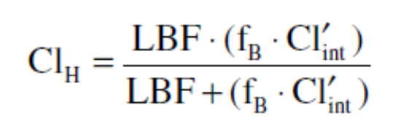
Implications of Hepatic Disease on Serum Drug Concentration Monitoring and Drug Effects
Drugs with a low hepatic extraction ratio (≤30%)
Drugs with a high hepatic extraction ratio (≥70%)
Drugs with intermediate hepatic extraction ratios

Slide 49
1- For drugs with a low hepatic extraction ratio (≤30%)
The numeric value of liver blood flow is much greater than the product of unbound fraction of drug in the blood and the intrinsic clearance of the compound (LBF >>fB⋅ Cl′int), and the sum in the denominator of the hepatic clearance equation is almost equal to liver blood flow and the sum in the denominator of the hepatic clearance equation is almost equal to liver blood flow [LBF ≈ LBF + (fB ⋅ Cl′int)].
Hepatic clearance is equal to the product of free fraction in the blood and the intrinsic clearance of the drug for a drug with a low hepatic extraction ratio:

Slide 50
2- For drugs with a high hepatic extraction ratio (≥70%)
The numeric value of liver blood flow is much less than the product of unbound fraction of drug in the blood and the intrinsic clearance of the agent (LBF << fB ⋅ Cl′int), and the sum in the denominator of the hepatic clearance equation is almost equal to the product of free fraction of drug in the blood and intrinsic clearance [fB ⋅ Cl′int ≈ LBF + (fB ⋅ Cl′int)].
Hepatic clearance is equal to liver blood flow for a drug with a high hepatic extraction ratio:

Slide 51
3- For drugs with intermediate hepatic extraction ratios

Slide 52
Drug interactions
1- The hepatic clearance or
2- Volume of distribution
3- Half-life
4- Steady-state concentration
5-The unbound steady-state concentration
6-The effect of the drug
Effect α Cssu, f_{B}

Slide 53
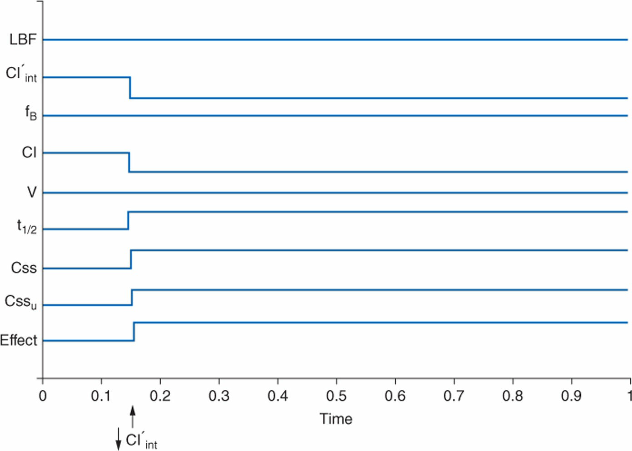
Ex: Drug with Low ER + Drug which decrease intrinsic Cl

Slide 54
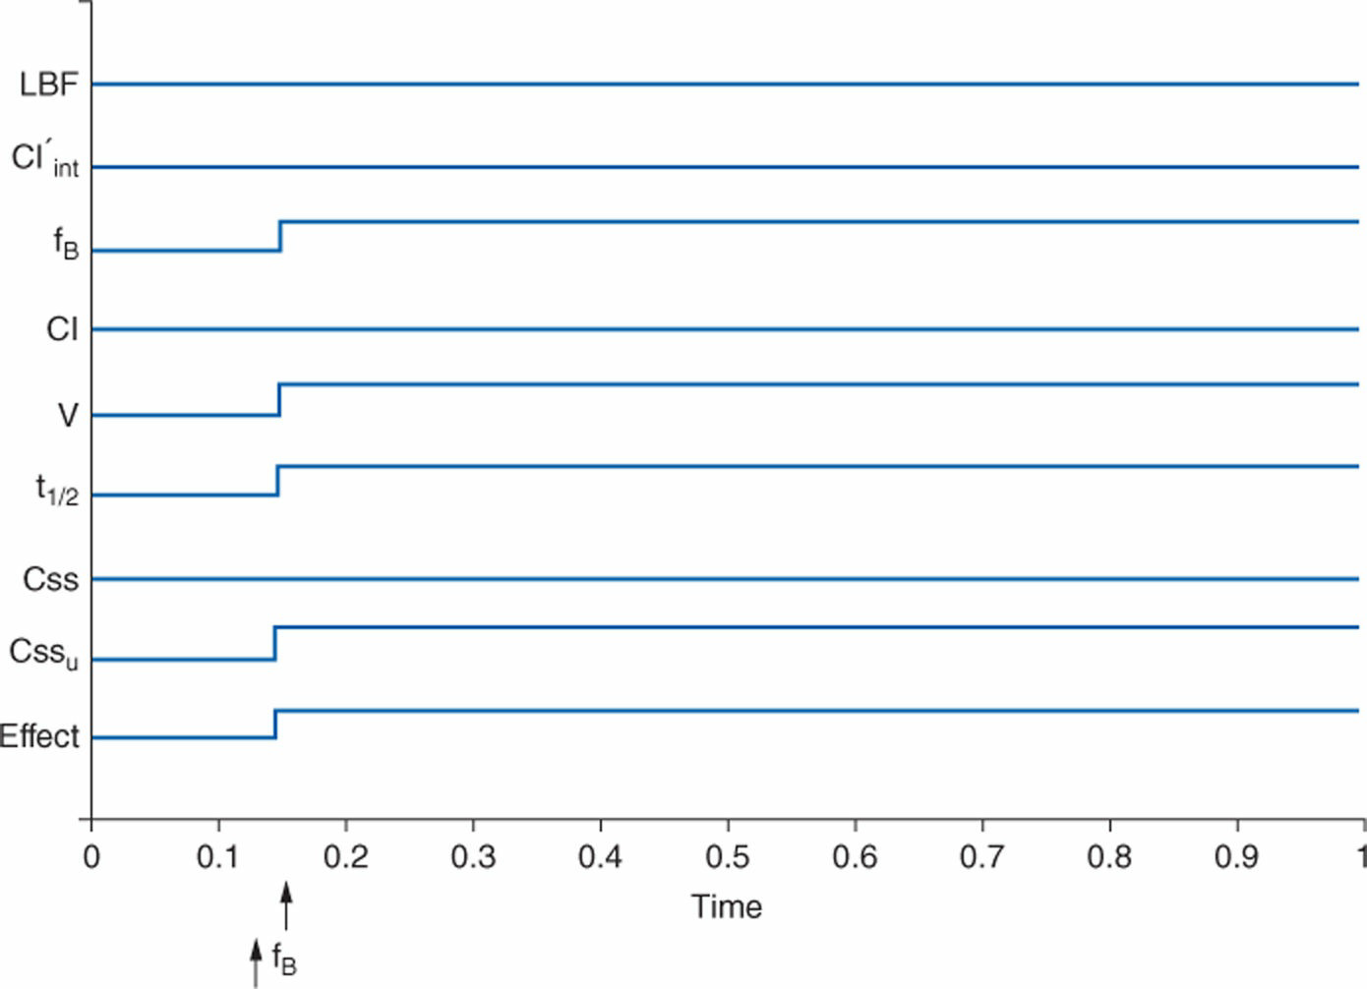
Ex: Drug with High ER+ Protein binding displacement

Slide 55
Ex: Drug with High ER+ Enzyme inhibitor
See examples and questions in the book

Slide 56
Thank u….

