Slide 1

Solubility product constant for slightly soluble salt
Lecturer Marwah malik

Slide 2

Introduction
When slightly soluble electrolyte is dissolved to form saturated solution, the solubility is described by special constant known as solubility product constant Ksp.
The aim of this experiment is to determine the Ksp for KHT (potassium acid tartrate).
silver chloride (Agcl) is an example of such slightly soluble salt. It is the excess solid in equilibrium with the ion in saturated solution at specific temperature

Slide 3
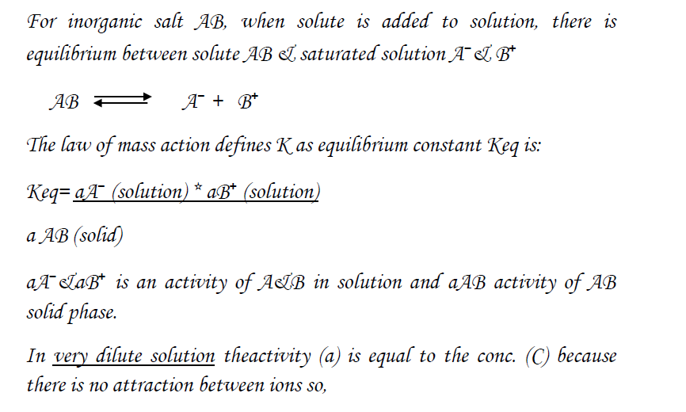

Slide 4
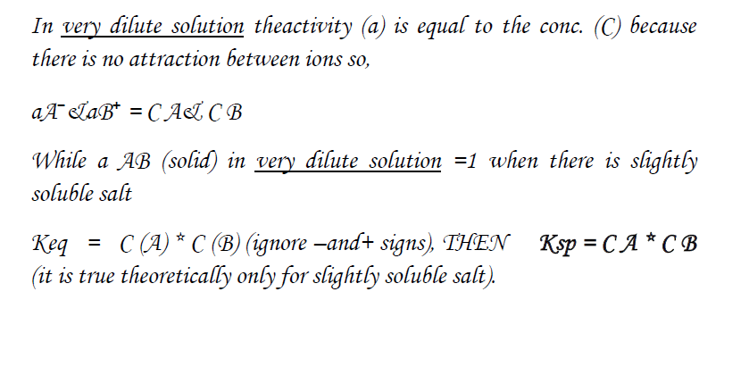

Slide 5
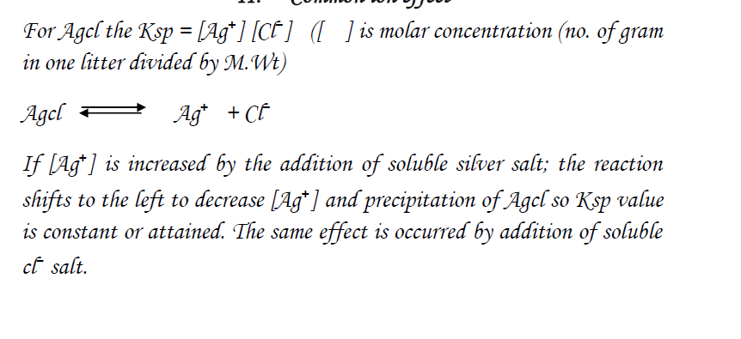

Slide 6
Factors affecting Ksp
1-Temperature: - Ksp is increased with increasing the temperature.
2- Common ion: - increasing the concentration of any ion in solution is leading to decrease the solubility (except if the ion forms soluble complex with the salt).

Slide 7
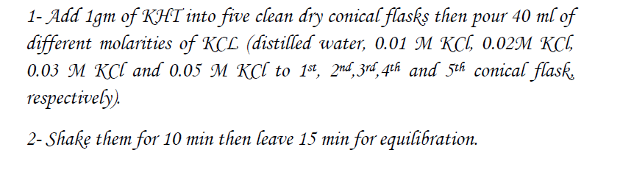
Experimental work

Slide 8
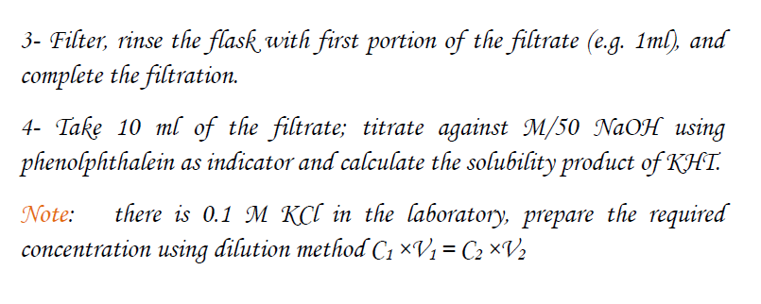

Slide 9
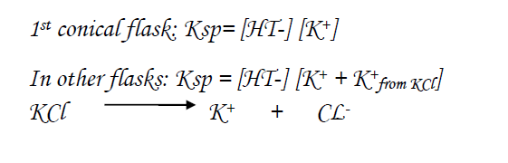
Calculation

Slide 10
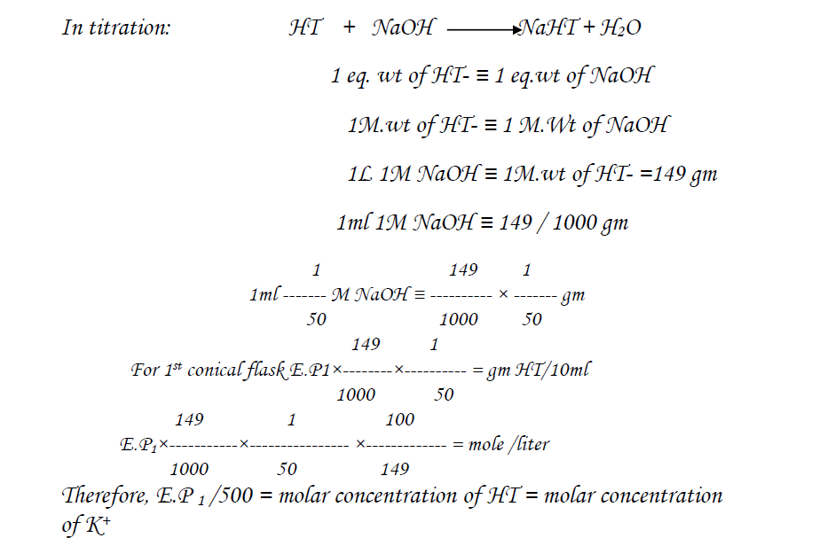

Slide 11
