Slide 1

Buffer solutions
Lab.6
Done By:
Lecturer Marwah malik

Slide 2
Buffers: are compounds or mixtures of compounds that, by their presence in solution, resist changes in pH upon the addition of small quantities of acid or alkali.
buffer action : The resistance to a change in pH .

Slide 3
What is a Buffer?
A combination of a weak acid and its conjugate base (i.e., its salt) or
a weak base and its conjugate acid .

Slide 4
Consider a buffer solution that includes of a weak acid and its salt such as the acetate buffer:
CH3COOH ↔ H3O⁺ + CH3COO⁻ (incomplete
dissociation)
CH3COOK → K⁺ + CH3COO⁻ (complete
dissociation)

Slide 5
When a strong acid, such as HCl is added, the following takes place:
HCl → H3O+ + Cl–
CH3COOH ←↔ H3O+ + CH3COO−
CH3COOK → K+ + CH3COO−
The increase in hydrogen ion causes a shift to the left and more CH3COOH is formed since there is a sufficiently high [CH3COO−] (it will tie up the hydrogen ions)

Slide 6
How can you differentiate between buffer system & non-buffer system?
If 1ml of 0.1 N HCl solution is added to 100ml of pure water the PH is reduced from 7 to 3.
When strong acid is added to 0.01 M solution containing equal quantities of acetic acid & sodium acetate the PH change only by 0.09 units bec. The base AC‾ ties up the H⁺ ion according to the following equation
AC‾ + H₃O → HAC + H₂O

Slide 7
When a strong base, such as KOH is added, the following occurs:
KOH → OH− + K+
CH3COOH ↔→ H3O⁺ + CH3COO⁻ (shifts to the
right)
CH3COOK → K⁺ + CH3COO⁻
The added OH− ions react with the H3O+ ions to form H2O
The decrease in [H3O+] causes a shift to the right and more CH3COO− is formed.

Slide 8
To illustrate the way that buffer resist PH change lets take acetate buffer as example:
HAC + H₂O ↔ AC⁻ + H₃O⁺
NaAC → AC⁻ + Na⁺
if strong acid added → H₃O⁺ → shifts the equation to the left so ties up the H₃O⁺ ion.
If strong base added → OH⁻ → shifts the equation to the right so ties up OH⁻ ion .

Slide 9
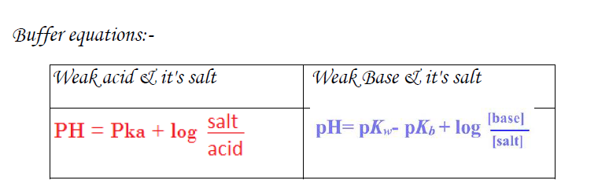

Slide 10
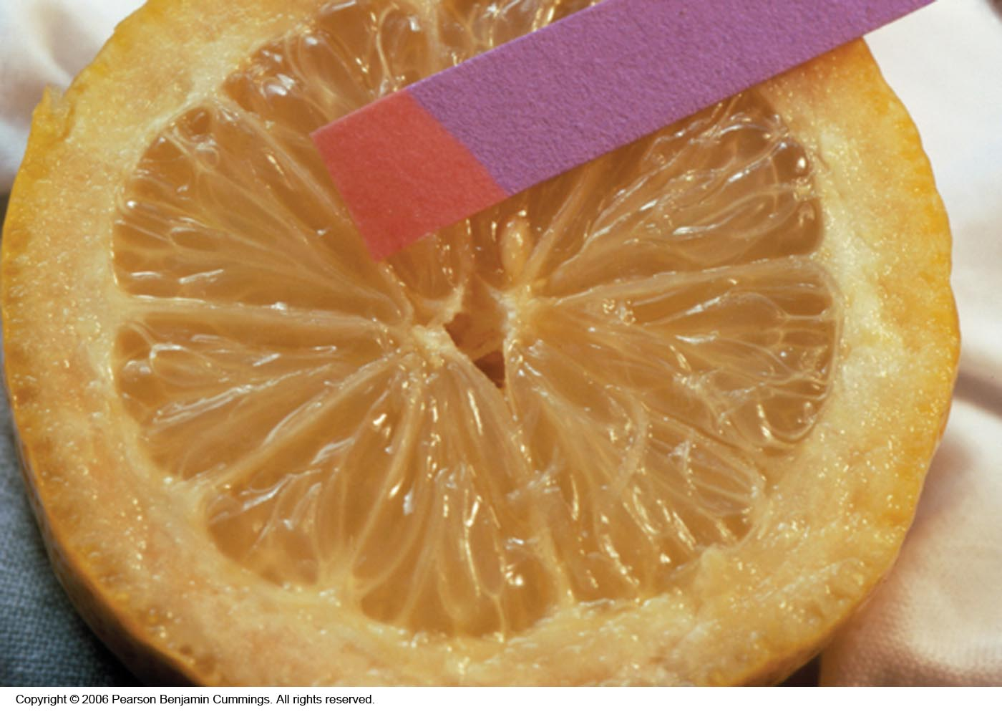
pH Indicators

Slide 11
pH- indicators
the pH of the buffer solution can be measured by:
1- Colorimetric method:
a)chemical indicator
b) paper indicators
2- Electrometric method (PH meter).

Slide 12
pH Indicators
Colorimetric method (chemical indicator):
may be considered as weak acids or weak bases that act like buffers and also exhibit color changes as their degree of dissociation varies with pH.
For example, methyl red shows its full alkaline color, yellow, at a pH of about 6 and its full acid color, red, at about pH 3.
The colour of an indicator is a function of the pH of the solution.

Slide 13

The dissociation of an acidic indicator is given in simplified form as:
HIn is the un-ionized form of the indicator, which gives the acid color, and In- is the ionized form, which produces the basic color.
If an acid is added to a solution of the indicator, the hydrogen ion concentration term on the right-hand side of equation is increased, and the ionization is repressed by the common ion effect. The indicator is then predominantly in the form of HIn, the acid color.
If base is added, [H3O+] is reduced by reaction of the acid with the base, reaction proceeds to the right, yielding more ionized indicator In-, and the base color is predominate.

Slide 14
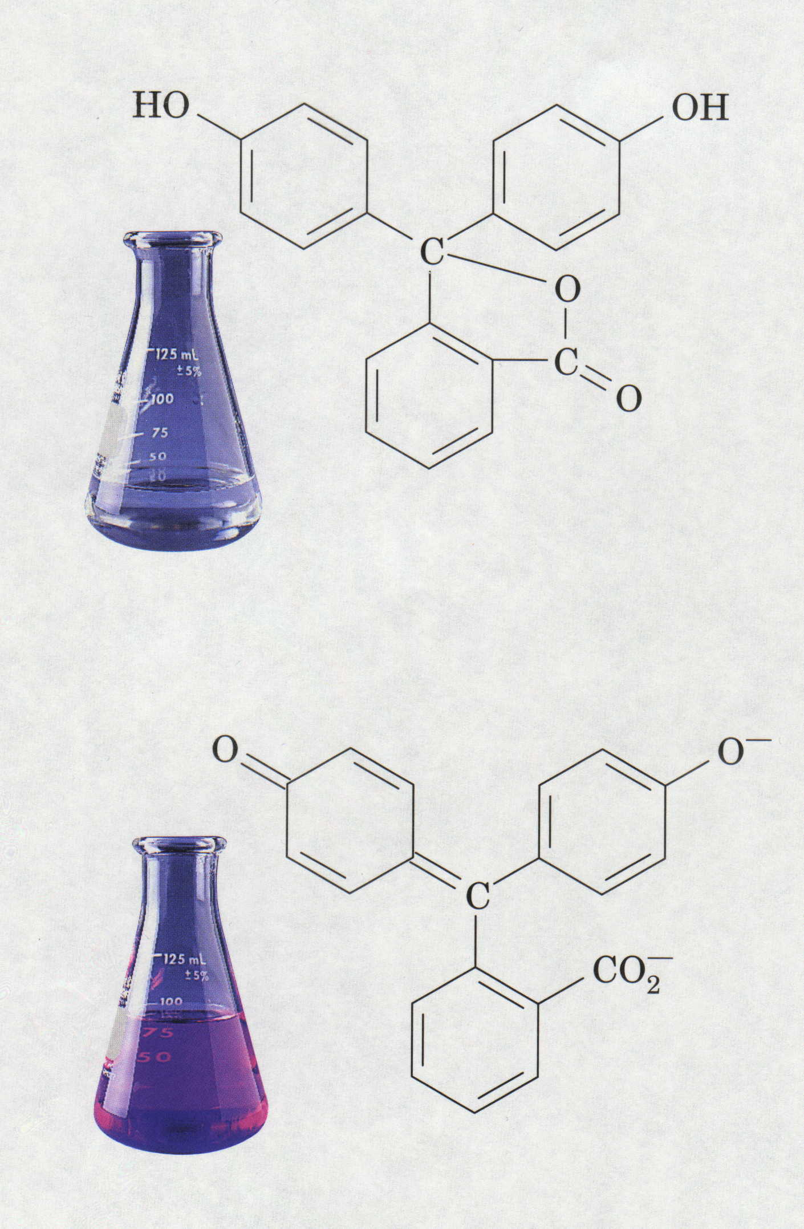
Phenolphthalein Indicator
H⁺
Colorless = Acidic pH
Pink = Basic pH

Slide 15
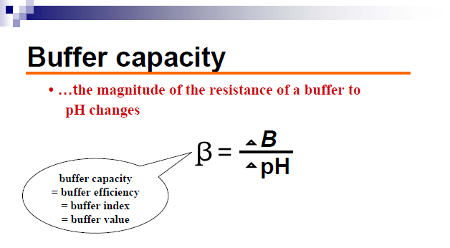
ΔB : small increment in gram equivalents/Liter of strong(base ) added to the buffer soln. to produce a pH change of ΔpH

Slide 17
Factors affecting on buffer capacity:-
1- value of the ratio salt / acid increasing as the value approaches unity .
2-the magnitude of individual conc. of the buffer component , the buffer becoming more efficient as the salt & acid conc. Increased bec. of greater acid & alkaline reserve.
3- depends on the amount of strong base added , with addition of more base buffer capacity decreases rapidly& when sufficient base is added the acid converts completely to sodium & acetate ions, the solution is no longer act as acid reserve.( i.e. max. β before any base is added )

Slide 18
Various buffer systems have been suggested for different pharmaceutical solutions:
Sorensen phosphate
Acetate buffer

Slide 19
Experimental work
Part l: prepare
0.2 M HAC, ( solution A)
0.2 M NaAC (Solution B)
0.1 M NaOH.

Slide 20
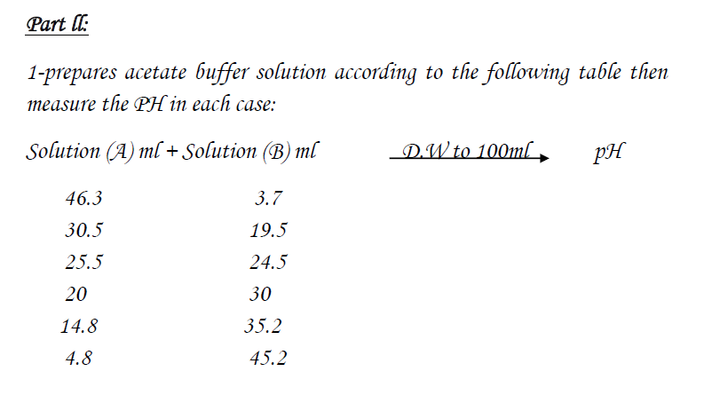

Slide 21
Part III
measuring the pH, using pH meter: Put the electrode of the pH meter in the buffer solution & read the pH.
Take a certain volume of acetate buffer solution; add 0.0004 M sodium hydroxide portions (0.1 ml of 0.1 M) to it. Then, measure the PH and calculate the buffer capacity.

