Slide 1
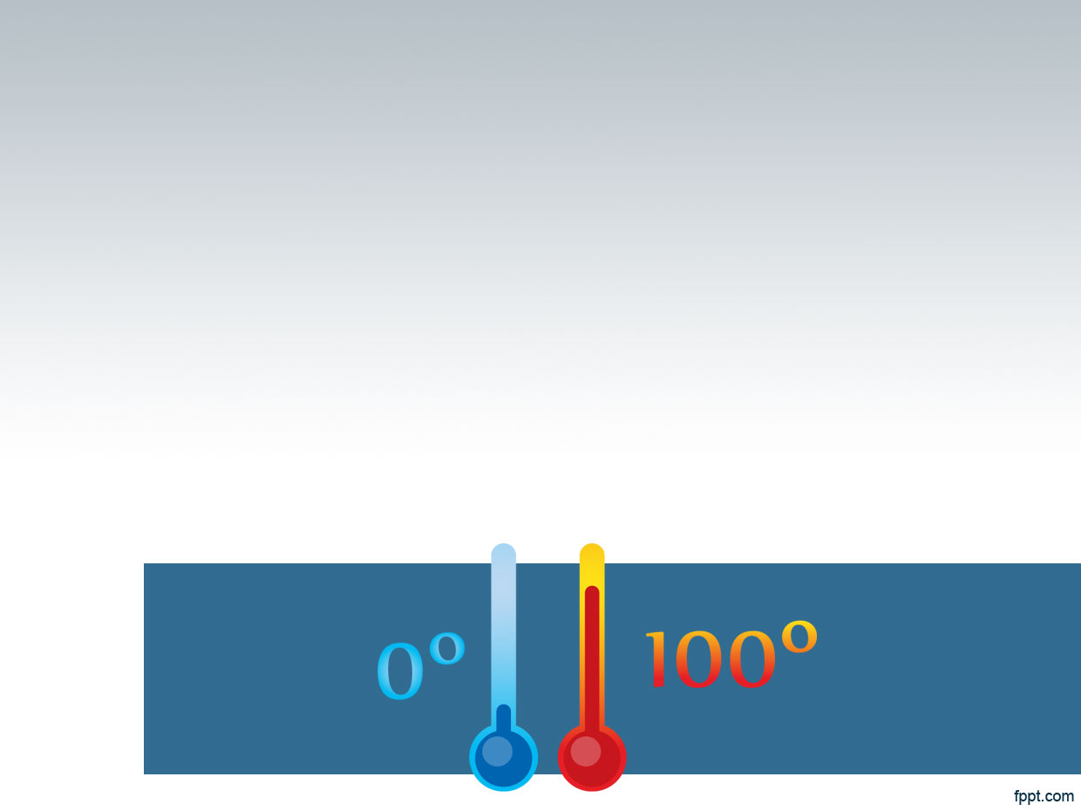

lab no.(5)
Partition coefficients
Done By:
Lec. Marwa malik Assis. Lec. Mona yahya

Slide 2
Introduction
If an excess mount of liquid or solid is added to a mixture of two immiscible liquids, it will distribute itself between the two phases so that each becomes saturated. If the substance is added to the immiscible solvents in an amount insufficient to saturate the solutions, it will still become distributed between the two layers in a definite concentration ratio.

Slide 3
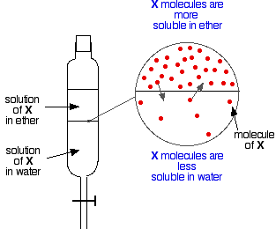

Slide 4
The partition-coefficient (P) is defined as the ratio of concentrations of a compound in a mixture of two immiscible phases at equilibrium. (a biphase of liquid phases), specifically for un-ionized solutes, and the logarithm of the ratio is thus log P. ... Hence the partition coefficient measures how hydrophilic ("water-loving") or hydrophobic ("water-fearing") a chemical substance is.

Slide 5
When one of the solvents is water and the other is a non-polar solvent, then the log P value is a measure of lipophilicity or hydrophobicity. By another meaning, If C1 and C2 are the equilibrium concentrations of the substance in solvent1 and solvent2, respectively, the equilibrium expression becomes
K = C₁ / C₂
The equilibrium constant, K, is known as the distribution ratio, distribution coefficient, or partition coefficient (p).

Slide 6
Example:
When boric acid is distributed between water and amyl alcohol at 25°C, the concentration in water is found to be 0.0510 mole/litter and in amyl alcohol it is found to be 0.0155 mole/litter.
What is the value of Partition coefficient?
P.C ‘
The greater value of P.C for the drug, meaning higher lipid solubility while if the value of P.C is small that mean the drug has greater solubility in water more than in non polar solvents

Slide 7
Importance of P.C. to the pharmacist:-
1)the preservation of oil / water system.
P.C. is important in preservations field for oil/water system. Briefly, the solute can exist partly or wholly as associated molecule in one phase or it may dissociate into ions in either of the liquid phases. However, in some cases for instance, benzoic acid can distribute between oil phase (peanut oil) & water phase, so it is used as preservative when it is neither associated in oil phase nor dissociated in aqueous phase.
2)absorption& distribution of drug through the body.
3)In the extraction process to remove a particular solute From homogeneous system by adding another solvent that is immiscible with the first one.
4)In dosage form formulation.

Slide 8
Experimental work:-
The aim is to determinate the partition coefficient of iodine between water and chloroform.
Part I:Iodine, potassium iodide, chloroform, water, and sodium thiosulphate have been prepared, as well as solutions; 10%w/v KI , 0.02N&0.1N sodium thiosulphate , and 1% I2 / CHCL3. Then bring conical flask (iodine flask), pipette, and burette

Slide 9
Part ll:
1. Put 20 ml of 1% iodine in chloroform (use burette) in dry stoppered conical flask (iodine flask).
2. Add 50 ml D.W. to it.
3. The flask is the thoroughly shaken from time to time half hour after equilibrium is established ,allow to stand for complete phase separation, this need another half an hour.
4. 10 ml of the sample are taken from the upper aqueous layer, care is taken to avoid touching the chloroforming layer. Then titrate against 0.02 N sodium thiosulphate the end point is the disappearance of light brownish colour.
5. 5 ml are taken from the organic layer (lower layer). Keep the inside wall of the pipette dry as it passes through aqueous phase by placing the finger tightly over the upper end of the pipette.
6. Then titrate against 0.1 N sodium thiosulphate. Before titration, add 5 ml of 10% potassium Iodide to accelerate extraction of I 2 from the organic layer and it's titration with aqueous sodium thiosulphate. The end point is the disappearance of the brownish colour .

Slide 10
Calculation
Iodine distributes between the aqueous phase and chloroformic phase.

Slide 11
Calculation
For Aqueous phase if the E.P1=0.5ml
V1 * C1 = V2 * C2
(Na2S2O3) = (iodine)
E.P * 0.02N =10 * N2
0.5 *0.02 = 10 * N2
N2 =0.001 mole /L conc. of iodine in water
For Chloroformic phase if the E.P2=4.3ml
V1 * C1 = V2 * C2
(Na2S2O3) = (iodine)
E.P2 * 0.1N = 5 * N2
4 .3 *0.1 = 5* N2
N2 = 0.086 mole /L conc. of iodine in chloroform
0.086
P.C= ----------- =86
0.001

Slide 12


