Slide 1
Inorganic Pharmaceutical Chemistry
Alkali Metals
Assist. Prof. Ali Albakaa

Slide 2
Group 1 of the periodic table (first vertical column), except for hydrogen, is called the alkali metals, so-called s-block metals, as they only have one electron in their outer shell, which is of s type.
Under the term alkali metals, the following elements are included: lithium (Li), sodium (Na), potassium (K), rubidium (Rb), cesium (Cs), and francium (Fr).
In terms of clinical use, sodium and potassium are essential ions for the human body, and any imbalance in them must be corrected.
Lithium is medically used to treat bipolar disorder (BD), and the application of lithium salts.
The chemistry of the metals is characterised by the loss of this s electron to form a mono-cationic ion M⁺, which results from the relatively low ionisation energy of this electron.
Most of the compounds of group 1 elements tend to be ionic in nature and form salts. In all pharmaceutical applications, only the salts of alkali metals are used.

Slide 3
Advantages and disadvantages of using lithium-based drugs
(Li) has a clinical application in the treatment of manic depression or BD. BD (bipolar disorder) affects (1–2) % of the population.
Research has shown that lithium salts are highly effective in treating BD, and extensive research in this area has been stimulated. How can lithium ions (Li⁺) be modified to improve their activity?
The simple ion is the active ingredient, making it difficult to patent and protect any intellectual property.
Lithium Isotopes and Their Medical Applications:
Lithium exists as a mixture of two naturally occurring stable isotopes: ⁶Li (7.59%) and the main isotope ⁷Li (92.41%).
Both ⁶Li and ⁷Li are active nuclei by nuclear magnetic resonance (NMR), meaning their presence can be detected using NMR.
This allows for the distinction between intracellular and extracellular Li⁺ concentrations, thereby enabling the monitoring of Li⁺ uptake in different cells. Its salts can also be used to monitor the distribution of lithium in the tissue.

Slide 4
Historical developments in lithium-based drugs
The medical use of lithium (Li⁺) began in the 19th century for treating rheumatic diseases, gout, and later, bipolar disorder. Lithium carbonate (Li₂CO₃) became the preferred salt.
In the early 20th century, a link between sodium chloride (NaCl) and high blood pressure led to the use of LiCl as a salt substitute. This practice extended to consumer products, most notably the original formula of 7-Up, which contained lithium citrate.
However, this use proved dangerous. The FDA banned lithium salts after the deaths of patients who consumed large amounts of LiCl. The development of alternative antipsychotic drugs like chlorpromazine also reduced lithium's prominence.
Despite these setbacks, lithium was reapproved by the FDA in the 1970s and remains a fundamental treatment for bipolar disorder, used in about half of all cases today (50%).

Slide 5
The biology of lithium
Li⁺ ions are not soluble in lipids and therefore do not cross plasma membranes.
The transport into cells occurs via an exchange mechanism involving Li⁺–Na⁺ counter-transport, anion exchange (also known as Li+/CO₃²⁻ co-transport), and other unrelated transport molecules.
The specific mode of action of the simple Li⁺ ion is currently unknown, but it is clear that displacement of Mg²⁺ by Li⁺ is involved. Therefore, an alteration of the Mg²⁺ balance in the blood and urine can be observed in patients treated with Li⁺.
This displacement is not surprising because the properties of Li⁺ and Mg²⁺ are similar, which can be explained by the concept of the diagonal relationship.

Slide 6
Sodium: an essential ion in the human body
Na⁺ is an essential element for all animal life.
The main biological roles of Na⁺ are the maintenance of body fluids in humans, the functioning of neurons, and the transmission of nerve impulses.
Na⁺ is an important electrolyte and a vital component of the extracellular fluid. Therefore, one of its roles is to maintain the fluid in the human body via osmoregulation, a passive transport mechanism.
Na⁺ ions also play a crucial role in the contraction of muscles and in the mode of action of several enzymes. In the human body, Na⁺ is often used to actively build up an electrostatic potential across membranes, with K⁺ ions being the counter-ion.
The build-up of an electrostatic potential across cell membranes is important to allow the transmission of nerve impulses.

Slide 7
hypertonic, which means the solution has a higher concentration of solutes than the surrounding area. This area will lose water through osmosis.
isotonic, which means the solution has the same concentration of solutes as the surrounding area. No movement of water will occur.
hypotonic, which means the solution has a lower concentration of solutes than the surrounding area. This area will gain water through osmosis.
A net movement of solvent (water) occurs from the hypotonic solution to the solution with the higher concentration to reduce the difference in concentrations.
The osmotic pressure is defined as the pressure that is required to establish equilibrium without the movement of solutes.
It is important to mention that osmotic pressure depends on the number of ions or molecules in the solution, not the identity of those.

Slide 8
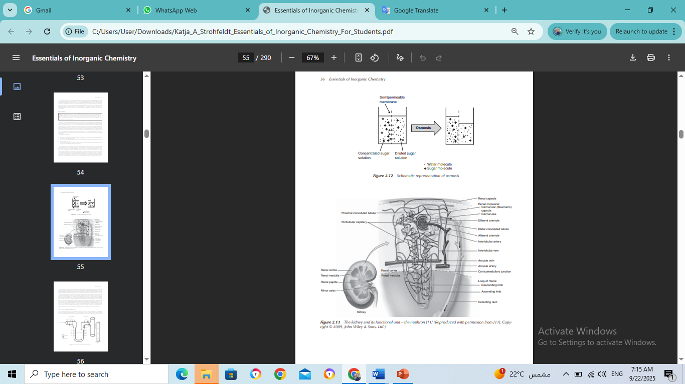
The human body uses osmosis for many processes, the excretion of urine being one of the most prominent ones.
Osmotic pressure is crucial in biology and is often described in terms of tonicity, which describes how a solution will affect a cell's volume.
Isotonic Solution: The solution outside the cell has the same osmotic pressure as the cell's cytoplasm. Water moves in and out at the same rate, and the cell size remains stable. (e.g., saline solution for intravenous drips).
Hypertonic Solution: The solution outside the cell has a higher osmotic pressure (higher solute concentration). Water flows out of the cell, causing it to shrivel (crenate).
Hypotonic Solution: The solution outside the cell has a lower osmotic pressure (lower solute concentration). Water flows into the cell, causing it to swell and potentially burst (lyse).

Slide 9
Active transport of sodium ions:
The active transport of sodium ions is essential for the functioning of neurons and the subsequent transmission of nerve impulses. This process is achieved by actively establishing a concentration gradient along the cell membrane using Na⁺/K⁺ pumps as the active units.
This active transport is responsible for the cells containing relatively high concentrations of potassium ions and low concentrations of sodium ions. The resulting electrostatic potential that is built up along the cell membrane is called the action potential and is subsequently responsible for the transmission of nerve impulses.
In summary, for each ATP molecule used, the pump exports three sodium (Na⁺) ions and imports two potassium (K⁺) ions, maintaining the crucial electrochemical gradient across the cell membrane.

Slide 10
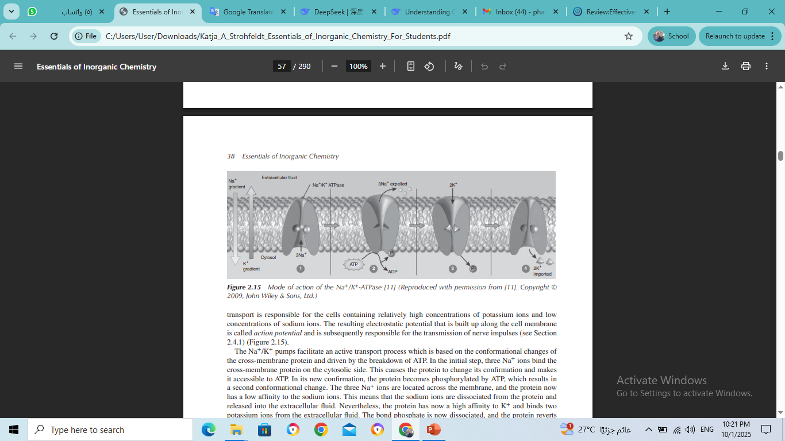
The Na⁺/K⁺ pump is an ATP-driven protein that actively transports sodium and potassium ions against their concentration gradients. In a continuous cycle:
Binding & Phosphorylation (1): Three Na⁺ ions from inside the cell bind to the pump, which then uses energy from ATP to phosphorylate itself (add a phosphate group).
Conformational Change & Na⁺ Release (2): This phosphorylation triggers a shape change, ejecting the three Na⁺ ions outside the cell.
K⁺ Binding & Dephosphorylation (3): The new shape has a high affinity for K⁺, allowing two K⁺ ions from outside to bind. This binding causes the release of the phosphate group.
Reset & K⁺ Release (4): The pump returns to its original shape, releasing the two K⁺ ions into the cell interior. The cycle is now ready to begin again.

Slide 11
Drugs, diet, and toxicity of Na⁺
Medical Uses:
  Sodium Chloride (NaCl) solutions are used intravenously to treat severe sodium depletion and dehydration, or orally for chronic, milder cases. Oral rehydration therapies often combine NaCl with other salts, as potassium chloride (KCl).
  Sodium Bicarbonate is administered orally to correct imbalances in blood plasma pH, such as in renal tubular acidosis. In this condition, the kidneys fail to properly excrete acid (H⁺ ions) or reabsorb bicarbonate (HCO₃⁻), leading to acidosis. The bicarbonate anion is the active component that neutralizes acid.
Dietary Source and Balance:
  The most common dietary source of NaCl is table salt. High salt content in food also acts as a preservative by inhibiting microbial growth.
  Maintaining the correct sodium balance is crucial. Excessive intake (hypernatraemia) is common and linked to hypertension and cardiovascular diseases. Insufficient intake (hyponatraemia), often due to illness, can cause dehydration, low blood pressure, and muscle cramps. Recommendations, such as a maximum of 6g of salt per day for adults in the UK, aim to prevent overconsumption.

Slide 12
Toxicity of Na⁺ :
Ingesting a large amount of sodium chloride (500–1000 mg per kg of body weight) can cause acute toxicity. The harmful effects primarily involve:
Gastrointestinal tract: Vomiting and ulceration.
Kidneys: Direct damage and an increased risk of kidney stone formation.
Potassium and its clinical application
Potassium (K⁺) is primarily found inside cells (95%), with a small amount (5%) in the blood plasma. This balance is critical and maintained by the Na⁺/K⁺ pump.
Hypokalaemia (Low Blood Potassium):
A serious condition caused by reduced K⁺ intake (e.g., from diarrhea/vomiting) or increased K⁺ excretion.
Symptoms include muscle weakness and ECG abnormalities.
It is a common side effect of loop diuretics and thiazides, which increase potassium loss. To counter this, potassium-sparing diuretics are often prescribed alongside them.

Slide 13
Potassium Excretion and Supplementation:
Potassium is excreted by the kidneys via filtration and secretion processes in the nephron.
Oral potassium supplements (primarily KCl) are necessary for patients on certain medications (anti-arrhythmics), with specific conditions (renal artery stenosis, heart failure), or with chronic potassium loss (e.g., from diarrhea).
Caution is required in patients with renal insufficiency, as their ability to excrete potassium is reduced, increasing the risk of overdose.
Specific Potassium Salts and Uses:
Potassium Chloride (KCl): The standard supplement, but its salty/bitter taste makes formulation difficult.
Potassium Bicarbonate: Used to treat chronic acidosis (low blood pH), but must be used carefully due to the risks of altering potassium levels.
Potassium Citrate: An over-the-counter treatment in the UK for mild urinary tract infections by increasing urine pH. It should be avoided by individuals with kidney stones, certain urinary symptoms, high blood pressure, diabetes, or renal/cardiac problems without consulting a doctor.

Slide 14


