Slide 1
Introduction to Artificial Intelligence (AI)
in Our Daily Lives & Key Applications

Slide 2
Simple Definition: The capability of machines to perform tasks that typically require human intelligence.
Key Abilities:
  Learning
  Problem-solving
  Decision-making
  Perception
The Core Driver: Data. AI systems learn by finding patterns in vast amounts of data.
"AI is the new electricity." - Andrew Ng

Slide 3
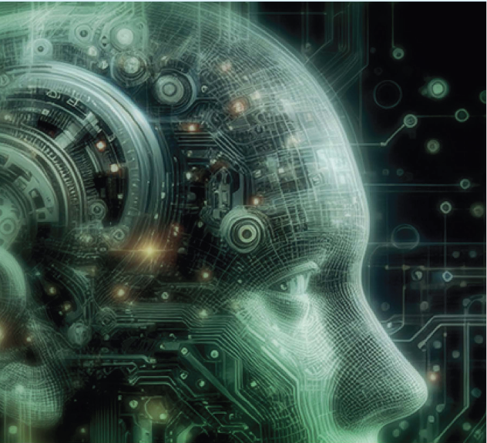

Slide 4
AI is Already Here: It's in Your Pocket
You interact with Narrow AI every day. This is AI designed for a specific task.
Virtual Assistants: Siri, Google Assistant, Alexa
  Use Natural Language Processing (NLP) to understand your voice commands.
  They learn your preferences over time to provide better answers.
Smartphone Features:
  Face ID / Facial Recognition: Uses AI to securely identify you.
  Photo Sorting: Automatically tags people and finds objects ("cat", "beach").
  Predictive Text: Suggests your next word while typing.

Slide 5
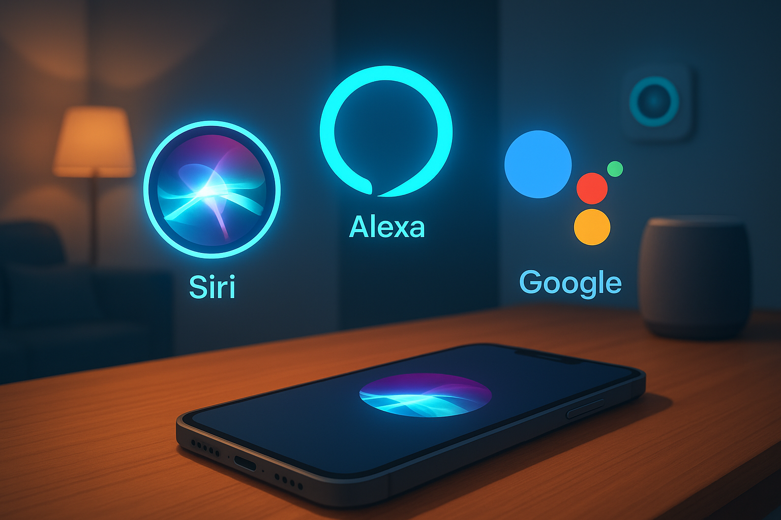

Slide 6
Let's Get Technical: How Do These Assistants Work?
(Visual: A simple flowchart: User speaks -> Speech-to-Text -> NLP processes intent -> AI formulates response -> Text-to-Speech responds)
It's a combination of several AI subfields we'll explore in this course:
Automatic Speech Recognition (ASR): Converts your sound waves to text.
Natural Language Processing (NLP): Understands the meaning and intent behind your words.
Knowledge & Reasoning: The AI accesses information and decides on the best response or action.
Text-to-Speech (TTS): Converts the text response back into spoken words.

Slide 7
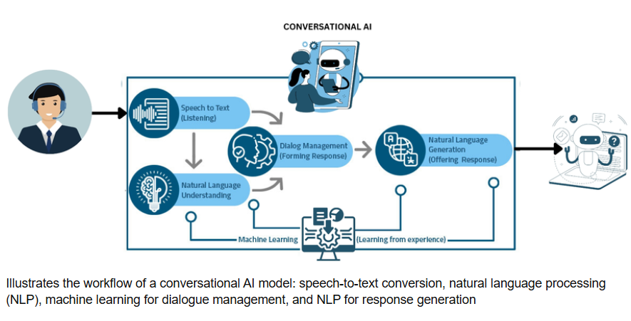

Slide 8
Application 1 - AI in Healthcare
Medical Imaging: AI algorithms can analyze X-rays, MRIs, and CT scans to detect diseases like cancer often with higher speed and accuracy than the human eye.
Personalized Medicine: AI can analyze your genetics and lifestyle to recommend personalized treatment plans and drug dosages.
Drug Discovery: AI can analyze vast molecular data to identify potential new drugs, drastically reducing development time.
Think About It: Would you trust an AI's diagnosis if it was 99.9% accurate?

Slide 10
Application 2 - AI in Finance
Algorithmic Trading: AI systems make high-frequency trades based on market data patterns, far too fast for any human.
Fraud Detection: AI monitors your transactions in real-time. If it sees a purchase that doesn't fit your profile (e.g., a luxury watch in a different country), it can flag it immediately.
Robo-Advisors: Provide automated, algorithm-driven financial planning and investment services with minimal human supervision.

Slide 11
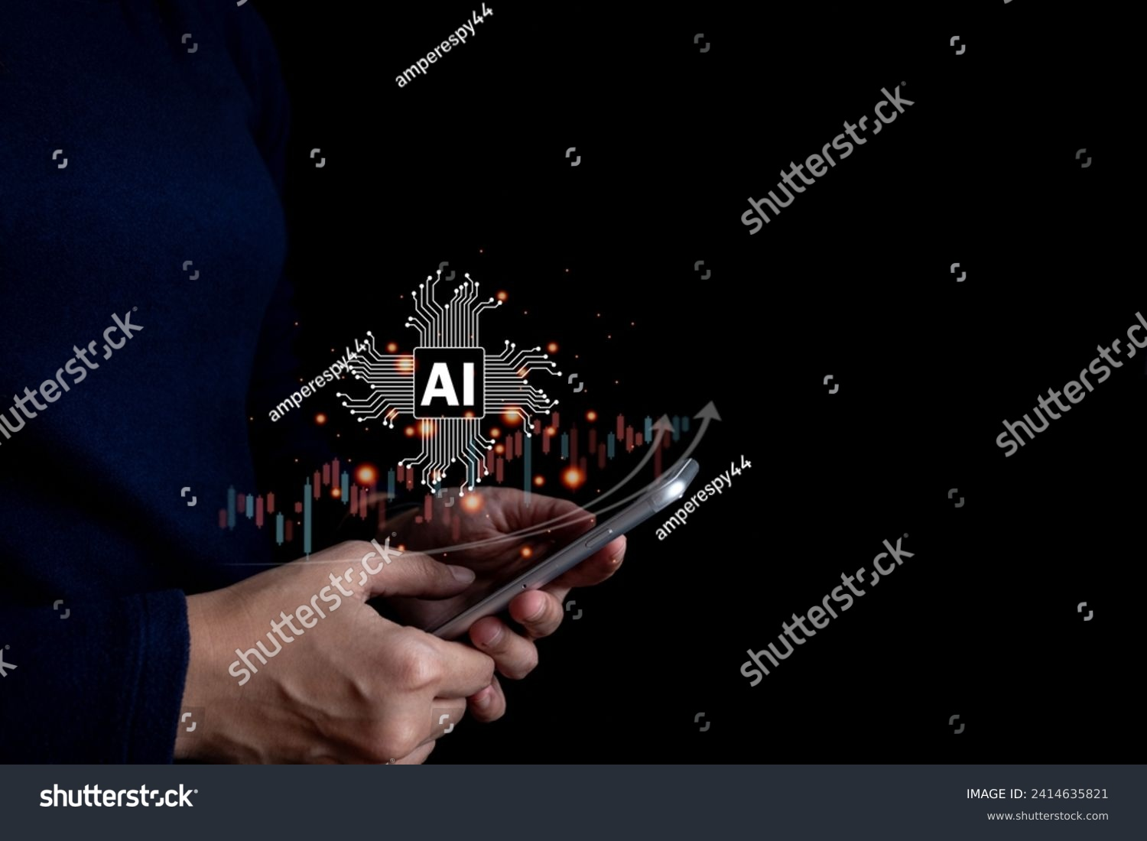

Slide 12
Application 3 - AI in Transportation
Self-Driving Cars: Use Computer Vision and sensors to "see" the road, detect obstacles, and make driving decisions.
Traffic Management: AI optimizes traffic light timings in real-time to reduce congestion in smart cities.
Ride-Sharing: Apps like Uber use AI to calculate your fare, match you with a driver, and predict your arrival time.

Slide 13
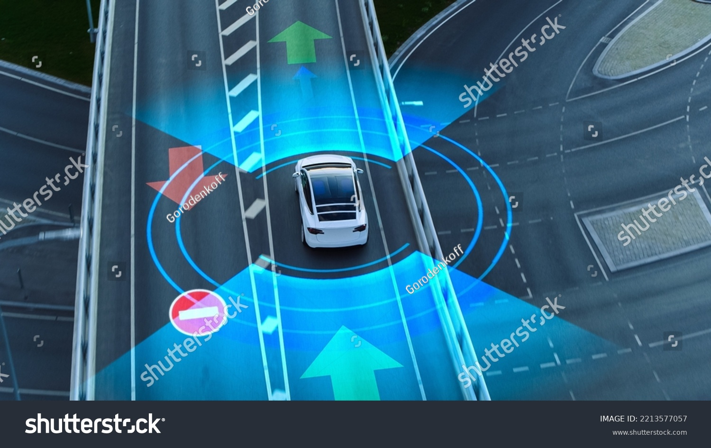

Slide 14
Application 4 - AI in Education
Personalized Learning: AI platforms adapt to each student's pace and understanding, offering extra practice in weak areas and advancing faster in strong ones.
Automated Grading: AI can grade multiple-choice and even written answers, freeing up professors for more interactive teaching.
Intelligent Tutoring Systems: Chatbots and AI tutors can provide 24/7 homework help and answer student questions.

Slide 15
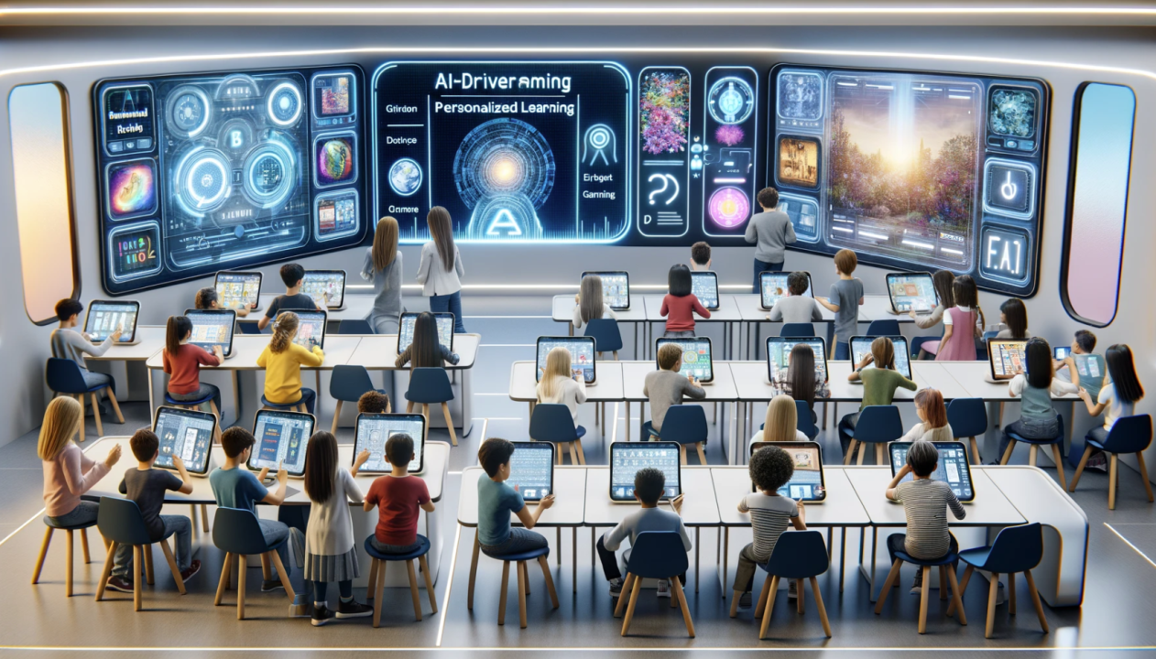

Slide 16
Application 5 - AI in Marketing & Advertising
Recommendation Systems: "Customers who bought this also bought..." – This is AI analyzing billions of user behaviors. (Think Netflix, Amazon, Spotify).
Personalized Advertising: AI uses your browsing history and demographics to show you highly targeted ads that you are more likely to click on.
Chatbots for Customer Service: AI-powered chatbots handle routine inquiries, providing instant support and reducing wait times.

Slide 17


Slide 18
A Word of Caution: Ethical Considerations
(As we embrace AI, we must be aware of the challenges:
Bias & Fairness: If AI is trained on biased data, it will make biased decisions (e.g., in hiring or lending).
Privacy: AI systems collect massive amounts of personal data. How is it stored and used?
Accountability: If a self-driving car causes an accident, who is responsible?
Job Displacement: Will AI automate my future job?
These are not just technical questions; they are societal and ethical questions that your generation will have to answer.

Slide 19
Key points
AI is not science fiction. It's a present-day technology that powers many tools we use daily.
It ranges from Narrow AI (specific tasks) to the theoretical General AI (human-level intelligence).
Its power comes from data, enabled by subfields like Machine Learning, NLP, and Computer Vision.
AI has transformative applications across Healthcare, Finance, Transportation, Education, and Marketing.
The future of AI depends on us developing it responsibly and ethically

