Slide 1
Benign Prostatic Hyperplasia

Slide 2
The Prostate Gland
Male sex gland
Size of a walnut
Helps control urine flow
Produces fluid component of semen
Produces Prostate Specific Antigen (PSA)
Notes:
2
Located in lower pelvis just below the bladder and in front of the rectum
Surrounds the urethra
prostate 4cm in diameter at broadest point
PSA is good indicator of activity of prostate
PSA tests are used to diagnose PC along with a physical examination.

Slide 3
Four Areas of the Prostate
Transition Zone
Peripheral Zone
Anterior Zone
Central Zone
Notes:
3
Prostate cancer is most likely to occur in the peripheral zone.
also known to occur in the central zone
Surrounding the prostate is the prostate capsule
When pc remains within this capsule, it is considered localized and treatable with surgery.
Once the cancer punctures the capsule and spreads outside, treatment is limited. This tumor is then labeled metastatic.

Slide 4
BPH
Generalised disease of the prostate due to hormonal derangement which leads to enlargement of the gland to cause compression of the urethra leading to symptoms

Slide 5
Causes of BPH
n
BPH is part of the natural aging process (increase in androgen receptor)
Microscopic disease started after the age of 30
20% in 40 yo men. And 50% in over 50 yo.
Over age of 85, over 90% experience symptoms due to BPH
Obesity
Dihydrotestosterone (DHT) play a role
BPH cannot be prevented
BPH can be treated
n
n
n
n
Notes:
5

Slide 6
common symptoms
Decrease in the urinary stream
Dribbling or leaking after urination
Intermittency
Hesitancy
Pain or burning during urination
Feeling that the bladder never completely empties
n
n
n
n
n
n
Notes:
6

Slide 7
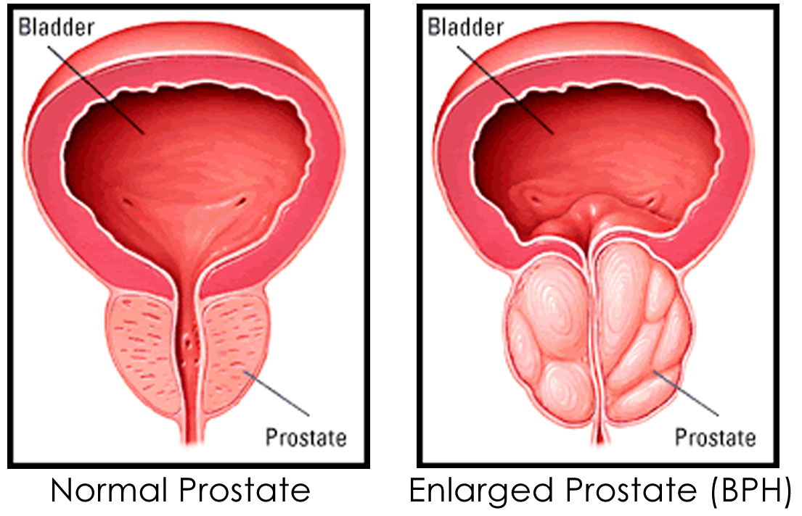
Causes of these symptoms
Prostate grows with age
Pressure on the urethra restricts urine flow
n
n
Notes:
7

Slide 8
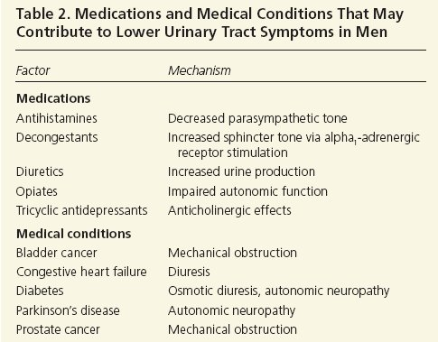
History

Slide 9
Diagnosis of BPH
Medical history
Physical examination
Prostate exam (cytoscopy)
Urinalysis
Uroflowmetry
PSA blood test (level;3-10ng/ml)
Transrectal ultrasound of prostate
Cystometry
n
n
n
n
n
n
n
n
Notes:
9

Slide 10
Physical examination
Digital rectal examination (DRE)
  to assess the size and contour of the prostate
  normal prostate volume is 20 to 30 mL
  Prostate volume predicts the response to finasteride (Proscar) therapy.
  Finasteride is more effective if the prostate volume is greater than 40 mL
  A palpable nodule suggests prostate cancer and requires biopsy.
  Abnormal sphincter tone suggests a neurological abnormality, which may contribute to urinary symptoms

Slide 11
Specialist investigations
Uroflowmetry
  max flow rate and volume of residual urine after voiding – low flow rate indicates need for (transurethral resection of the prostate)TURP
  Young men peak flow should be 25 ml/s, while less than 12 ml/s suggests outflow obstruction.
Bladder pressure studies
  pressure measurement during filling and emptying (cystometry) gives information on over/under activity of detrusor muscle and obstruction of bladder outlet.
Notes:
11

Slide 12
Assesment
A validated questionnaire using international prostate symptom scale (IPSS).
Completion gives total score of 35
  1 – 7 mild
  8 – 19 moderate
  20 – 35 severe
Response to the quality of life questionnaire strong predictor or whether intervention is necessary
Notes:
12

Slide 13
Questions
  In last month how often have you
    Had sensation of not emptying bladder completely
    Had urge to urinated < 2 hours after previously finished
    Found you stopped and started again several times
    Found it difficult to postpone urination
    Had a weak stream (compared to when aged 30)
    Had to push or strain to begin urination
    How many times did you get out of bed per night to urinate
Notes:
13

Slide 14
Scoring system
  Ask 7 questions. Answers on scale 0 – 5 depending on severity of symptoms
  For first 6 questions scores are
    Not at all = 0
    < 1 in 5 = 1
    < half the time = 2
    About half the time = 3
    > half the time = 4
    Almost always = 5
  Q7
    Never = 0, once = 1, 2x = 2, 3x = 3, 4x = 4, 5x = 5
Notes:
14

Slide 15

When should BPH be treated
BPH needs to be treated ONLY IF:
  The symptoms are severe enough to bother patient and affect the quality of life
  Renal insufficiency
  Frequent urinary tract infections
n
n
n
Notes:
15

Slide 16
Enlarged prostate
Lifestyle modification
Medication
Phytotherapy
Heat therapies
Surgical approaches
treatment options
n
n
n
n
n
Notes:
16

Slide 17
Management
Lifestyle modification
  Reduce fluid intake
  Stop diuretics if possible
  Avoid xs night time fluid intake/caffeine /alcohol
  Empty bladder before long trips/meetings
Notes:
17

Slide 18
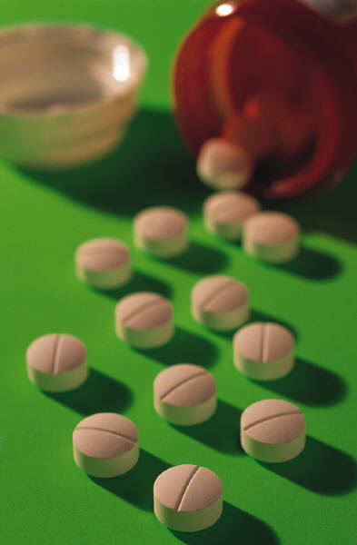
medications
n
First line of defense against bothersome urinary symptoms
  Manage the condition - don’t fix it
Two major types:
  (Alpha-1-blocker) - relax the prostate and provide a larger urethral opening (prazosin,terazosin,tamsulosin,alfazusin, indoramin)
n
n
n
  Shrink the prostate gland (5-alpha reductase inhibitor) (finasteride, & dutasteride)
n
Notes:
18
Relaxation of these muscle bundles lessens the resistance to outflow during urination.

Slide 19
medication
Benefits
Convenient
No loss of work
time
Minimal risk
Disadvantages
Expensive
  Not all are covered
Drug Interactions
Must be taken every day
n
n
n
n
n
n
n
Notes:
19
Medications address the desire we all have to find a “cure” to fix the problem. We all like a “quick and easy” solution.
They can, however, become less effective over time.
Studies have shown that people tend to become less careful about following directions regarding the dose and/or frequency of taking their medication.

Slide 20
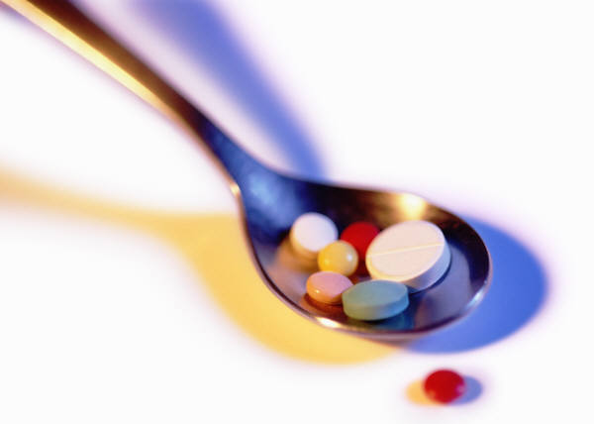
possible side effects of medications
Impotence
Dizziness
Headaches
Fatigue
Loss of sexual drive
n
n
n
n
n
Notes:
20
Relaxation of these muscle bundles lessens the resistance to outflow during urination.

Slide 21
medications
Therapeutic management
The principal treatment options are α-adrenoceptor blocking drugs, 5α-reductase inhibitors and combination therapy.
Phytotherapy is also used in the management of BPH, although the benefits remain unproven.
α-Adrenoceptor blocking drugs: In the prostate, α1-receptors predominate and mediate the contraction of the gland's smooth muscle.
At least three subtypes of this receptor exist (α1A, α1B and α1D). The α1A is thought to be the dominant receptor in the prostate
Notes:
21
Relaxation of these muscle bundles lessens the resistance to outflow during urination.

Slide 22
medications
In general, all the agents are considered to produce similar clinical improvements of LUTSs and urinary flow.
Benefits can be seen usually within the first few days of therapy and can be maintained in the long-term.
α-Adrenoceptor antagonists also have a comparable side-effect profile, which includes postural hypotension, dizziness, fatigue, headache, drowsiness, nasal congestion and ejaculatory dysfunction.
Notes:
22
Relaxation of these muscle bundles lessens the resistance to outflow during urination.

Slide 23
medications
Prazosin: was the first α1-blocker used to relieve the symptoms of BPH but it lacks relative selectivity for α1A receptors and has been associated with many adverse affects such as drowsiness, weakness, headache and postural hypotension (especially after the first dose).
Terazosin: Efficacy is dose dependent and dose titration is necessary, as terazosin can cause postural hypotension.
Adverse effects, although generally mild, occur more frequently than with other α1-adrenoceptor antagonists, resulting in up to a fourfold increase in treatment discontinuation.
Notes:
23
Relaxation of these muscle bundles lessens the resistance to outflow during urination.

Slide 24
medications
Doxazosin: has a long half-life of about 22h, which allows for once-daily dosing.
When starting treatment, dose titration is recommended to limit postural hypotension.
Indoramin: is readily absorbed from the gastro-intestinal tract and undergoes extensive first-pass hepatic metabolism.
Its hypotensive effect may be increased by diuretics and other anti-hypertensive agents.
Alcohol has been reported to increase the bioavailability and sedative effects of indoramin.
Notes:
24
Relaxation of these muscle bundles lessens the resistance to outflow during urination.

Slide 25
medications
Tamsulosin: is a selective inhibitor of the α 1A adrenoceptor.
It has an elimination half-life of about 13h and is available as a prolonged release formulation that allows once-daily dosing.
There is no requirement to titrate the dose upward when initiating treatment
Alfuzosin: displays a higher selectivity for the prostate compared with tamsulosin or doxazosin.
It has a half-life of 5h, but it is available as a once-daily formulation.
Alfuzosin has the least effect on ejaculatory function.
should not be co-administered with potent inhibitors of cytochrome P450 3A4 such as itraconazole, ketoconazole and ritonavir, since this can lead to a several fold increase to exposure in alfuzosin.
Notes:
25
Relaxation of these muscle bundles lessens the resistance to outflow during urination.

Slide 26
medications
5-alpha-Reductase inhibitors
The primary androgen responsible for the development and progression of BPH is DHT.
There are two isoenzymes of 5α-reductase: type 1 is found in liver, skin and hair; type 2 is predominant in genital tissue, including the prostate.
5α-Reductase inhibitors downregulate prostate growth by blocking the conversion of testosterone to the more potent DHT.
Finasteride and Dutasteride: both have been shown to reduce prostate volume, to improve symptom scores and flow rates, and reduce the incidence of complications such as acute urinary retention (AUR) and the need for surgical intervention to treat BPH.
Notes:
26
Relaxation of these muscle bundles lessens the resistance to outflow during urination.

Slide 27
medications
Finasteride is a type 2, 5α-reductase inhibitor that can reduce prostate size by about 30%, improve symptom scores and increase urinary flow.
Those most likely to benefit are men with a prostate larger than 40mL.
Side effects include decreased libido, impotence, reduced ejaculatory volume and, less commonly, gynaecomastia and breast tenderness.
Notes:
27
Relaxation of these muscle bundles lessens the resistance to outflow during urination.

Slide 28
medications
Dutasteride inhibits both type 1 and type 2 isoenzymes of 5α-reductase.
This double inhibition can reduce serum dihydotestosterone levels by about 90%.
Dutasteride decreases prostate volume by up to 26% and reduces the risk of progression to serious complications of BPH.
Notes:
28
Relaxation of these muscle bundles lessens the resistance to outflow during urination.

Slide 29
medications
Phytotherapy
A number of plant extracts are reputed to be effective in the management of symptoms of BPH. They include saw palmetto berry (Serenoa repens), African plum tree (Pygeum africanum), stinging nettle (Urtica dioica) and rye grass pollen.
Their mechanism of action remains unclear but may exert an anti-inflammatory effect by inhibition of prostanoid formation and perhaps produce some degree of inhibition of 5α-reductase.
Notes:
29
Relaxation of these muscle bundles lessens the resistance to outflow during urination.

Slide 30
heat therapies
Destroy prostate tissue with heat
Tissue is left in the body and is expelled over time (sloughing)
  Transurethral Microwave Therapy (TUMT)
  Transurethral Needle Ablation (TUNA®)
  Interstitial Laser Coagulation (ILC)
  Water Induced Thermotherapy (WIT)
n
n
n
n
n
n
Notes:
30

Slide 31
heat therapies
Benefits
Office treatments
Local anesthesia
Minimally invasive
  Reduced risk of complications as compared to invasive surgical “TURP”
Disadvantages
Some symptoms will persist for up to 3 months
Cannot predict who will respond
May require prolonged catheterization
n
n
n
n
n
n
n
Notes:
31
Medications address the desire we all have to find a “cure” to fix the problem. We all like a “quick and easy” solution.
They can, however, become less effective over time.
Studies have shown that people tend to become less careful about following directions regarding the dose and/or frequency of taking their medication.

Slide 32
possible side effects of
heat therapies
Urinary Tract Infection
Impotence
Incontinence
n
n
n
Notes:
32
Medications address the desire we all have to find a “cure” to fix the problem. We all like a “quick and easy” solution.
They can, however, become less effective over time.
Studies have shown that people tend to become less careful about following directions regarding the dose and/or frequency of taking their medication.

Slide 33
surgical treatment
Notes:
33
Until recently, the only option we could offer patients for treatment of their symptoms was either an open abdominal surgical procedure, or a trans-urethral resection of the prostate.

Slide 34
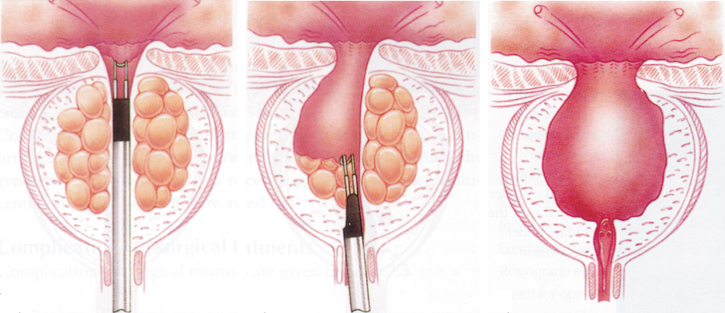
TURP
(transurethral resection of the prostate)
“Gold Standard” of care for BPH
Uses an electrical “knife” to surgically cut and remove excess prostate tissue
Effective in relieving symptoms and restoring urine flow
n
n
n
Notes:
34

Slide 35
the “gold standard”- TURP
Benefits
Widely available
Effective
Long lasting
Disadvantages
Greater risk of side effects and complications
1-4 days hospital stay
1-3 days catheter
4-6 week recovery
n
n
n
n
n
n
n
Notes:
35

Slide 36
possible side effects of
TURP
Impotence
Incontinence
Bleeding
UTI
Electrolyte imbalance (TUR Syndrome)
  May result in ICU (Intensive Care Unit)
n
n
n
n
n
n
Notes:
36

Slide 37
Open prostectomy
Involve surgical removal of an enlarged prostate and done under general or spinal anaesthesia.
Infrequently used, and restricted to very enlarged prostate glands, and for individuals with bladder stone where TURP is not possible.
Required longer hospital stay & associated with higher incidence of bleeding and other complications.

