Slide 1
Understanding network threats
Network threats are dangers that target computer networks.
Data threats There are a number of security risks to data held on a computer/smartphone or data being transferred around networks.
risks:
» hacking
» phishing
» vishing
» smishing
» pharming
» viruses
» malware
» card fraud.

Slide 2
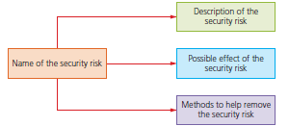
Each security risk together with its description, possible effects and risk mitigation will be set out as shown

Slide 3
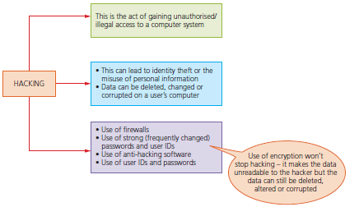
Hacking

Slide 4
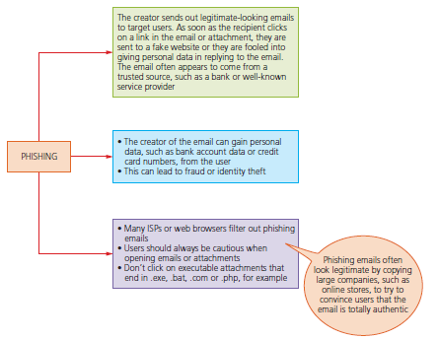
Phishing, smishing, vishing

Slide 5
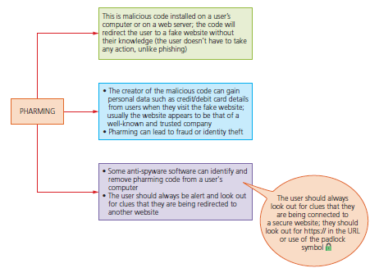
Pharming

Slide 6
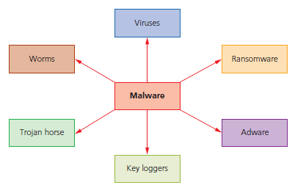
Viruses and malware
Malware is one of the biggest risks to the integrity and security of data on a computer system. Many software applications, such as anti-virus, are capable of identifying and removing most of the forms of malware. There are many forms of malware; this section details just a selection of those forms.

Slide 7
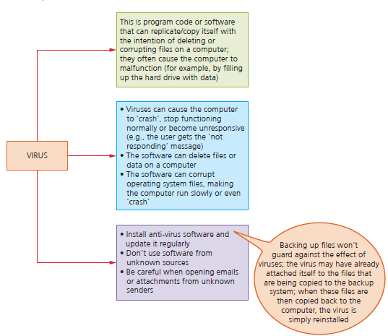
Viruses are programs or program code that replicates (copies itself) with the intention of deleting or corrupting files and causing the computer to malfunction (for example, by deleting .exe files, filling up the hard drive with ‘useless’ data, and so on).
Viruses need an active host program on the target computer or an operating system that has already been infected, before they can actually run and cause harm (that is, they need to be executed by some trigger to start causing any damage).

Slide 8
Worms are a type of stand-alone virus that can self-replicate. Their intention is to spread to other computers and corrupt whole networks; unlike viruses, they donot need an active host program to be opened in order to do any damage – they remain inside applications, which allows them to move throughout networks.
In fact, worms replicate without targeting and infecting specific files on acomputer; they rely on security failures within networks to permit them to spread unhindered.

Slide 9
Trojan horse
A Trojan horse is a malicious program which is often disguised as some legitimate software, but contains malicious instructions embedded within it. A Trojan horse replaces all or part of the legitimate software with the intent of carrying out some harm to the user’s computer system.
They need to be executed by the end-user and therefore usually arrive as an email attachment or are downloaded from an infected website. For example, they could be transmitted via a fake anti-virus program that pops up on the user’s screen claiming their computer is infected and action needs to be taken. The user will be invited to run fake anti-virus as part of a free trial. Once the user does this, the damage is done.
Once installed on the user’s computer, the Trojan horse will give cyber criminals
access to personal information on your computers, such as IP addresses, passwords and other personal data. Spyware (including key logging software) and ransomware are often installed on a user’s computer via Trojan horse malware.
Because they rely on tricking end-users, firewalls and other security systems are often useless because the user can overrule them and initiate the running of the malware.

Slide 10
Ransomware = “malicious software that locks or encrypts files and demands payment to unlock them.”
Adware is software that automatically displays or downloads advertisements, often slowing down the device or tracking user behavior.

Slide 11
Card fraud
Card fraud is the illegal use of a credit or debit card. This can be due to:
» shoulder surfing when using the card on any device that requires keyboard entries (for example, an ATM or a handheld POS terminal)
» card cloning
» key logging software.

Slide 12
Shoulder surfing
Shoulder surfing is a form of data theft where criminals steal personal information from a victim when they are using a cash dispensing machine (for example, an automatic teller machine – ATM), when paying for goods/services using a handheld point-of-sale (POS) device or even when paying using a smartphone. Examples of shoulder surfing includes:
» somebody watching you key in data, such as your PIN; this can be something simple like just looking over your shoulder or somebody watching from a distance using binoculars or using a video camera
» somebody listening in when you are giving credit or debit card details over the phone; by simply listening in, a criminal will gain very important data about your card
» some of the more sophisticated examples of shoulder surfing include the use of tiny digital cameras (placed near to the keyboard on the ATM or other device) which take high-quality images of the keys being pressed.
There are ways to overcome this security risk:
» When using ATMs shield the keyboard with your other hand so that no-one can see which keys you are pressing (many ATMs also have a small mirror built into them so you can see if somebody is standing right behind you).
» When using a mobile device (such as a smartphone, tablet or laptop) never key in data in a public place; nor should you speak card details into your smartphone in a public place.
» If you are using a public place, make sure you are nowhere near security cameras which could record passwords or other data about you; it is also a good idea to use biometrics (touch ID or face ID) on your smartphone or tablet, because these cannot be duplicated by simply watching you.

Slide 13
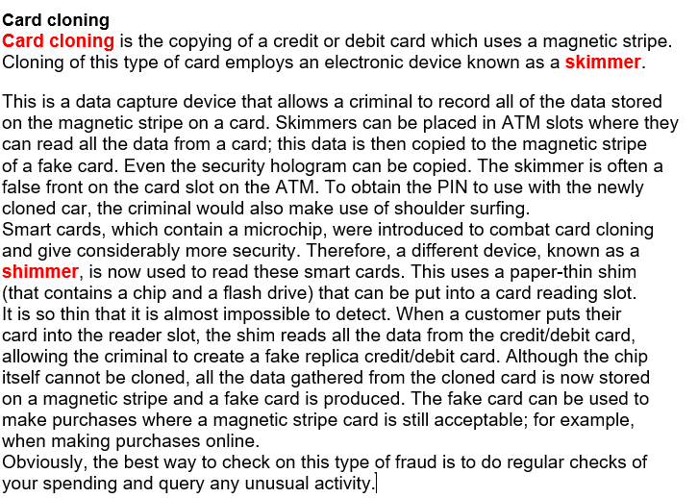

Slide 14
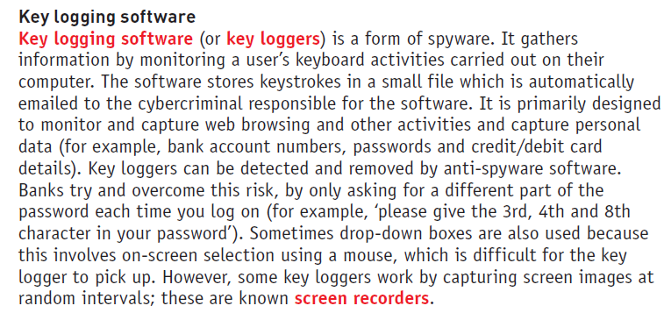

Slide 15
Summary of types of malware
Viruses Programs or program code that can replicate/copy itself with the intention of deleting or corrupting files, or cause the computer to malfunction; they need an active host program on the target computer or an operating system that has already been infected before they can run
Worms This is a type of stand-alone virus that can replicate itself with the intention of spreading to other computers; often uses networks to search out computers with weak security which are prone to such attacks
Trojan horses These are malicious programs often disguised as legitimate software; they replace all or part of the legitimate software with the intent of carrying out some harm to the user’s computer system
Spyware Software that gathers information by monitoring, for example, all the activity on a user’s computer; the gathered information is then sent back to the person who sent the software (sometimes they monitor key presses, which is referred to as key logging software)
Adware Software that floods a user’s computer with unwanted advertising; usually in the form of pop-ups, but can frequently appear in the browser address window redirecting the browser to a fake website which contains the promotional adverts
Ransomware Programs that encrypt the data on a user’s computer; a decryption key is sent back to the user once they pay a sum of money (a ransom); they are often sent via a Trojan horse or by social engineering

Slide 16
Network Troubleshooting
Trace route (tracert)
A command-line tool that shows the series of routers (“hops”) between sender and destination.
Useful to find where the connection fails.
MAC addresses in troubleshooting
Since MAC addresses are permanent, they help network admins locate which device sent/received a packet.
Understanding device behaviour
Hub: sends packets to all devices → congestion if overloaded.
Switch: forwards only to correct device → easier to trace.
Router: connects networks → if routing table fails, packets can’t reach destination.
Common checks
Check cables and connectors.
Verify IP settings.
Restart devices/servers.

