Slide 1
Basic network components
NIC (Network Interface Card)
-onnects a computer to the network medium (cable or wireless).
- Converts data from binary to electrical/radio signals.
- Every NIC has a permanent MAC address.

Slide 2
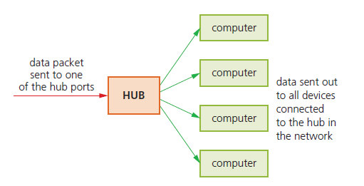
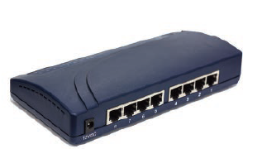
Hubs
Hubs are hardware devices that can have a number of other devices connected to them. They are used
primarily to connect devices together to form a local area network (LAN), often in the same building.
A hub will take a data packet received at one of its ports and broadcast it to every device connected to it.
Because data packets are delivered to every device on the network:
*hubs are not very secure because every device will receive every data packet
* there will be unnecessary traffic on the network, which results in reduced bandwidth.

Slide 3
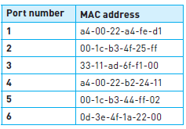
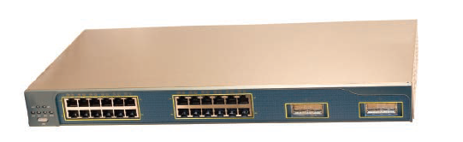
Switches are ‘intelligent’ versions of hubs. As with hubs, they connect
a number of devices together to form a LAN. However, unlike a hub, a
switch stores the MAC addresses of all devices on the network.
Each port on the switch connected to a device will have a matching
MAC address (called a look-up table) as
Using the look-up table, a switch matches the MAC address of an incoming data packet arriving at one of its ports, and directs it to the correct device. None of the other devices will see this data packet. Thus, if a data packet arrives at port 2, and the MAC address in the data packet is a4-00-22-b2-24-11, then the switch will connect the data packet to port 4 only.
Consequently, switches are more secure than hubs (because only the intended device is sent the data) and do not waste bandwidth (because network traffic is reduced).
In conclusion, hubs and switches are used to exchange data within their own local area networks. They are unable to exchange data with outside networks (such as the internet). To exchange data outside their own LAN, a device needs to be able to read an IP address. Therefore, we need another device to allow communication with external networks.
In summary:
» both a hub and a switch are used to connect devices in a LAN
» hubs send data packets to every device on the network; whereas switches
send data packets to a specific device only
» security is lower with hubs than with switches
» a switch uses a look-up table to determine the destination device
» switches use MAC addresses to locate the destination device.

Slide 4
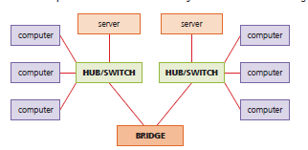
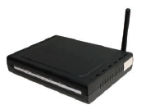
Bridges are devices that connect one LAN to another LAN that uses the same protocol (communication rules). They are often used to connect together different parts of a LAN so that they can function as a single LAN.
Unlike routers, bridges cannot communicate with other external etworks, such as the internet.

Slide 5
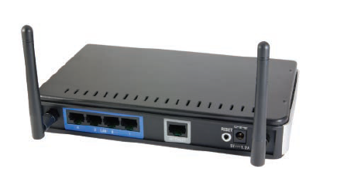
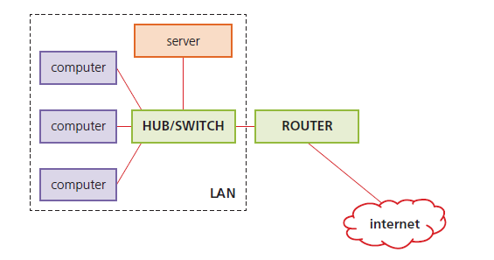
Routers are used to route data packets from one network to another network, based on IP addresses. It can do this because each router has its own IP address. Routers are used to join a LAN to the internet.
address and determines whether the data packet is meant for its own network or for another, external network. If the data packet is meant for its own network, then the data packet is routed to the local switch or hub. Otherwise, the data packet is transmitted to a different router (and therefore to an external network).
Routers know where to send data packets by consulting a routing table (stored on the router’s RAM). The routing table will contain information about the router’s immediate network (such as computer addresses) and information about other routers in its immediate vicinity. When a data packet reaches a router, it examines the IP address. Because the routing table contains computer addresses of all the computers/devices on its network, it will be able to work out that the data packet is intended for a computer on its network. Routers however, do not store the MAC addresses of devices (only IP addresses of all computers and devices are stored). The router does not need the MAC address because the data packet will be sent by the router to the switch on the recipient local network. The switch can then use its look-up table to send the data packet to the correct device.

Slide 6
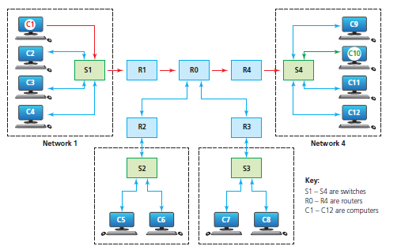
Connects different networks (e.g., LAN to WAN).
Uses routing tables to decide the best path for packets.
Reads IP addresses in packet headers to determine the route.
Consumer routers often combine router + switch + wireless AP.

Slide 7
Network Security Basics
Passwords are used in many instances when accessing the internet. For example:
» when accessing your email account
» when carrying out online banking
» accessing social networking sites.
There are many more instances when you might need to type in a password and,in many cases, a user ID. It is important that passwords are protected. Some
ways of doing this are described below:
» Run anti-spyware software to make sure that your passwords are not being
relayed back to whoever put the spyware on your computer
» Change passwords on a regular basis in case it has come into the possession of
another user illegally or accidentally.
» Passwords should not be easy to crack (e.g. your favorite colour, name of a
pet or favourite rock group); passwords are grouped as either strong (hard to
crack or guess) or weak (relatively easy to crack or guess).
» Strong passwords should contain:
– at least one capital letter
– at least one numerical value
– at least one other keyboard character (such as @, *, & etc.).
An example of a strong password is: Sy12@#TT90kj=0
An example of a weak password is: GREEN1

Slide 8
Password Authentication Methods (Summary)
Single-Factor Authentication (SFA)
  Uses only a password or PIN.
  Easiest to implement, but least secure.
Two-Factor Authentication (2FA)
  Password + one additional factor (e.g., a code sent to a phone or an authenticator app).
  Stronger security since it combines something you know with something you have.
Multi-Factor Authentication (MFA)
  Password + two or more additional factors (e.g., password + phone code + fingerprint).
  Provides the highest security level.

Slide 9
What is a firewall?
A firewall is either hardware or software placed between a user’s computer (or private network) and an external network (such as the Internet).
It acts as a barrier that checks data entering or leaving the system.
- Functions of a firewall :
Examines traffic entering and leaving the computer/network.
Checks data against a set of security rules.
For example: block data from a specific IP address, or prevent access to certain websites.
Blocks traffic that does not meet the criteria.
Keeps a log of traffic to allow later inspection (useful to detect hacking attempts).
Warns the user if traffic is suspicious.
- Benefits of a firewall:
Helps to prevent hackers gaining access to a computer or network.
Can stop viruses or worms from entering through network connections.
Gives the user or administrator control over which applications can access the internet.
📌 Limitations (also noted):
Cannot stop individuals using USB devices or infected files already on the computer.
Needs to be regularly updated to stay effective.

Slide 10
