Slide 1
What is a network?
Definition:
A network is two or more devices connected so they can exchange data and share resources
(files, printers, internet access, services). Networks range from a simple home setup (router + a few devices)
to global systems (the Internet).
Why use networks?
Resource sharing (printers, storage, software).
Communication (email, messaging, VoIP).
Centralised storage and backups.
Remote services (web, cloud apps).
Scalability and management (one admin can manage many devices).
Key terms
NIC (Network Interface Card): hardware that connects a device to a network (wired or wireless).
MAC address: physical hardware address assigned to NIC (e.g. 00:1C:B3:4F:25:FF). It’s unique per interface.
IP address: logical address used to route packets across networks (IPv4 like 192.168.1.10, IPv6 like 2001:db8::1).
Packet: the unit of data sent across networks. A packet has a header
(source/destination IP, protocol, seq. number, checksum) and payload (data).

Slide 2
    Common network devices and terms
    We will begin this section by defining four important terms you will often come across in this chapter:
network interface card (NIC)
media access control (MAC) address
internet protocol (IP) address
data packet.

Slide 3
Network interface card (NIC)
-A network interface card (NIC) is needed to allow a device to connect to a network. An NIC turns binary data into an electrical signal that allows access to a network. The NIC is usually integrated into the motherboard on most modern computers.
-Each NIC is given a unique hardwired (or hard-coded) media access control (MAC) address at the manufacturing stage. When installed in a device, this uniquely identifies that device.
-Wireless network interface cards (WNICs) are the same as NICs in that they are used to connect devices to the internet or other networks. However, they use wireless connectivity,
-media access control (MAC) address
-The media access control (MAC) address is a number which uniquely identifies a device when it is connected to a network. The MAC address is made up of 48 bitS which are shown as six groups of hexadecimal digits with the general format:
NN - NN - NN - DD - DD - DD
manufacturer's code devlce serial number

Slide 4
Internet protocol (IP) addresses
Whenever a computer connects to the internet it is given an internet protocol (IP) address. This is usually assigned to the computer by the internet service provider (ISP). Because the operation of the internet is based on a set of protocols (rules), it is necessary to supply an IP address. Internet protocols define the rules that must be agreed by senders and receivers of data communicating through the internet. An IP address essentially identifies the location of a device on a network.
This means that if you are using your laptop at home, it Will have been given an IP address when it connected to the internet. If you now take your laptop to a coffee shop, and log into the internet again, it will be assigned a new IP address.
Unlike the MAC address which remains constant, the IP address changes each time you log in at different locations.
There are two versions of IP: IPv4 and IPv6. IPv4 is based on 32 bits and the address is written as four groups of eight bits (shown in decimal format); for example:
Because there are now so many devices connected to the internet, and this number is growing, in the future 32 bits will no longer be enough to give each of them a unique address. Therefore, a newer version called IPv6 is now being used. This uses a 128-bit address, whiCh take the form of eight groups of hex digits; for example:
254.25.28.77
A8FB:7A88:FFF0:0FFF:3D21:2085:66FB:FOFA

Slide 5
Data packets
Data is moved around networks in the form of data packets. Whenever a user sends some data, it is split up into a number of packets and each packet is transmitted separately. Packets of data will usually have a header which contains: "the sender's IP address" & "the receiver's IP addres"
the sequence/identity number of the packet (this is to ensure that all the packets can be reassembled into the correct order once they reach the destination)
the packet size (this is to ensure the receiving station can check if all of the packets have arrived intact)
number of data packets make up the whole message.
When a router (see later) receives a packet of data, it checks the destination IP address against the stored routing table, which allows the router to determine the packet's next step in the path. A data packet will pass through a number of routers before it reaches its final destination. All the information in the data packet headers allows the data packets to be reassembled in their correct order, according to the sequence/identity number, by the receiving station.

Slide 6
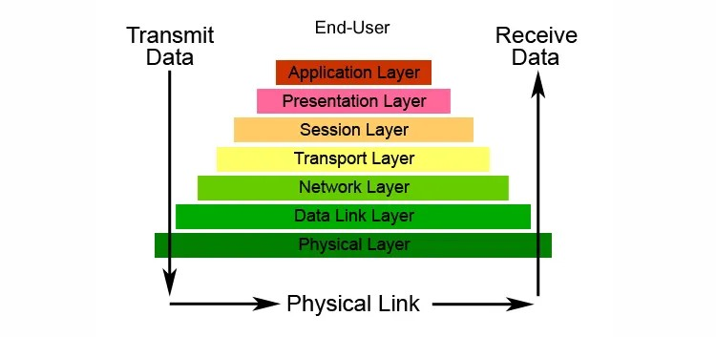
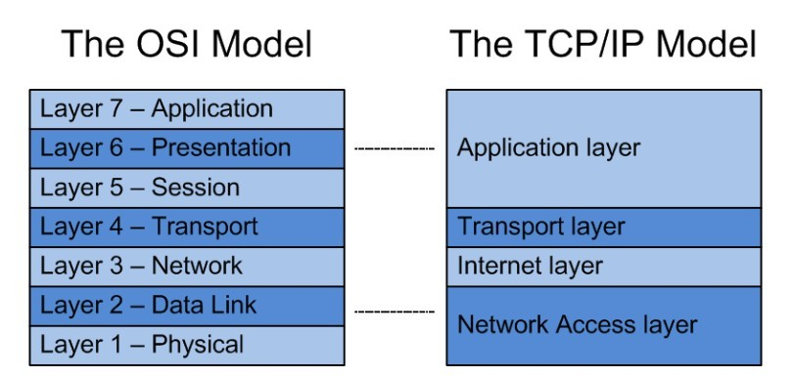
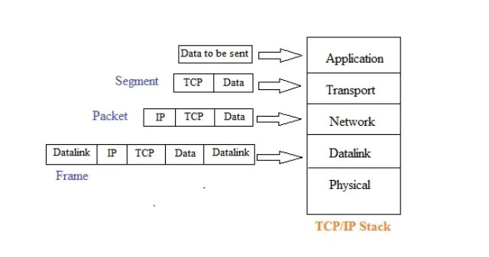
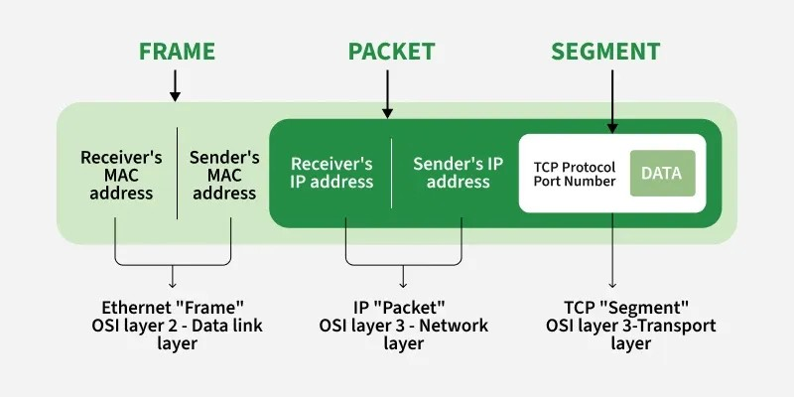

Slide 7
Types of Networks - LAN , WLAN & WAN
This section will cover the following types of network:
local area network (LAN)
wireless local area network (WLAN)
wide area network (WAN).
1. Locaí area network (LAN)
Local area networks (LANs) are usually within one building or geographically near each other. A typical LAN will consist of a number of computers and devices (for example, printers) which will be connected to hubs or switches. One of the hubs Or SWitches will usually be connected to a router to allow the LAN to connect to external networks, such as the internet.
2. Wireless local area network (WLAN)
Wireless LANs (WLANS) are similar to LANs, but there are no wires or cables. In other words, they provide wireless network communications over fairly short distances using radio or infrared signals instead of using cables.
Devices, known as access points (APs), are connected into a wired network at fixed locations. Because of the limited range, most commercial LANs (for example, a college campus or an airport) need several APs to permit uninterrupted wireless communications.

Slide 8
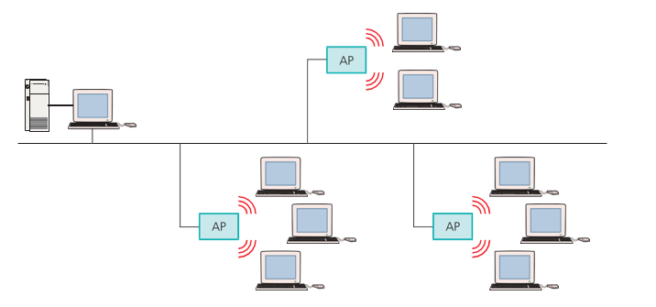
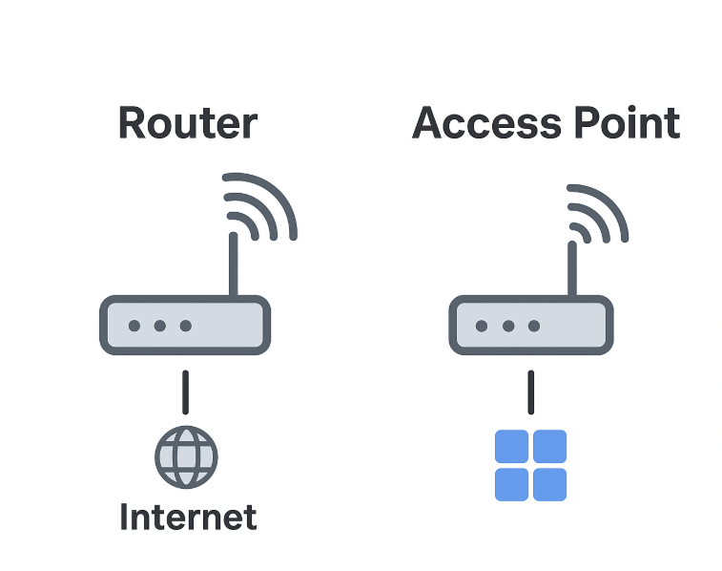
10 Wireless LAN set- up

Slide 9
3. Wide area network (WAN)
Wide area networks (WANs) are used where computers or networks are situated a long distance from each other geographically (for example, in a different city or country). As mentioned earlier, if a number of LANs are joined together using a router, then they can form a WAN. The network of ATMs (automated teller machines) used by banks is one of the most common examples of the use of a WAN.
Because of the long distances between devices, WANs usually make use of some public communications network (such as telephone lines or satellites), but they can use dedicated or leased communication lines, which can be less expensive and also more secure (less risk of hacking, for example).

Slide 10










A typical WAN will consist of end systems and intermediate systems (as shown in Figure).
In Figure 1, 3, 7 and 10 are known as end systems and the remainder are known as intermediate systems. The distance between each system can be considerable, especially if the WAN is run by a multinational company.
4
5

