Slide 1
BIOPHARMACEUTICS
PRESENTED BY:
ASSISTANT PROF. ANAS TARIK NAFEI
LECTURER ZEINA DAWOOD
LECTURER NORA ZAWAR
LECTURER SURA ZUHAIR

Slide 2
THE PRACTICAL COURSE WILL COVER THE FOLLOWING EXPERIMENTS….
Exp .1 Construction Of Calibration Curve Of Salicylic Acid With The Application Of Statistics
Exp .2 In Vitro Evaluation Of Antacid
Exp .3 In Vitro Evaluation Of Bulk Forming Laxatives
Exp .4 Hydrolysis Of Acetyl Salicylic Acid Solution In Sorensen Phosphate Buffer At pH 8
Exp.5 pH And Solvent Effect On Drug Solubility
Exp.6 In Vitro Dissolution Of Per-oral Tablet

Slide 3
Introduction For Biopharmaceutics And Pharmacokinetics
Biopharmaceutics : The study of Formulation influence on The Therapeutic Activity of Drug products
Pharmacokinetics : Deal With The Mathematical Description of Biological Processes which Affect The Time Course of Absorption and Fate of Drug In The Body (Effect of drug on body) and which are themselves Affected By Drugs (pharmacodynamics).

Slide 4
BY KINETIC WE LEARN ABOUT :
Rate Of Absorption
Rate Of Elimination Of A Drug
Calculate The Half Life Of A Drug In The Body
So We Can Predict What Will Be The Duration Of Correct Dosage Regimen For Maintaining A Therapeutic Level

Slide 5
During The Practical Course Certain Dosage Form Will Be Evaluated In Vitro (Means Outside The Body In The Lab )
In Vivo (Means Inside The Body )

Slide 6
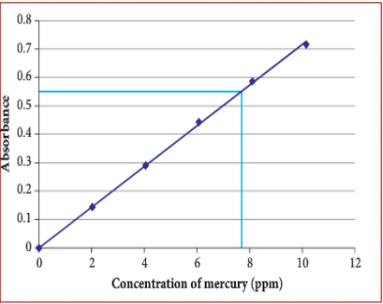
Calibration curve:
• It is the curve prepared from
a series of standard solution
• It used as a reference curve to obtain the concentration of
unknown sample of the same drug
• X axis s the conc. of sample
• Y axis is the absorbance

Slide 7
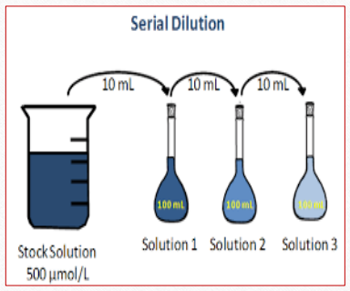
Stock solution:
Solution of known and high conc. from which we prepare standard solution.
Solution of known conc. Prepared from stock solution using dilution equation:
C1*V1=C2*V2

Slide 8
Blank solution:
Its the solution which contain all the constituents of the sample except the active ingredient which is required to be measured

Slide 9
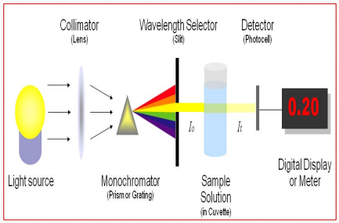
SPECTROPHOTOMETRY
It is a method to measure how much a chemical substance absorbs light
• The basic principle is that each compound absorbs or transmits light over a certain range of wavelength.
• In our work usually, the analysis concerned with the absorbed amount of light

Slide 10
SPECTROPHOTOMETRY
Depending on the range of wavelength of light source, it can be classified into two different types:
1. UV-visible spectrophotometer:
• uses light over the ultraviolet range (185 - 400 nm) and
Visible range (400 - 700 nm) of electromagnetic radiation spectrum.
2. IR spectrophotometer:
uses light over the infrared range (700 - 15000 nm) of electromagnetic radiation spectrum

Slide 11
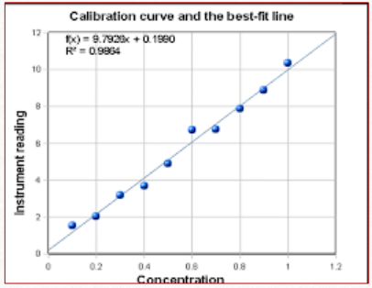
METHODS TO OBTAIN THE UNKNOWN CONC.
1. Curve fitting method:
To fit a straight line among
scattered points
Not reliable

Slide 12
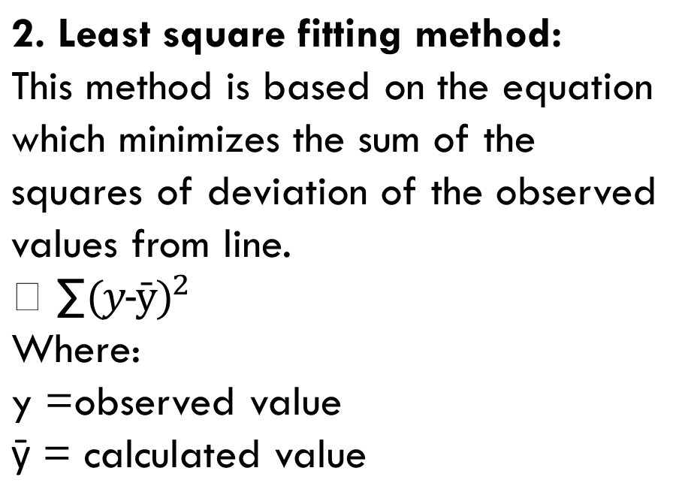
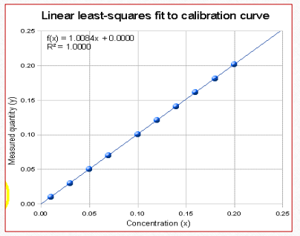
Ý: Represents error (either positive or negative) or residual
∑: sum squared errors

Slide 13
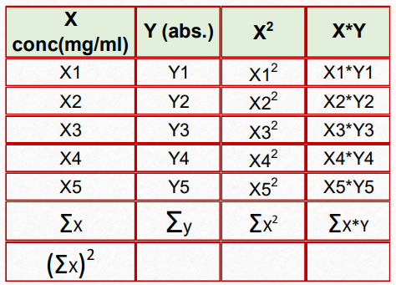
Methods to obtain the unknown conc.
2. Least square fitting method:

Slide 14
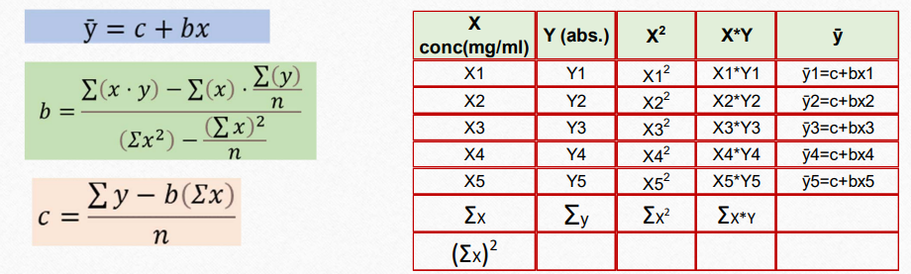
From these variables using the above equations we can obtain c & b, then by substitute each X value we can get ȳ ( calculated value)
c= intercept of the least square line with the ordinate.
b= slope of the least square line.

Slide 15
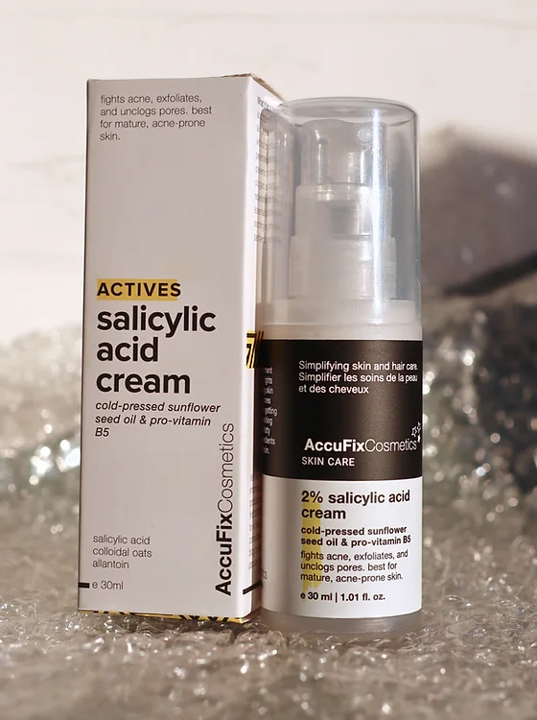
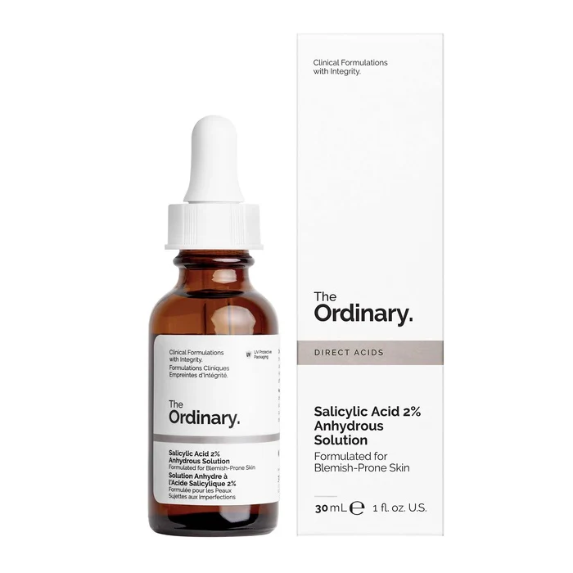
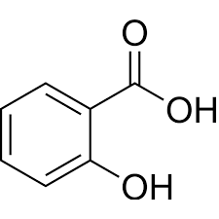
CALIBRATION CURVE OF SALICYLIC ACID

Slide 16
SALICYLIC ACID ACTIVITY AND SOLUBILITY
* Activity: Salicylic acid topical is used to treat many skin disorders, such as acne, dandruff, psoriasis, corns, common warts, and plantar warts, depending on the dosage form and strength of the preparation.
* Solubility: Due to its lipophilic nature, its solubility in water is very poor i.e., 1.8 g/L at room temp.
Salicylic acid is soluble in organic solvents like carbon tetrachloride, benzene, propanol, ethanol and acetone.

Slide 17
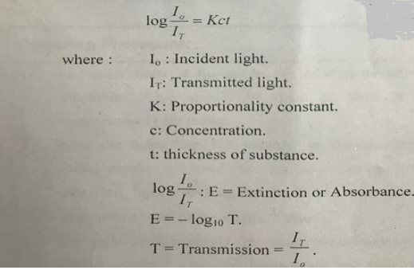
The fundamental relationship Used in spectrophotometry is Beer and lambert laws in combination:

Slide 18
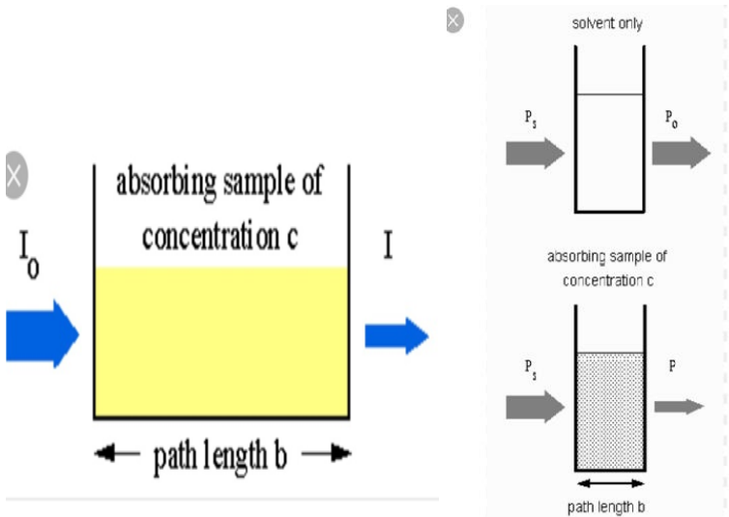

Slide 19
WHAT IS THE AIM OF EXPERIMENT
The aim is to prepare a calibration curve of salicylic acid from a series of standard solutions why?
 to use it as a reference curve to obtain the concentration of unknown sample of the same drug .

Slide 20
PROCEDURE AND CALCULATIONS:
 1. prepare 250 ml of stock solution of sodium
salicylate containing equivalent of 200 mg
salicylic acid /100 ml
 Why sodium salicylate ?
Note : sodium salicylate is readily soluble in cold water , so it is used to prepare the stock solution of sodium salicylate after calculating its equivalent content of the acid .
 while salicylic acid is sparingly soluble in cold water
(1 part in 550 parts of water ), but more soluble in hot
water (1part acid in 15 parts of boiling water ), from
which it can be recrystallized

Slide 21
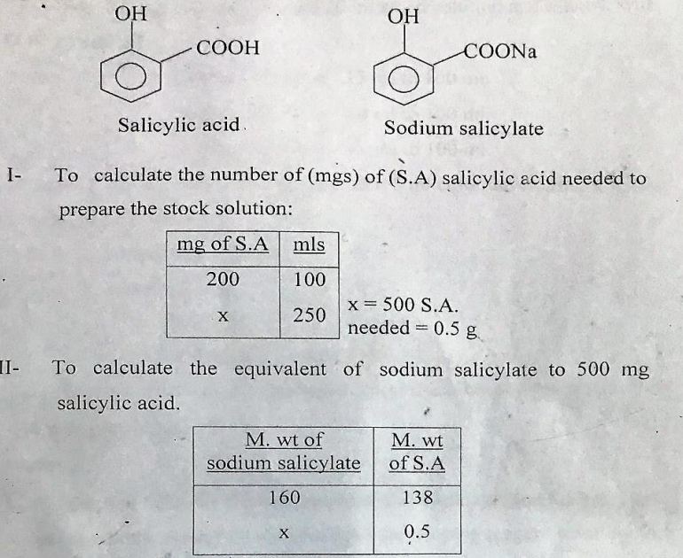

Slide 22
 579.7 mg of sodium salicylate needed to prepare 200 mg of salicylic acid /100mL
 2- dissolve 579.7 mg of sod. Salicylate in 180
mL of water then complete the volume to 250 mL by using volumetric flask (PRIMARY STOCK)
 3- the PRIMARY stock solution of sodium salicylate
containing equivalent of 200 mg\100 mL of salicylic acid , From this primary stock prepare other stock solution 100 mg \100 mL by using
 CIVI=C2V2
 200%X V1= 100%X100
 V1=50 mL of primary stock and complete the volume up to 100 mL with D.W (SECONDARY STOCK)

Slide 23
 from this secondary stock Prepare serial dilutions (use volumetric procedures )
accurately prepare solutions containing equivalent of 50, 40 ,30 , 20 , 10mg/ 10 mL
 For example to prepare 50 mg\10 mL
 C1V1=C2 V2
 100 mg x V1= 50 mgx10 mL
 V1 =5 mL of stock solution to be taken and
complete the volume by DW up to 10 mL
 Same procedure for other dilutions

Slide 24
 For 40 mg 4 mL of stock complete up to 10
mL by DW
 For 30 mg 3 mL of stock complete up to 10
mL by DW and so on for other dilution
4- set the spectrophotometer wave length
at 265 nm( lambda max for salicylic acid )
5- the blank in this experiment is DW
6- auto zero the spectrophotometer by
using blank
7-put the sample in the cuvette and read
absorbance

Slide 25
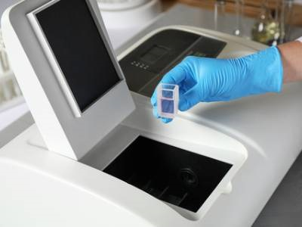
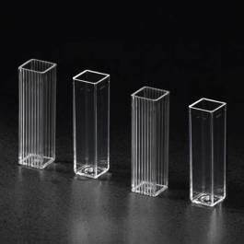

Slide 26
8 –record your results concentration versus absorbance
9- draw your results by using graph paper
(make calculation using excel program)
10 – obtain straight line equation by using least square method
11- calculate y prime for each concentration
12 – draw y prime versus concentration by using excel Microsoft program
13- add trend line

Slide 27


Slide 28


