Slide 1
Cost-effectiveness analysis
Assist.prof. Abeer Aljuburi

Slide 2
Cost-effectiveness analysis is a technique designed to assist a decision-maker in identifying a preferred choice among possible alternatives.
Generally, cost-effectiveness is defined as a series of analytical and mathematical procedures that aid in the selection of a course of action from various alternative approaches.
Cost-effectiveness analysis has been applied to health matters where the program's inputs can be readily measured in dollars, but the program's outputs are more appropriately stated in terms of health improvement created (e.g., life-years extended, clinical cures).

Slide 3
Outcome measures in cost-effectiveness analysis
In CEA, outcomes are reported in a single unit of measurement, and are given in natural units, for example mmHg for blood pressure reduction, or life years gained by transplantation.
The outcome measure is common to both alternatives, but may be achieved to different degrees (i.e. there is a difference in effectiveness).
An economic evaluation could examine the use of coronary artery bypass graft (CABG) surgery for ischemic heart disease compared with medical (drug therapy only) management.

Slide 4
The effectiveness of both treatment methods can be measured using mortality at 10 years. Evidence suggests that it is likely that mortality will be lower if CABG is used.
Therefore, cost-effectiveness analysis is the appropriate method to use because the outcome is common to the two alternatives, but there is a difference in effectiveness.

Slide 5
Compares results with other interventions affecting the same outcomes
you can see that very expensive interventions that are also very effective may still be cost - effective relative to less expensive but less effective interventions.

Slide 6
Cost-Effectiveness Ratios
Results from a CEA are typically expressed as a cost-effectiveness (C/E) ratio; the numerator of the ratio reflects total costs, while the denominator is the expression of the outcome variable.
Two forms of the C/E ratio exist: (1) average, or simple, and (2) incremental (ICER). The average/simple C/E ratio is a straightforward approach, defined as follows:

Slide 7
Although average C/E ratios provide useful information for analyses, incremental analyses are considered a hallmark of CEA.
In cost-effectiveness analysis (and cost-utility analysis) you will come across the regular use of incremental economic analysis. This is a systematic method for identifying the difference (increment) in costs and outcomes between two healthcare interventions.
The following questions are always asked:
  What is the difference in cost between the interventions?
  What is the difference in outcome between the interventions?

Slide 8
The answers to these questions allow the explanation of the incremental cost-effectiveness ratio (ICER). Incremental cost/outcome ratios may be calculated using the following equation:
Outcome1 is the number of patients successfully treated with intervention 1.
Outcome 2 is the number of patients successfully treated with intervention 2.
Cost 1 is the cost of treating patients with intervention 1.
Cost 2 is the cost of treating patients with intervention 2.

Slide 9
The ICER expresses the cost required to achieve each extra unit of outcome. When one alternative is more effective but requires more resources, the ICER must be calculated.
In the situation when one alternative is more effective and less costly, this alternative is the dominant therapy.
When there is dominance, ICERs do not need to be generated (see Worked example 5.1).

Slide 10
EXAMPLE 5.1 incremental economic analysis:
An economic evaluation could examine the first-line management of community-acquired pneumonia using antibiotics A or C. The effectiveness for both treatment methods can be measured using 'infections successfully treated first line'.
The incremental economic analysis is carried out in the following way:
What are the costs associated with treatment with
a) Antibiotic A [Cost A]
b) Antibiotic C [Cost C]
What are the outcomes associated with
a) Antibiotic A [Outcome A]
b) Antibiotic C [Outcome C]

Slide 11
What is the difference in cost between using antibiotic A and antibiotic C?
[Cost A – Cost C]
What is the difference in outcome between using antibiotic A and antibiotic C?
[Outcome A – Outcome C]
ICER for treating community-acquired pneumonia with antibiotic A instead of antibiotic C

Slide 12
Ways of using outcome data in incremental economic analysis
ICERs present as the cost per unit of outcome.
This could be cost per life year gained, cost per death averted, cost per case successfully diagnosed, or cost per patient successfully treated.
It can also be cost per mmHg reduction or cost per percentage point improvement in lung function.
For example, in the cost-effectiveness analysis of rhDNase in children with cystic fibrosis, the outcome measure was percentage improvement in FEV1. In this study, it's reported that the ICER to be £200 per 1% gain in FEV1. This approach is often used in CEA.

Slide 13
The advantage of this outcome measure is that it is objective and generally accepted as 'true'.
However, sometimes it is not easy to interpret the clinical significance of this type of ICER.
An improvement of 1% in FEV1 is not likely to be clinically significant.
Therefore, we might be more interested in knowing the ICER for an improvement of 10% or 20% in FEV1 which is more likely to be clinically significant. The ICER will also be correspondingly larger.

Slide 14
Another approach would be to convert the results into numbers of patients successfully treated:
We can easily explain this if we consider the cost-effectiveness analysis of rhDNase in children with cystic fibrosis again.
Clinicians working in the management of people with cystic fibrosis consider that a clinically significant improvement in FEV1 is 10% or greater.

Slide 15
Therefore, an alternative approach would be to examine the change in FEV1 of each patient in the study and allocate them to 'successfully treated' or 'unsuccessfully treated'.
Then the ICER could be calculated on the basis of patients rather than percentage change in FEV1.
The disadvantage of this method is that it may introduce subjective judgments about whether a patient has been treated successfully or not.

Slide 16
Using an incremental cost-effectiveness ratio to make a decision
After reading Worked example 5.1, you may now ask yourself: which antibiotic do you think should be chosen by the healthcare decision maker?
This example illustrates that carrying out incremental cost-effectiveness analysis does not necessarily provide an obvious option: this will only happen when dominance occurs, where it is clear that the more effective, less costly option should be selected.
However, the decision-maker usually has to select between the more costly, more effective option and the less costly, less effective option.

Slide 17
The generation of the ICER allows us to see how much extra cost is incurred for the extra benefit.
It is then left to the decision-maker to make a value judgment as to whether the extra benefit is worth the extra cost.
In the example above, the decision-maker must decide whether they think that the extra case of pneumonia successfully treated with antibiotic C is worth £200. This is a disadvantage of cost-effectiveness analysis.

Slide 18
Should the incremental cost-effectiveness ratio be large or small?
The larger the ICER, the more money is required to buy each unit of outcome. Therefore, as an ICER becomes larger, the intervention is said to be less cost-effective.
For example, a CEA of reducing cholesterol concentration with statins generated cost per life year gained for different types of patients in which the drugs may be indicated. Table 5.1 shows the different ICERs generated for these different groups of patients.

Slide 19
It can be seen that different groups of patients had very different ICERs.
To generate one additional life year women aged 45-54 with a history of angina and cholesterol 5.5-6.0 mmol/1 it would cost £361,000.
This is 60 times what it would cost to generate one additional life year in men aged 55-64 with a history of myocardial infarction and cholesterol above 7.2 mmol/1.

Slide 21
Therefore, although statins are effective and safe in all these groups of patients, they have very different levels of cost-effectiveness.
It is generally accepted that healthcare providers cannot afford to treat all patients in whom statin treatment is likely to be effective.
The implications of these different magnitudes of ICERs, in a resource-constrained healthcare system are that they may be used to prioritize which patients receive statins.

Slide 22
Cost-Effectiveness Grid
A cost-effectiveness grid can be used to illustrate the definition of "cost-effectiveness" (Figure 5.1). To determine if a therapy or service is cost effective, both the costs and effectiveness must be considered. Think of comparing a new drug with the current standard treatment. If the new treatment is:
1) Both more effective and less costly (cell A),
2) More effective at the same price (cell B), or
3) Has the same effectiveness at a lower price (cell D),The new therapy is considered cost effective.

Slide 23
On the other hand, if the new drug is:
1) Less effective and more costly (cell I),
2) Has the same effectiveness but costs more (cell F), or
3) Has lower effectiveness for the same costs (cell H).
Then the new product is not cost effective.

Slide 24
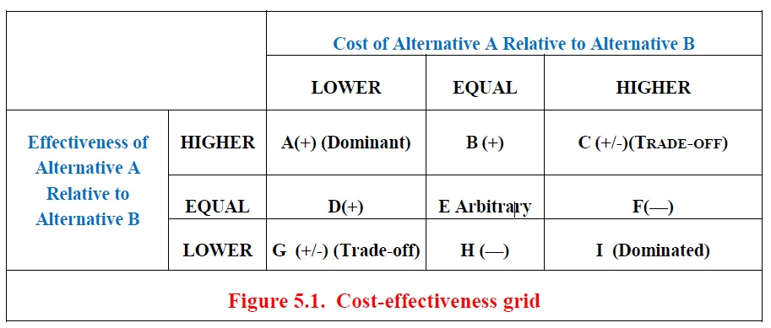
For the middle cell E, other factors may be considered to determine which medication might be best. For the other two cells (C and G), an ICER is calculated to determine the extra cost for each extra unit of outcome.

Slide 25
Dominant strategies are defined as offering both lower cost and higher effectiveness compared with an alternative, while a dominated strategy is one that costs more than the comparator and is less effective.
Options requiring a trade-off include technologies that present a higher cost with higher effectiveness or lower cost with lower effectiveness relative to comparators.

Slide 26
Cost-Effectiveness Plane
A graphical depiction of cost-effectiveness comparisons is also sometimes seen in the literature. Figure 5.3 is a cost-effectiveness plane.
The point on the plane where the x and y axes cross indicates the starting point of costs and effectiveness for the standard comparator.
A point is placed in the plane for each alternative to the standard comparator by indicating how much more or less it costs than the starting point (y-axis) and how much more or less effective it is than the starting point (x-axis).

Slide 27
If an alternative is more expensive and more effective than the standard comparator, this point will fall in quadrant I, and a Trade-off is required (i.e., is the increased cost of the new treatment worth the increase in effectiveness?)
If an alternative is less expensive and more effective, the point would fall in quadrant II, and the alternative would dominate the standard comparator.
If an alternative was less costly and less effective, the point would fall in quadrant III, and again a tradeoff would have to be considered. (Do the costs savings of the alternative outweigh its decrease in effectiveness?).

Slide 28
If an alternative was more expensive and less effective, the point would fall in quadrant IV, and the alternative would be dominated by the standard comparator.

Slide 29
Examples

Slide 36





Slide 37






Slide 40
To illustrate the differences between the simple/average and incremental C/E ratios, Example One presents two treatments as follows:
Treatment One (a baseline comparator) costs $500 to treat 100 patients and treatment Two (a new innovation) costs $750 to treat the same number of individuals.

Slide 41
The effectiveness measure is a final outcome, cure rate; where in 95 percent of the patients are cured with treatment One and 97 percent of the patients are cured with Treatment Two.
Calculating the average C/E ratio yields a relatively small difference between the average costs to treat the patient groups between the two alternatives, $246.88.
However, an incremental analysis finds the cost of treatment two to be substantially higher, costing $12,500 to obtain one additional cure.

Slide 45


Slide 47


Slide 49




Slide 50













