Slide 1
Introduction to pharmacoeconomy
Assist prof. Abeer Aljuburi

Slide 2

What is pharmacoeconomy…….?

Slide 3
The description and analysis of the costs of drug therapy to health care systems and society.
It identifies, measures, and compares the costs and consequences of pharmaceutical products and services.
pharmacoeconomics attempts to find whether the added benefit of one intervention is worth the added cost of that intervention.

Slide 4

To show this graphically, think of two sides of an equation.
The left-hand side of the equation represents the inputs (costs) used to obtain and use the pharmaceutical product or service.
The right-hand side of the equation represents the health-related outcomes produced by the pharmaceutical product or service.

Slide 5
If just the left-hand side of the equation is measured without regard to outcomes, it is a cost analysis (or a partial economic analysis).
If just the right-hand side of the equation is measured without regard to costs, it is a clinical or outcome study (not an economic analysis).
To be a true pharmacoeconomic analysis, both sides of the equation must be considered and compared.

Slide 6
Why is economic evaluation important?
1. To understand how limited resources can be used most efficiently and effectively.
2. Clinicians want their patients to receive the best care and outcomes available, and payers want to manage rising costs. Pharmacoeconomics combines these objectives by estimating the value of patient outcomes received for the expenditures spent on medications and other health care products and services.

Slide 7
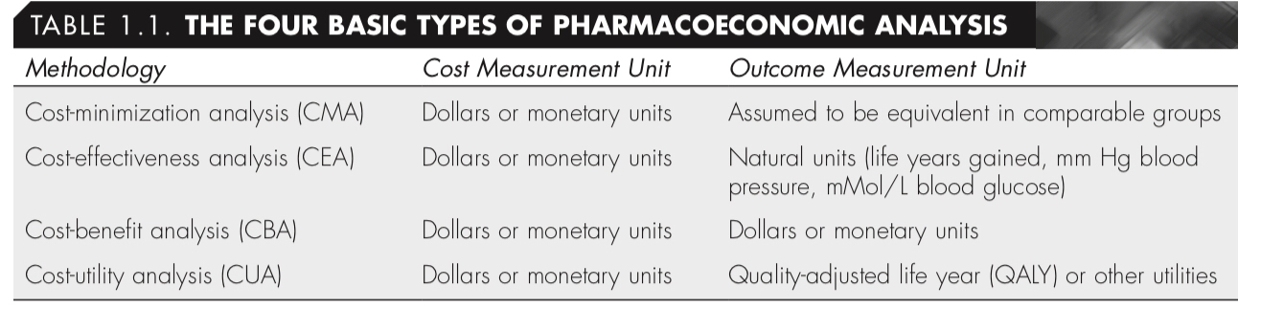
Types of Pharmacoeconomic studies:

Slide 8
cost-minimization analysis
CMA has the advantage of being the simplest to conduct because the outcomes are assumed to be equivalent; thus, only the costs of the intervention are compared.
CMA disadvantage: CMA cannot be used when outcomes of interventions are different.
A common example of a CMA is comparing two generic medications that are rated as equivalent by the FDA.
If the drugs are equivalent to each other (but manufactured and sold by different companies), only the differences in the cost of the medication are used to choose the one that provides the best value.

Slide 9
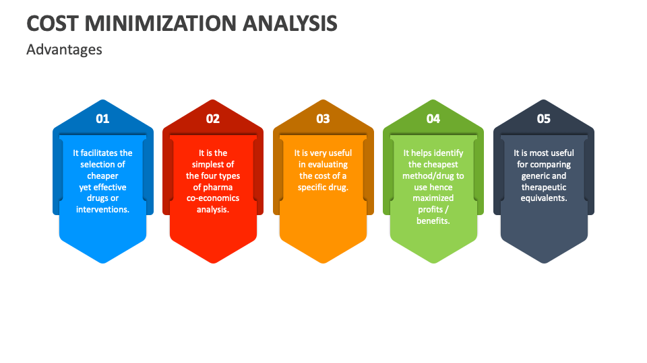

Slide 10
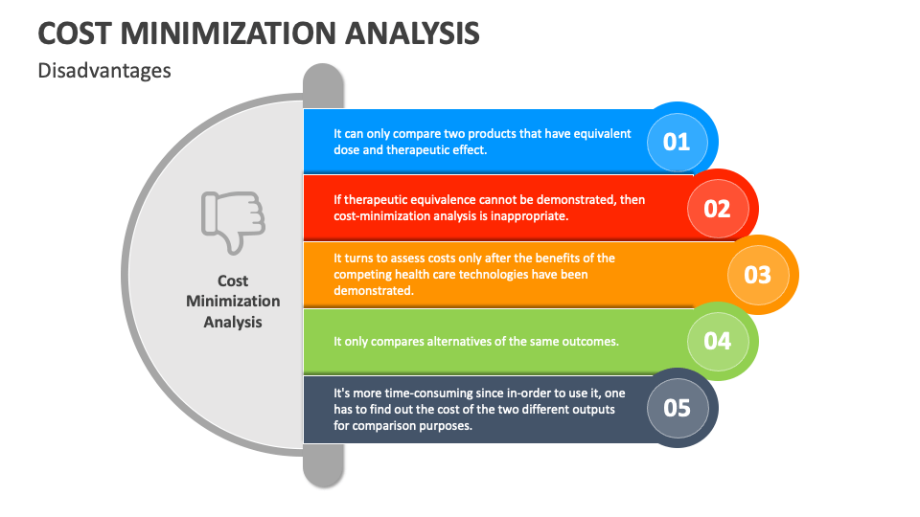

Slide 11
It would not be appropriate to compare different classes of medications using cost-minimization analyses if there are noted differences in outcomes.
For example, if a new antibiotic was available that had a higher rate of alleviating inner-ear infections (but a higher cost) than a currently marketed antibiotic, it would not be appropriate to choose the current antibiotic based solely on the basis that it cost less than the new product.
Cost-minimization comparisons are usually between different dosing routes (e.g., intravenous [IV] versus oral [PO] routes of administration for the same medicine), dosing frequency (e.g., q6h versus q8h for the same drug), or therapeutic equivalents (e.g., doxycycline versus tetracycline).

Slide 12
To perform an accurate analysis, all costs of the drug's administration must be included. This includes expenses difficult to measure, such as nursing time, as well as other costs borne by the patient.
Simply add all the costs of each therapy being considered and compare the totals. The lowest total is the least expensive (minimal cost) therapy.

Slide 13
Cost effectiveness analysis
CEA measures outcomes in natural units (e.g., mm Hg, cholesterol levels, symptom-free days [SFDs], years of life saved).
The main advantage of this approach is that the outcomes are easier to quantify when compared with a CUA or a CBA.
One disadvantage of CEA is that programs with different types of outcomes cannot be compared.

Slide 14
For example, it would not be possible to compare the cost-effectiveness of implementing an anticoagulation clinic with implementing a diabetes clinic because the clinical outcomes measured would be valued in different units (e.g., prothrombin time versus blood glucose measures).

Slide 15
cost-utility analysis
CUA measures outcomes based on years of life that are adjusted by “utility” weights, which range from 1.0 for “perfect health” to 0.0 for “dead.”
These utility weights incorporate patient or society preferences for specific health states. When morbidity and mortality are both important outcomes of a treatment, CUA should be used to incorporate both into one unit of measure.
The main disadvantage of CUA is that there is no consensus on how to measure these utility weights, and they are more of a “rough estimate” than a precise measure.

Slide 16
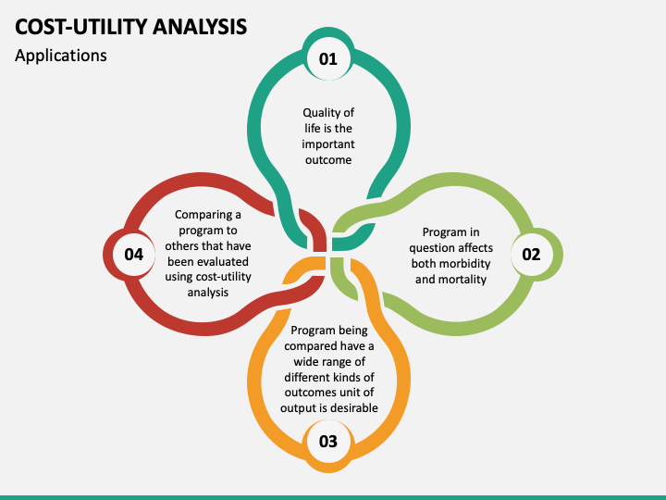

Slide 17
cost-Benefit analysis
CBA is unique in that not only are costs valued in monetary terms, but also the benefits. Measuring both costs and benefits in monetary terms has two major advantages:
First, clinicians and other decision makers can determine whether the benefits of a program or intervention exceed the costs of implementation.
Second, clinicians and other decision makers can compare multiple programs or interventions with similar or unrelated outcomes.

Slide 18
Because all inputs and outcomes are converted to dollars, it is now possible to compare two alternatives that provide different types of outcomes (e.g., the implementation of an anticoagulation clinic versus the implementation of a diabetes clinic). The major disadvantage of CBA is that it is difficult to place a monetary value on health outcomes.

Slide 19
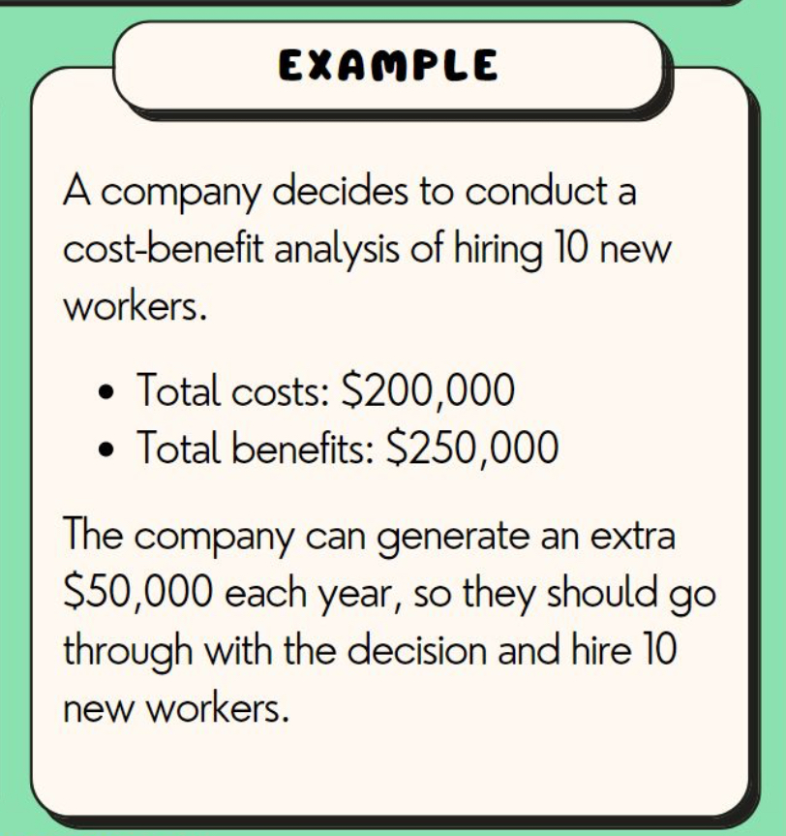

Slide 20
Other types of analysis

Slide 21
cost-consequence analysis (CCA)
Consisting of comparing various options, in which the cost components and the various outcomes of a disease or intervention are calculated and presented separately.
Outcomes are presented in disaggregated form.

Slide 22
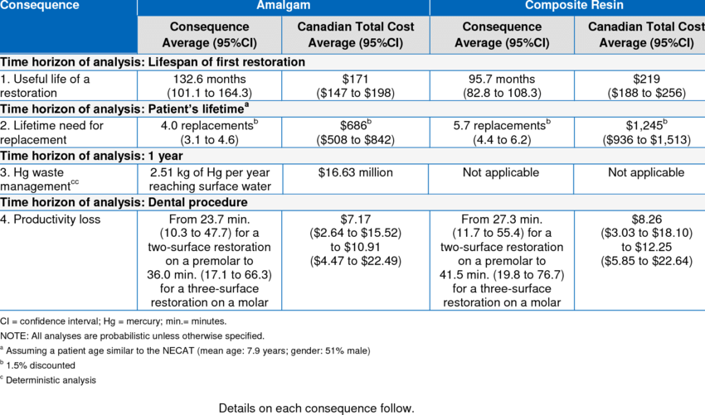

Slide 23
cost-of-illness (COI) analysis
To determine the total economic burden (including prevention, treatment, losses caused by morbidity and mortality, and so on) of a particular disease on society. The costs included in this method are usually summarized into two categories:
(1) direct costs, or the costs associated with providing treatment or prevention (e.g., medical services).
(2) indirect costs, or the costs attributable to loss of productivity of patients with that disease or condition.

Slide 24
COI studies are used to indicate the magnitude of resources needed for a specific disease or condition, and they may be used to compare the economic impact of one disease versus another (e.g., costs of schizophrenia versus costs of asthma)
Or the economic impact of a disease on one country compared with another (e.g., costs of HIV in the United States versus costs of HIV in Zimbabwe).
These estimates are sometimes used by pharmaceutical firms to determine the market potential for a new product or by payers to set priorities for reimbursement.

Slide 25
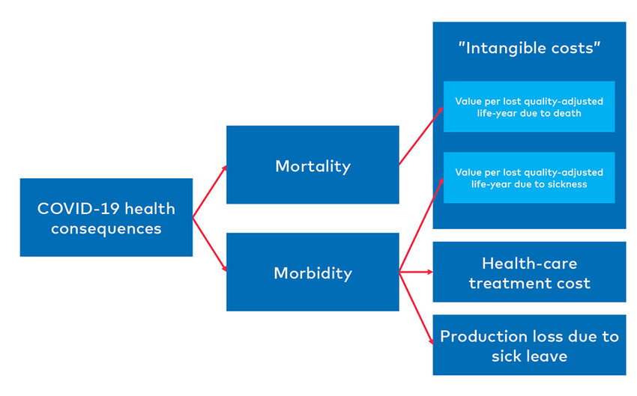

Slide 26
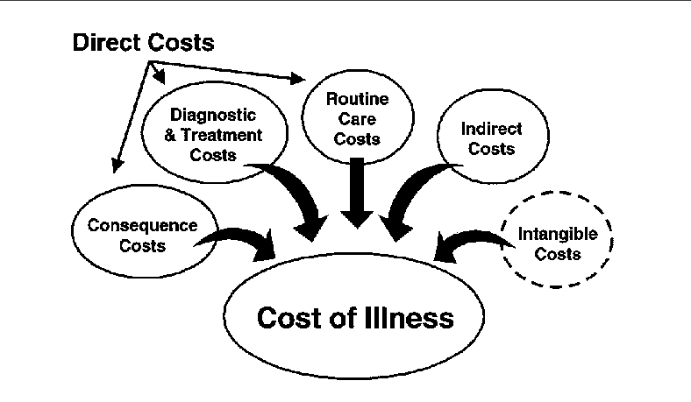

Slide 27
Average versus marginal or incremental costs
When deciding between medication A and medication B, a clinician would find it useful to know the estimated difference in costs and the estimated difference in outcomes between the medications to determine whether added benefits outweigh the added costs. Therefore, when comparing the costs of options, it is important to look at the change in costs.

Slide 28
The terms marginal costs and incremental costs are often used interchangeably to refer to this change or difference between alternatives.
The result of this calculation is termed the incremental cost-effectiveness ratio (ICER), and it can be very different from comparing the average costs of the options or alternatives, especially when the difference in outcomes is small.

Slide 29
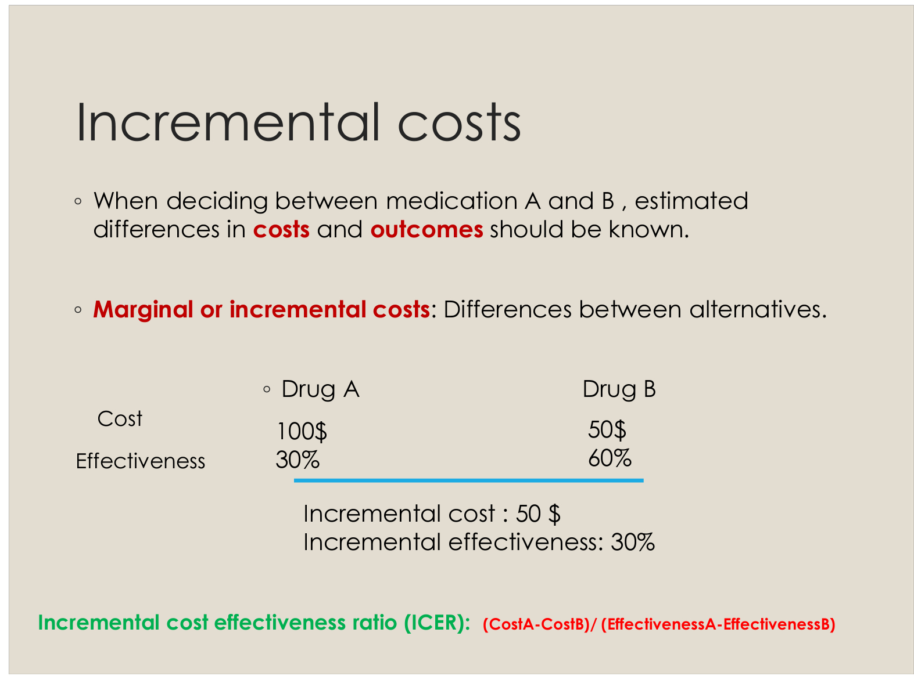

Slide 31
87 would have a successful outcome, but 91 of the 100 patients treated with treatment B would have a successful outcome (four extra successes). Therefore, it is estimated that it costs $12,500 more to treat 100 patients with treatment B in order to achieve four extra successes (or as before $3,125 per extra success).

Slide 32
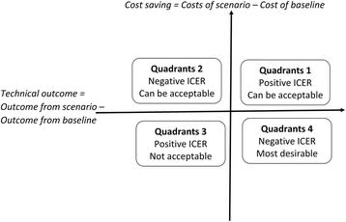

Slide 33
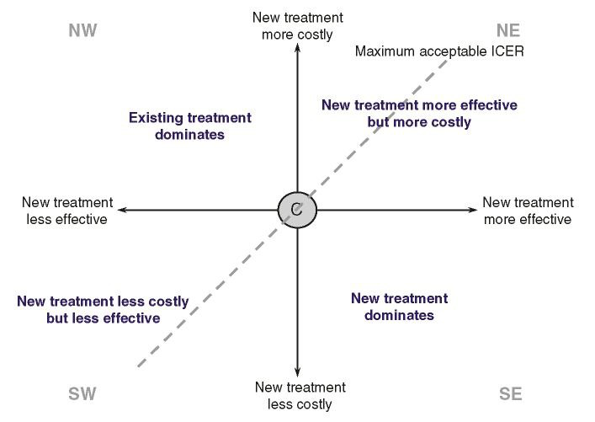














Slide 34
Marginal cost is the cost of producing one additional unit of a good or service.

Slide 35

Opportunity costs

Slide 36
Represent the economic benefit forgone when using one therapy instead of the next best alternative therapy.
Therefore, if a resource has been used to purchase a program or treatment alternative, then the opportunity to use it for another purpose is lost.
In other words, opportunity cost is the value of the alternative that was forgone.

Slide 37
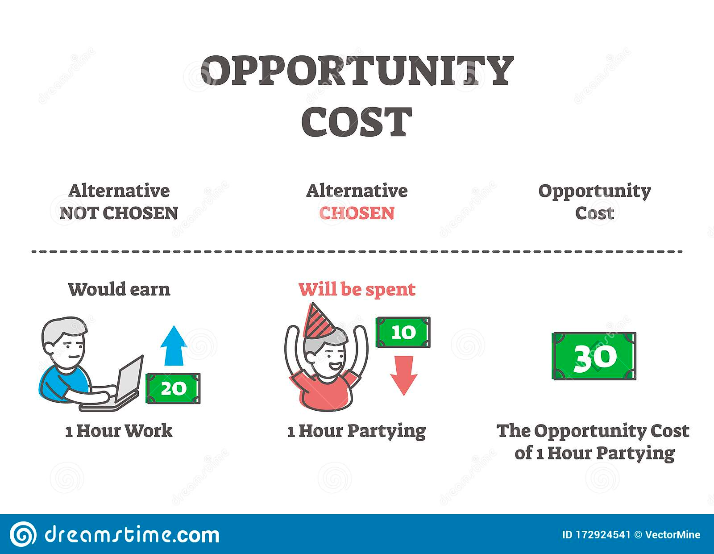

Slide 38
Types of costs
1. Direct medical cost
2. Direct non-medical cost
2. Indirect cost
3. Intangible cost

Slide 39
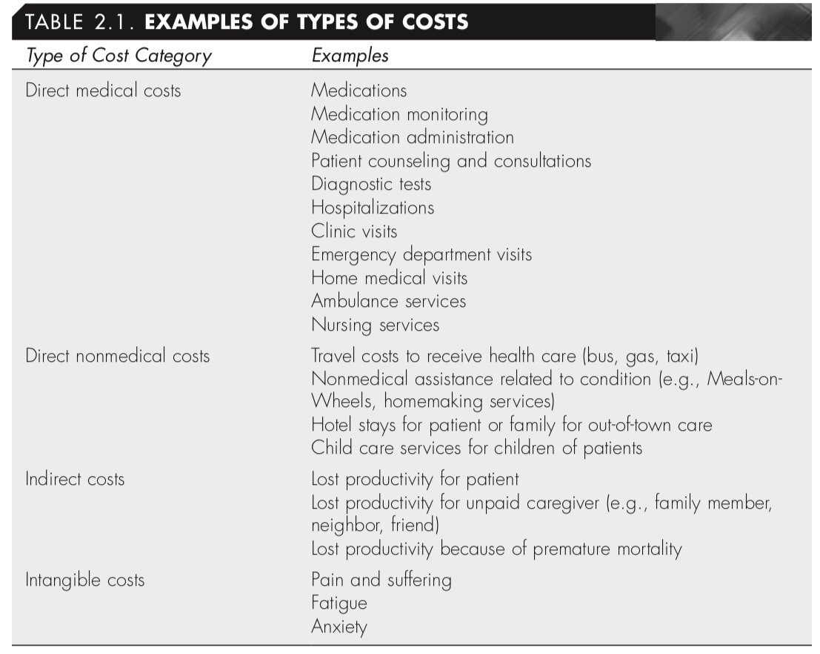

Slide 40
✦ Timing Adjustments for Costs
1. Bringing Past Costs to the Present: standardization of Costs
2. Bringing future Costs (Benefits) to the Present: Discounting

Slide 41
standardization of Costs
When costs are estimated from information collected for more than 1 year before the study, adjustment of costs is needed; this is also referred to as standardization of costs. If retrospective data are used to assess resources used over a number of years back, these costs should be adjusted

Slide 42
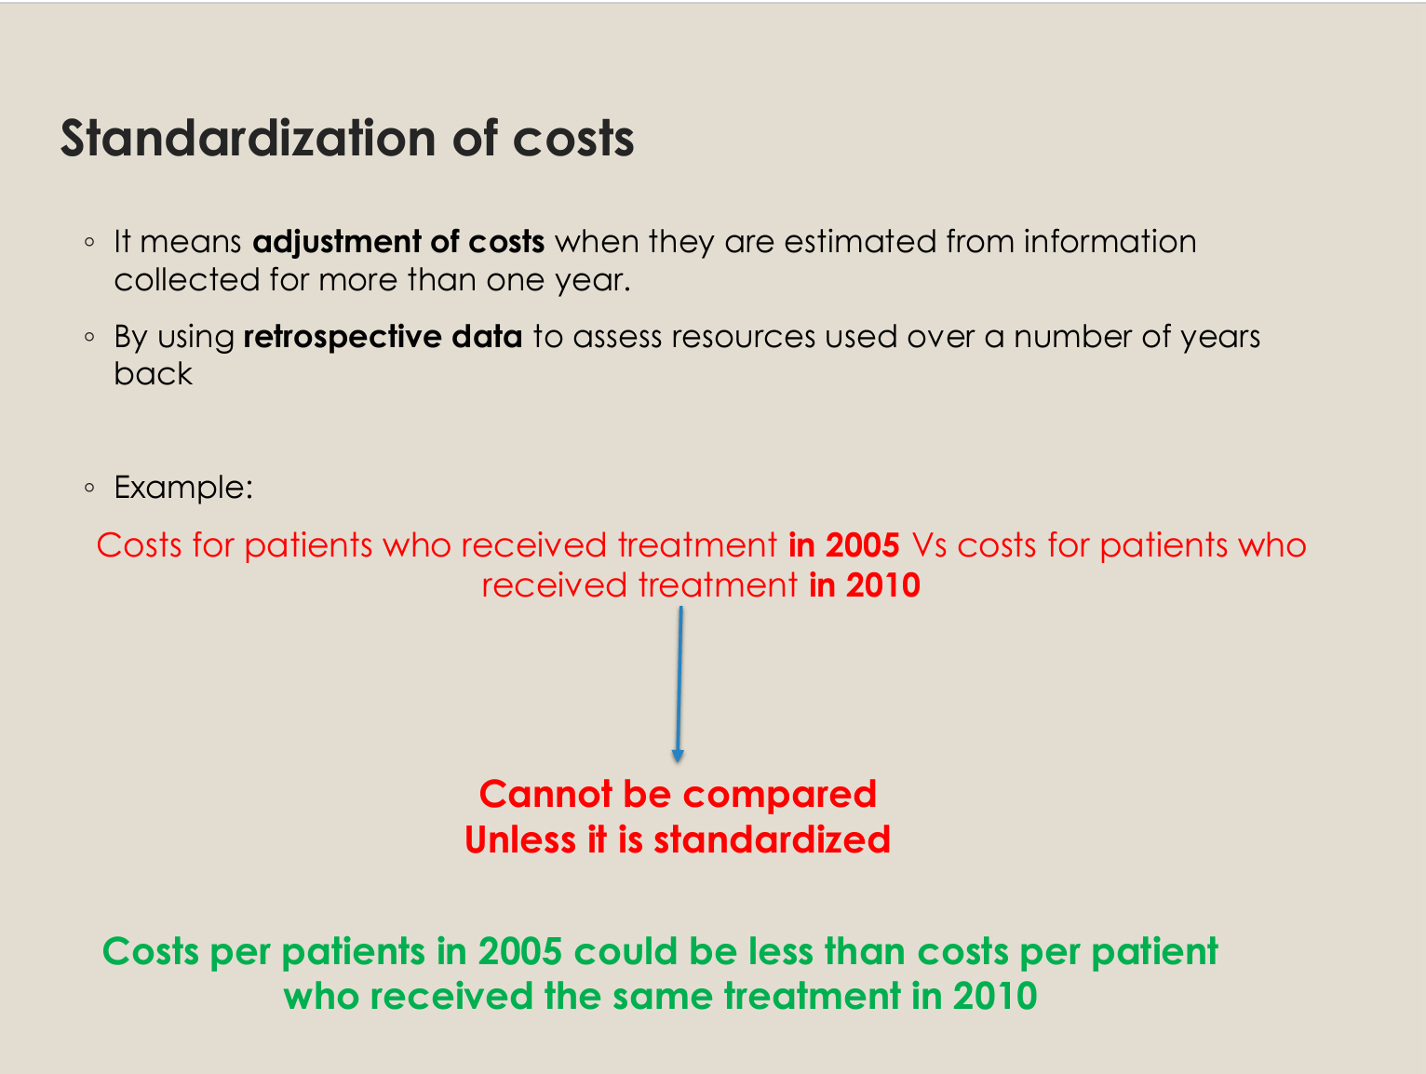

Slide 43
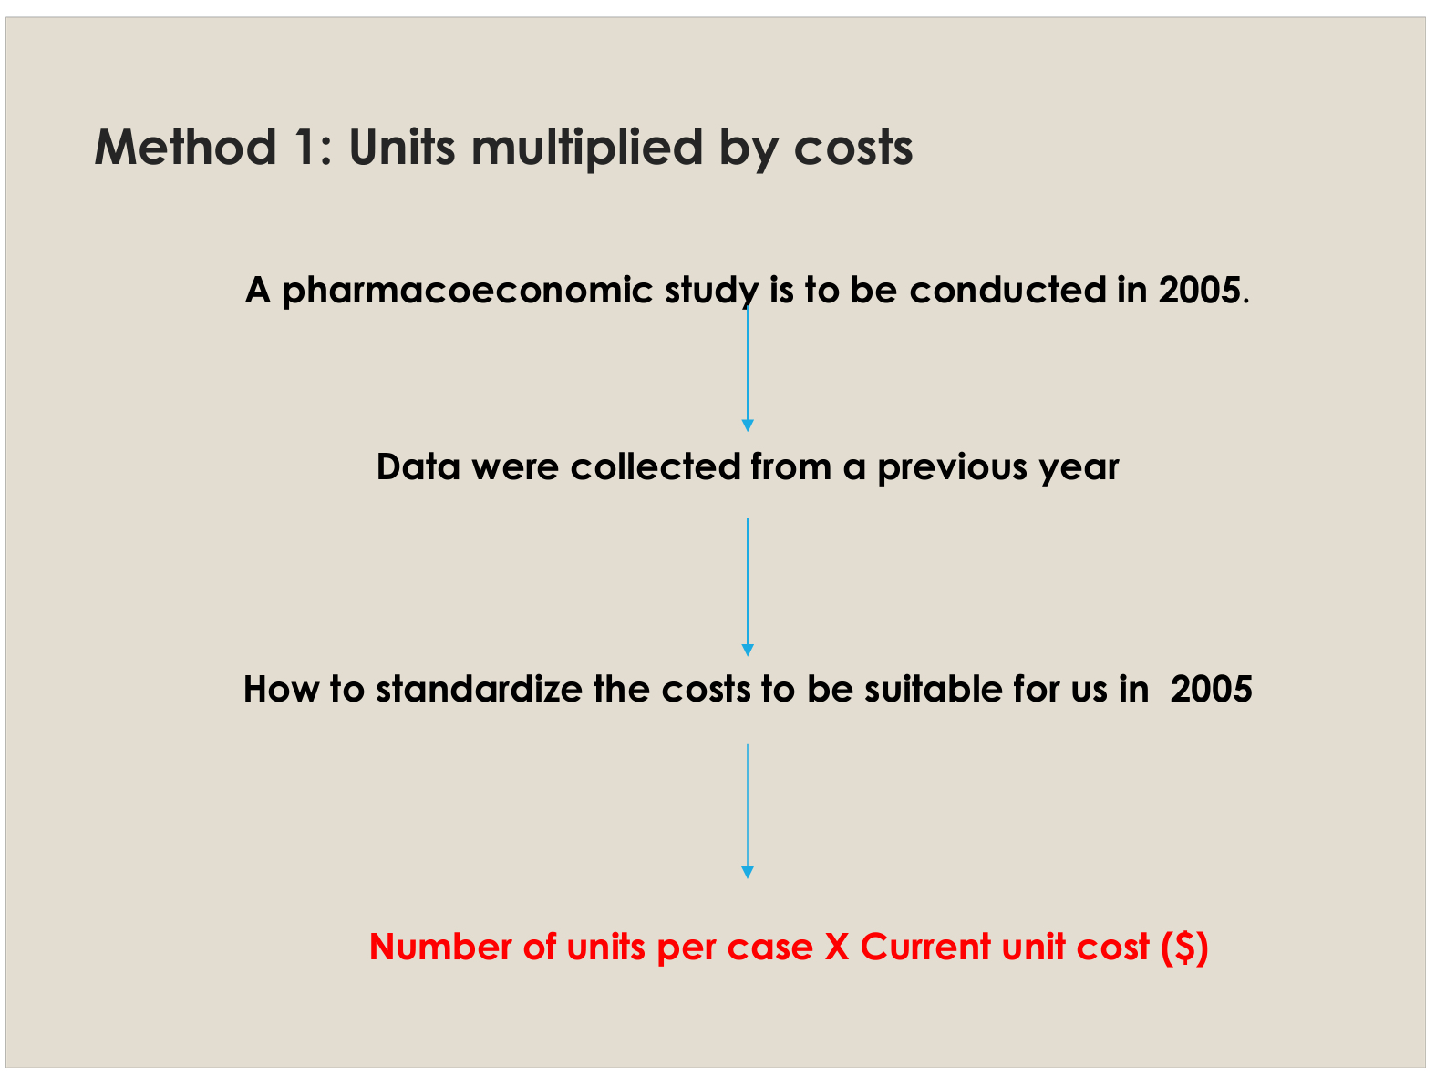

Slide 44
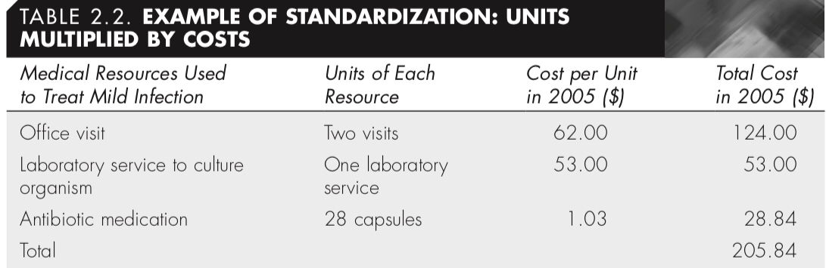
A pharmacoeconomic study to be conducted in 2005, the objective is to estimate the difference in the costs of Chemotherapy regimens. retrospective data were collected from a past medical record. calculate the total standardized cost for the current year.

Slide 45
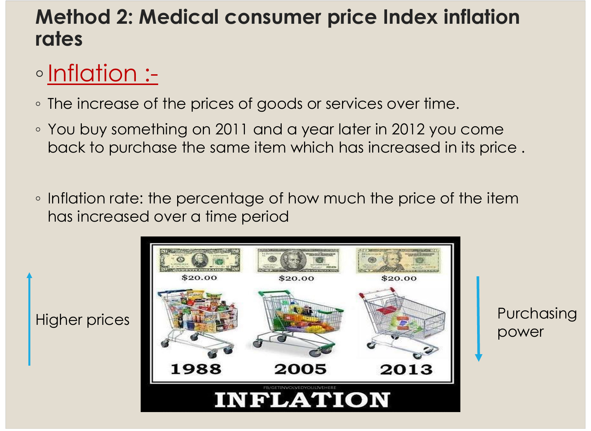

Slide 46
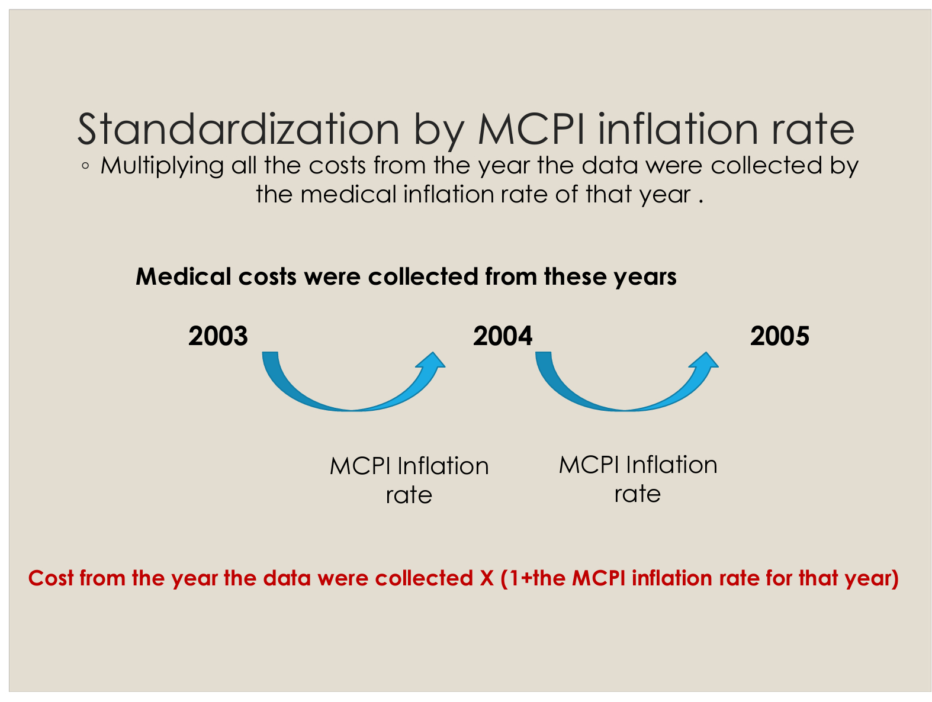

Slide 47
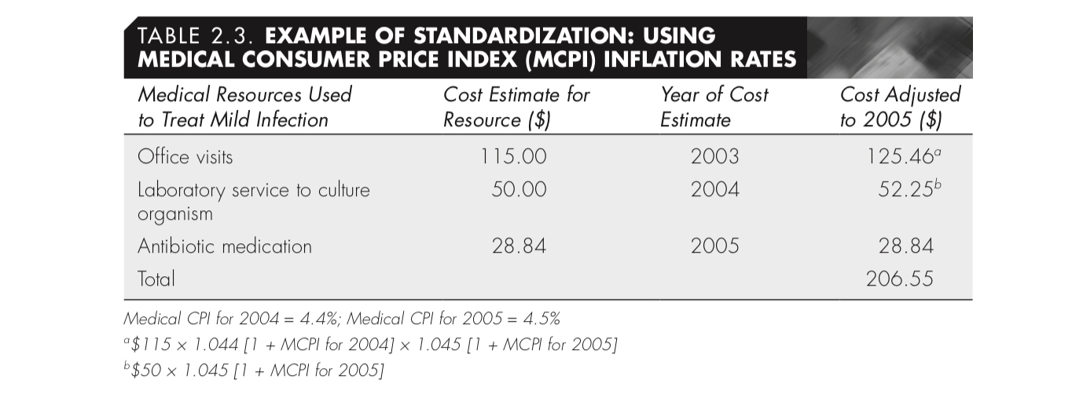
Example A pharmacoeconomic study to be conducted in 2005, the objective is to estimate the difference in the costs of Chemotherapy regimens. retrospective data were collected from a past medical record. calculate the total standardized cost given that the MCPI for the year 2004 is 4.4% and for 2005 is 4.5%.

Slide 48
Cost adjusted from 2004: 50x (1+0.045)
Cost adjusted from 2003: 115x(1+0.44) X (1+0.045)
Cost adjusted from 2005 is the same as there is no inflation rate at the same year

Slide 49
Discounting
There is a time value associated with money
Money promised in the future is valued at a lower rate than money received Today.
Example: a bank Lending a person a 1000$ and agrees to pay it back in 3 years. There is an interest rate on this 1000 (the person will pay more than a 1000$ at the end)

Slide 50
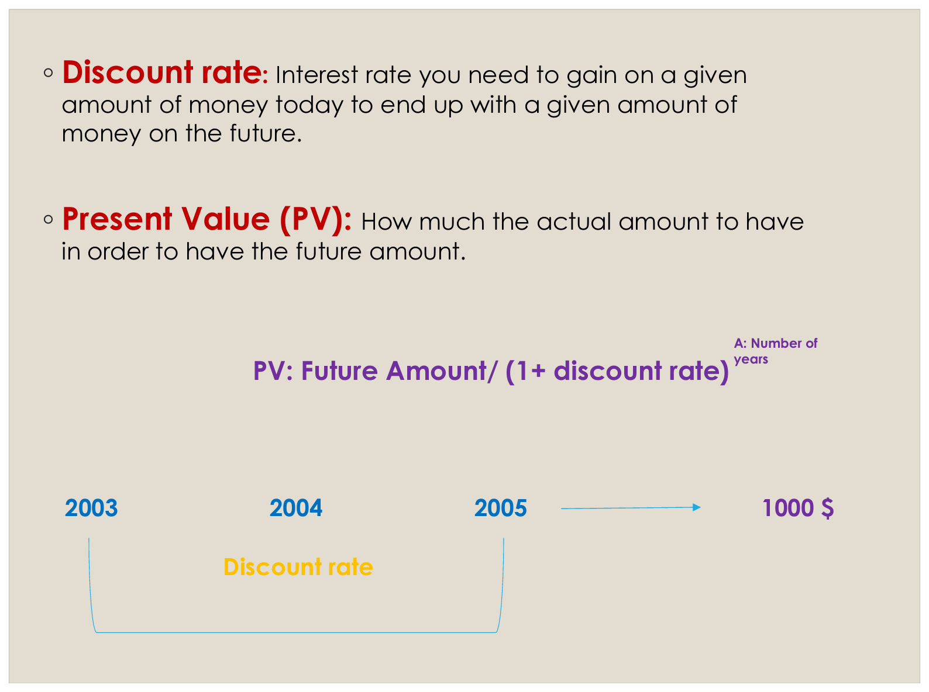

Slide 51
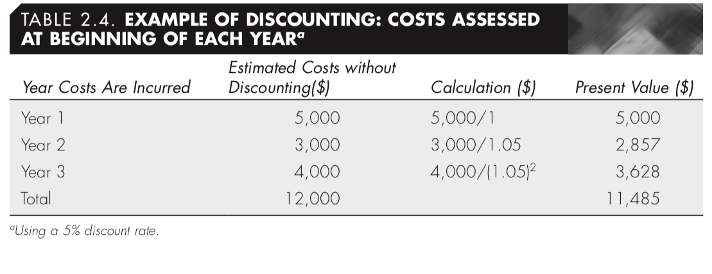
Example: The expenses of cancer treatment for the next 3 years are as the following in the table. Calculate the Total present value of the expenses if you knew that expenses occur at the beginning of each year given that the discount rate is 5%.

Slide 52
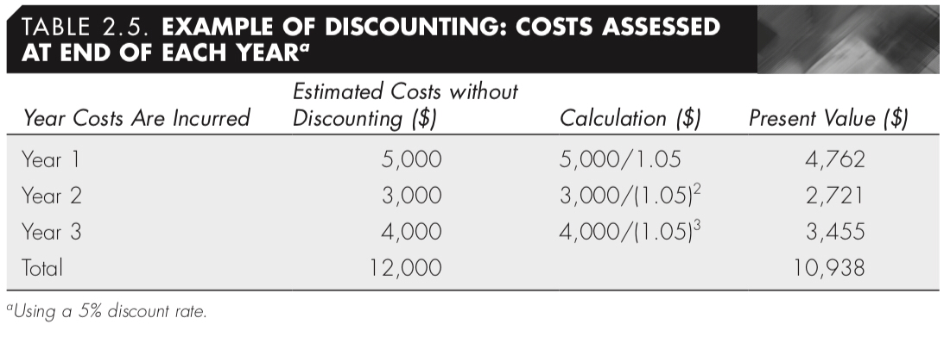
Example: The expenses of cancer treatment for the next 3 years are as the following in the table. Calculate the Total present value of the expenses if you knew that expenses occur at the end of each year given that the discount rate is 5%.

Slide 53
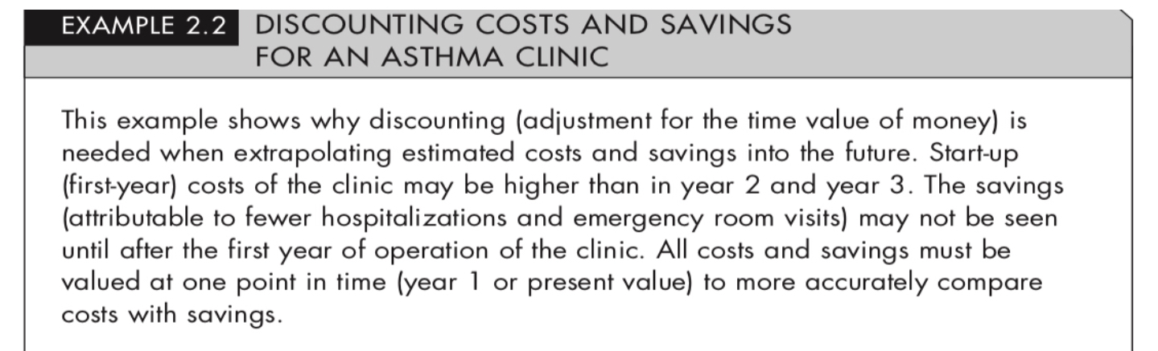

Slide 54
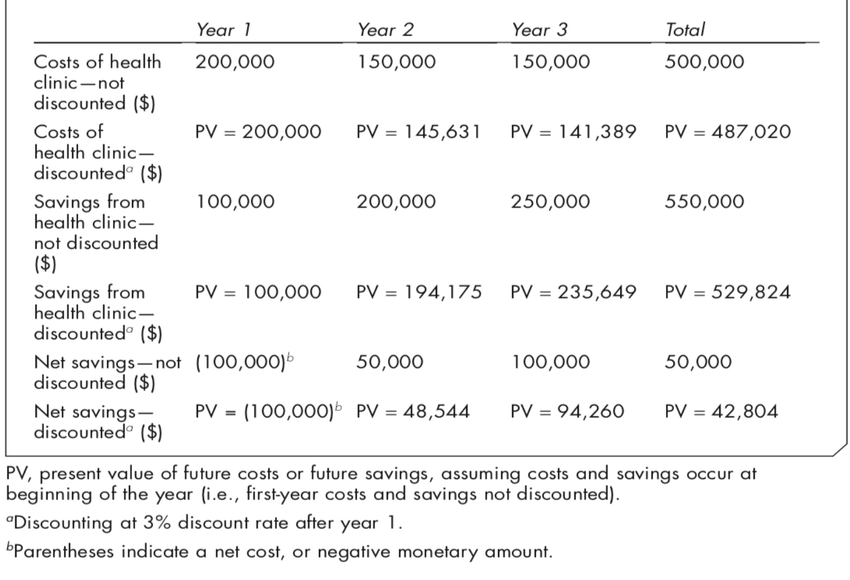

Slide 55
The End

