Slide 1
warts

Slide 2
warts
Cutaneous warts are benign epithelial hyperplasia caused by human papillomaviruses.

Slide 3
Warts PATTERNS
Warts adopt in variety of patterns……

Slide 4
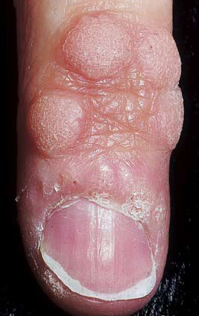
Common wart

Slide 5
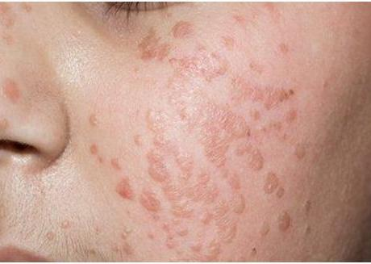
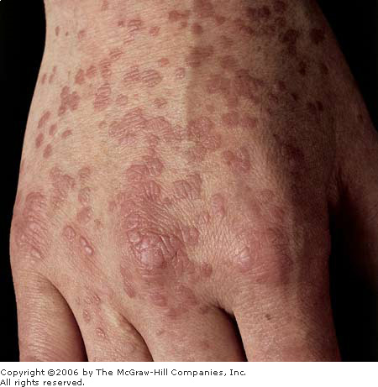
Plane wart
Plane wart

Slide 6
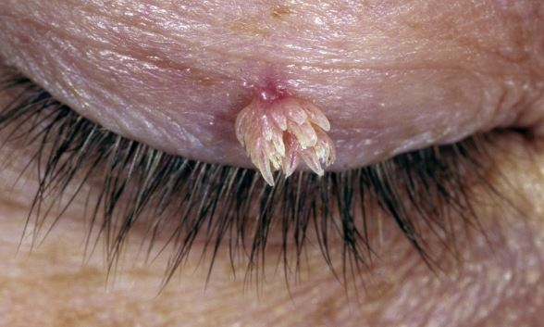
Filiform wart

Slide 7
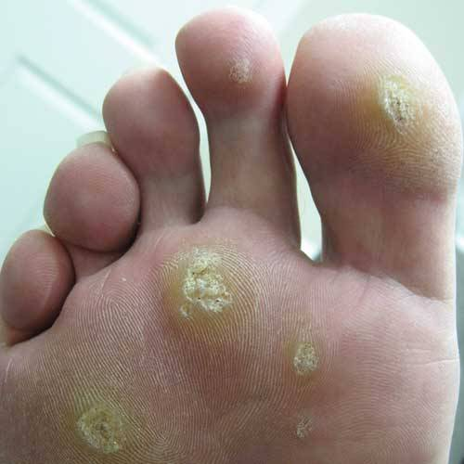
Plantar wart

Slide 8
keratolytic
Keratolytics: are agents that cause keratolysis, or peeling of epidermis.

Slide 9
keratolytic
Keratolytic include:
α-hydroxy acids (lactic acid, glycolic acid, citric acid, glucoronic acid, pyruvic acid, mandelic, malic )
propylene glycol
Salicylic acid

Slide 10
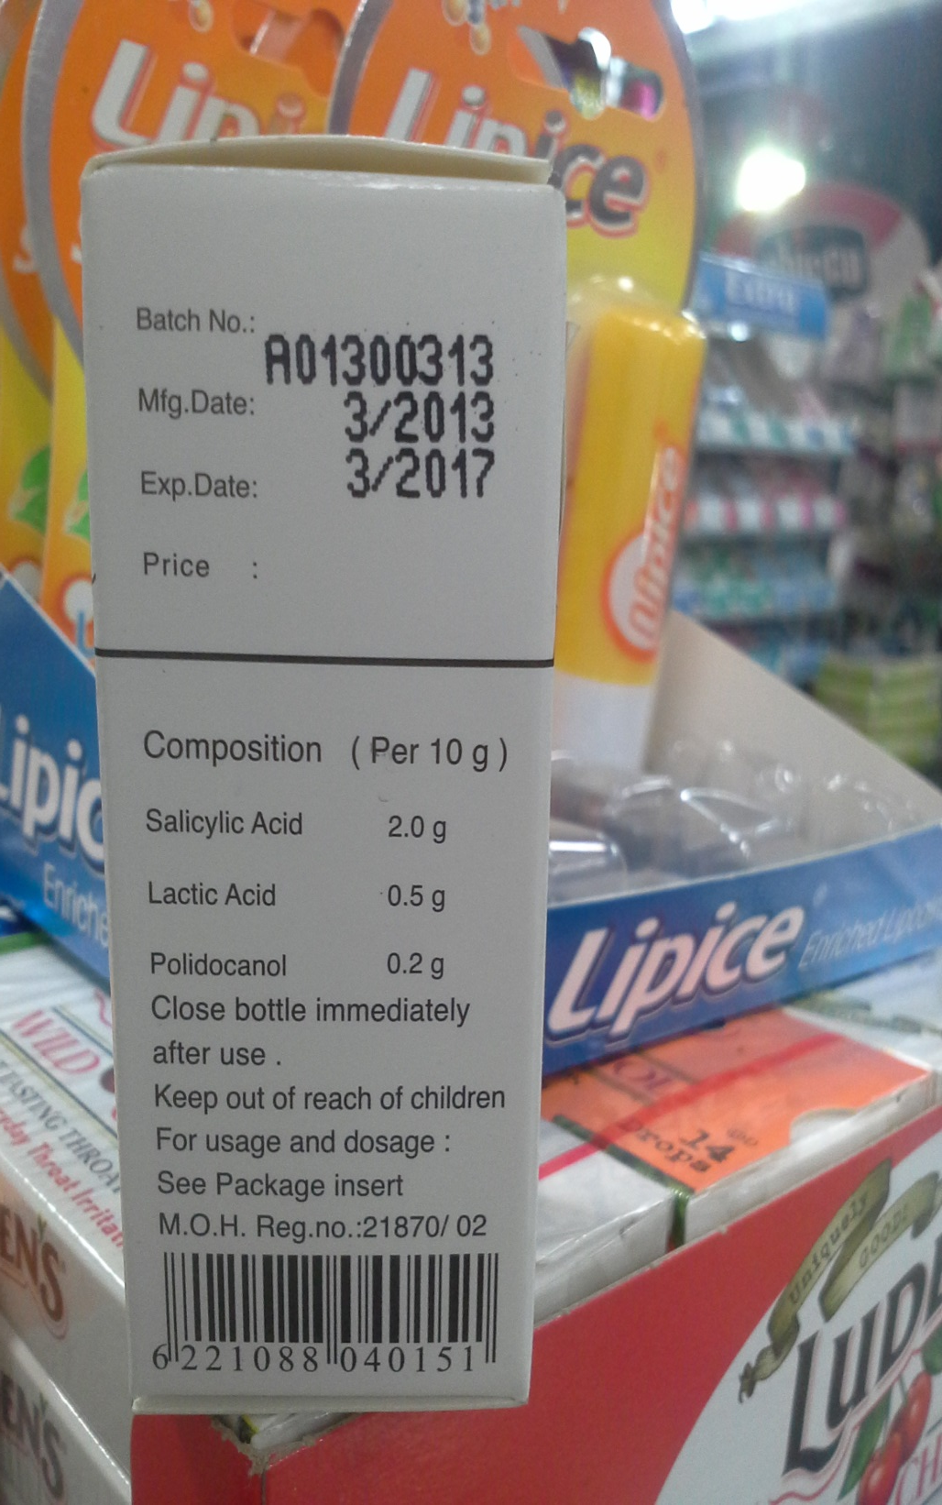

Slide 11
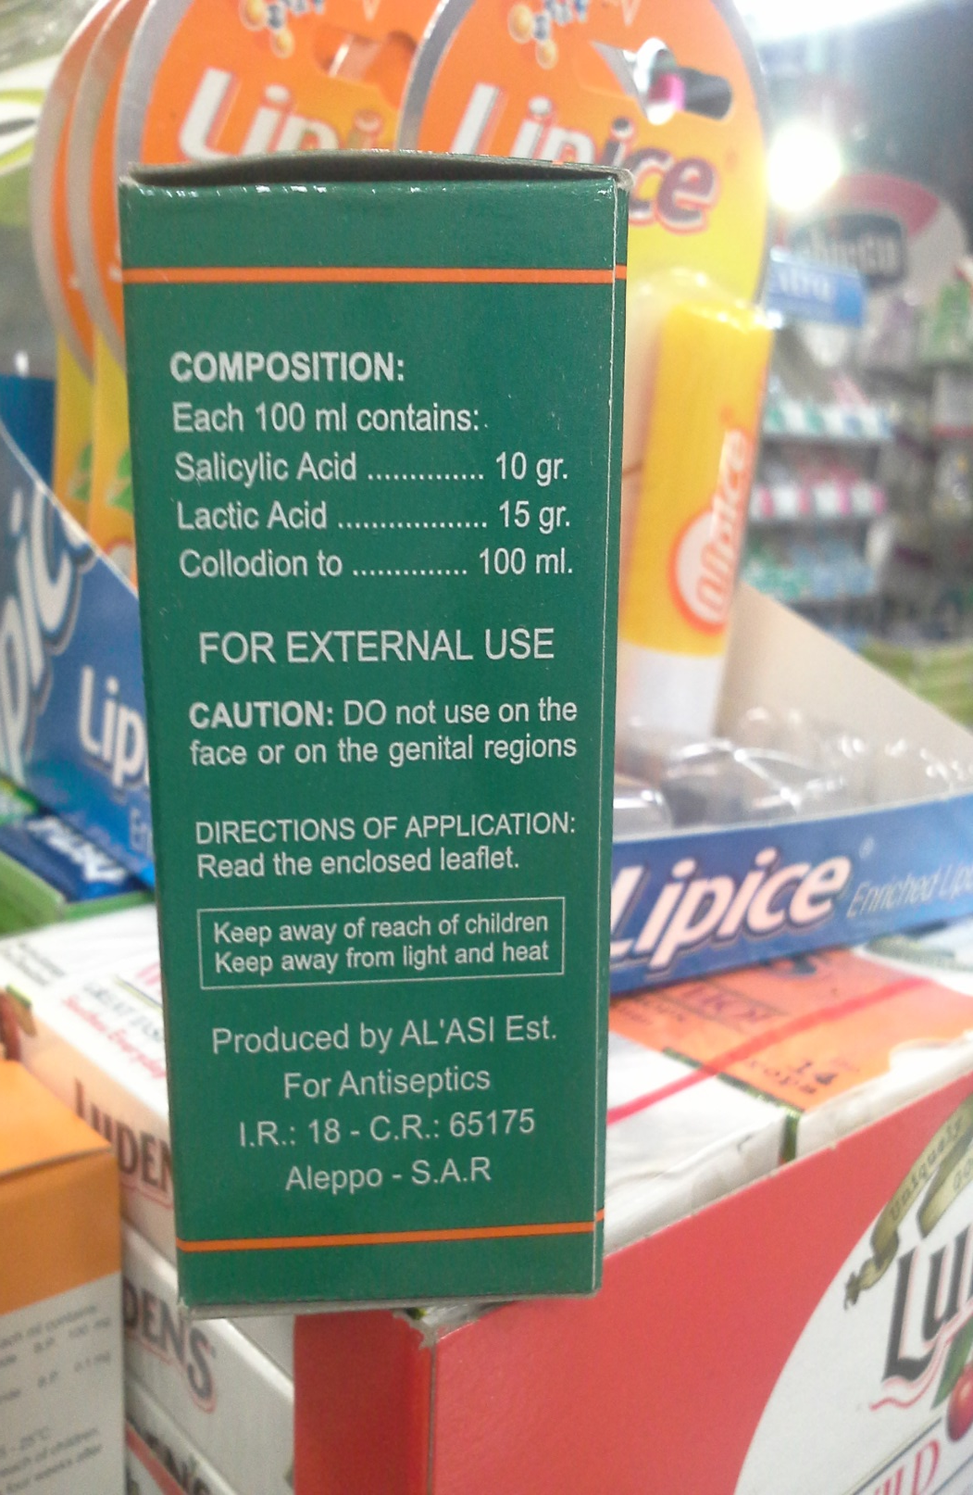

Slide 12
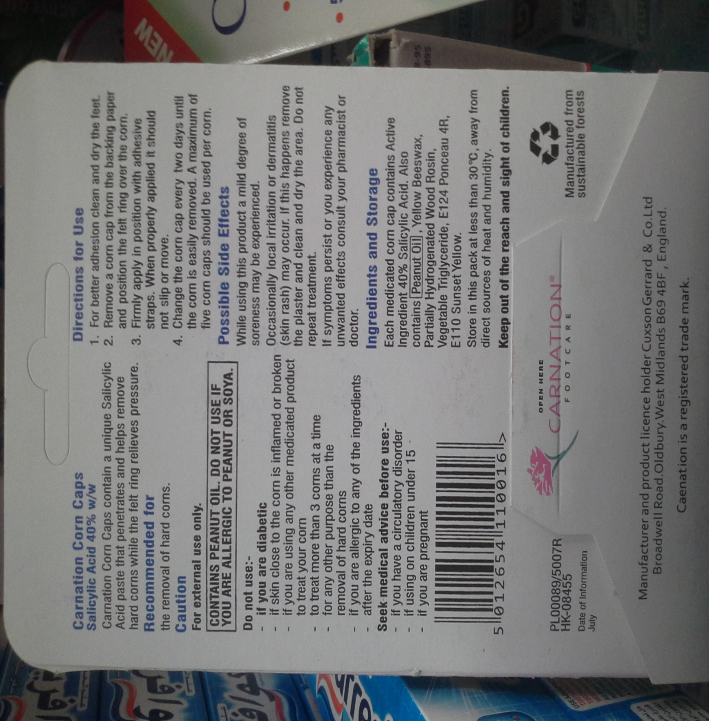

Slide 14
TCA

Slide 15
Glycolic acid

Slide 16
Glycolic acid

