Slide 1
Clinical Pharmacokinetic Equations and Calculations
Dr. Haider Raheem Mohammad

Slide 2
Question 8
Oral mean extravascular equations
• LM is a 59-year-old, 85-kg male needing treatment with oral quinidine for an arrhythmia.
Assuming F = 0.7, T_{max} = 2 h, V = 200 L, and t_{1/2} = 8 h,
compute Css_{min} for a dose of oral quinidine 400 mg every 6 hours.
Solution/ From table (2-3):
Extravascular equations:
τ = [(ln Css_{max} − ln Css_{min})/k_{e}] + T_{max}
D = [(Css_{max} V)/F][(1 − e^{−keτ}) / e^{−keTmax}]
Css_{min} = ?
Css_{min} is not found in table (2-1) equations.
2 unknown values
1 unknown value

Slide 3
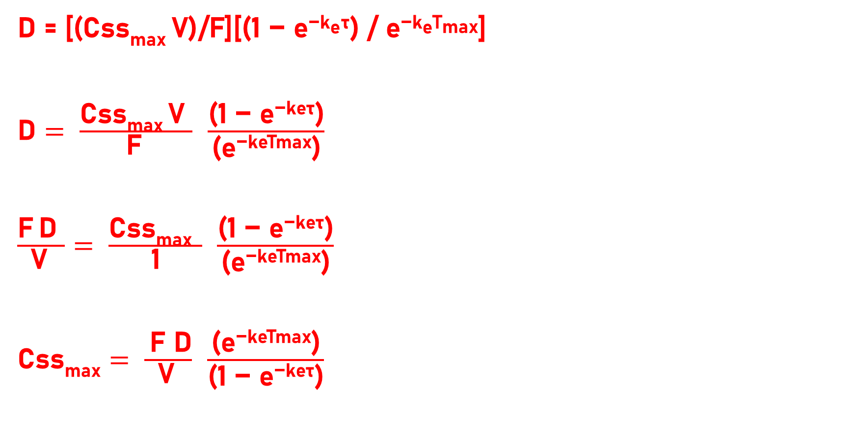
Question 8
D = [(Css_{max} V)/F][(1 − e^{−keτ}) / e^{−keTmax}]
$\text{D}= \frac{\text{Css}\text{max} \text{V} }{\text{F} }$ $\frac{\text{(1 − }\text{e}\text{−}\text{keτ}\text{)}}{\text{(}\text{e}\text{−}\text{keTmax}\text{)}}$
$\frac{\text{F} \text{D} }{\text{V} }= \frac{\text{Css}\text{max} }{\text{1}}$ $\frac{\text{(1 − }\text{e}\text{−}\text{keτ}\text{)}}{\text{(}\text{e}\text{−}\text{keTmax}\text{)}}$
$\text{Css}\text{max}= \frac{ \text{F} \text{D}}{\text{V} }$ $\frac{\text{(}\text{e}\text{−}\text{keTmax}\text{)}}{\text{(1 − }\text{e}\text{−}\text{keτ}\text{)}}$
Cross-multiplication
Rearrangement of means & extremes

Slide 4
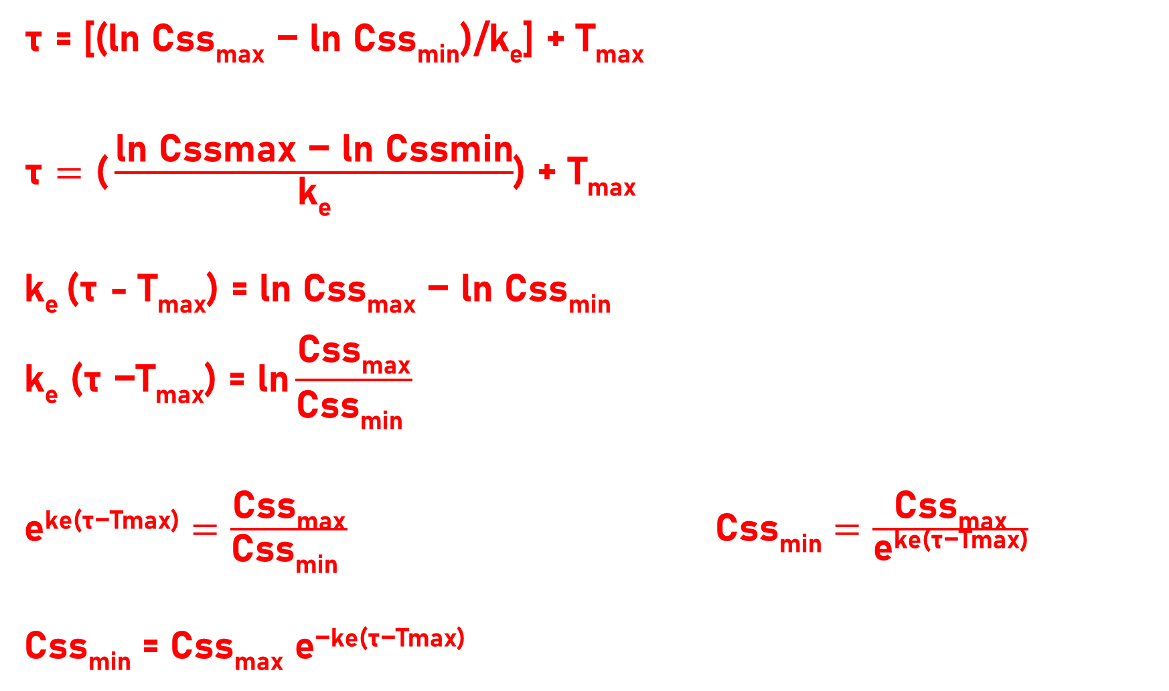
Question 8
τ = [(ln Css_{max} − ln Css_{min})/k_{e}] + T_{max}
$\text{τ}=\text{(}\frac{\text{ln} \text{Cssmax}\text{ − }\text{ln} \text{Cssmin}}{\text{k}\text{e}}$) + T_{max}
k_{e} (τ - T_{max}) = ln Css_{max} − ln Css_{min}
$$\text{k}\text{e}\text{ (}\text{τ}\text{ −}\text{T}\text{max}\text{) = }\text{ln}\frac{\text{Css}\text{max}}{\text{Css}\text{min} }$$
$\text{e}\text{ke}\text{(}\text{τ}\text{−}\text{Tmax}\text{)}=\frac{\text{Css}\text{max}}{\text{Css}\text{min} } \text{Css}\text{min}=\frac{\text{Css}\text{max}}{\text{e}\text{ke}\text{(}\text{τ}\text{−}\text{Tmax}\text{)}}$
Css_{min} = Css_{max} $\text{e}\text{−}\text{ke}\text{(}\text{τ}\text{−}\text{Tmax}\text{)}$
ln (a/b) = ln a − ln b
Take e for both sides of the equation
rearrangement

Slide 5
Question 12
• OP is a 28-year-old, 55-kg female with complex partial seizures. She has the following information available:
Css = 8 mg/L while receiving phenytoin 300 mg at bedtime and
Css = 22 mg/L while receiving phenytoin 400 mg at bedtime.
Compute the patient’s Michaelis-Menten parameters for phenytoin, and the phenytoin dose that would achieve Css = 15 mg/L.

Slide 6
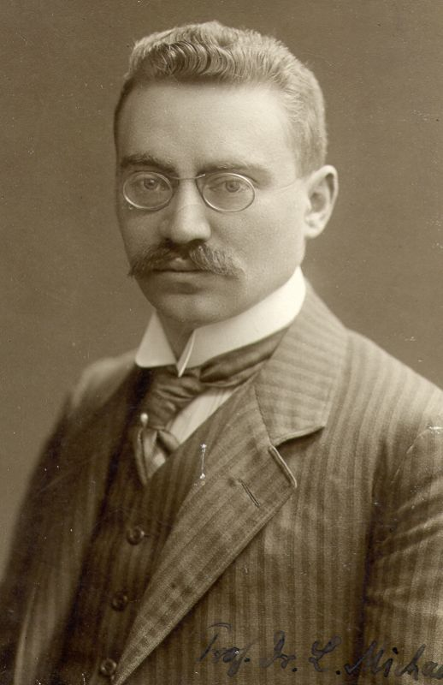
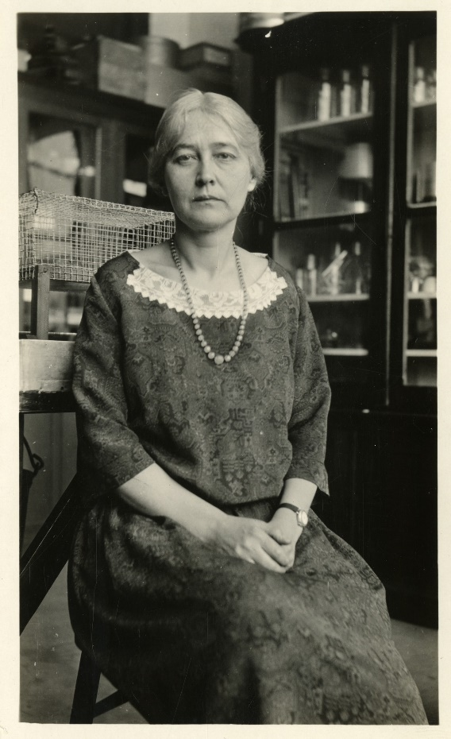
Leonor Michaelis (16 January 1875 – 8 October 1949) was a German biochemist, physical chemist, and physician.
Maud Leonora Menten (March 20, 1879 – July 17, 1960) was a Canadian physician and chemist.

Slide 7
Question 12
• The Michaelis-Menten equation is rearranged:
D = (Vmax ⋅ Css) / (Km + Css)
D (Km + Css) = (Vmax ⋅ Css)
D Km + D Css = (Vmax ⋅ Css)
(D/Css) Km + D = Vmax
D = Vmax − [Km (D/Css)]
• This version of the function takes the form of the equation of a straight line: y = y-intercept + [(slope)x].
rearrangement
× 1/Css
rearrangement

Slide 8
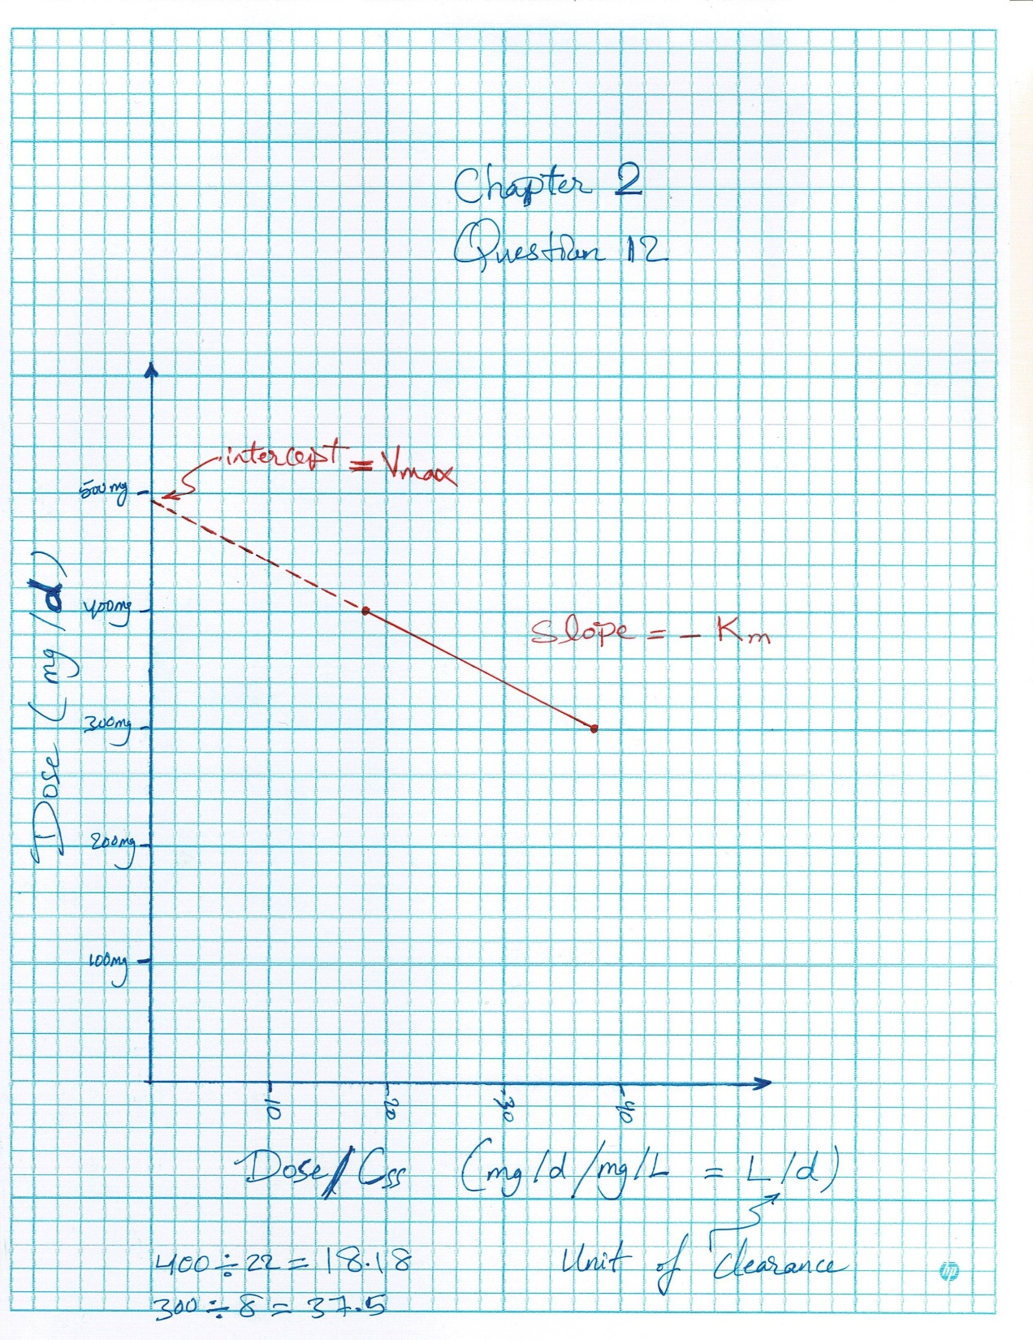
A plot of dose (D) versus dose divided by the steady-state concentration (D/Css) will yield a straight line with a slope equal to −Km and a y-intercept of V_{max}.

Slide 9

Thank You

