Slide 1
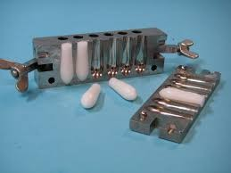
Suppositories (2)

Slide 2
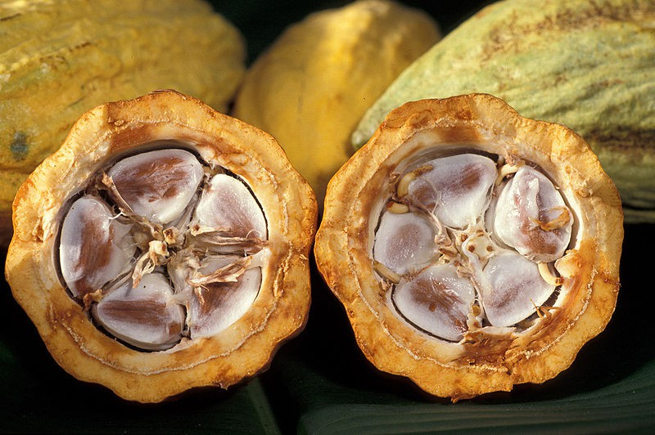
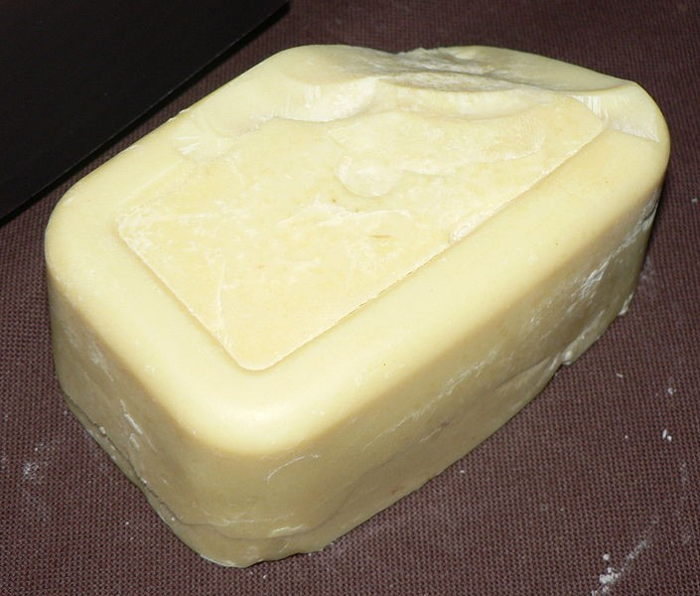
The fatty bases
The most important base is theobroma oil (cocoa – butter) which exhibits many of the properties of an ideal suppository base:
It has melting point range of 30 – 36 0C and therefore, is solid at normal room temperature.
It readily liquefies on heating but sets rapidly when cooled.
It is bland, therefore, no irritation occurs.

Slide 3
theobbroma oil is
not longer used because of its many
disadvantages such as:
Theobroma oil is polymorphic, i.e. when it is heated and cooled it solidifies in different crystalline forms (α, β, σ) which are differe in physical properties.
Theobbroma oil shrinks only slightly on cooling and therefore, may tend to adhere to the walls of the suppository mold. For this reason, the mold must be lubricated before use.
The relatively low melting point masks it unsuitable for use in hot climates.

Slide 4
The melting point is reduced if the active ingredients are soluble. This can be counteracted by adding bees wax.
theobbroma oil deteriorates on storage.
It dose not have a high water – absorbing capacity.
Relatively high cost.

Slide 5
Preparation of suppositories using theobbroma oil base
Accurately weigh required amount of base, place in beaker and put on water – bath, over gentle heat.
Allow approximately two – thirds of the base to melt and remove from the heat. The residual heat will be sufficient for the rest of the base to melt.
Reduce the particle size of the active ingredients, if necessary. This will be done by either grinding in a mortar and pestle or sieving.
Weigh the correct amount of medicament and place on a slab.
Add about half of the molten base to the powdered drug and rub together with a spatula.

Slide 6
6. scrap this mixture off the slab, using the spatula and place
back into the beaker
7. If necessary, put the backer back over the water – bath to
re-melt the ingredients
8. Remove from the heat and stir constantly until almost on the point of setting
9. Quickly pour into the mold, slightly overfilling each cavity.This is to allow for contraction on cooling
10. Leave the mold ant its contents to cool for about 5 minutes and then, using a spatula, trim the tops of the suppositories
11. Allow to cool for another 10 – 15 minutes until the suppositories are completely firm and set.

Slide 7
Rx1
Tannic acid
Oil of theobroma Ft. supp.
gr.v q.s
Dv 0.9
Mitt. iii supp. Using 2 g mold. Sig. insert one as direct
Calculations:
0.33 ☓ 5 = 1.65 g tannic acid
The wight of base required to prepare five ummedicated suppositories = 5 ☓
2g = 10 g base
1.65 g / 0.9 = 1.83 the base displaced by tannic acid Therefore, weight of the base required for medicated suppositories =
10 g – 1.83 g = 8.17 g
The total weight = 8.17 g + 1.65 g = 9.82 g The weight of each suppository =
9.82 ÷ 5 = 1.96 g

Slide 8
Rx 2 D.V
Bismuth subgallate 0.2 g 2.6
Resorcinol 0.3 g 1.3
Zinc oxide 0.13 4.8
Oil of theobromaq.s.
Ft.supp.
M.Ft. 3 supp. using 2 g mold
Sig. insert one at night.
Calculations:
Let no. of supp. formulated = 3+2= 5
0.2 g *5 = 1 g Bismuth subgallate
1g /2.6 =0.38 g the base displaced by Bismuth subgallate.
0.3 g *5 = 1.5 g Resorcinol
1.5 g / 1.3 = 1.15 g the base displaced by Resorcinol
0.13 g *5 = 0.65 g Zinc oxide
0.65 g /4.8 = 0.135 the base displaced by Zinc oxide
The total amount of the base displaced = 0.38 + 1.15 + 0.135 = 1.665 ≈ 1.67 g
The weight of the base required to prepare five unmedicated suppositories =5*2 = 10 g
The weight of the base required to prepare five medicated suppositories=10 g – 1.67g = 8.33g
The total weight of the three drugs = 1+ 1.5 +0.65 =3.15 g
8.33 g + 3.15 g = 11.48 g
The weight of each suppository = 11.48 /5 = 2.296 g

Slide 9
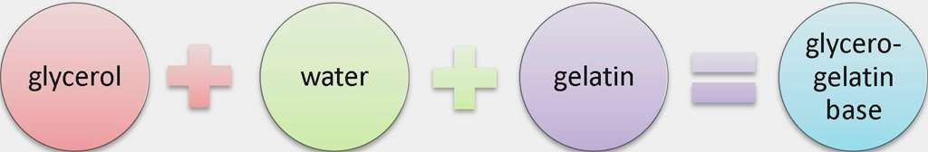
Glycero – gelatin bases (Water Soluble Bases)
These are compirse a mixture of glycerol and water, which is stiffened with gelatin. The commonest in use is glycerol suppositories BP which has 14 % w/w gelatin and 70 % w/w glycerol. In hot climates, the gelatin content can be increased to 18 % w/w.
Stiffer masses containing a higher proportion of gelatin are also used when the product contains more than about 20 % of semi – liquid or liquid because such additions make the pervious mass to soft.

Slide 10
The glycero – gelatin base have some properties:
clycero– gelatin bases have a physiological effect (laxative effect).
They are much more difficult to prepare and handle.
The solution time depends on the content and quality of the gelatin and the gas of the suppository.
They are hygroscopic and therefore, require careful storage and may cause rectal irritation.
Because of the water content, microbial contamination is more likely than with the fatty bases. Preservatives may require to be added to the product.
Gelatin is incompatible with protein precipitants such as tannic acid

Slide 11
Preparation of suppositories using Glycero– gelatin base
The correct amount of gelatin is weighted out and placed in a previously weighed beaker.
Sufficient water to just cover the gelatin is added and the contents left for about five minutes.
When the gelatin has softened, any excess water is drained off. This step is not necessary if powdered gelatin is being used.
the exact amount of glycerol is then weighed into the beaker
The beaker is placed on a water – bath, over gentle heat and the mixture gently stirred until the gelatin has melted.
.

Slide 12
When the gelatin is melted, the beaker is removed from the heat and weighed. If the weight is less than the required total, water is added, to the correct weight. If the contents of the beaker are too heavy it must be put back on, the heat and the excess water evaporated off.
When the correct weight is achieved the active ingredient is added with careful stirring.
The mixture is then poured into the prepared mold, lubricated with either almond oil.
It is not necessary to overfill the molds and this type of product does not require to be trimmed

Slide 13
Rx
Glycerinated gelatin suppositories (B.P.)
Gelatin |  | 14 g
Glycerol |  | 70 g
Purified water | q.s | 100 g
Ft. supp.
Mitt. 5 supp. Using 1 g mold.
Sig. one supp. To be used when required.

Slide 14
Rx
Glycerin suppositories (U.S.P.) Glycerol
Sodium stearate Purified water To make about Ft. supp.
Mitt. 5 supp. using 2 g mold. Sig. one supp. at night.
91 g
9 g
5 g
100 g

Slide 15
Rx
Soap glycerin suppositories Glycerol
Sodium carbonate Stearic acid
Ft. supp.
90 g
9 g
5 g
Mitt. 5 supp. using 1 g mold. Sig. supp. used as direct.

Slide 16
Macrogol (PEG)
These are polyethylene glycols which are blended together to produce suppository bases which vary in melting points, dissolution rates and physical characteristics. High polymers produce preparations, which release the drug slowly. They are also brittle, less brittle products, which release the drug more readily can be prepared by mixing high polymers with medium and low polymers. Drug is released as the base dissolves in the rectal contents.
Macrogols have several properties, which make them ideal suppository bases:
They have no physiological effect, e.g. do not produce a laxative effect.
They are not prone to microbial contamination.
Some polymers have at a high melting point. These are useful for drugs, which lower the melting point of other bases.
They have a high water –absorbing capacity.

Slide 17
The disadvantages of macrogols:
They are hygroscopic which means they must be carefully stored. Irritation of the rectal mucosa can also occur.
They are incompatible with several drugs e.g. benzocaine penicillin, tannins, phenol and bismuth salts.
They became brittle if cooled too quickly and may become brittle on storage.
Crystal growth occurs with some active ingredients.

Slide 18
Rx
PEG1000 PEG400 PEG4000
Ft. supp.
35 %
40 %
25 %
Mitt. 5 supp. Using 2 g mold.

Slide 19
Rx 2
PEG400 PEG6000 PEG6000
Ft. supp.
20%
33%
47%
Mitt. 5 supp. Using 2 g mold.

Slide 20
Rx
PEG4000 PEG1540
Water Ft. supp.
20%
33%
47%
Mitt. 5 supp. Using 1 g mold.

Slide 21
Rx
PEG1540 PEG6000
Water Ft. supp.
33%
47 %
20%
Mitt. 5 supp. Using 1g mold.

Slide 22
Rx
PEG400 PEG1000
Ft. supp.
4 %
96 %
Mitt. 5 supp. Using 1 g mold.

Slide 23
Rx
PEG4000 PEG1000
Ft. supp.
25 %
75 %
Mitt. 5 supp. Using 2g mold.

