Slide 1
Emulsions

Slide 2
EMULSIONS
An emulsion is a dispersion in which the dispersed phase is composed of small globules of a liquid distributed throughout a vehicle in which it is immiscible.
Many pharmaceutical preparations that may actually be emulsions may not be classified as such because they fit some other pharmaceutical category more appropriately. e.g, certain liniments, creams , ointments and commercial vitamin drops.
In emulsion terminology, the dispersed phase is the internal phase, and the dispersion medium is the external or continuous phase.

Slide 3
Types of emulsions:
O/W emulsions
in this type the oil droplets (internal phase) are dispersed throughout the aqueous phase (external phase)
W/O emulsions
in which the water (internal phase )is dispersed throughout the oil phase (external phase).

Slide 4
Factors that affect the type of emulsions :
The ratio of phases or relative phase volume : This means the phase in small volume will be the dispersed phase while the phase present in large volume is called the dispersion medium. But this is not a rule because sometimes the internal phase concentration may reach 74% but it is in uniform perfectly spherical droplets so it is considered as internal phase.
Emulsifying agent (EA) : It is very important to keep emulsion stability . Most of emulsifying agents prefer one type of emulsion , like acacia prefer o/w emulsion.
Order of mixing or method of preparation.
Note : The type of emulsion depend on the solubility of EA in the external phase.

Slide 5
Tests for identification of emulsion type:
Miscibility test: In this test the emulsion is mixed with a liquid that is miscible with the continuous phase. e.g . Dilution of emulsion with water, if no destruction occur ,this indicates its o/w ,while if destruction occurs, this means the emulsion is w/o.
Conductivity test: Emulsions with aqueous continuous phase will readily conduct electricity ,while emulsions with oily continuous phase will not .
Staining test: In this test we use water soluble dye .If the continuous phase is colored , this means that the emulsion is o/w emulsion.

Slide 6
Requirement for good emulsion:
All equipment used must be clean and dry.
A primary emulsion should be prepared first, which is thick , stable emulsion.
A suitable emulsifying agent should be chosen.
All water soluble components should be dissolved in part of water forming an aqueous phase .Also all oil soluble components should dissolve in oil phase.
If there is any waxy material or semisolid surfactant, the phases should be warmed and the temperature of the aqueous phase SHOULD be 2-3 ºC above that of the oily phase to prevent crystallization of the waxy material which will affect the stability of the emulsion.
Additive –like strong electrolytes may affect the stability of emulsion so these should be added after finishing the primary emulsion to prevent interaction with the emulsifying agent

Slide 7
Calculation of primary emulsions:
The amount of the emulsifying agent needed for preparation of primary emulsion depend on the type and the amount of the oil present in the prescription.
E.A | Ratio of Oil :Water :E.A.
Acacia Tragacanth | Fixed oil except liquid petrolatum and linseed oil | Volatile oil and liquid petrolatum and linseed oil
 | 4:2:1 | 3:2:1 or 2:2:1
 | 40:20:1 | 30:20:1 or 20:20:1

Slide 8

Notes: If more than one oil is to be incorporated, the quantity of E.A for each is calculated separately and the sum of quantities used.

Slide 9
Examples of volatile and fixed oils :
Type of oil | Volatile oils(essential oils) | Fixed oils
no
1 | Turpentine oil | Castor oil
2 | Clove oil | Lard oil
3 | Camphor oil | Olive oil
4 | Caraway oil | Almond oil
5 | Menthol | Cod liver oil
6 | Anethol | Theobroma oil
7 | Orange oil | Cotton seed oil
8 | Anise oil | Linseed oil
9 | Lemon oil | Maize oil
10 | Rose oil | Sesame oil
11 | Cinnamon oil | Sunflower oil
12 | Nutmeg oil
13 | Thyme
14 | Peppermint oil
15 | Sandal wood oil
16 | Terebene

Slide 10
Rx1
Castor oil 20 ml
Acacia Q.S.
Water Q.S. 40 ml
Calaculations :
Oil= 20 ml
Water= 2/4 *20= 10 ml
Acacia= 1/4 *20 = 5 g

Slide 11
Methods of preparation of emulsions:
Dry gum method
Wet gum method
Nascent soap method
Electrical method (Using electrical homogenizers)

Slide 12
Dry gum method :
Measure the oil in a dry measuring cylinder.
Triturate the oil with acacia powder in a dry mortar.
Measure water for primary emulsion and immediately add all of the water and stir continuously and vigorously (in the same direction) until the mixture thickens and the primary emulsion is formed .This is characterized by crackling sound.
Gradually dilute the primary emulsion with small volumes of the vehicle.
Gradually add any other ingredients.
Transfer to a measuring cylinder and make up to a final volume with the vehicle.

Slide 13
Wet gum method :
Water is added to the acacia gum and quickly triturated until the gum dissolve , to make mucilage.
Oil is added to this mucilage in small portions drop by drop , triturating the mixture thoroughly after each addition (in the same direction) until a thick primary emulsion is obtained.
Gradually dilute the primary emulsion with small volumes of the vehicle .
Gradually add any other ingredient.
Transfer to a measuring cylinder and make up to final volume with the vehicle.

Slide 14
Differences between wet and dry gum method:
Emulsifying agent is mixed with the oil in dry gum method while it is mixed with water in wet gum method.
The addition of water will be all at ONCE in dry gum method , while the oil is added drop by drop in wet method.
The crackling sound is heard higher in wet method than in dry method.

Slide 15
Nascent soap method (Bottle method):
This method involve placing the oil phase with an equal amount of alkali solution(NaOH, KOH, Mg(OH)₂ ) in a suitable bottle that is closed firmly and mixture is shaken vigorously, a reaction takes place between the free fatty acids in oil and alkali solution that will form the emulsifying agent which is the soap(nascent soap).
Notes:
Nascent soap method requires an oil rich in free fatty acids as olive oil or linseed oil.
The type of emulsion produced by nascent soap method depend on the type of alkali.

Slide 16
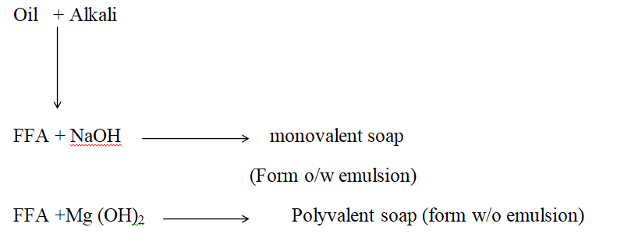

Slide 17
Types of instability of emulsions:
Bad emulsion
Flocculation and creaming (reversible).
Coalescence and breaking( irreversible).
Deterioration by microorganisms.
Miscellaneous physical and chemical changes.

Slide 18
Rx2
Oil of turpentine fƷii
Purified water Q.S. f℥i
Ft. emulsion
Sig. as directed
Calculations ( primary emulsion)
1 fƷ(fluidrachm)= 4 ml
2*4= 8 ml oil of turpentine
½ *8 = 4 g acacia
Amount of water =8 ml
Note :Oil of turpentine is rubefacient for muscle spasm.

Slide 19
Rx3
Castor oil fƷii
Bismuth carbonate gr x
Purified water Q.S. f℥ i
Ft. emulsion
Sig. f℥ss o.n
Calculations (primary emulsion)
2*4 = 8 ml of oil
¼ *8 = 2 g of acacia
½ *8 = 4 ml of water
Notes :
Castor oil is used internally as cathartic and externally as emollient.
Bismuth carbonate is used for mild irritant skin , duodenal ulcer.
Bismuth carbonate (insoluble diffusible solid ) is added or spread on the surface of the primary emulsion with continuous trituration.

Slide 20
Rx4
Almond oil fƷii
Ferric ammonium citrate gr x
Water Q.S. f℥i
Ft. emulsion
Calculations (primary emulsion )
2*4= 8ml of oil
¼ *8 =2 g acacia
1/2 *8 = 4 ml water
Method :
Put the acacia in dry mortar then add oil phase all at once with trituration , then add water at once with trituration , until you have a crackling sound of primary emulsion, dissolve ferric ammonium citrate in part of water to get a solution then add the remaining water or dilution (gradually also with trituration then add ferric solution gradually also with trituration)
Notes :
Almond oil is used as nutritive.
Ferric ammonium is used for iron deficiency anemia .
This prescription is used as tonic .

Slide 21
Rx5
Oil of turpentine fƷ i
Arachis oil fƷ i
Purified water Q.S. f℥ i
Calculations (primary emulsion)
1*4= 4 ml of each oil
½ *4 = 2 g acacia for oil of turpentine
¼ *4 = 1 g acacia for arachis oil
Total amount of acacia = 3 g
½ * 4 = 2 ml water (for arachis oil)
1*4 = 4 ml water ( for oil of turpentine )
Total amount of water = 6 ml
Notes :
Turpentine oil is used as emollient and counterirritant.
Almond oil is used as emollient and nutrient.

Slide 22
Rx 6
Castor oil 10 ml
Oleic acid 5 ml
Ca(OH)₂ q.s 30 ml
Ft. emulsion
Procedure:
Ca(OH)₂+ oleic acid Ca oleate(E.A.) to prepare w/o emulsion By nascent soap method

Slide 23
Rx7
Liquid paraffin 10 ml
Oleic acid 5 ml
Sodium hydroxide Q.S. 30 ml
Ft. emulsion
Procedure:
We take 10 of liquid paraffin with 5 ml of oleic acid with 15 ml sodium hydroxide in a bottle , then we shake for few seconds and an emulsion is formed .
Notes:
Sodium hydroxide with oleic acid leads to formation of sodium oleate (soap)which is the emulsifying agent and will form o/w emulsion.
Liquid paraffin used internally as a laxative and externally as emollient to the skin.

Slide 24
Classification of emulsifying agents:
Naturally occurring emulsifying agents. e.g. acacia(Arabic gum), tragacanth, starch and pectin.
Semisynthetic emulsifying agents .e.g. methylcellulose and carboxy methylcellulose .
Synthetic emulsifying agents (surfactants)
Anionic surfactants , e.g. sodium lauryl sulfate , sodium stearate and calcium oleate.
Cationic surfactants, e.g. cetrimide and benzylkonium chloride.
Amphoteric surfactants, e.g. polysorbate (tweens) and sorbitan esters(spans)
Non ionic surfactants,e.g. polysorbate( tweens) and sorbitan esters (spans)
4. Finally divided solids . e.g. Bentonite , magnesium hydroxide and aluminum .Magnesium silicate.

Slide 25
Concentrated Peppermint emulsion
Rx8
Peppermint oil 20 ml
Polysorbate 20(tween 20) 1ml
Double strength chloroform water 500 ml
Purified water Q.s. 1000 ml
Ft. emulsion
M.ft. 50 ml
Procedure:
Shake the peppermint oil with polysorbate 20
Gradually add double strength chloroform water and shake well after each addition.
Add sufficient water to produce 1000 ml.

Slide 26
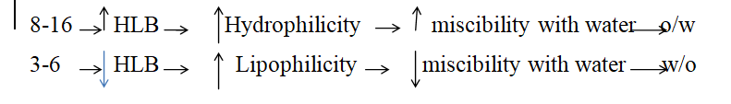
HLB System:
The most important property for the effective emulsifying agent is to undergo strong adsorption at the interface between oil and aqueous phase. This requires a good balance between the hydrophilic and hydrophobic properties in the molecule and this value is called the (HLB value).
The HLB value has been expressed as numerical scale that extends from (1 to 50) but practically the values are taken from (1 to 18).
Notes:

Slide 27
Required HLB:
Is the HLB that must be provided by emulsifying agent to produce a stable emulsion for a specific oil and each oil has two required HLB once for w/o and for o/w emulsion.
The required HLB value may vary according to :
Source of the material .
Required concentration.
Method of preparation.

Slide 28
Rx9
Mineral oil 25 g
E.A. (span 80+ tween 80) 2 g
Preservative 0.2 g
Purified water q.s. 100 g
The required HLB for the mineral oil = 11 and the HLB for span 80 = 4.3 and the HLB for tween 80 = 15
How much span 80 and tween 80 required to produce a stable emulsion ?
F_{S} * HLB s + F_{T} * HLB _{T} = required HLB of the oil
Let fraction of span =X
Let fraction of tween = 1-X
X*4.3 + (1-X)*15 = 11
10.7 X= 4
X= 0.37 fraction of span
Amount of span = 2 g * 0.37 = 0.74 g
1-X = 0.63 fraction of tween
Amount of tween = 2* 0.63 = 1.26 g

Slide 29
Rx10
Petrolatum 25 g
Cetyl alcohol 20 g
E.A. (S+T) 2 g
Preservative 0.2 g
Purified water 100 g

Slide 30
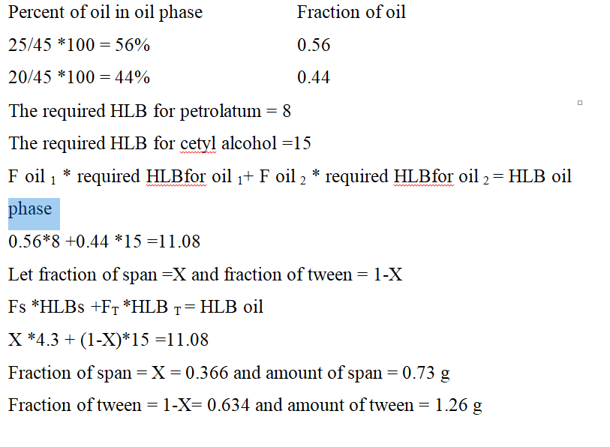

Slide 31
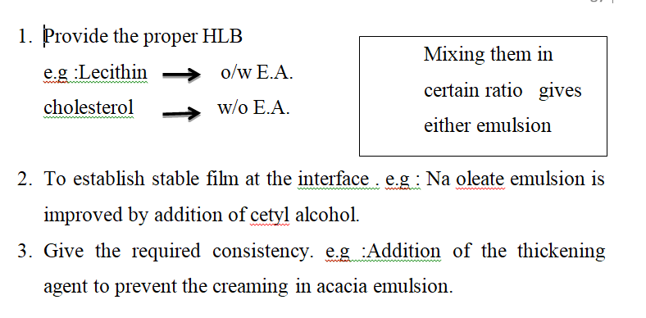
Notes :
The advantage of mixing the emulsifying agent :

Slide 32
Rx11
Liquid paraffin 35 g
Wool fat 1 g
Cetyl alcohol 1 g
Emulgent 7 g
Water 100 g
HLB of liquid paraffin = 12
HLB of wool fat = 10
HLB of cetyl alcohol = 15
35+ 1+1= 37 g of oil phase
35/37 *100 = 94% w/w of liquid paraffin
1/37 *100 = 2.7% w/w of wool fat
1/37 *100 = 2.7% w/w of cetyl alcohol
0.94 *12 + 0.027*10 + 0.027*15 =12.1 required HLB for the oil phase
HLB of span 80 = 4.3
HLB of tween 80 = 15
Suppose that the fraction of span = X
Fraction of tween =1-X
4.3 *X + 15 (1-X)= 12.1
X =0.27 fraction of span
7* 0.27 =1.89 g amount of span
1-0.27 = 0.73 fraction of tween
7 *0.73 = 5.11g amount of tween

Slide 33
Rx11 ( continue )
Procedure
Mix the liquid paraffin with wool fat with cetyl alcohol and span .Heat the mixture on water bath at 70 ºC.
Mix water and tween , heat the mixture on water bath at 75ºC.
Add the oil phase to water phase gradually with mixing using stirrer.
Transfer to suitable bottle.

