Slide 1
Oxidation-Reduction Titrations
Preparation And Standardization Of Potassium Permanganate Solution
2022 -2023

Slide 2
Reactions in which electrons are transferred from one species to another are called oxidation-reduction (redox) reactions. When one species loses electrons by an oxidation process another species simultaneously gains electrons by a reduction process in a chemical reaction. The balanced chemical reaction can be written as the combination of two half-reactions representing the oxidation reaction and the reduction reaction , respectively
In the oxidation –reduction methods of analysis, a change in valence of the reacting products is a must, while in the contrary to precipitation and neutralization methods of analysis where no change in valence occur

Slide 3
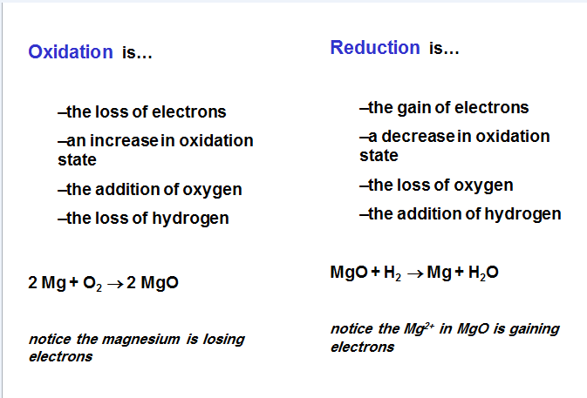

Slide 4
Assay Methods:
1- Permanganate Methods:
1.Direct Titration Methods.
2.In direct Titration Methods.
2-Dichromat Methods:
Direct Titration with Potassium Dichromate.
3- Cerci Sulphate Titration Methods:
Direct Titration with Cerci Sulphate

Slide 5
Permanganate Methods
Potassium permanganate: its an inorganic chemical compound with chemical formula KMnO4,M. Wt.=158.04 It is an odorless dark purple crystalline compound, soluble in water and freely soluble in boiling water. chemically, potassium permanganate is a strong oxidizing agent both in the dry state and in solution state.
Potassium permanganate is not primary standard substance because it contains reduced products like manganese oxide MnO2 where the concentration of KMnO4 changed after preparation because it dissociated via reducing agents such as ammonia and organic substances in water ;therefore, potassium permanganate must be standardized before use it and keep it at least 2-3 days after preparation at dark place and dark bottle

Slide 6
Uses:
Potassium permanganate solution are used for both antibacterial and antifungal action, and its primarily used today for skin produced (dermatitis) caused by bacteria and fungi. The concentration of KMnO4 is usually 1:10000, one teaspoon of solution is diluted with water to 2 liters
The permanganate ion is strong oxidizing reagent in an acidic medium:
2KMnO ₄ + 3H2SO4 K2SO4 + 2MnSO4 + 3H2O + 5(O)
MnO⁴⁻ + 8H⁺ + 5e⁻ Mn²⁺ + 4H₂O

Slide 7
Oxalate compounds have importance in many chemical and biological reactions. the main component of kidney stones. Excess vitamin C is converted into oxalate and excreted in the gut and urine, therefore, kidney stone patients must limit their intake of vitamin C to control the formation of calcium oxalate stones, as well as foods high in oxalate, such as spinach, beets, and beans.

Slide 8
Standardization of potassium permanganate with oxalic acid
In this experiment, The oxalate ion, C₂O₄²⁻, will react quantitatively with permanganate ion, MnO₄⁻, in the presence of strong acid according to the following equation:
2 MnO₄⁻ (aq) + 5 C₂O₄²⁻ (aq) + 16 H⁺ (aq) ↔ 2Mn²⁺ (aq) + 10 CO₂ (g) + 8 H₂O

Slide 9
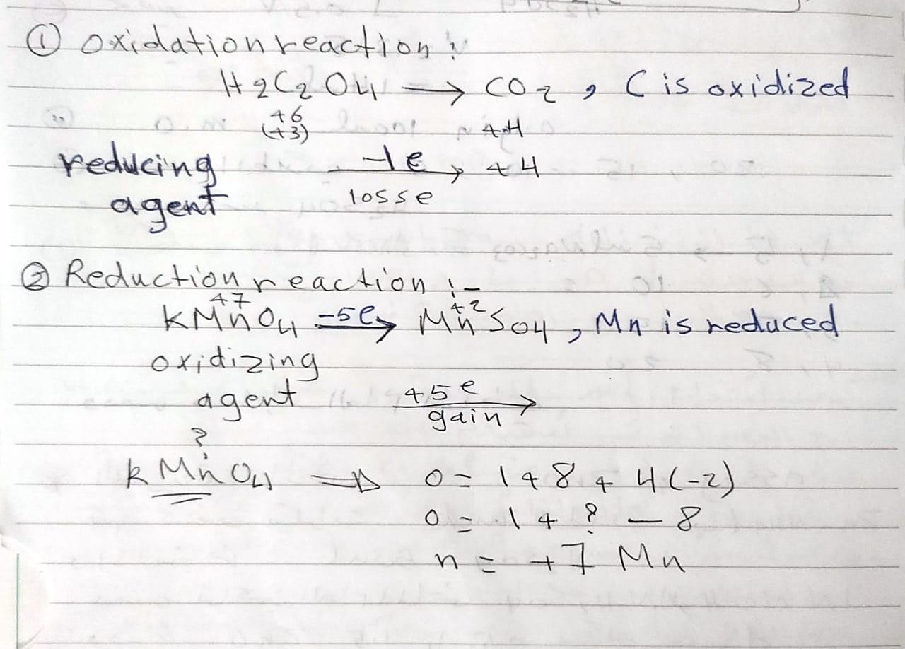
+5 e
2KMnO₄ + 5H₂C₂O₄ + 3H₂SO₄ → K₂SO₄ + 2 MnSO₄ + k₂SO₄ + 8H₂O + 10CO₂
- 2 e

Slide 10
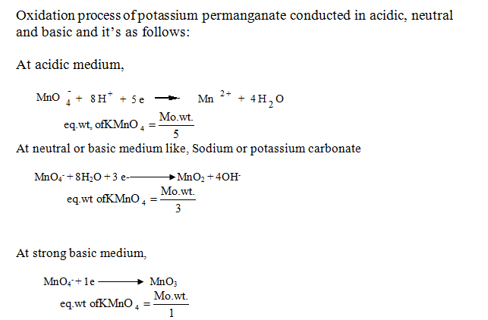

Slide 11
Procedure
1. Using measuring cylinder transfer 5 ml 0.1N oxalic acid and 5 ml sulphuric acid , swirl the contents carefully .
2. Heat the resulting solution for 1 to 1.5 min on hot plate up to 70°C.
3. Titrate the hot solution against the potassium permanganate solution, an end point is reached when a pink color persists .
4. Calculate the normality for the potassium permanganate solution.

Slide 12
N1V1 (Oxalic acid) = N2 V2 ( KMnO₄ )
M.Wt. KMnO₄ = 158.04 g/ mol
Eq.Wt. KMnO₄ = -------- g/ eq

Slide 13
Notes
During preparation of KMnO4 solution , the liquid allowed to stand for 2-3 days .
Prepared solution must be filtrated through cleaned glass wool and not cotton wool, or with filtering crucible .
Avoid heat in the preparation of KMnO4 solution because traces of grease or other possible contaminants on the glass vessels used can catalyst its decomposition.
Adding H2SO4 is very important in Standardization.

Slide 14
Procedure
KMnO4
5ml H2C2O4
5ml H2SO4
heating

