Slide 1
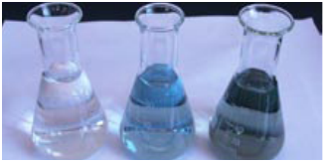
Assay of Ascorbic Acid (Vit. C)
Lecturer Luma Amer
2018-2019

Slide 2
Introduction:
Ascorbic acid (Vitamin C), molecular formula (C₆H₈O₆) is a naturally occurring organic compound with antioxidant properties
It is a white solid, but impure samples can appear yellowish.
Its melting point ( 190°C) with decomposition.
It dissolves well in water to give acidic solutions and sparingly soluble in ethanol.
Ascorbic acid solution rapidly oxidized in air and alkali media.
many animals are able to produce it (as a hormone), but humans require it as part of their nutrition.

Slide 3
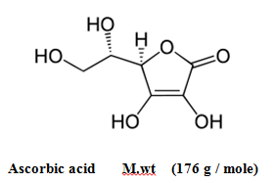
Ascorbic acid is a strong reducing agent and it is assayed by titration with iodine solution.

Slide 4
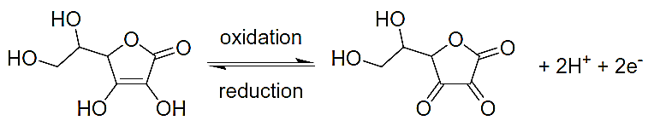
Principle:
This method determines the vitamin C concentration in a solution by a redox titration with potassium iodate in the presence of potassium iodide.
Ascorbic acid is a reducing agent and can be oxidized to form dehydroascorbic acid by iodine.
while iodine is reduced to iodine ion.
Ascorbic acid + I2 → 2 I− + dehydroascorbic acid

Slide 5
a) KIO3 +5KI + 6HCl 3I2 + 6KCl + 3H2O
b) I2 + C6H8O6 C6H6O6 + 2I- +2H+
Due to this reaction the iodine formed is immediately reduced to iodide as long as there is any ascorbic acid present. Once all the ascorbic acid has been oxidized, the excess iodine is free to react with the starch indicator, forming the blue-black starch-iodine complex. This is the endpoint of the titration

Slide 6
Explanation of equation (a)
KIO3 +5KI + 6HCl 3I2 + 6KCl + 3H2O
- The iodate ions are reduced to form iodine.
IO3− + 6 H+ + 5 e− → ½ I2 + 3 H2O
- While the iodide ions are oxidized to form iodine.
2I− → I2 + 2 e−
Combining these half-equations demonstrates the reaction between iodate and iodide.
2 IO3- + 10 I− + 12 H+ → 6 I2 + 6 H2O

Slide 7
Procedure:
Fill the burette with 20 ml of KIO3 .
Transfer 5 ml of unknown solution to the conical flask.
Add 1 ml of HCl +1 ml of potassium iodide KI.
Add 1 ml of 0.1 N potassium iodate solution KIO3 from burette .
Add 1ml of starch indicator.
Complete titration with KIO3 until end point , endpoint of the titration is the first permanent trace of a dark blue-black color.
Calculate the practical wt.

Slide 8
Calculations:
Calculate the weight of the sample(Vit C)
The mass for ascorbic acid was 176 g/mole?
a) KIO3 +5KI + 6HCl 3I2 + 6KCl + 3H2O
b) I2 + C6H8O6 C6H6O6 + 2I- +2H+

