Slide 1
Principles of pharmacy practice
Lec 1
Lecturer Dr Athmar Dhahir Habeeb Al-Shohani
PhD in industrial pharmacy and pharmaceutical formulations
athmar1978@uomustansiriyah.edu.iq
athmar1978@yahoo.com
athmar.habeeb.12@ucl.ac.uk

Slide 2
Density, Specific Gravity, and Specific Volume
Density (d) is mass per unit volume of a substance. It is usually expressed as grams per cubic centimeter (g/cc). Because the gram is defined as the mass of 1 cc of water at 4ºC, the density of water is 1 g/cc.
For our purposes, because the United States Pharmacopeia1 states that 1 mL may be used as the equivalent of 1 cc, the density of water may be expressed as 1 g/mL
Density may be calculated by dividing mass by volume, that is:

Slide 3


Thus, if 10 mL of sulfuric acid weighs 18 g, its density is:

Slide 4

Specific gravity
Specific gravity (sp gr) is a ratio, expressed decimally, of the weight of a substance to the weight of an equal volume of a substance chosen as a standard, both substances at the same temperature or the temperature of each being known.
Water is used as the standard for the specific gravities of liquids and solids; the most useful standard for gases is hydrogen.
Specific gravity may be calculated by dividing the weight of a given substance by the weight of an equal volume of water, that is:

Slide 5

Thus, if 10 mL of sulfuric acid weighs 18 g, and 10 mL of water, under similar conditions, weighs 10 g, the specific gravity of the acid is:
Substances that have a specific gravity less than 1 are lighter than water.
Substances that have a specific gravity greater than 1 are heavier than water

Slide 6
If 54.96 mL of oil weighs 52.78 g, what is the specific gravity of the oil?
54.96 mL of water weighs 54.96 g
Specific gravity of oil= 52.78 (g)/ 54.96 (g)
= 0.9603, answer.
If a pint of a certain liquid weighs 601 g, what is the specific gravity of the liquid?
1 pint =473 mL.
473 mL of water weighs 473 g
Specific gravity of liquid= 601 (g) /473 (g)
= 1.27, answer.

Slide 7
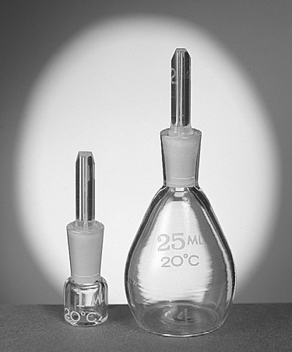
Pycnometer or Specific Gravity Bottle
A pycnometer is a special glass bottle used to determine specific gravity. Pycnometers are generally available for laboratory use in volumes ranging from 1 mL to 50 mL.
Pycnometers have fitted glass stoppers with a capillary opening to allow trapped air and excess fluid to escape. Some pycnometers have thermometers affixed, because temperature is a factor in specific gravity determinations.

Slide 8
Example:
A 50 mL pycnometer is found to weigh 120 g when empty, 171 g when filled with water, and 160 g when filled with an unknown liquid. Calculate the specific gravity of the unknown liquid.
Weight of water: 171 g - 120 g = 51 g
Weight of unknown liquid: 160 g - 120 g = 40 g
Specific gravity= Weight of substance/ Weight of equal volume of water
Specific gravity of unknown liquid = 40 (g)/ 51 (g)
= 0.78, answer.

Slide 9
Calculating Weight, Knowing the Volume and Specific Gravity
Grams = Milliliters × Specific gravity
Grams (other liquid)= Grams (of equal volume of water) × Specific gravity (other liquid)
Example:
What is the weight, in grams, of 2 fl. oz. of a liquid having a specific gravity of 1.118?
2 × 29.57 mL =59.14 mL
59.14 mL of water weigh 59.14 g
59.14 g × 1.118 =66.12 g, answer.
What is the cost of 1000 mL of glycerin, specific gravity 1.25, bought at $54.25 per pound?
1000 mL of water weigh 1000 g
Weight of 1000 mL of glycerin =1000 g × 1.25 =1250 g
1 lb =454 g
454 (g) /1250 (g) = ($) 54.25 ($) /x
x = $149.37, answer

Slide 10
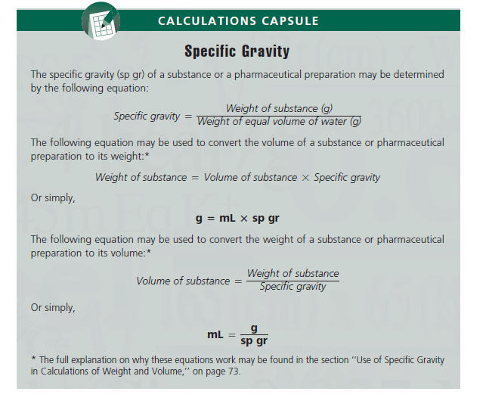

Slide 11
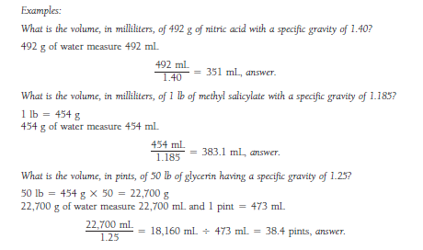

Slide 12
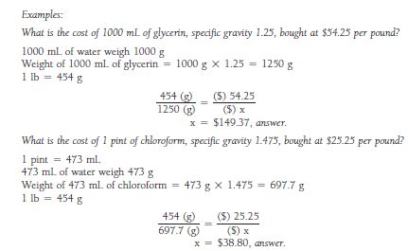

Slide 13
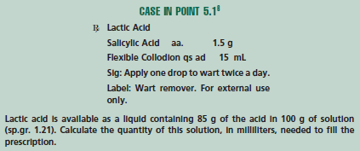

Slide 14
Calculating Specific Volume
Specific volume, in pharmaceutical practice, is usually defined as an abstract number representing the ratio, expressed decimally, of the volume of a substance to the volume of an equal weight of another substance taken as a standard, both having the same temperature. Water is the standard.
Example:
Calculate the specific volume of a syrup, 91.0 mL of which weighs 107.16 g.
107.16 g of water measures= 107.16 mL
Specific volume of syrup = 91.0 (mL) /107.16 (mL)
= 0.849, answer

Slide 15
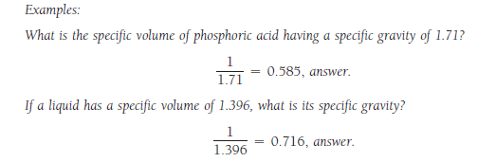
Because specific gravity and specific volume are reciprocals, a substance that is heavier than water will have a higher specific gravity and a lower specific volume,
whereas a substance that is lighter than water will have a lower specific gravity and a higher specific volume.
It follows, therefore, that we may determine the specific volume of a substance by dividing 1 by its specific gravity, and we may determine the specific gravity of a substance by dividing 1 by its specific volume.

Slide 16
