Slide 1
Principles of pharmacy practice
Lec 1
Lecturer Dr Athmar Dhahir Habeeb Al-Shohani
PhD in industrial pharmacy and pharmaceutical formulations
athmar1978@uomustansiriyah.edu.iq
athmar1978@yahoo.com
athmar.habeeb.12@ucl.ac.uk

Slide 4
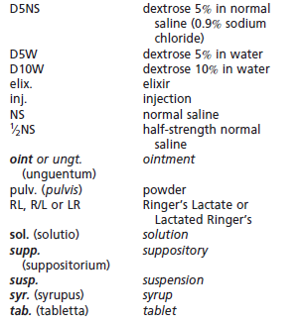

Slide 6
calculation of doses
The dose of a drug is the quantitative amount administered or taken by a patient for the intended medicinal effect. The dose may be expressed as
a single dose, the amount taken at one time
a daily dose
a total dose, the amount taken during the course of therapy.
A daily dose may be subdivided and taken in divided doses, two or more times per day depending on the characteristics of the drug and the illness.
The schedule of dosing (e.g., four times per day for 10 days) is referred to as the dosage regimen

Slide 8
The usual adult dose of a drug is the amount that ordinarily produces the medicinal effect intended in the adult patient.
The usual pediatric dose of a drug is the amount that ordinarily produces the medicinal effect intended in infant or child patient.
The ‘‘usual’’ adult and pediatric doses of a drug serve as a guide to physicians who may select to prescribe that dose initially or vary it depending on the assessed requirements of the particular patient.
The usual dosage range for a drug indicates the quantitative range or amounts of the drug that may be prescribed within the guidelines of usual medical practice.

Slide 9
The median effective dose of a drug is the amount that produces the desired intensity of effect in 50% of the individuals
The median toxic dose of a drug is the amount that produces toxic effects in 50% of the individuals tested.
The priming or loading dose is the dose that is larger-than-usual initial dose that may be required to achieve the desired blood drug level.
The maintenance doses is the dose that is similar in amount to usual doses, are then administered according to the dosage regimen to sustain the desired drug blood levels or drug effects

Slide 10
Certain biologic or immunologic products, such as vaccines, may be administered in prophylactic doses to protect the patient from contracting a specific disease. Other products, such as antitoxins, may be administered in therapeutic doses to counter a disease after exposure or contraction.

Slide 11
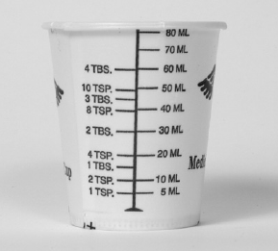
Dose measurements
In the institutional setting, doses are measured and administered by professional and paraprofessional personnel. A variety of measuring devices may be used, including calibrated cups for oral liquids and syringes and intravenous sets for parenteral medication.

Slide 12
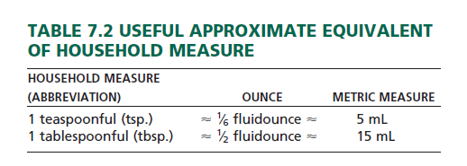
In the home setting, the adult patient or a child’s parent generally measures and administers medication. Liquid dosage is usually measured in ‘‘household’’ terms, most commonly by the teaspoonful and tablespoonful. It should be noted that the capacities of household teaspoons may vary from 3 to 7 mL and those of tablespoons may vary from 15 to 22 mL.

Slide 13
The Drop as a Unit of Measure
Occasionally, the drop (abbreviated gtt) is used as a measure for small volumes of liquid medications.
A drop does not represent a definite quantity, because drops of different liquids vary greatly.
In an attempt to standardize the drop as a unit of volume, the United States Pharmacopeia defines the official medicine dropper as being constricted at the delivery end to a round opening with an external diameter of about 3 mm.
The dropper, when held vertically, delivers water in drops, each of which weighs between 45 and 55 mg.
Accordingly, the official dropper is calibrated to deliver approximately 20 drops of water per milliliter (i.e., 1 mL of water 1 gram or 1000 mg

Slide 14
If a pharmacist counted 40 drops of a medication in filling a graduate cylinder to the 2.5-mL mark, how many drops per milliliter did the dropper deliver?

Slide 15
General Dose Calculations

Slide 17
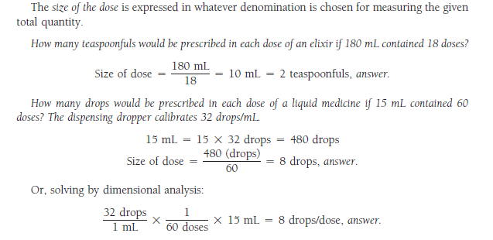

Slide 21
