Slide 1
Functional classification of the neuron:
1. Sensory neurons: from the afferent division of the PNS, the cell bodies of the sensory neurons are found in peripheral sensory ganglia (a ganglion is a collection of neuron cell bodies in the PNS).
-somatic sensory neurons ( monitor the outside world & our position within it).
-visceral sensory neurons ( monitor internal conditions & the status of other organ system).
2. Motor neurons: or efferent neurons, which carries instructions from the CNS to peripheral effectors (the motor neuron stimulates a peripheral tissue or organ).

Slide 2
EXCITATION & CONDUCTION الاثارة والتوصيل
Nerve cells have a low threshold for excitation. The stimulus may be electrical, chemical, or mechanical. Two types of physicochemical disturbances are produced: local, nonpropagated potentials called, and propagated potentials, the action potentials (or nerve impulses ). These are the only electrical responses of neurons and other excitable tissues, and they are the main language of the nervous system. They are due to changes in the conduction of ions across the cell membrane that are produced by alterations in ion channels. The electrical events in neurons are rapid, being measured in milliseconds (ms); and the potential changes are small, being measured in millivolts (mV).

Slide 3
Conduction is an active, self-propagating process, and the impulse moves along the nerve at a constant amplitude and velocity. The process is often compared to what happens when a match is applied to one end of a trail of gunpowder; by igniting the powder particles immediately in front of it, the flame moves steadily down the trail to its end as it is extinguished in its progression.

Slide 4
RESTING MEMBRANE POTENTIALجهد الغشاء الساكن
A membrane potential results from separation of positive and negative charges across the cell membrane . In neurons, the resting membrane potential is usually about –70 mV, which is close to the equilibrium potential for K+.
The resting membrane potential represents an equilibrium situation at which the driving force for the membrane-permeant ions down their concentration gradients across the membrane is equal and opposite to the driving force for these ions down their electrical gradients.

Slide 5
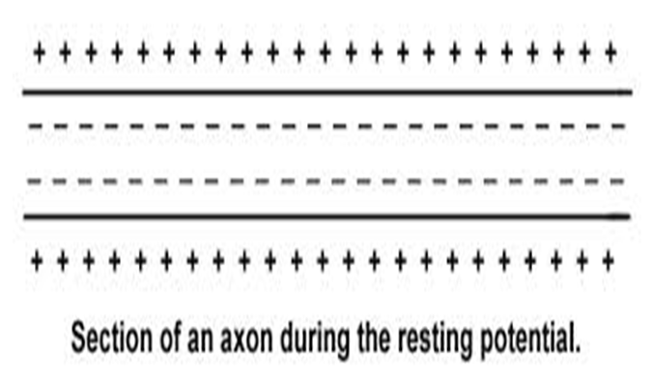
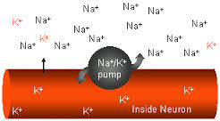

Slide 6
In neurons, the concentration of K+ is much higher inside than outside the cell, and contains high concentrations of negatively charged proteins (Pr-).while the reverse is the case for Na +. This concentration difference is established by the Na+ -K +ATPase. The outward K+ concentration gradient results in passive movement of K+ out of the cell when K+ -selective channels are open. Similarly, the inward Na+ concentration gradient results in passive movement of Na+ into the cell when Na+ -selective channels are open. Because there are more open K+ channels than Na+ channels at rest, the membrane permeability to K+ is greater.

Slide 7
Consequently, the intracellular and extracellular K+ concentrations are the prime determinants of the resting membrane potential, which is therefore close to the equilibrium potential for K+. Steady ion leaks cannot continue forever without eventually dissipating the ion gradients. This is prevented by the Na+ -K+ ATPase, which actively moves Na+ and K+ against their electrochemical gradient.

Slide 8
Action Potentials (AP):
APs are propagated changes in the transmembrane potential that once initiated, spread across the entire excitable membrane. An AP generally begins at the initial segment of the axon, the AP is then propagated along the length of the axon reaching the synaptic knobs

Slide 9
(the stimulus that initiate an AP is a depolarization large enough to open voltage-regulated Na+ channels), and the opening occur at the transmembrane potential called the Threshold (-60mV or -55mV).
**all stimuli that bring the membrane to threshold will generate an AP, so the properties of the AP dose not depend on the strength of depolarizing stimulus (graded-depolarization) as long as the stimulus exceeds threshold.
--this is called the all or non principle (because a stimulus either triggers a typical AP or dose not at all).

Slide 10
Action Potential Generation:
Depolarization to threshold: before an AP can begin, an area of excitable membrane must be depolarized to threshold by local current.
Activation of Na+ channels and rapid depolarization: at threshold the activation gates open & the cell become much more permeable to Na+ (by the effect of the electro-chemical gradients. Na+ rush into the cytoplasm and rapid depolarization occur).

Slide 11
Na+ channel inactivation & K+ channel activation:
at trans membrane potential of +30mV the inactivated gates of the voltage-regulated Na+ channels begin closing (this step is called Na+ channel inactivation). At the same time K+ channels are opened

Slide 12
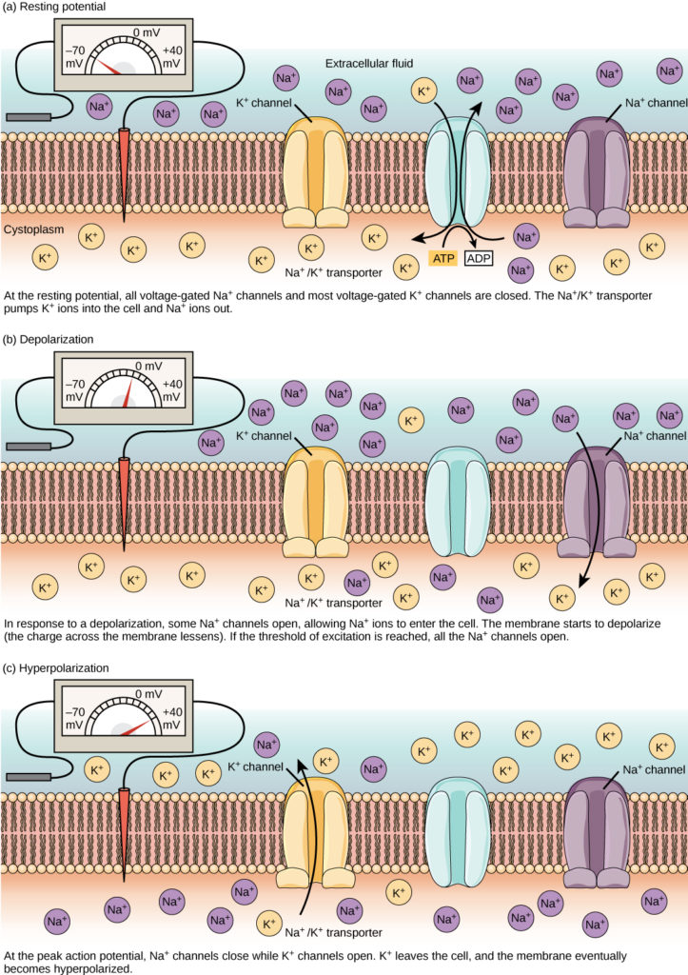

Slide 13
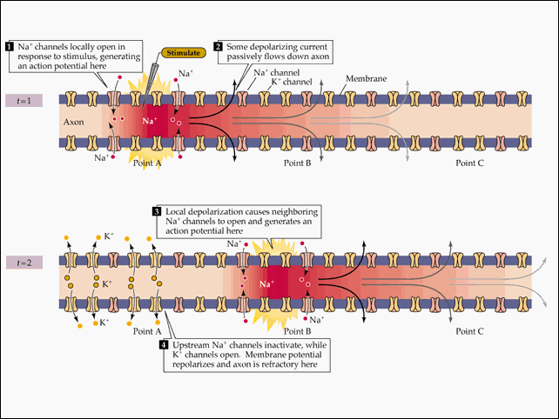

Slide 14
Return to normal permeability:
voltage regulated Na+ channels remain inactivated until the membrane repolarize to threshold (about -60mV) then they remain closed but capable opening. Voltage regulated K+ channel begin closing as membrane reaches normal resting potential (about -70mV).

Slide 16
Chemical transmission at the synapse.
The action potential in the presynaptic cell is transmitted to the postsynaptic cell via a chemical signal, which, in turn, triggers an action potential in the postsynaptic cell. When the action potential of the presynaptic cell reaches the terminal bulb, it triggers the opening of voltage-gated calcium channels in the plasma membrane. Calcium ions flow into the presynaptic cell. The elevated intracellular concentration of calcium triggers the fusion of synaptic vesicles with the plasma membrane of the terminal bulb. The synaptic vesicles reside in the terminal bulb, filled with neurotransmitters. When they fuse with the plasma membrane, the neurotransmitters are released into the synaptic cleft. Extracellular neurotransmitters bind to specific receptors in the plasma membrane of the postsynaptic cell. Upon the binding of neurotransmitter to its receptor, an action potential is triggered in the postsynaptic cell.

Slide 17
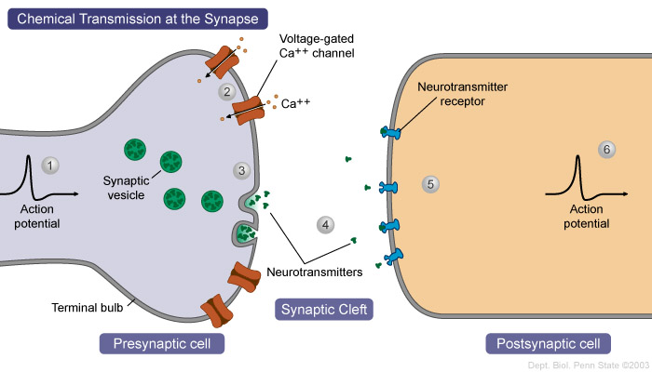

Slide 18
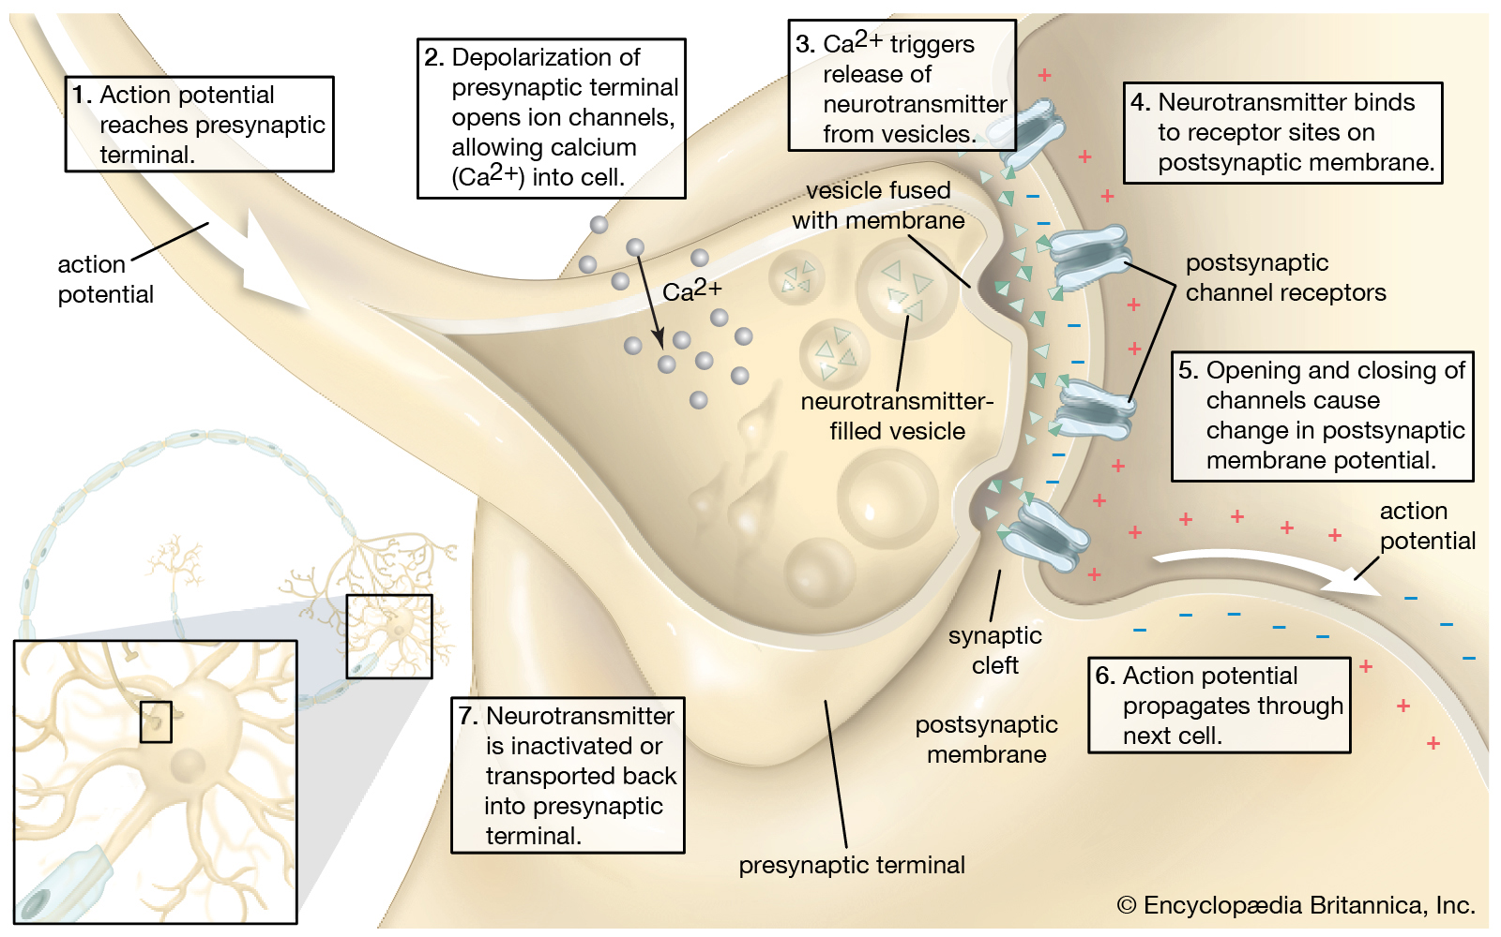

Slide 19
SALTATORY CONDUCTION التوصيل القفزي
myelin is an effective insulator, and current flow through it is negligible. Instead, depolarization in myelinated axons jumps from one node of Ranvier to the next .This jumping of depolarization from node to node is called saltatory conduction. It is a rapid process that allows myelinated axons to conduct up to 50 times faster than the fastest unmyelinated fibers.

Slide 20
ORTHODROMIC & ANTIDROMIC
CONDUCTION
An axon can conduct in either direction. When an action potential is initiated in the middle of it, two impulses traveling in opposite directions are set up by electrotonic depolarization on either side of the initial current sink. In the natural situation, impulses pass in one direction only, from synaptic junctions or receptors along axons to their termination. Such conduction is called orthodromic. Conduction in the opposite direction is called antidromic. Because synapses, unlike axons, permit conduction in one direction only, an antidromic impulse will fail to pass the first synapse they encounter and die out at that point.

Slide 21
NERVE FIBER TYPES & FUNCTION
mammalian nerve fibers can be classify into A, B, and C groups, further subdividing the A group into α, β, γ, and δ fibers. their classification depends on their diameters, electrical characteristics, and functions. In general, the greater the diameter of a given nerve fiber, the greater its speed of conduction. The large axons are concerned primarily with proprioceptive sensation, somatic motor function, conscious touch, and pressure, while the smaller axons subserve pain and temperature sensations and autonomic function. In addition to variations in speed of conduction and fiber diameter, the various classes of fibers in peripheral nerves differ in their sensitivity to hypoxia and anesthetics

Slide 22
Regeneration of a Cut Axon
When an axon in a peripheral nerve is cut, the distal portion of the axon that was severed from the cell body degenerates and is phagocytosed by Schwann cells. The Schwann cells, surrounded by the basement membrane, then form a regeneration tube as the part of the axon that is connected to the cell body begins to grow and exhibit amoeboid movement. The Schwann cells of the regeneration tube are believed to secrete chemicals that attract the growing axon tip, and the regeneration tube helps to guide the regenerating axon to its proper destination. Even a severed major nerve may be surgically reconnected—and the function of the nerve largely reestablished—if the surgery is performed before tissue death occurs.

Slide 23
