Slide 1
CELLULAR ELEMENTS IN THE CNS
1- GLIAL CELLS
The major distinction is that glia do not participate directly in synaptic interactions and electrical signaling. Neuroscience currently identifies four main functions of glial cells:
To surround neurons and hold them in place
To supply nutrients and oxygen to neurons
To insulate one neuron from another
To destroy pathogens and remove dead neurons.

Slide 2
There are two major types of glial cells:
1-Microglia
are scavenger cells that resemble tissue macrophages and remove debris resulting from injury, infection, and disease.
2-Macroglia :There are three types of macroglia: oligodendrocytes, Schwann cells, and astrocytes.

Slide 3
Oligodendrocytes and Schwann cells are involved in myelin formation around axons in the CNS and peripheral nervous system, respectively. Astrocytes, which are found throughout the brain, are of two subtypes. Fibrous astrocytes, which contain many intermediate filaments, are found primarily in white matter. Protoplasmic astrocytes are found in gray matter and have a granular cytoplasm. Both types send processes to blood vessels, where they induce capillaries to form the tight junctions making up the blood–brain barrier. They also send processes that envelop synapses and the surface of nerve cells.

Slide 4
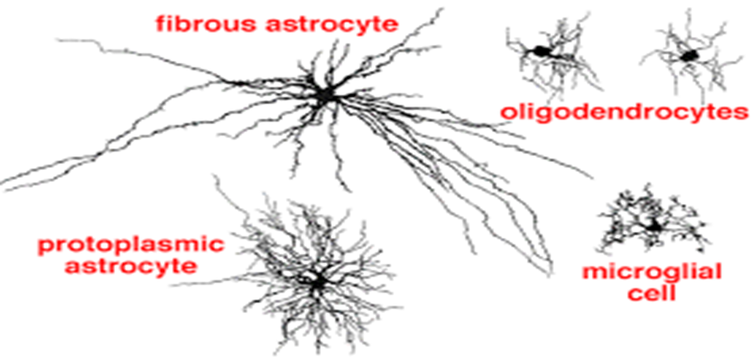
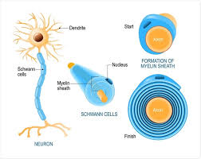

Slide 5
2-NEURONS (nerve cells) :
Neurons in the mammalian central nervous system come in
many different shapes and sizes. Most have the same parts as
the typical spinal motor neuron .

Slide 6
The cell body (soma) contains the nucleus and is the metabolic center of the neuron. Neurons have several processes called Dendrites that extend outward from the cell body and arborize extensively. Particularly in the cerebral and cerebellar cortex, the dendrites have small knobby projections called dendritic spines.
A typical neuron also has a long fibrous axon that originates from a somewhat thickened area of the cell body, the axon hillock. The first portion of the axon is called the initial segment. The axon branches into presynaptic terminals, each ending in a number of synaptic knobs which are also called terminal buttons or boutons.

Slide 7
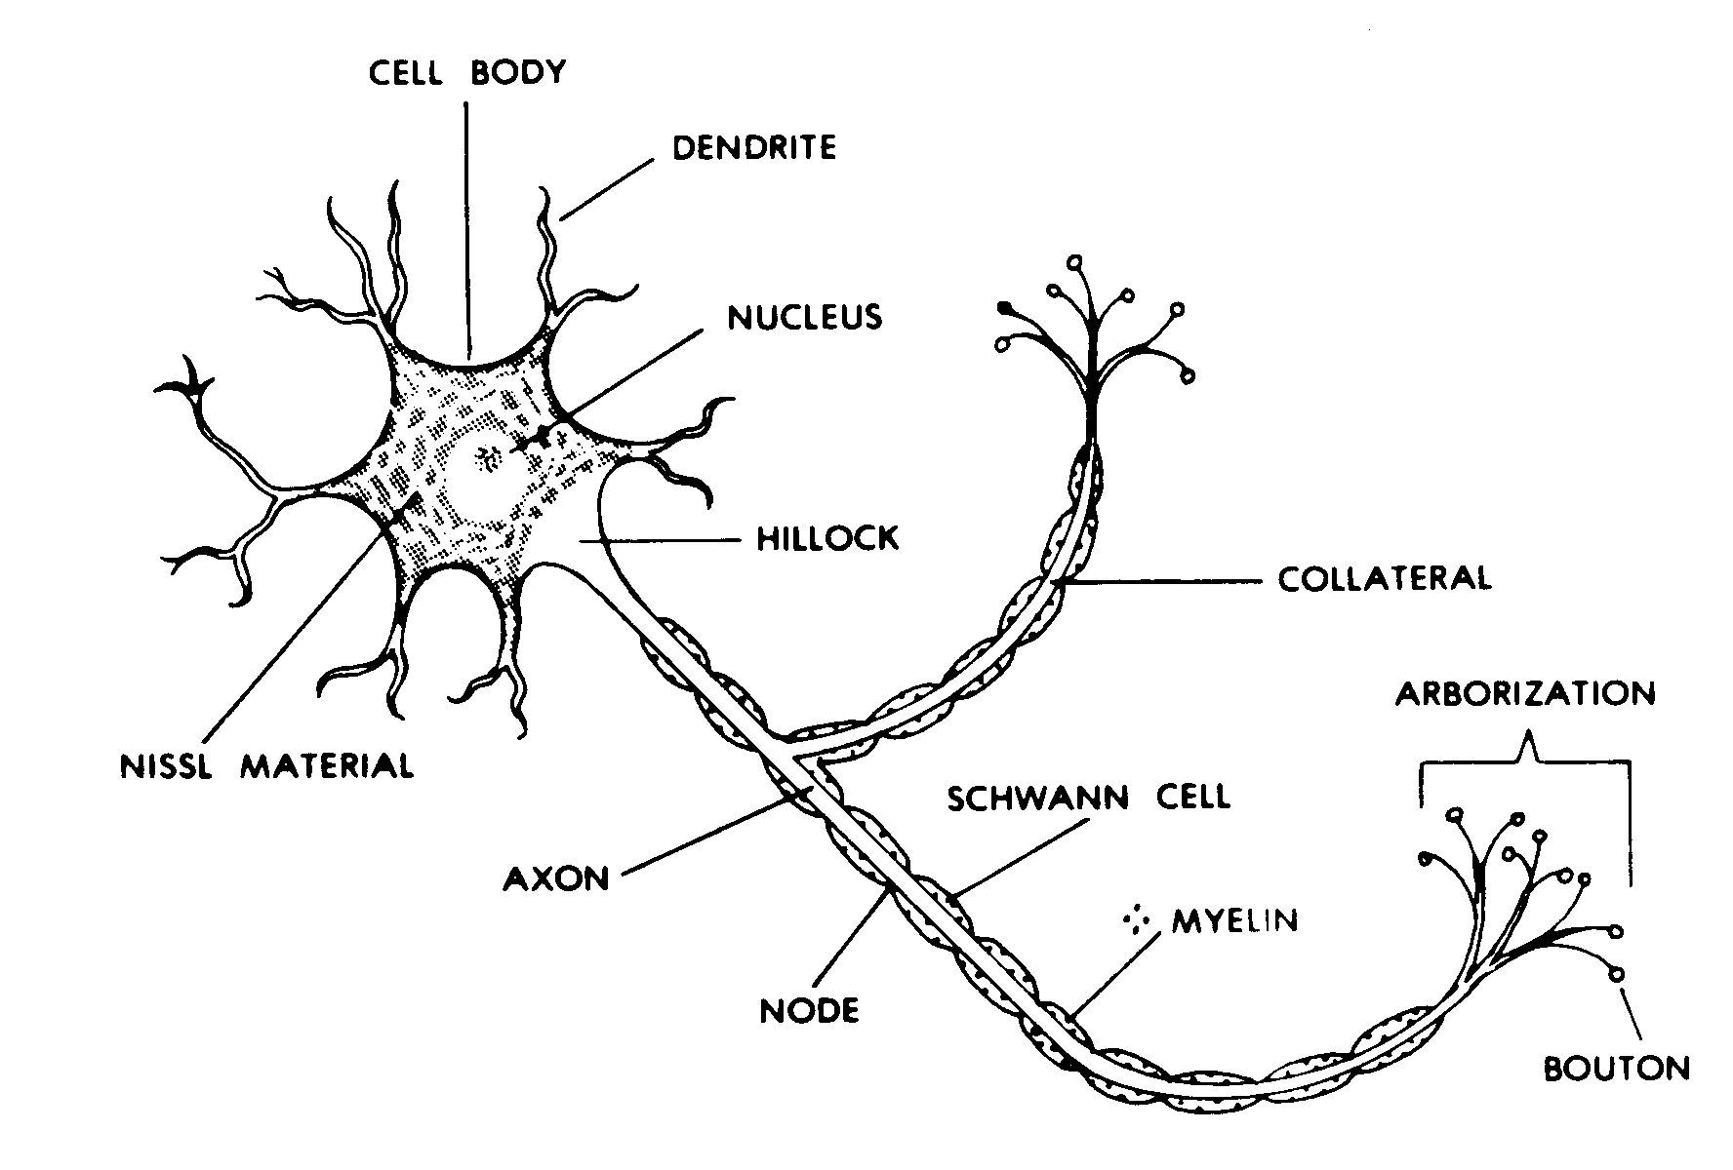
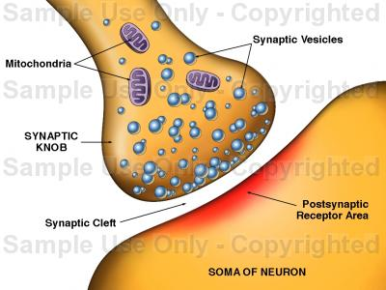

Slide 8
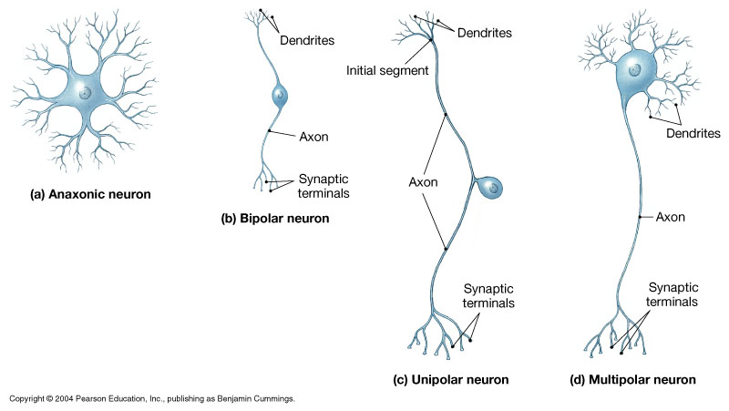
Presynaptic terminals contain granules or vesicles in which the synaptic transmitters secreted by the nerves are stored. Based on the number of processes that emanate from the cell body, neurons can be classified as unipolar, bipolar, and multipolar .

Slide 9
neurons generally have four important zones:
(1) a receptor, or dendritic zone, where multiple local potential changes generated by synaptic connections are integrated;
(2) a site where propagated action potentials are generated (the initial segment and the initial node of Ranvier.
(3) an axonal process that transmits propagated impulses to the nerve endings; and
(4) the nerve endings, where action potentials cause the release of synaptic transmitters.

Slide 10
The axons of many neurons are myelinated, that is, they acquire a sheath of myelin,
a protein–lipid complex that is wrapped around the axon . In the peripheral nervous system, myelin forms when a Schwann cell wraps its membrane around an axon up to 100 times.
The myelin sheath envelops the axon except at its ending and at the nodes of Ranvier.

Slide 11
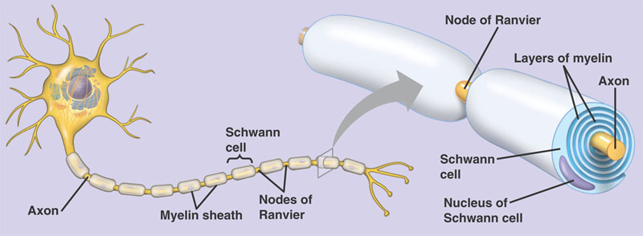

Slide 12
AXONAL TRANSPORT
Neurons are secretory cells, but they differ from other secretory cells in that the secretory zone is generally at the end of the axon, far removed from the cell body. The apparatus for protein synthesis is located for the most part in the cell body, with transport of proteins and polypeptides to the axonal ending by axoplasmic flow and axonal transport.
Thus, the cell body maintains the functional and anatomic integrity of the axon; if the axon is cut, the part distal to the cut degenerates.

Slide 13
Axoplasmic Flow
- Transport rate comparatively slow (1–2 mm/day)
- Molecules transported only from cell body
-Bulk movement of proteins in axoplasm, including microfilaments and tubules
Transport accompanied by peristaltic waves of axon membrane
Axonal Transport
-Transport rate comparatively fast (200–400 mm/day)
-Molecules transported from cell body to axon endings and in reverse direction
-Transport of specific proteins, mainly of membrane proteins and acetylcholinesterase
-Transport dependent on cage-like microtubule structure within axon and on actin and Ca2+

