Slide 1
Nucleus:
is a membrane-enclosed organelle found in eukaryotic cells. It contains most of the cell's genetic material, organized as multiple long linear DNA molecules in complex with a large variety of proteins, such as histones, to form chromosomes. The genes within these chromosomes are the cell's nuclear genome. The function of the nucleus is to maintain the integrity of these genes and to control the activities of the cell by regulating gene expression.
everyone knows that the genes, control heredity from parents to children, but most people do not realize that these same genes also control day-today function of all the body’s cells. The genes control cell function by determining which substances are synthesized within the cell—which structures, which enzymes, which chemicals.

Slide 2
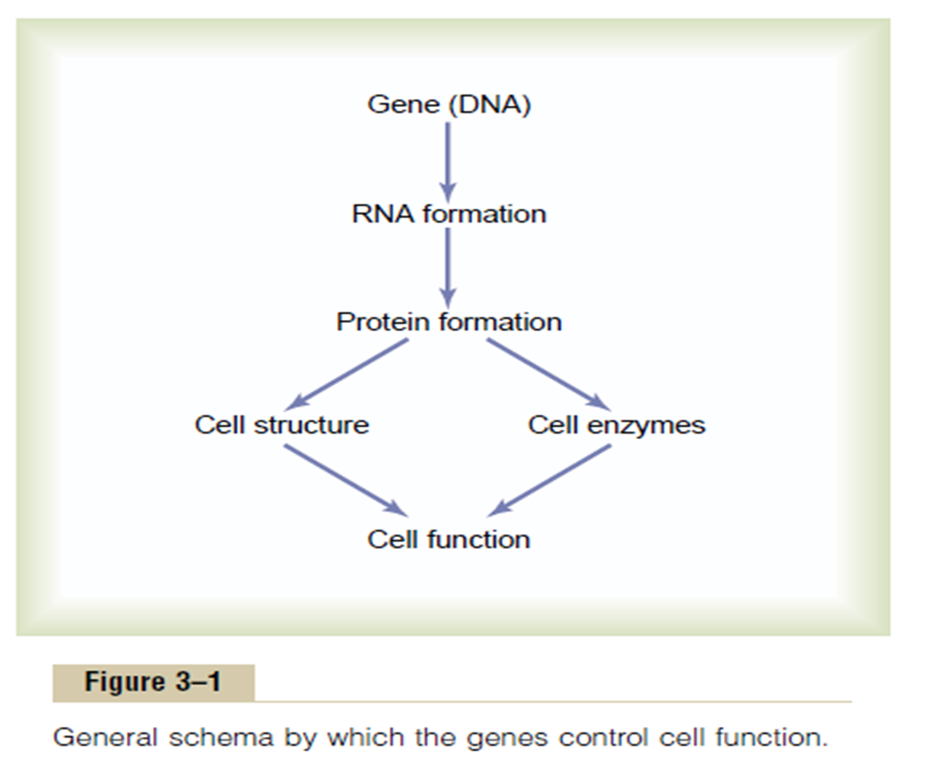

Slide 3
Protein Synthesis and Secretion
In order for a gene to be expressed, it first must be used as a guide,
or template, in the production of a complementary strand of
messenger RNA. This mRNA is then itself used as a guide to produce
a particular type of protein whose sequence of amino acids is
determined by the sequence of base triplets (codons) in the mRNA.
When mRNA enters the cytoplasm, it attaches to ribosomes,
which appear in the electron microscope as numerous
small particles. A ribosome is composed of four molecules of ribosomal RNA and eighty-two proteins, arranged to form two
subunits of unequal size. The mRNA passes through a number of ribosomes to form a “string-of-pearls” structure called a polyribosome (or polysome, for short), as shown in figure

Slide 4
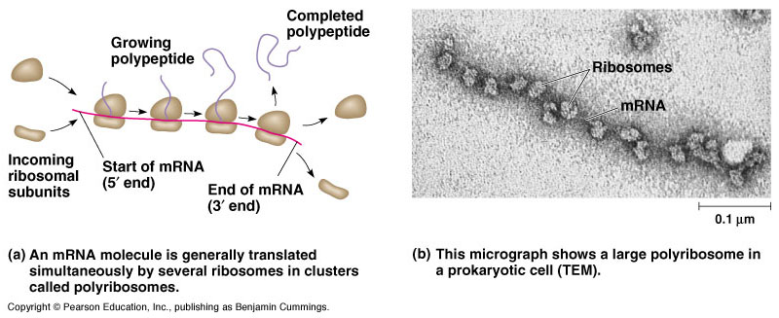

Slide 5
The association of mRNA with ribosomes is needed for the process of genetic translation—the production of specific proteins according to the code contained in the mRNA base sequence. Each mRNA molecule contains several hundred or more nucleotides, arranged in the sequence determined by complementary base pairing with DNA during transcription (RNA synthesis). Every three bases, or base triplet, is a code word—called a codon—for a specific amino acid. Sample codons and their amino acid “translations”
As mRNA moves through the ribosome, the sequence of codons is translated into a sequence of specific amino acids within a growing polypeptide chain.

Slide 6
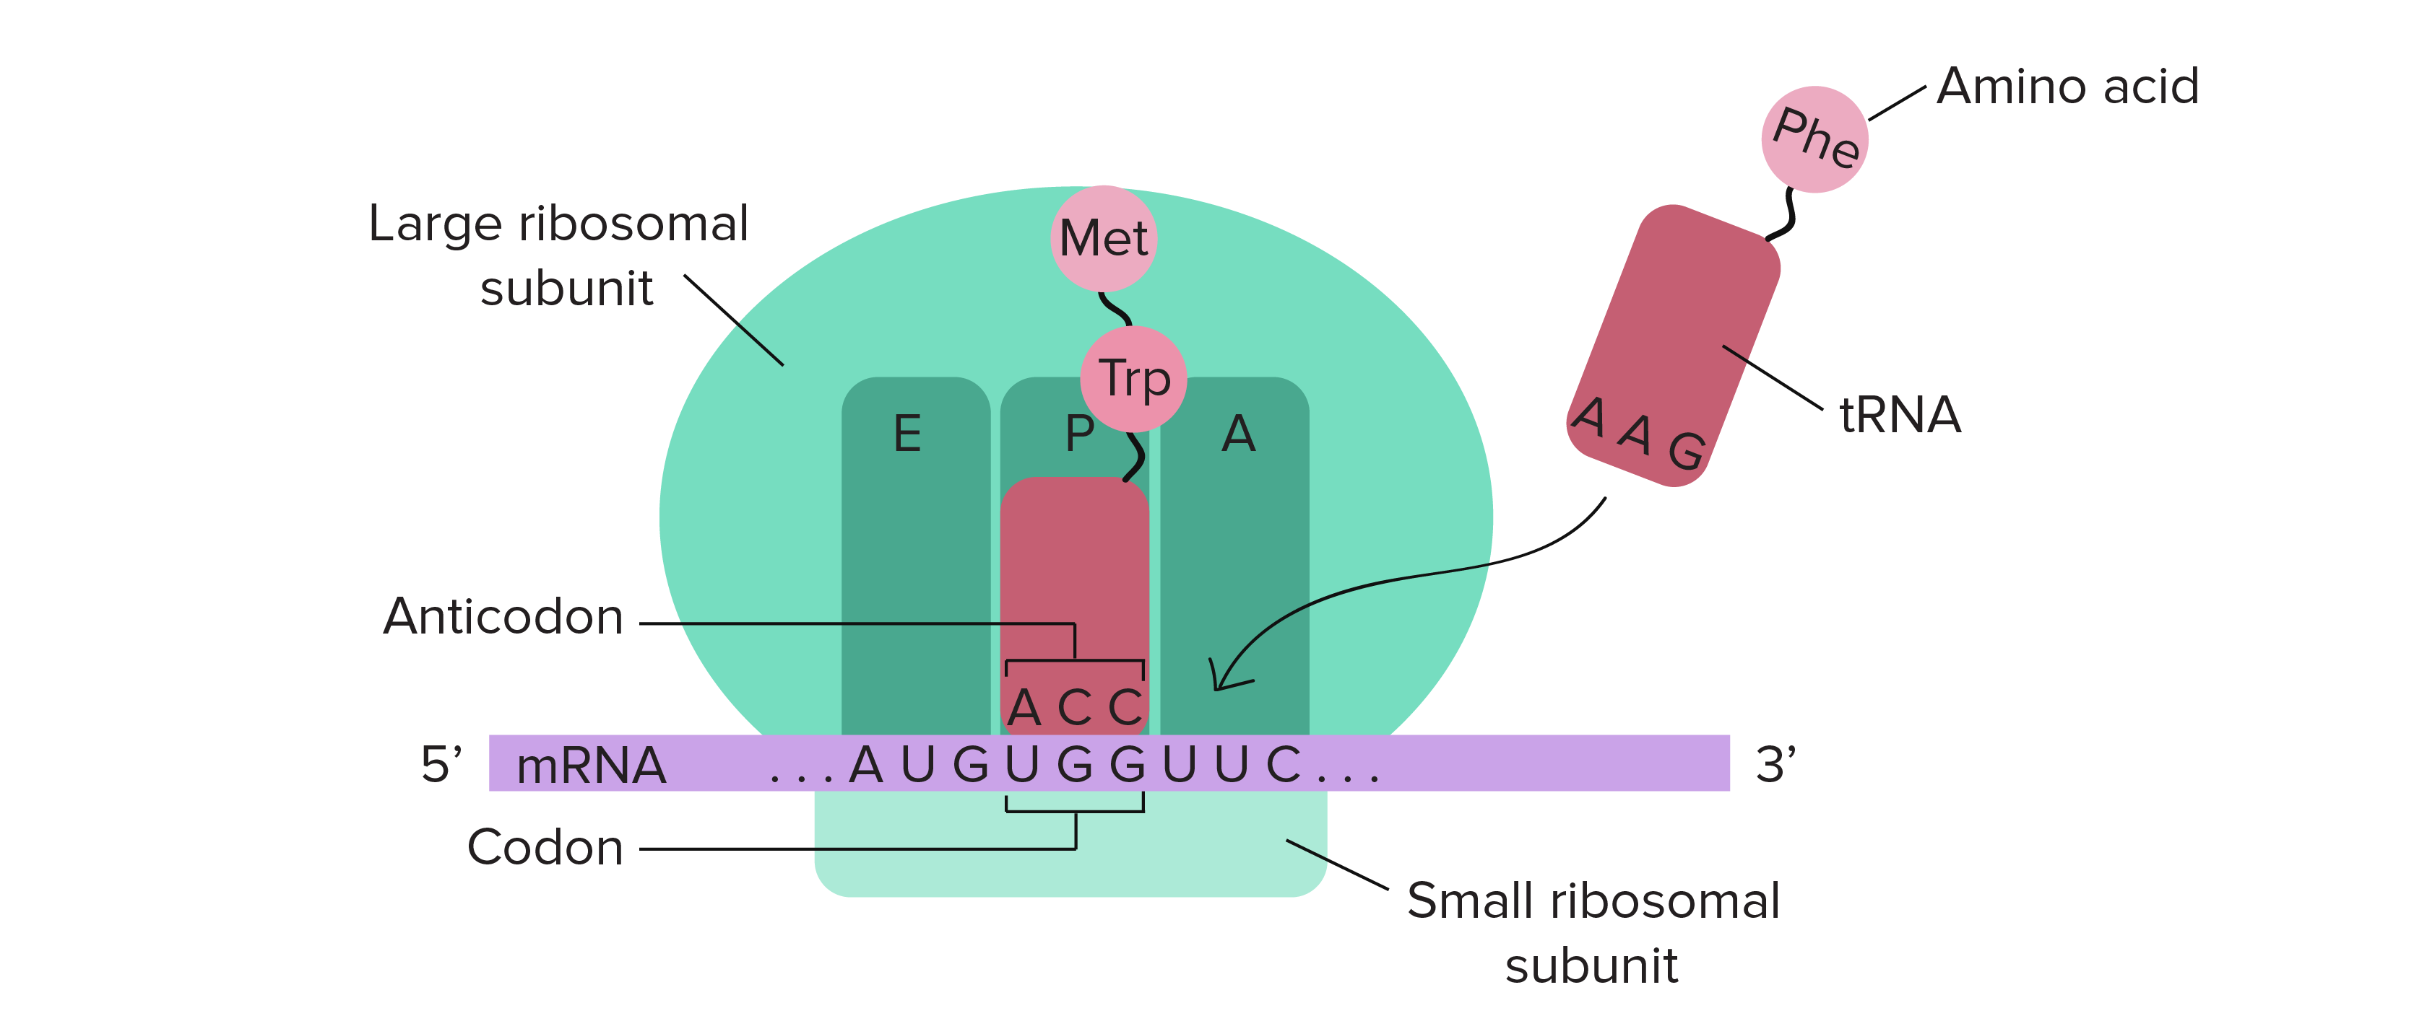

Slide 7
Three Different Types of RNA.
There are three different types of RNA, each of which plays an independent and entirely different role in protein formation
1. Messenger RNA, which carries the genetic code to the cytoplasm for controlling the type of protein formed.
2. Transfer RNA, which transports activated amino acids to the ribosomes to be used in assembling the protein molecule
3. Ribosomal RNA, which, along with about 75 different proteins, forms ribosomes, the physical and chemical structures on which protein molecules are actually assembled.

Slide 8
Control of Gene Function and Biochemical Activity in Cells:
Genes control both the physical and the chemical functions of the cells.
Each cell has powerful internal feedback control mechanisms that keep the various functional operations of the cell in step with one another.

Slide 9
There are basically two methods by which the biochemical activities in the cell are controlled. One of these is *genetic regulation, in which the degree of activation of the genes themselves is controlled, and the other is *enzyme regulation, in which the activity levels
of already formed enzymes in the cell are controlled.

Slide 10
Genetic Regulation
Formation of all the enzymes needed for the synthetic process often is controlled by a sequence of genes located one after the other on the same chromosomal DNA strand. This area of the DNA strand is called an operon, and the genes responsible for forming the respective enzymes are called structural genes. In the DNA strand there is segment called the promoter. This is a group of nucleotides that has specific affinity for RNA polymerase. The polymerase must bind with this promoter before it can begin traveling along the DNA strand to synthesize RNA. Therefore, the promoter is an essential element for activating the operon.

Slide 11
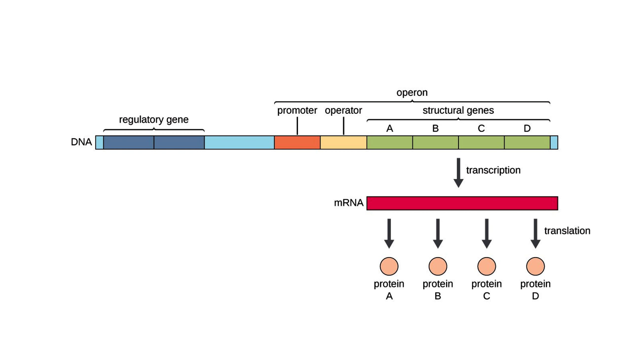
Genetic Regulation

Slide 12
Control of Intracellular Function by Enzyme Regulation
In addition to control of cell function by genetic regulation, some cell activities are controlled by intracellular inhibitors or activators that act directly on specific
intracellular enzymes. Thus, enzyme regulation represents a second category of mechanisms by which cellular biochemical functions can be controlled.

Slide 13
Enzyme Inhibition.
Some chemical substances formed in the cell have direct feedback effects in inhibiting the specific enzyme systems that synthesize them causing an allosteric conformational change that inactivates it.
Enzyme Activation.
Enzymes that are normally inactive
often can be activated when needed. An example of this occurs when most of the ATP has been depleted in a cell.

Slide 14
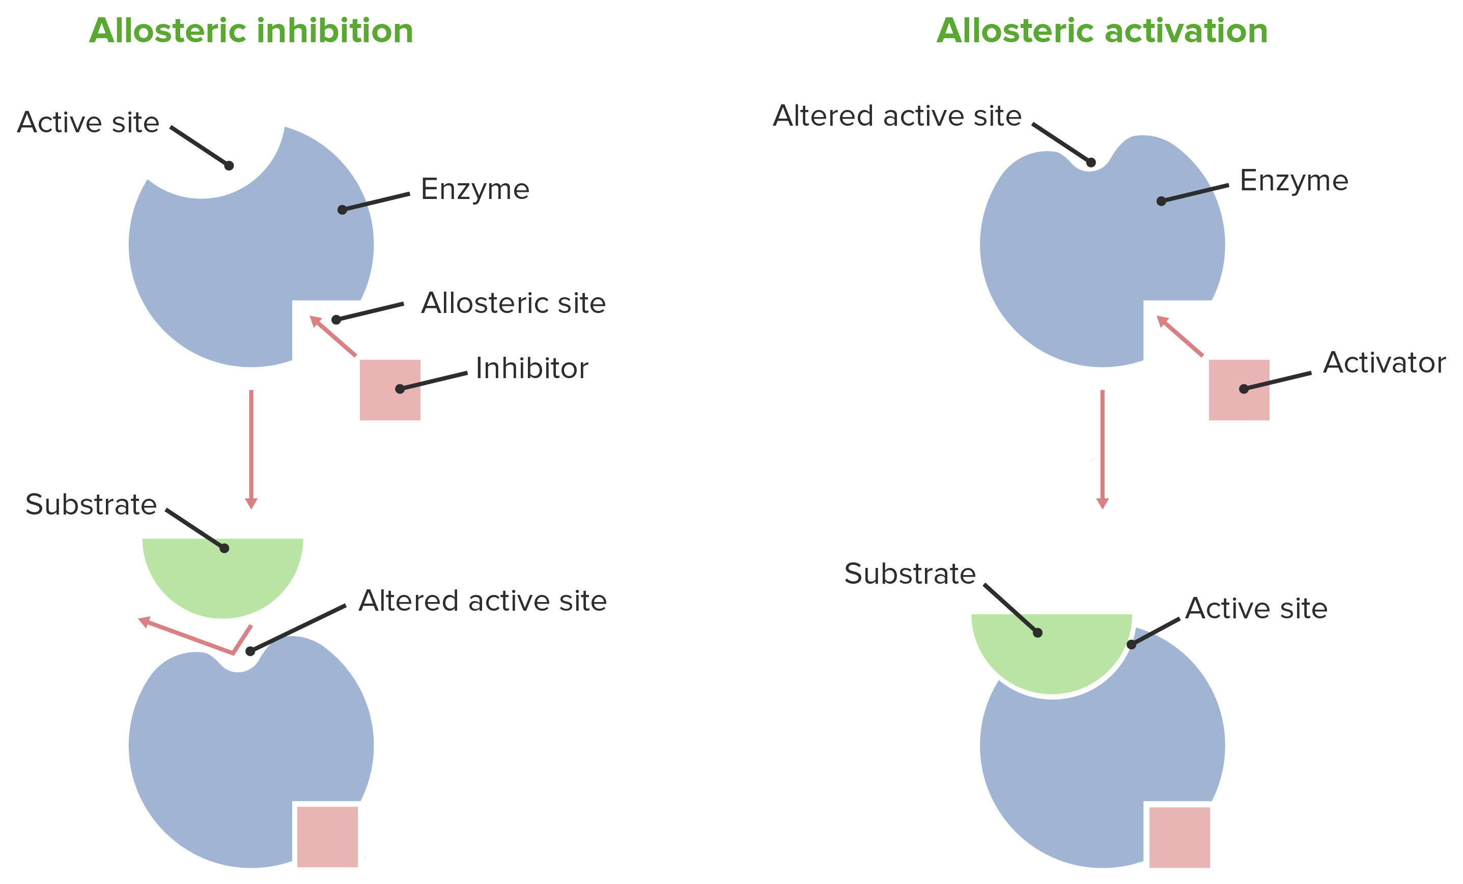
Enzyme Inhibition and Activation

Slide 15
In this case, a considerable amount of cyclic adenosine monophosphate (cAMP) begins to be formed as a breakdown product of the ATP; the presence of this cAMP, in turn, immediately activates the glycogen-splitting enzyme phosphorylase, liberating glucose molecules that are rapidly metabolized and their energy used for replenishment of the ATP stores.
Thus, cAMP acts as an enzyme activator for the enzyme phosphorylase and thereby helps control intracellular ATP concentration.

Slide 16
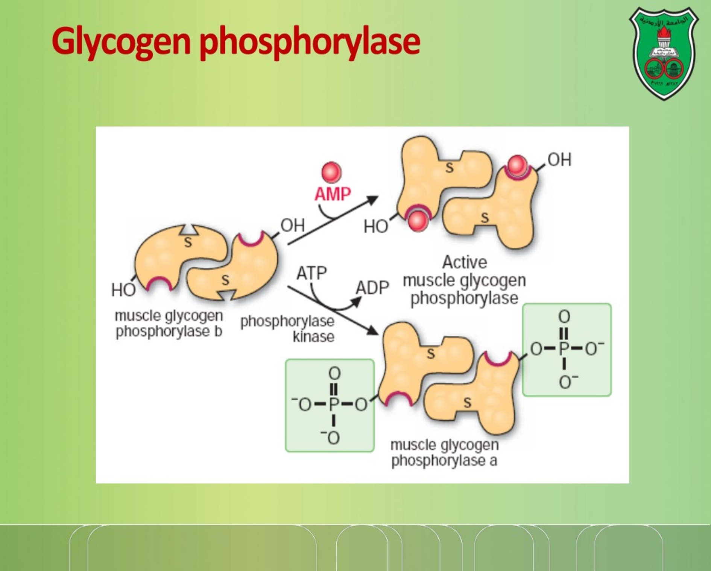

Slide 17
Cell Mitosis
The actual process by which the cell splits into two new cells is called mitosis. Once each chromosome has been replicated to form the two chromatids, in many cells, mitosis follows automatically within 1 or 2 hours.
Cell Differentiation
A special characteristic of cell growth and cell division is cell differentiation, which refers to changes in physical and functional properties of cells as they proliferate in the embryo to form the different bodily structures and organs.

Slide 18
Apoptosis—Programmed Cell Death
When cells are no longer needed or become a threat to the organism, they undergo a suicidal programmed cell death, or apoptosis. This process involves a specific proteolytic cascade that causes the cell to shrink and condense, to disassemble its cytoskeleton, and to alter its cell surface so that a neighboring phagocytic cell, such as a macrophage, can attach to the cell membrane and digest the cell.

Slide 19
In contrast to programmed death, cells that die as a result of an acute injury usually swell and burst due to loss of cell membrane integrity, a process called cell necrosis. Necrotic cells may spill their contents, causing inflammation and injury to neighboring cells.
Apoptosis, however, is an orderly cell death that results in disassembly and phagocytosis of the cell before any leakage of its contents occurs, and neighboring cells usually remain healthy.

Slide 20
Cancer
Cancer is caused in all or almost all instances by mutation or by some other abnormal activation of cellular genes that control cell growth and cell mitosis. the abnormal genes are called oncogenes. Also present in all cells are antioncogenes, which suppress the activation of specific oncogenes. Therefore, loss of or inactivation of antioncogenes can allow activation of oncogenes that lead to cancer.

Slide 21
Invasive Characteristic of the Cancer Cell.
The major differences between the cancer cell and the normal cell are the following: (1) The cancer cell does not respect usual cellular growth limits; the reason for this is that these cells presumably do not require all the same growth factors that are necessary to cause growth of normal cells.

Slide 22
(2) Cancer cells often are far less adhesive to one another than are normal cells. Therefore, they have a tendency to wander through the tissues, to enter the blood stream, and to be transported all
through the body, where they form numerous
new cancerous growths.
(3) Some cancers also produce angiogenic factors that cause many new blood vessels to grow into the cancer, thus supplying the nutrients required for cancer growth.

