Slide 4
GENERAL PRINCIPLES
Organization of the Body:
The cells that make up the bodies of all but the simplest multicellular animals, both aquatic and terrestrial, exist in an "internal sea" of extracellular fluid (ECF) enclosed within the integument of the animal. From this fluid, the cells take up O₂ and nutrients. In animals with a closed vascular system, the ECF is divided into two components: the interstitial fluid and the circulating blood plasma. The plasma and the cellular elements of the blood, principally red blood cells, fill the vascular system.

Slide 5
The interstitial fluid is that part of the ECF that is outside the vascular system, bathing the cells.
About a third of the total body water (TBW) is extracellular; the remaining two-thirds are intracellular (intracellular fluid).
Body Composition :
In the average young adult male, 18% of the body weight is protein and related substances, 7% is mineral, and 15% is fat. The remaining 60% is water.

Slide 6
Differences Between ECF and ICF
The ECF contains large amounts of sodium, chloride, and bicarbonate ions plus nutrients for the cells, such as oxygen, glucose, fatty acids, and amino acids. It also contains carbon dioxide that is being transported from the cells to the lungs to be excreted, plus other cellular waste products that are being transported to the kidneys for excretion.
The ICF differs significantly from the ECF; specifically, it contains large amounts of potassium, magnesium, and phosphate ions.

Slide 7
“Homeostatic” Mechanisms of the Major Functional Systems
Homeostasis: التوازن الداخلي
The term homeostasis is used by physiologists to mean maintenance of nearly constant conditions in the internal environment.
Essentially all organs and tissues of the body perform functions that help maintain these constant conditions.

Slide 8
ECF Transport and Mixing System –
The Blood Circulatory System
ECF is transported through all parts of the body in two stages:
The first stage is movement of blood through the body in the blood vessels.
The second is movement of fluid between the blood capillaries and the intercellular spaces between the tissue cells.
The walls of the capillaries are permeable to most molecules in the plasma of the blood, with the exception of the large plasma protein molecules.

Slide 10
Origin of Nutrients in the ECF
Respiratory System:
Each time the blood passes through the body, it also flows through the lungs.
The blood picks up oxygen in the alveoli. The membrane between the alveoli and the lumen of the pulmonary capillaries, the alveolar membrane, is only 0.4 to 2.0 micrometers thick, and oxygen diffuses by molecular motion through the pores of this membrane into the blood in the same manner that water and ions diffuse through walls of the tissue capillaries.

Slide 11
Origin of Nutrients in the ECF
Gastrointestinal Tract (GIT):
A large portion of the blood pumped by the heart also passes through the walls of the GIT.
Here different dissolved nutrients, including carbohydrates, fatty acids, and amino acids, are absorbed from the ingested food into the ECF of the blood.

Slide 12
Origin of Nutrients in the ECF
Liver and Other Organs That Perform Primarily Metabolic Functions:
Not all substances absorbed from the GIT can be used in their absorbed form by the cells. The liver changes the chemical compositions of many of these substances to more usable forms, and other tissues of the body such as fat cells, GIT mucosa, kidneys, and endocrine glands helps modify the absorbed substances or store them until they are needed.

Slide 13
Origin of Nutrients in the ECF
Musculoskeletal System:
the body could not move to the appropriate place to obtain the foods required for nutrition. Without muscles.
The musculoskeletal system also provides motility for protection against adverse surroundings.

Slide 14
Removal of Metabolic End Products
Removal of Carbon Dioxide by the Lungs:
At the same time that blood picks up oxygen in the lungs, carbon dioxide is released from the blood into the lung alveoli; the respiratory movement of air into and out of the lungs carries the carbon dioxide to the atmosphere.
Carbon dioxide is the most abundant of all the end products of metabolism.

Slide 15
Removal of Metabolic End Products
Kidneys:
Passage of the blood through the kidneys removes most of the substances from the plasma that are not needed by the cells.
These substances include different end products of cellular metabolism, such as urea and uric acid; they also include excesses of ions and water that might have accumulated in the ECF.

Slide 16
Removal of Metabolic End Products
The kidneys perform their function by:
Filtering large quantities of plasma through the glomeruli into the tubules.
Reabsorbing into the blood those substances needed by the body, such as glucose, amino acids, appropriate amounts of water, and many of the ions.
Most of the other substances that are not needed by the body, especially the metabolic end products such as urea, are reabsorbed and pass through the renal tubules into the urine.

Slide 17
Regulation of Body Functions
Nervous System:
The nervous system is composed of three major parts:
1 - The sensory input portion.
2 - The central nervous system (or integrative portion).
3 - The motor output portion.
Sensory receptors detect the state of the body or the state of the surroundings. For instance, receptors in the skin apprise one whenever an object touches the skin at any point.

Slide 18
Regulation of Body Functions
The CNS is composed of the brain and spinal cord.
The brain can store information, generate thoughts, create ambition, and determine reactions that the body performs in response to the sensations.
Appropriate signals are transmitted through the motor output portion of the nervous system to carry out one’s desires.
the autonomic system. It operates at a subconscious level and controls many functions of the internal organs.

Slide 19
Regulation of Body Functions
Hormonal System of Regulation:
There are eight major endocrine glands that secrete chemical substances called hormones.
Hormones are transported in the ECF to all parts of the body to help regulate cellular function.
For instance
thyroid hormone increases the rates of most chemical reactions in all cells.
Insulin controls glucose metabolism
Adrenocortical hormones control sodium ion, potassium ion, and protein metabolism.
parathyroid hormone controls bone calcium and phosphate.

Slide 20
Regulation of Body Functions
The hormones are a system of regulation that complements the NS.
The NS regulates mainly muscular and secretory activities of the body.
The hormonal system regulates many metabolic functions.

Slide 21
The Cell and Its Functions
Organization of the Cell
A typical cell, as seen by the light microscope has two major parts, the nucleus and the cytoplasm. The nucleus is separated from
the cytoplasm by a nuclear membrane, and the cytoplasm is separated from the surrounding fluids by a cell membrane, also called the plasma membrane.

Slide 22
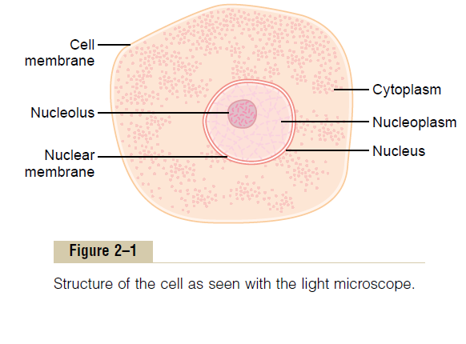
The different substances that make up the cell are collectively called protoplasm.
Protoplasm is composed mainly of five basic substances: water, electrolytes,
proteins, lipids, and carbohydrates.

Slide 23
Physical Structure of the Cell
The cell is not only contain fluid, enzymes, and chemicals; it also contains highly organized physical structures, called intracellular organelles. The physical
nature of each organelle is as important as the cell’s chemical constituents for cell function. For instance, without one of the organelles, the mitochondria, more
than 95 per cent of the cell’s energy release from nutrients would cease immediately.

Slide 24
Cell Membrane
The cell membrane is a thin semi-permeable membrane that surrounds the cytoplasm of a cell, enclosing its contents. Its function is to protect the integrity of the interior of the cell by allowing certain substances into the cell, while keeping other substances out. It also serves as a base of attachment for the cytoskeleton in some organisms and the cell wall in others. Thus the cell membrane also serves to help support the cell and help maintain its shape.

Slide 25
The cell membrane is primarily composed of a mix of proteins and lipids. While lipids help to give membranes their flexibility, proteins monitor and maintain the cell's chemical climate and assist in the transfer of molecules across the membrane.
Phospholipids are a major component of cell membranes. They form a lipid bilayer in which their hydrophillic (attracted to water) head areas spontaneously arrange to face the aqueous cytosol and the extracellular fluid, while their hydrophobic (repelled by water) tail areas face away from the cytosol and extracellular fluid. The lipid bilayer is semi-permeable, allowing only certain molecules to diffuse across the membrane.

Slide 26
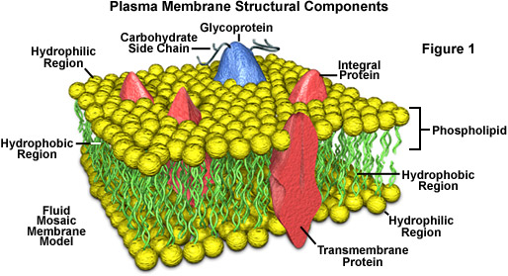

Slide 27
There are many different proteins embedded in the membrane. They exist as separate globular units and many pass through the membrane (integral proteins), whereas others (peripheral proteins) stud the inside and outside of the membrane . Some are cell adhesion molecules that anchor cells to their neighbors or to basal laminas. There are proteins that function as pumps, actively transporting ions across the membrane. Other proteins function as carriers, transporting substances down electrochemical gradients by facilitated diffusion. Still others are ion channels, which, when activated, permit the passage of ions into or out of the cell.

Slide 28
Proteins in another group function as receptors that bind neurotransmitters and hormones, initiating physiologic changes inside the cell. Proteins also function as enzymes, catalyzing reactions at the surfaces of the membrane. In addition, some glycoproteins function in antibody processing and distinguishing self from non self.
Underlying most cells is a thin, fuzzy layer plus some fibrils that collectively make up the basement membrane or, more properly, the basal lamina. The basal lamina and, more generally, the extracellular matrix are made up of many proteins that hold cells together, regulate their development, and determine their growth.

Slide 29
Cell Adhesion Molecules
Cells are attached to the basal lamina and to each other by
cell adhesion molecules (CAMs). These adhesion proteins have attracted great attention in recent years because they are important in embryonic development and formation of the nervous system and other tissues; in holding tissues together in adults; in inflammation and wound healing; and in the metastasis of tumors. Many pass through the cell membrane and are anchored to the cytoskeleton inside the cell. Some bind to like molecules on other cells (homophilic binding), whereas others bind to other molecules (heterophilic binding). Many bind to laminins, a family of large cross-shaped molecules with multiple receptor domains in the extracellular matrix

Slide 30
Intercellular Connections
Two types of junctions form between the cells that make up tissues: junctions that fasten the cells to one another and to surrounding tissues, and junctions that permit transfer of ions and other molecules from one cell to another. The types of junctions that tie cells together and endow tissues with strength and stability, include the1- Tight junction, which is also known as the zonula occludens ,tight junctions between epithelial cells are also essential for transport of ions across epithelia. 2-The desmosome and zonula adherens) hold cells together, and the hemidesmosome attach cells to their basal laminas..

Slide 31
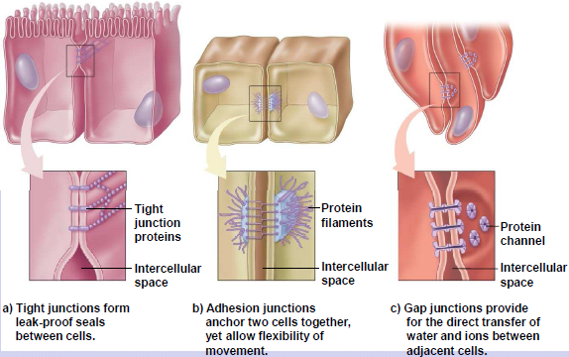

Slide 32
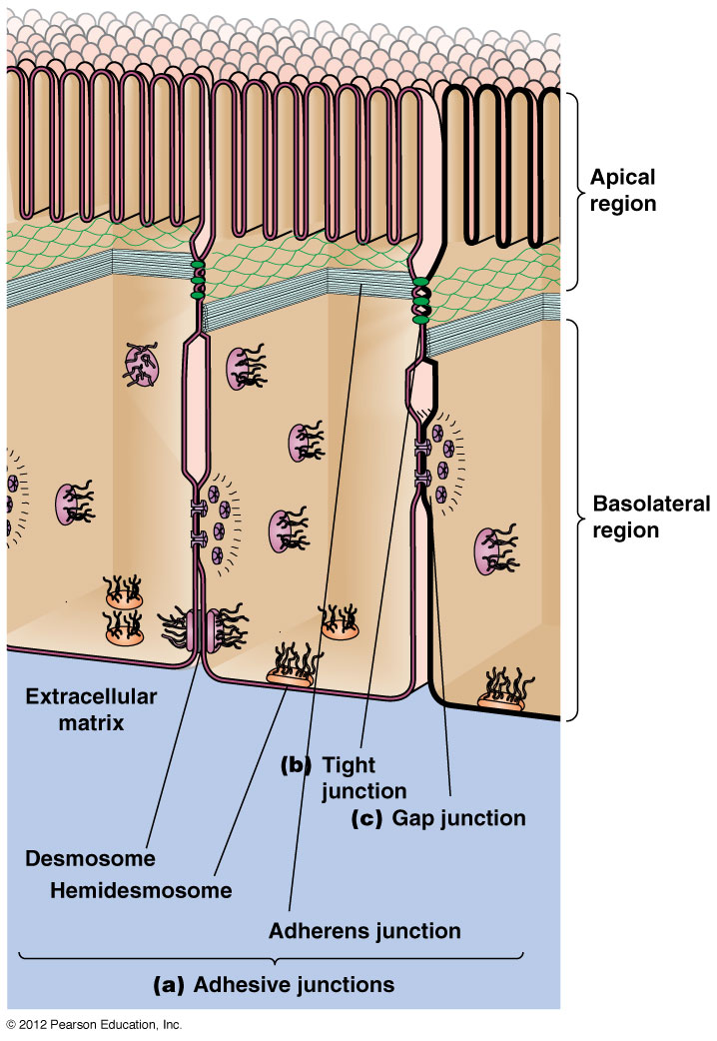
3-Gap Junctions
At gap junctions, the intercellular space narrows from 25 nm to 3 nm, and hexagonal arrays of protein units connexons in the membrane of each cell are lined up with one another.

Slide 33
Ribosomes and the Granular Endoplasmic Reticulum
Attached to the outer surfaces of many parts of the endoplasmic reticulum are large numbers of minute granular particles called ribosomes. Where these are
present, the reticulum is called the granular endoplasmic reticulum. The ribosomes are composed of mixture of RNA and proteins, and they function to synthesize new protein molecules in the cell.

Slide 34
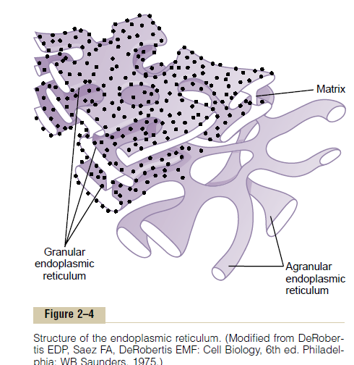

Slide 35
Agranular Endoplasmic Reticulum
Part of the endoplasmic reticulum has no attached ribosomes. This part is called the agranular, or smooth, endoplasmic reticulum.
The agranular reticulum functions for the synthesis of lipid substances and for other processes of the cells promoted by intrareticular enzymes.

Slide 36
Golgi Apparatus
The Golgi apparatus, is closely
related to the endoplasmic reticulum. It has membranes similar to those of the agranular endoplasmic reticulum. This apparatus is prominent in secretory cells, where it is located on the side of the cell from which the secretory substances are extruded.

Slide 37
The Golgi apparatus functions in association with the endoplasmic reticulum. In this way, substances entrapped in the endoplasmic reticulum (ER) vesicles are transported from the endoplasmic reticulum to the Golgi apparatus.
The transported substances are then processed in the Golgi apparatus to form lysosomes, secretory vesicles, and
other cytoplasmic components

Slide 38
Lysosomes:, are vesicular organelles that form by breaking off from the Golgi
apparatus and then dispersing throughout the cytoplasm.
The lysosomes provide an intracellular digestive system that allows the cell to digest
(1) damaged cellular structures,
(2) food particles that have been ingested by the cell, and
(3) unwanted matter such as bacteria.

Slide 39
It is surrounded by a typical lipid bilayer
membrane and is filled with large numbers of small granules, which are protein aggregates of as many as 40 different hydrolase (digestive) enzymes. A hydrolytic enzyme is capable of splitting an organic compound into two or more parts by combining hydrogen from a water molecule with one part of the compound and combining the hydroxyl portion of the water molecule with the
other part of the compound.

Slide 40
Peroxisomes
Peroxisomes are similar physically to lysosomes, but they are different in two important ways. First, they are believed to be formed by self-replication (or perhaps
by budding off from the smooth endoplasmic reticulum) rather than from the Golgi apparatus. Second, they contain oxidases rather than hydrolases

Slide 41
Cytoskeleton
All cells have a cytoskeleton, a system of fibers that not only maintains the structure of the cell but also permits it to change shape and move. The cytoskeleton is made up primarily of microtubules, intermediate filaments, and microfilaments, along with proteins that anchor them and tie them together. In addition, proteins and organelles move along microtubules and microfilaments from one part of the cell to another propelled by molecular motors.

Slide 42
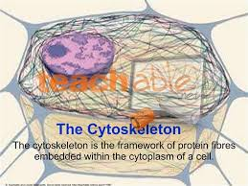
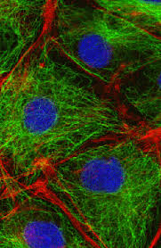

Slide 43
Mitochondria
The mitochondria, are called the “powerhouses” of the cell. Without them,
cells would be unable to extract enough energy from the nutrients, and essentially all cellular functions would cease. Mitochondria are present in all areas of each cell’s cytoplasm, mitochondria are concentrated in the portions of cell that are responsible for the major share of
its energy metabolism.

Slide 44
The basic structure of the mitochondrion, is composed mainly of two lipid bilayer–protein membranes: an outer membrane and an inner membrane.
Many foldings of the inner membrane form shelves onto which oxidative enzymes are attached. In addition, the inner cavity of the mitochondrion is filled with a matrix that contains large quantities of dissolved enzymes that are necessary for extracting energy from nutrients.

Slide 45
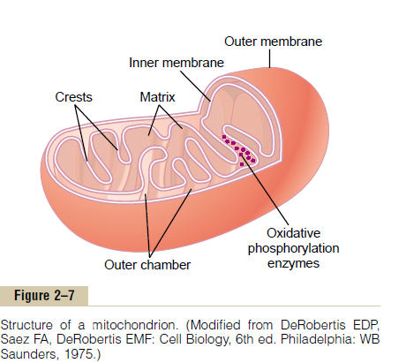

Slide 46
These enzymes operate in association with the oxidative enzymes on the shelves to cause oxidation of the nutrients, thereby forming carbon dioxide and water and at the same time releasing energy.
The liberated energy is used to
synthesize a “high-energy” substance called adenosine triphosphate (ATP).

Slide 47
ATP is then transported out of the
mitochondrion, and it diffuses throughout the cell to release its own energy wherever it is needed for performing
cellular functions.
Mitochondria are self-replicative, which means that one mitochondrion can form a second one, a third one, and so on, whenever there is a need in the cell for
increased amounts of ATP. Indeed, the mitochondria contain DNA similar to that found in the cell nucleus.

Slide 48
Functional Systems of the Cell
If a cell is to live and grow and reproduce, it must obtain nutrients and other substances from the surrounding fluids. Most substances pass through the cell
membrane by diffusion and active transport.

Slide 49
Diffusion involves simple movement through the membrane caused by the random motion of the molecules of the substance; substances move either through cell membrane pores or, in the case of lipid soluble substances, through the lipid matrix of the membrane.
Active transport involves the actual carrying of a substance through the membrane by a physical protein structure that penetrates all the way through the membrane. These active transport mechanisms are so important to cell function

Slide 50
Very large particles enter the cell by a specialized function of the cell membrane called endocytosis. The principal forms of endocytosis are pinocytosis and phagocytosis.
Pinocytosis means ingestion of minute particles that form vesicles of extracellular fluid and particulate constituents inside the cell cytoplasm.
Phagocytosis means ingestion of large particles, such as bacteria, whole cells, or portions of degenerating tissue.

Slide 51
