Slide 1
Mechanism of Drug Action Drug design: optimizing target interactions
M.Sc. Students
Assist . Prof . Karima F. Ali
Mustansiriyah University
College of Pharmacy
2020-2021

Slide 2
Drug optimization: strategies in drug design
Once the important binding groups and pharmacophore of the lead compound have been identified, it is possible to synthesize analogues that contain the same pharmacophore.
But why is this necessary? If the lead compound has useful biological activity, why bother making analogues?
The answer is that very few lead compounds are ideal.
Most are likely to have low activity, poor selectivity, and significant side effects. They may also be difficult to synthesize, so there is an advantage in finding analogues with improved properties. We look now at strategies that can be used to optimize the interactions of a drug with its target in order to gain better activity and selectivity.

Slide 3
Variation of substituents
Alkyl substituents
Certain alkyl substituents can be varied more easily than others.
The alkyl substituents of ethers, amines, esters, and amides are easily varied
In these cases, the alkyl substituent already present can be removed and replaced by another substituent.
Alkyl substituents which are part of the carbon skeleton of the molecule are not easily removed, and it is usually necessary to carry out a full synthesis in order to vary them.
If alkyl groups are interacting with a hydrophobic pocket in the binding site, then varying the length and bulk of the alkyl group (e.g. methyl, ethyl, propyl, butyl isopropyl, isobutyl, or t -butyl) allows one to probe the depth and width of the pocket.
Choosing a substituent that will fill the pocket will then increase the binding interaction

Slide 4
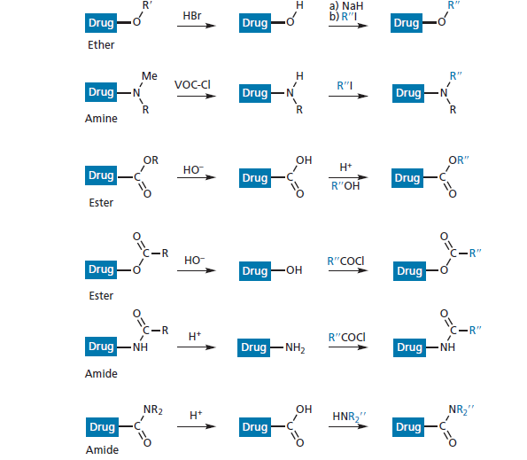

Slide 5
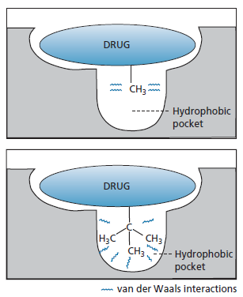
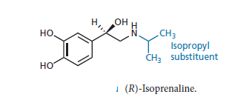
Larger alkyl groups may also confer selectivity on the drug. For example, in the case of a compound that interacts with two
different receptors, a bulkier alkyl substituent may prevent the drug from binding to one of those receptors and so cut down side effects Isoprenaline is an analogue of
Adrenaline where a methyl group was
replaced by an isopropyl group,
resulting in selectivity for adrenergic
β-receptors over adrenergic α-receptors

Slide 6
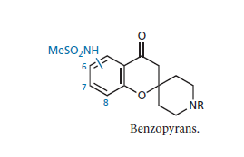
Aromatic substituents
If a drug contains an aromatic ring, the position of substituents
can be varied to find better binding interactions, resulting in increased activity.
For example: the best anti-arrythmic activity for a series of benzopyrans was found when the sulphonamide substituent was at position 7 of the aromatic ring

Slide 7
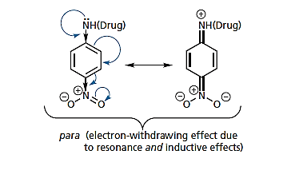
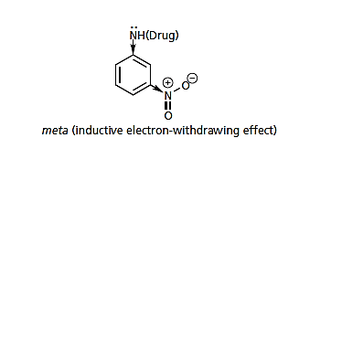
Changing the position of one substituent may have an important effect on another.
For example, an electron withdrawing nitro group will affect the basicity of an aromatic amine more significantly if it is at the para position rather than the meta position .
At the para position, the nitro group will make the amine
a weaker base and less liable to protonate. This would decrease the amine’s ability to interact with ionic binding groups in
the binding site, and decrease activity.

Slide 8
If the substitution pattern is ideal, then we can try varying
the substituents themselves.
Substituents have different steric, hydrophobic, and electronic properties, and so varying these properties may have an effect on binding and activity.
Activity might be improved by having a more electron-withdrawing substituent, in which case a chloro substituent might be tried in place of a methyl substituent.

Slide 9
Synergistic effects
It does not take into account the synergistic effect that two or more substituents may have on activity. For example, two substituents that are individually bad for activity may actually be beneficial for activity when they are both present.
The design of the anticancer drug sorafenib provides an illustration of this effect
The strategy of multiple point modifications allows the identification of such synergistic effects and demonstrates that there are limitations to simple SAR analyses. Structure IV was now adopted as the new lead compound.
Replacing the phenyl ring with a pyridine ring led to structure
(V) and a fivefold increase in activity, as well as improving
aqueous solubility and cLogP.

Slide 10
Conventional optimization strategies then led to sorafenib which is 1000-fold more active than the original lead compound.
The urea functional group serves as an anchor group in a similar manner to the amide group present in imatinib.
It forms two hydrogen bonding interactions to the catalytic
aspartate and glutamate residues in the active site, and orientates
the molecule such that each half of the molecule is positioned into two selectivity regions

Slide 11
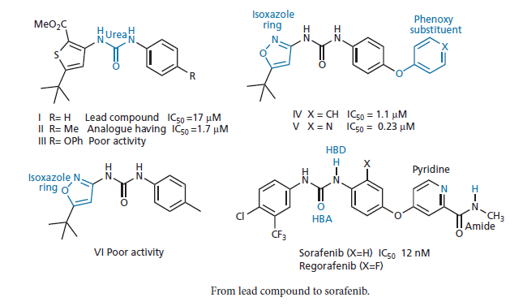

Slide 12
Extension of the structure
The strategy of extension involves the addition of another
functional group or substituent to the lead compound in order to probe for extra binding interactions with the target.
Lead compounds are capable of fitting the binding site and have the necessary functional groups to interact with some of the important binding regions present. However, it is possible that they do not interact with all the binding regions available. For example, a lead compound may bind to three binding regions in the binding site but fail to use a fourth .Therefore, why not add extra functional groups to probe for that fourth region?

Slide 13
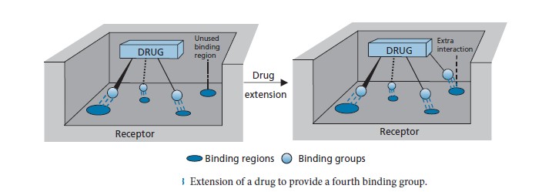

Slide 14
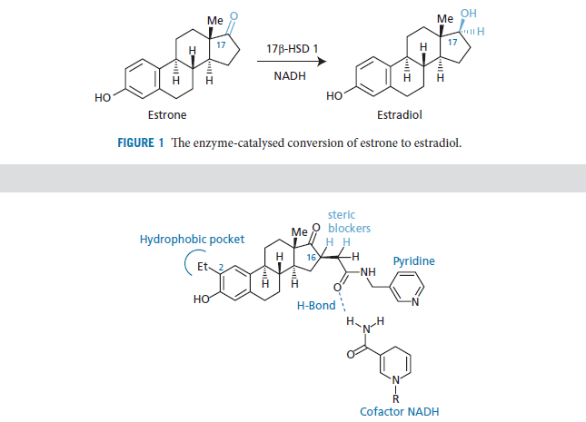
Converting an enzyme substrate to an inhibitor by extension tactics

Slide 15
The amide group interacts with the primary amide NADH by
hydrogen bonding, while the pyridine ring interacts with the
phosphate groups of the cofactor.
A more conventional extension strategy was to add an ethyl group at C-2, which allowed additional van der Waals interactions with a small hydrophobic pocket in the active site.
It was also observed that two protons acted as steric blockers and prevented NADH reducing the ketone group of the analogue. The extension tactic has been used successfully to produce more active analogues of morphine and more active adrenergic agents
It was also used to improve the activity and selectivity of the protein kinase inhibitor, imatinib.

Slide 16
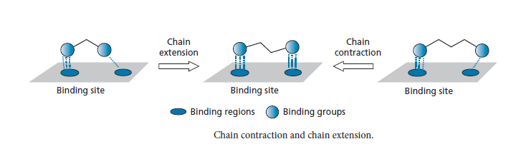
Chain extension/contraction
Some drugs have two important binding groups linked together by a chain, in which case it is possible that the chain length is not ideal for the best interaction. Therefore, shortening or lengthening the chain length is a useful tactic to try

Slide 17
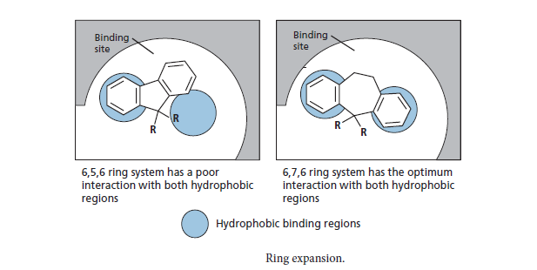
Ring expansion/contraction
If a drug has one or more rings that are important to binding, it is generally worth synthesizing analogues where one of these rings is expanded or contracted. Expanding or contracting a ring may put other rings in different positions relative to each other, and may lead to better interactions with specific regions in the binding site

Slide 18
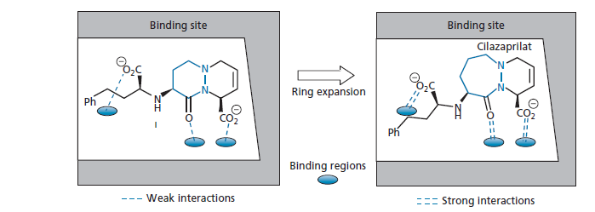
Development of the anti-hypertensive agent cilazaprilat
(another ACE inhibitor), the bicyclic structure I showed promising activity .The important binding groups were the two carboxylate groups and the amide group. By carrying out various ring contractions and expansions , cilazaprilat was identified as the structure having the best interaction with the binding site.

Slide 19
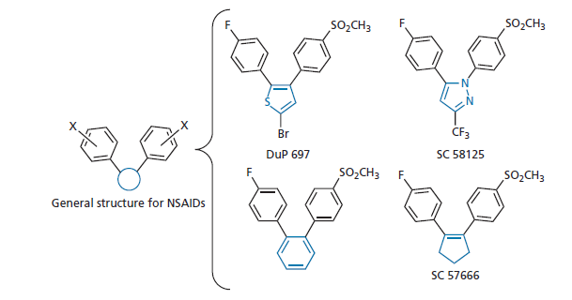
Ring variations
A popular strategy used for compounds containing an aromatic or heteroaromatic ring is to replace the original ring with a range of other heteroaromatic rings of different ring size and heteroatom positions. several non-steroidal anti-inflammatory agents (NSAIDs) have been reported, all consisting of a central ring with 1,2-biaryl substitution. Different pharmaceutical companies have varied the central ring to produce a range of active compounds

Slide 20
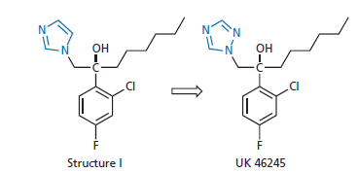
the antifungal agent (I) acts against an enzyme present in both fungal and human cells. Replacing the imidazole ring of structure (I) with a 1,2,4-triazole ring to give UK 46245 resulted in better
selectivity against the fungal form of the enzyme.

Slide 21
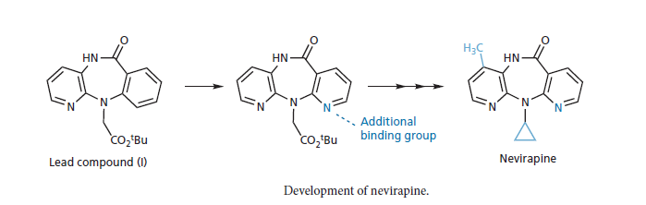
Replacing the aromatic ring with a pyridine ring resulted in an additional binding interaction with the target enzyme. Further development led eventually to the antiviral agent nevirapine

Slide 22
Ring fusions
Extending a ring by ring fusion can sometimes result in increased interactions or increased selectivity. One of the major advances in the development of the selective β-blockers was the replacement of the aromatic ring in adrenaline with a naphthalene ring system
( Pronethalol ) .This resulted in a compound that was able to distinguish between two very similar receptors—the α- and β-receptors for adrenaline.
One possible explanation for this could be that the β-receptor
has a larger van der Waals binding area for the aromatic system than the α-receptor, and can interact more strongly with Pronethalol than with adrenaline. Another possible explanation is that the naphthalene ring system is sterically too big for the α-receptor, but is just right for the β-receptor.

Slide 23
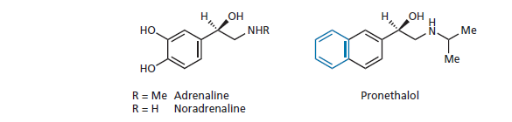

Slide 24
Isosteres and bioisosteres
Isosteres are atoms or groups of atoms which share the same valency and which have chemical or physical similarities
For example, SH, NH2 , and CH3 are isosteres of OH, whereas S, NH, and CH2 are isosteres of O.
Isosteres can be used to determine whether a particular group is an important binding group or not by altering the character of the molecule in as controlled a way as possible.
Replacing O with CH2 , for example, makes little difference to the size of the analogue, but will have a marked effect on its polarity, electronic distribution, and bonding.
Replacing OH with the larger SH may not have such an influence on the electronic character, but steric factors become more significant.

Slide 25
Isosteric groups could be used to determine whether a particular group is involved in hydrogen bonding.
For example, replacing OH with CH3 would completely eliminate hydrogen bonding, whereas replacing OH with NH2 would not.

Slide 26
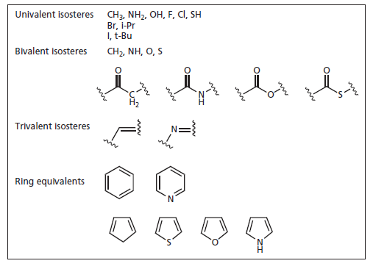

Slide 27
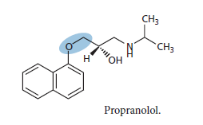
The β-blocker propranolol has an ether linkage
Replacement of the OCH2 segment with the isosteres
CH = CH, SCH2 , or CH2CH2 eliminates activity, whereas replacement with NHCH2 retains activity (though reduced).
These results show that the ether oxygen is important to the activity of the drug and suggests that it is involved in hydrogen bonding with the receptor

Slide 28
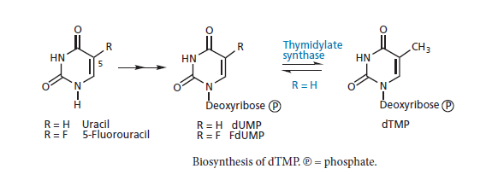
Some isosteres can be used to determine the importance of size towards activity, whereas others can be used to determine the importance of electronic factors. For example, fluorine is often used as an isostere of hydrogen as it is virtually the same size. However, it is more electronegative and can be used to vary the electronic properties of the drug without having any steric effect.
The presence of fluorine in place of an enzymatically labile hydrogen can also disrupt an enzymatic reaction, as C–F bonds are not easily broken.

Slide 29
For example, the antitumour drug 5-fluorouracil described in is
accepted by its target enzyme because it appears little different
from the normal substrate— uracil . However, the mechanism of the enzyme-catalysed reaction is totally disrupted, as the fluorine has replaced a hydrogen which is normally lost during the enzyme mechanism. Several non-classical isosteres have been used in drug design as replacements for particular functional groups.
Non-classical isosteres are groups that do not obey the steric and electronic rules used to define classical isosteres, but which have similar physical and chemical properties.

Slide 30
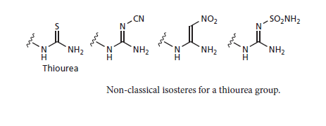
Non-classical isosteres for a thiourea group are all planar groups of similar size and basicity.
The term bioisostere is used in drug design and includes both classical and non-classical isosteres.
A bioisostere is a group that can be used to replace another group while retaining the desired biological activity.
Bioisosteres are often used to replace a functional group that is important for target binding, but is problematic in one way or another.

Slide 31
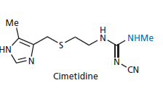
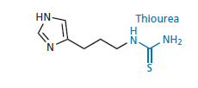
For example, the thiourea group was present as an important binding group in early histamine antagonists, but was responsible for toxic side effects. Replacing it with bioisosteres allowed the important binding interactions to be retained for histamine antagonism but avoided the toxicity problems

Slide 32
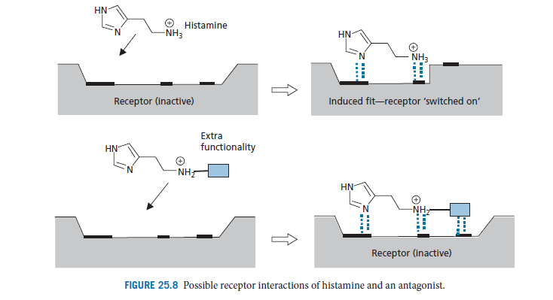
Possible receptor interactions of histamine and an antagonist.

Slide 33
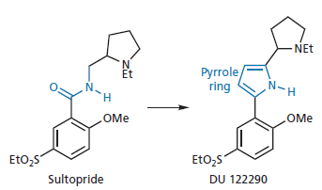
In some situations, the use of a bioisostere can actually increase target interactions and/or selectivity.
For example, a pyrrole ring has frequently been used as a bioisostere for an amide. Carrying out this replacement on the dopamine antagonist sultopride led to increased activity and selectivity towards the dopamine D 3 -receptor over the dopamine D 2 -receptor Such agents show promise as antipsychotic agents that lack the side effects associated with the D 2 -receptor.

Slide 34
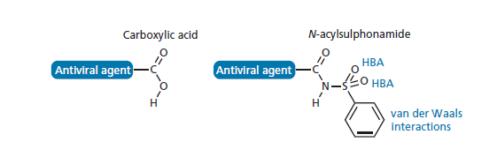
Introducing a bioisostere to replace a problematic group often involves introducing further functional groups that might form extra binding interactions with the target binding site
For example, a 10-fold increase in activity was observed for an antiviral agent when an N -acylsulphonamide was used as a bioisostere for a carboxylic acid The N -acylsulphonamide group introduces the possibility of further hydrogen bonding or van der Waals interactions with the binding site.
Extra binding interactions that might be possible when using an N acylsulphonamide as a bioisostere for a carboxylic acid.

