Slide 1

SYNTHESIS Benzanilide BY
BENZOLATION

Slide 2
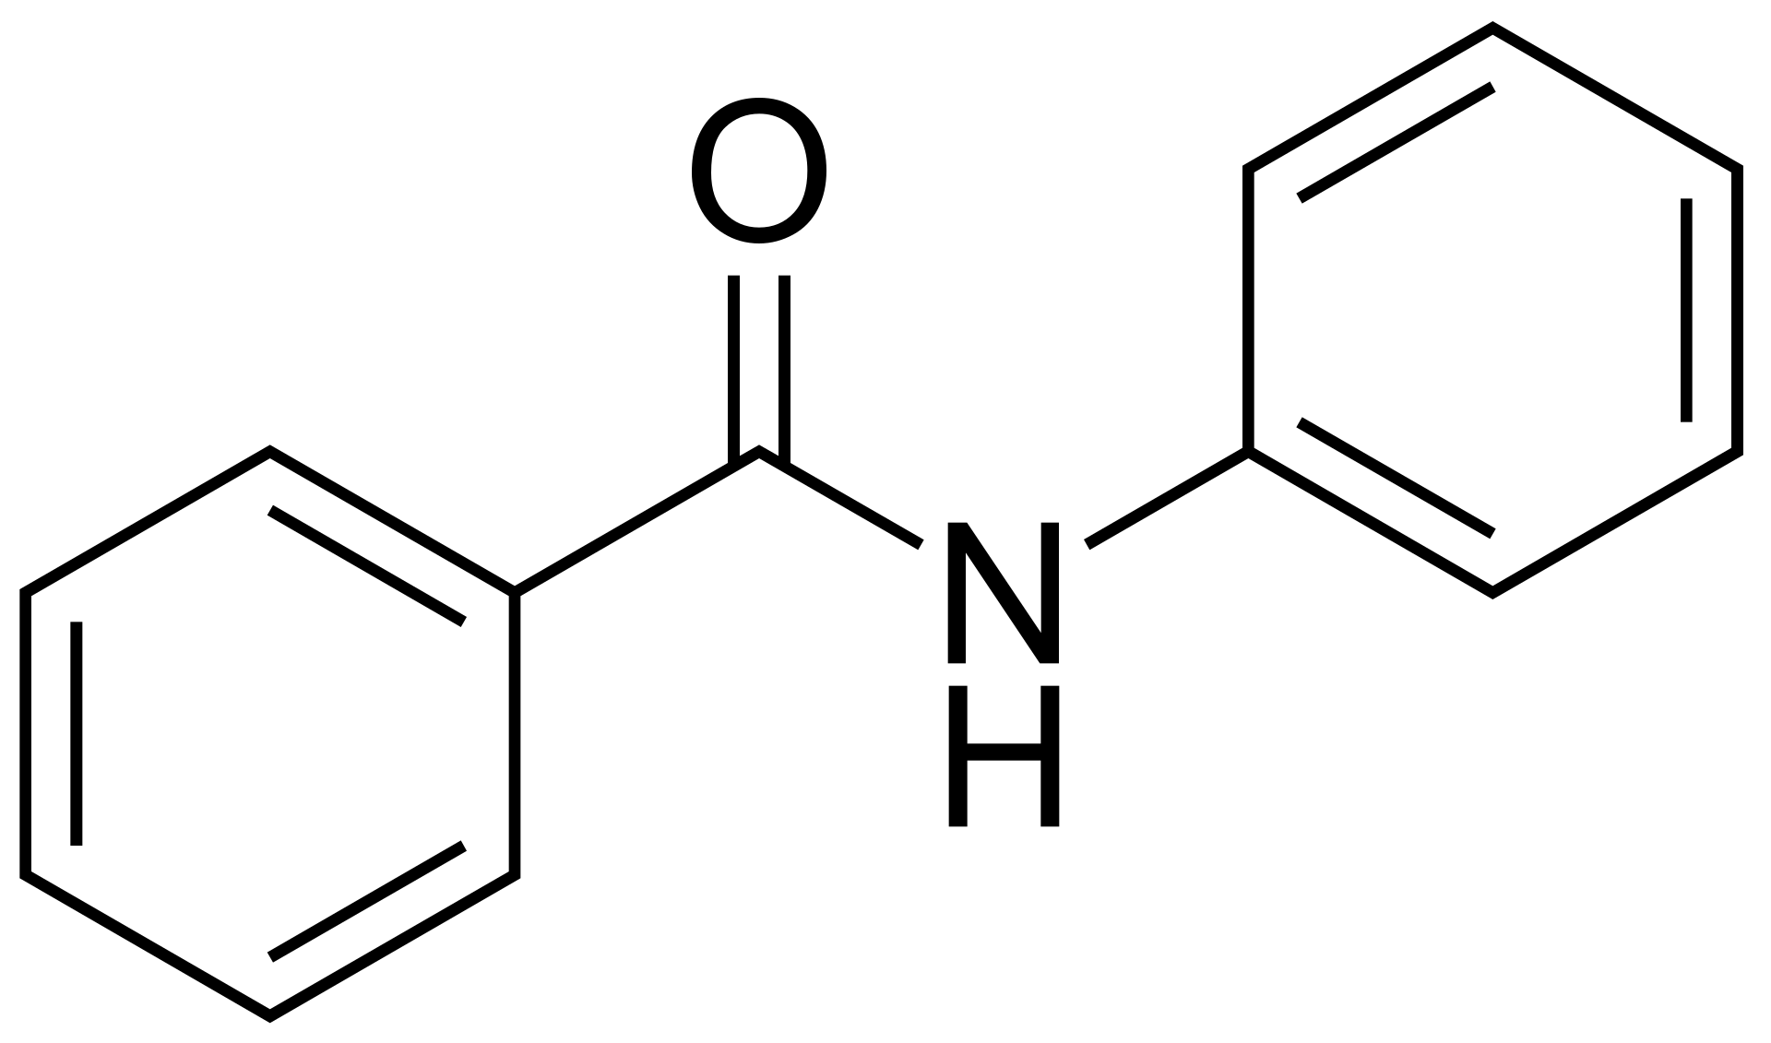
Benzanilide
Benzanilide is an important organic compound within the class of aromatic amides, bearing the chemical formula C₁₃H₁₁NO. It is structurally composed of a benzoyl group (C₆H₅CO-) linked to an aniline moiety (C₆H₅NH-). This compound typically manifests as a white to pale yellow crystalline solid and exhibits limited solubility in water while being more soluble in various organic solvents such as ethanol, ether, and chloroform.

Slide 3
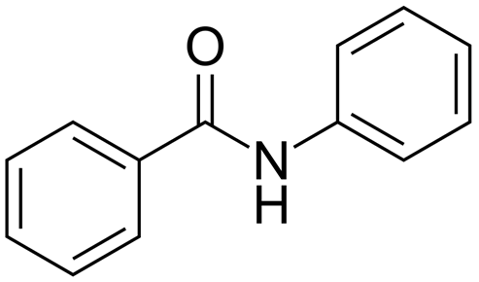
Names
N-Phenyl-benzamide.(IUPAC name )
N-Benzoylaniline.
N-Benzoylphenylamine.

Slide 4
some of the primary applications of benzanilide:
Intermediate in Organic Synthesis: Benzanilide is widely used as an intermediate in the synthesis of more complex organic compounds. Its amide functional group makes it a valuable starting material for creating pharmaceuticals, agrochemicals, and dyes.
Pharmaceutical Industry: In drug development, benzanilide serves as a building block for synthesizing various medicinal compounds. Its structure allows chemists to modify it and develop drugs with desired therapeutic properties.
Polymer and Resin Production: The compound is involved in synthesizing specific polymers and resins, contributing to materials that require particular mechanical or thermal properties.

Slide 5
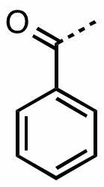
Benzoylation
Benzoylation is a chemical reaction in organic chemistry where a benzoyl group (C₆H₅CO-) is introduced into another molecule. This process typically involves the removal of a hydrogen atom from a nitrogen atom in amines (R-NH₂) or an oxygen atom in alcohols (R-OH), replacing it with a benzoyl group.

Slide 6
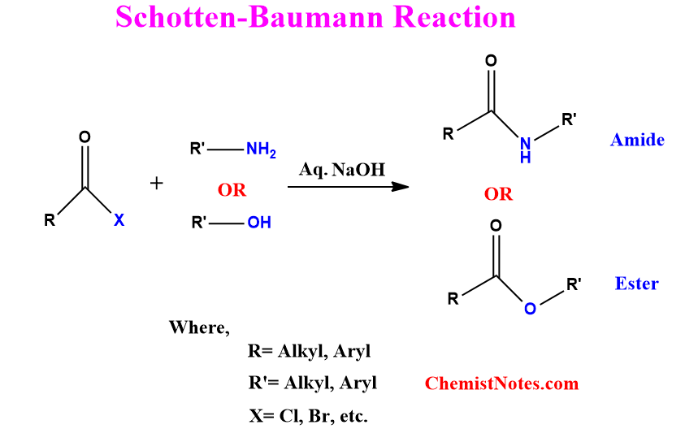
Features of Schotten Baumann Reaction
The Schotten Baumann reaction can also refer to the benzoylation of active hydrogen-containing compounds with the help of benzyl chloride and aqueous sodium hydroxide. Pyridine can also be used as an alternative to the sodium hydroxide base.
This reaction can be generalized as follows.

Slide 7
Some key features of the Schotten Baumann Reaction are:
It is a base-catalyzed reaction. The base is necessary to encourage an equilibrium shift towards the formation of amides.
The base also neutralizes the hydrochloric acid which is formed in the process, thereby preventing the further protonation of the amide product formed.
Usually, aqueous sodium hydroxide is used as the base catalyst, but pyridine also can be used in this reaction.

Slide 8
Schotten Baumann Reaction Mechanism
The mechanism of this reaction can be broken down into three steps in order to easily understand it. These steps are:
The formation of a protonated compound from the reaction between the acyl chloride and the amine. First, the nitrogen atom puts forth a lone pair of electrons towards the formation of a carbon-nitrogen bond , The positive and negative charges on the nitrogen and oxygen atoms are neutralized by the exchange of a proton between them.
The catalyst of the reaction (i.e. the base) proceeds to absorb the acidic proton which is formed when oxygen attempts to reform a double bond with the carbonyl carbon (which is favourable as the electronegative chlorine atom can easily break its bond with carbon and be liberated as a chloride ion).
In the final step of the Schotten Baumann reaction mechanism, the required amide product is formed along with hydrochloric acid now that the base catalyst has absorbed the acidic proton. This HCl is neutralized by the base catalyst as well.

Slide 9
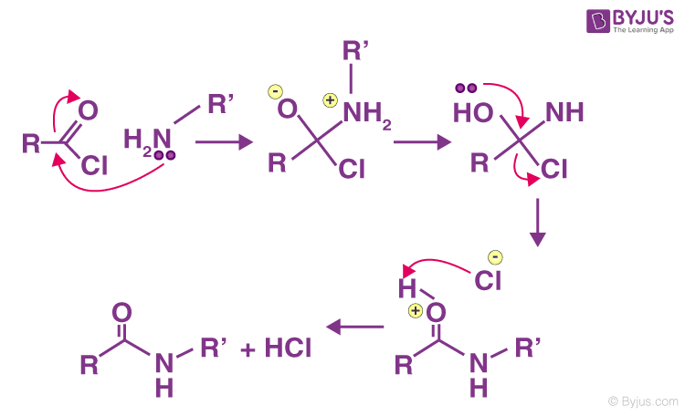

Slide 10
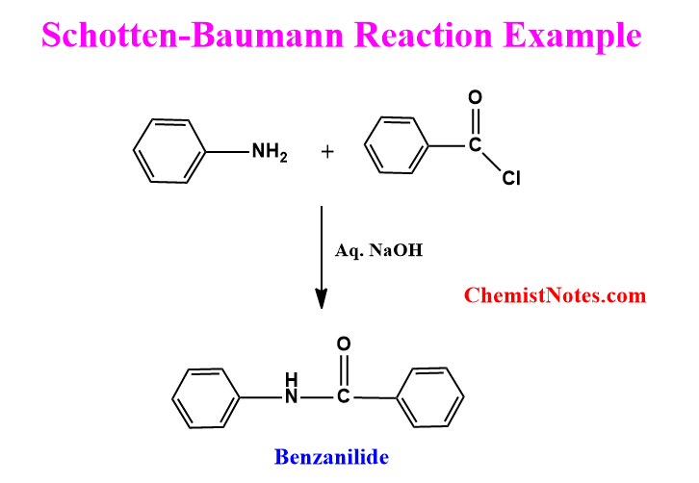

Slide 11
why esters generally hydrolyze faster than amides.
Factor | Esters | Amides
Resonance Stabilization | Limited resonance with the carbonyl group. | Extensive resonance between the nitrogen lone pair and the carbonyl group, stabilizing the bond.
Bond Strength | Weaker C–O bond due to less resonance stabilization, making it more susceptible to hydrolysis. | Stronger C–N bond reinforced by resonance, making it less susceptible to hydrolysis.
Bond Length | Longer C–O bond (~1.43 Å), which is weaker and more reactive. | Shorter C–N bond (~1.33 Å) due to partial double bond character from resonance.
Leaving Group Stability | Typically releases a stable alcohol (ROH) as the leaving group. | Releases a less stable amine (RNH₂) as the leaving group.
Electronegativity Effects | Oxygen is more electronegative, increasing the carbonyl carbon's susceptibility to nucleophilic attack. | Nitrogen donates electron density through resonance, decreasing the carbonyl carbon's susceptibility to attack.
Hydrolysis Mechanism | More favorable for nucleophilic attack due to higher electrophilicity of the carbonyl carbon. | Less favorable for nucleophilic attack due to reduced electrophilicity from resonance.
Stability of Products | Products (alcohol and carboxylic acid) are generally more stable. | Products (amine and carboxylic acid) are less stable compared to ester hydrolysis products.
Steric Factors | Generally, less steric hindrance around the carbonyl carbon. | Potentially more steric hindrance due to the presence of the nitrogen atom.

Slide 12
Schotten Baumann reaction procedure
The procedure for the Schotten-Baumann reaction is described as follows:
Take a 100 mL Erlenmeyer flask and add 1mL or 1.04 g of aniline to it. Afterward, add 10 mL of 10% aq. NaOH solution.
In a gradual and controlled manner (drop wisely), add 1.4 mL or 1.72 g of benzoyl chloride with vigorous shaking for 1 minute after each addition.
Once the addition of benzoyl chloride is finished, tightly cork the flask and proceed to vigorously shake it for 15 minutes.
Upon completion of the reaction, the benzoyl derivatives might precipitate as a white powder.
Filter the white solids and perform multiple washes with water. Ultimately, recrystallize the solid by using boiling alcohol.

Slide 13
Physical Properties of Benzanilide.
Molecular Weight: 197.23 g/mol.
Molecular Formula: C₁₃H₁₁NO.
Appearance: White crystalline solid.
Melting Point: 155–157 °C.
Boiling Point: Not readily available; expected to be high due to aromatic amide structure.
Density: Approximately 1.1 g/cm³ at room temperature.
Odor: Odorless or faint characteristic odor.
Solubility:
In Water: Limited solubility.
In Organic Solvents: Soluble in ethanol, acetone, chloroform, and other common organic solvents.

Slide 14
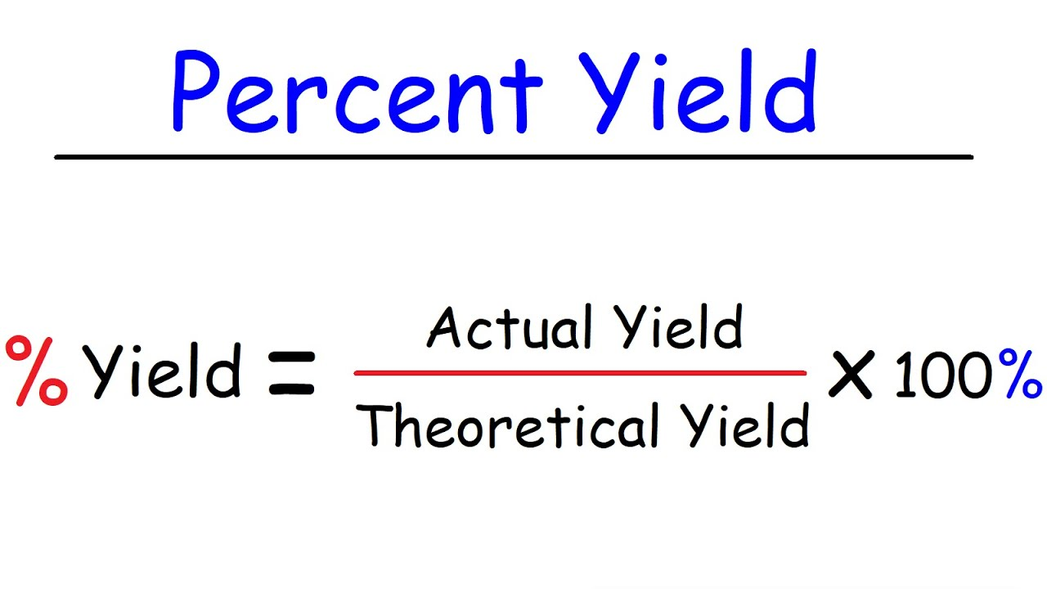
calculations

