Slide 1
Obesity, Pediatrics, & Oral Thrush
Dr. Haider Raheem Mohammad

Slide 2
Obesity: Background, Prevalence and Epidemiology
Obesity is widely regarded as a pandemic, with potentially disastrous consequences for human health.
Globally, overweight and obesity, are the fifth most common risk factors for death. As per World Health Organization (WHO) estimates, in 2008, more than 1.4 billion adults aged 20 and older, were overweight and among them, over 500 million were obese.
Proportion of key food groups recommended for a healthy, well-balanced diet.

Slide 3
Obesity: Anthropometric Measurements
Body mass index (BMI) is useful for categorising under-and over-nutrition.
It is the weight in kilograms divided by the height in metres, squared.
For example, an adult weighing 70 kg with a height of 1.75 m has a BMI of 70/1.75² = 22.9 kg/m².
Quantifying obesity with body mass index (weight/height²)
A waist circumference of > 102 cm (40 inches) in men or > 88 cm (35 inches) in women indicates that the risk of metabolic and cardiovascular complications of obesity is high.

Slide 4
Obesity: Body Fat Distribution
Individuals with upper body obesity (left) have greater health risks than individuals with lower body obesity (right).
Increased intra-abdominal fat causes ‘central’ (‘abdominal’, ‘visceral’, ‘android’ or ‘apple-shaped’) obesity, which contrasts with subcutaneous fat accumulation causing ‘generalised’ (‘gynoid’ or ‘pear-shaped’) obesity.
Central obesity is more common in men and is more closely associated with type 2 diabetes, metabolic syndrome and cardiovascular disease.
Visceral fat is located inside the abdominal cavity, packed in between the internal organs. Subcutaneous fat is found underneath the skin.

Slide 5
Aetiology
Accumulation of fat results from a discrepancy between energy consumption and energy expenditure.
Obesity is correlated positively with the number of hours spent watching television, and inversely with levels of physical activity (e.g. stair climbing).
Some reasons for the increasing prevalence of obesity – the ‘obesogenic’ environment.

Slide 6
Aetiology
Other factors associated with obesity include cultural norms, socioeconomic status, gender and ethnicity.
In addition certain medical conditions (e.g., hypothyroidism) and medicines (e.g., corticosteroids, beta-blockers, anticonvulsants) can cause weight gain.

Slide 7
The Adipocyte and Adipose Tissue
Adipose mass increases by enlargement of adipose cells through lipid deposition, as well as by an increase in the number of adipocytes.
Adiponectin, an abundant adipose-derived protein whose levels are reduced in obesity, enhances insulin sensitivity and lipid oxidation and it has vascular protective effects, whereas resistin, whose levels are increased in obesity, may induce insulin resistance.
Hypertrophic (increased size ) and hyperplastic (increased number) changes to adipocytes are thought to occur in severe obesity.

Slide 8
Leptin
Leptin, a name derived from the Greek root leptos, meaning thin. Leptin is secreted by adipose cells and acts primarily through the hypothalamus.
Its level of production provides an index of adipose energy stores. High leptin levels decrease food intake and increase energy expenditure.
The vast majority of obese persons have increased leptin levels but do not have mutations of either leptin or its receptor. They appear, therefore, to have a form of functional “leptin resistance.”
The physiologic system regulated by leptin

Slide 9
Management
Maximising physical activity should be incorporated in the daily routine (e.g. walking rather than driving to work).
Most involve recommending a reduction of daily total energy intake of −2.5 MJ (600 kcal) from the patient’s normal consumption.
Vitamin supplementation is wise in those diets in which macronutrient balance is markedly disturbed.
Low-calorie diet therapy for obesity

Slide 10
Management
A 5% to 10% weight loss as derived from the patient’s current weight is the initial goal of obesity management because favorable outcomes on the negative effects of obesity have been documented.
Weight loss should occur at a rate of 0.45 to 0.9 kg (1–2 lb) per week, meeting the initial weight loss goal within the first 6 months of therapy.
Therapeutic options for obesity.
Relevant comorbidities include type 2 diabetes, hypertension, cardiovascular disease, sleep apnoea, and waist circumference > 102 cm in men or 88 cm in women. This is an approximate consensus of the numerous national guidelines, which vary slightly in their recommendations and are revised every few years.

Slide 11
Treatment
Drugs Commonly Prescribed for Weight Loss
Among the currently approved antiobesity agents for chronic weight management, orlistat was approved in 1999 and subsequently after a long gap of more than a decade, two new therapies, lorcaserin (5-HT_{2C} agonist) and phentermine/topiramate (noradrenergic agent/antiepileptic) were approved in 2012. In 2014, FDA finally approved the combination of bupropion/naltrexone (antidepressant/opioid antagonist) as a treatment option for the management of obesity.

Slide 12
Orlistat
Orlistat promotes and maintains weight loss by acting locally in the GI tract. It inhibits pancreatic and gastric lipases and thereby decreases the hydrolysis of ingested triglycerides, reducing dietary fat absorption by approximately 30%.
Orlistat is taken with each of the three main meals of the day (or up to 1 hour after the meal) and the dose can be adjusted (60–120 mg) to minimise side-effects.
If a meal is missed or contains little fat, the dose of orlistat may be omitted. Doses above 360 mg/day provide no greater benefit and thus are not recommended.
Patients taking orlistat adhere better to low-fat diets in order to avoid unpleasant gastrointestinal side-effects.

Slide 14
Surgery
Bariatric surgery is by far the most effective long-term treatment for obesity and is the only anti-obesity intervention that has been associated with reduced mortality.
Bariatric surgery is usually reserved for those with severe obesity (BMI > 40 kg/m²), or those with a BMI > 35 kg/m² and significant complications, such as type 2 diabetes or obstructive sleep apnoea.
Schematic diagrams of Roux-en-Y gastric bypass (A), laparoscopic adjustable gastric banding (B), sleeve gastrectomy (C), biliopancreatic diversion (D), and biliopancreatic diversion with duodenal switch (E).

Slide 15
Surgical Complications
The average 30-day mortality rate is 0.2% for gastric bypass, 0.14% for vertical sleeve gastrectomy (VSG), and 0.02% for gastric banding (GB).
Complications of bariatric procedures include anastomotic leak or stenosis, pulmonary embolus (PE) and DVT, GI bleeding, nutritional deficiencies, wound complications, bowel obstructions, ulcers, hernias, and respiratory and cardiovascular complications.
Band erosion
Among the different surgical procedures, the rate of complications is proportional to the amount of weight loss produced by each operation: banding (7%), gastric bypass (17%), gastroplasty (18%), and biliopancreatic diversion (BPD) (38%).
A, Anastomotic ulcer. B, Jejunal ulcer.

Slide 16
Threadworm (Pinworm)
Classes of helminth that parasitise humans
Helminths (from the Greek helmins, meaning worm) include three groups of parasitic worm, large multicellular organisms with complex tissues and organs.
In Western countries, the most common worm infection is threadworm (Enterobius vermicularis), known in some countries as pinworm, which is a condition that causes inconvenience and embarrassment.

Slide 17
Threadworm (Pinworm)
Distribution: It is worldwide in distribution and commonly affects children. UK prevalence rates have been estimated at 20% in the community, rising to 65% in institutionalized settings.
Habitat: The adult worm remains attached to the large intestine (cecum, appendix and adjacent portion of colon) by their mouth end.
It has been said, “You had this infection as a child; you have it now; or you will get it again when you have children!”
Egg of Enterobius vermicularis (colorless in saline mount).
Enterobius vermicularis, adult female pinworm. The female worm has a pointed tail (hence the name “pinworm”).

Slide 18
Threadworm: Life Cycle
Eggs are transmitted to the human host primarily by the faecal-oral route (autoinfection) but also by retroinfection (generally occurs from the anus to the colon) and inhalation.
Faecal-oral transmission involves eggs lodging under fingernails, which are then ingested by finger sucking after anal contact.
After the ova are swallowed, development takes place in the small intestine, but the adult worms are found chiefly in the colon.
Life cycle of Enterobius vermicularis

Slide 19
Threadworm: Clinical Features & Diagnosis
About one-third of infections are asymptomatic.
Nighttime perianal itching is the classic presentation (caused from the mucous produced by females when laying eggs).
In females, the genitalia may be involved.
The adult worms may be seen moving on the buttocks or in the stool.
Ova are detected by applying the adhesive surface of cellophane tape (Scotch tape) to the perianal skin in the morning. This is then examined on a glass slide under the microscope.
A perianal swab, moistened with saline, is an alternative sampling method.
Enterobius vermicularis (A) cellophane tape; (B) adult worm (actual size); (E) NIH swab method (National institute of health, USA).

Slide 20
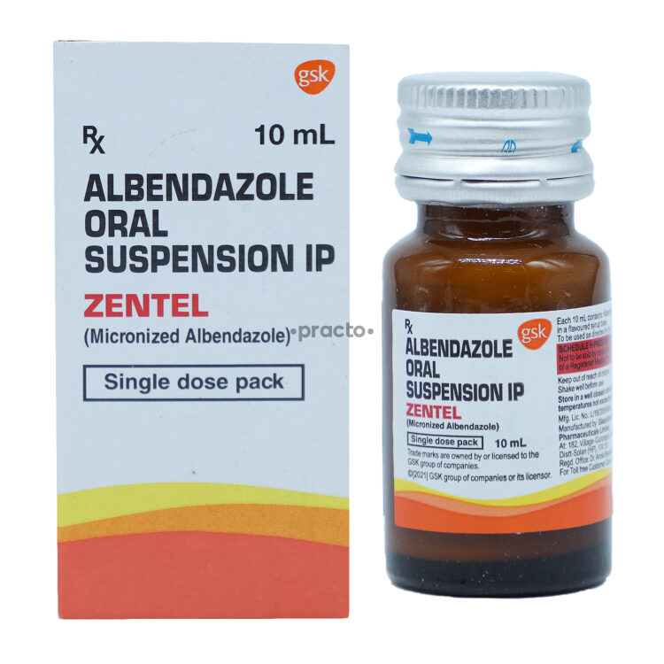
Threadworm: Management
Albendazole and mebendazole are poorly resorbed from the GIT, except when there is an inflammation. However, enteral absorption may be increased due to high-fat diet.
Mebendazole may be used during pregnancy to treat relevant worm diseases. Albendazole may be used in cases of echinococcosis.
One of the following drugs can be given:
A single dose of mebendazole (100 mg)
A single dose of albendazole (400 mg) or
A single dose of pyrantel pamoate (11 mg/kg; maximum, 1 g)
A single dose of piperazine (4 g).
The same treatment should be repeated after 2 weeks to kill worms that might have hatched from eggs.
Treatment of household members is advocated to eliminate asymptomatic reservoirs of potential reinfection.
Prevention and Control
1. Hand washing and keeping finger nails short
2. Washing of bed linen
3. Treatment of infected persons and household members.
Albendazole susp. 200mg/5ml.

Slide 21
Behavioral Disorders: Crying & Colic
Infant crying, a sign of pain, distress, hunger, or fatigue.
Most infants cry little during the first 2 weeks of life, gradually increasing to 3 hours per day by 6 weeks and decreasing to 1 hour per day by 12 weeks.
At 6 weeks of age, the mean frequency of combined crying and fussing is 10 episodes in 24 hours.
The intensity of infant crying varies, with descriptions ranging from fussing to screaming.
Distribution of total crying time among 80 infants studied from 2 to 12 weeks of age. Data derived from daily crying diaries recorded by mothers.

Slide 22

Colic: Background
The word “colic” is derived from Greek kolikos (“pertaining to the colon”).
There is no universally agreed definition of colic.
A widely used definition of colic is that proposed by Wessel et al. (1954) and has come to be known as the rule of threes.
Wessel proposed that an infant could be considered to have colic if he or she cries for more than 3 hours a day for more than 3 days a week for more than 3 weeks.
However, the definition by Wessel is arbitrary, and few parents are willing to wait 3 weeks to see if the infant meets the criteria for colic.
As a result, in the clinical setting, colic is usually defined as episodes of excessive and inconsolable crying in an infant who otherwise appears to be healthy (NICE, 2015).

Slide 23

Colic: Epidemiology & Aetiology
Its prevalence is difficult to determine, and estimates vary widely from 3% to 40%, depending on which definition is used.
Because the etiology of colic is unknown, this syndrome may represent the extreme of the normal phenomenon of infant crying.
Although colic has traditionally been attributed to gastrointestinal disturbances (allergy to cow’s milk, lactose intolerance, or inadequate amounts of lactobacilli), this has never been proved.
Others have suggested that colic reflects a disturbance in the infant’s sleep-wake cycling or an infant state regulation disorder. Anyway, colic is a behavioral sign or symptom that begins in the first few weeks of life.
Fewer than 5% of infants evaluated for excessive crying have an organic etiology.

Slide 24
Colic: Clinical Features & Diagnosis
Excessive crying and inconsolable crying are obvious clinical features, accompanied by facial flushing and drawing up of the legs.
Pain may be mild, merely causing the child to be restless in the evenings or severe, resulting in rhythmic screaming attacks lasting a few minutes at a time, alternating with equally long quiet periods in which the child almost goes to sleep before another attack starts.
Attacks appear to be more common in the early evening, giving rise to the name 6:00 PM colic.
Algorithm for medical evaluation of infants with acute excessive crying.

Slide 25

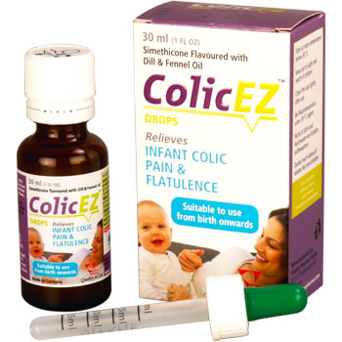
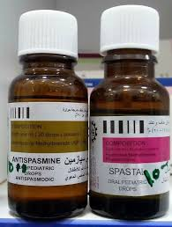

Slide 26
Colic: Management
The management of colic begins with education and demystification. When the family and the physician are reassured that the infant is healthy, education about the normal pattern of infant crying is appropriate.
Medications, including phenobarbital, diphenhydramine, alcohol, simethicone, dicyclomine, and lactase, are of no benefit in reducing colic and should be avoided. Phenobarbital elixir and dicyclomine have been found to be somewhat helpful, but their use is to be discouraged because of the risk of adverse reactions and overdosage.
For colic that is refractory, a trial of changing the feedings, and eliminating cow’s milk from the formula or from the mother’s diet if she is nursing, may be indicated. The use of whey hydrolysate formulas for formula-fed infants has been suggested.
Parents, especially from Mexico and Eastern Europe, often use chamomile, fennel, vervain, licorice, and balm-mint teas. These teas have not been studied scientifically as remedies for colic.
A trial of PPI might be of help if gastroesophageal reflux is contributing to the child’s discomfort.

Slide 27
Fever: Background
Fever, defined as a centrally mediated rise in the core body temperature, can be due to many factors.
The normal core body temperature varies by age, time of day, and even from person to person.
Normal oral temperature is 37°C (98.6°F), (normal range, 35.8–37.2 °C), although rectal temperature is about 0.5°C higher and underarm temperature is 0.5°C lower than oral temperature.
Fever is often classified as being mild (low-grade; up to 39°C) or high (>39°C).
Fever is a common symptom of many conditions; in children, viral and to a lesser extent bacterial causes are most commonly implicated.

Slide 28


Fever: Measurement
Temperature in pediatric patients can be measured in a variety of manners:
rectal (using a mercury or digital thermometer),
oral (mercury or digital),
axillary (mercury, digital, or liquid crystal strip),
forehead (liquid crystal strip), or
tympanic (using a device that measures thermal infrared energy from the tympanic membrane).
Forehead strip thermometers are popular because they are easy to use, but should be avoided because they are unreliable.

Slide 29
Fever: Clinical Features
Guidelines for evaluating children with fever
Fever occurs when there is a rise in the hypothalamic set point in response to endogenously produced pyrogens.
Teething does not cause fever over 38.4°C.
Establishing fever is usually a subjective perception by the parent that the child feels warm or is off-colour.
NICE recommends using a traffic light system to assess the seriousness of fever.
A child with fever will generally be irritable, off his or her food, and seek greater parental attention. Other signs that might be seen include facial flushing and shivering.

Slide 30
An approach to the patient with rash and fever

Slide 31
Fever: Treatment
Fever phobia is a term that describes parents’ anxious response to the fevers that all children experience.
Parents need to be reassured that fevers lower than 41.7°C do not cause brain damage.
They should be counseled that, although fevers can occasionally cause seizures, febrile seizures are generally harmless and likewise do not cause brain damage.
Two reviews considered the effect of physical cooling methods – for example, tepid sponging for reducing fever.
Infants in the first month of life should generally be hospitalized for empirical treatment.

Slide 32
Fever: Treatment
Reducing the body temperature is necessary only to provide symptomatic relief or to decrease metabolic demands.
Paracetamol and ibuprofen are effective in reducing fever. Either could be used as monotherapy and, if the first is not helping, switch to the other.
Acetaminophen is given in a dosage of 15 mg/kg of body weight per dose and can be given every 4–6 hours.
Ibuprofen is given in a dosage of 10 mg/kg of body weight per dose and can be given every 6–8 hours.
Dosing schedule for Ibuprofen
Age, 3 to 5 months: 50 mg, three times a day.
Age, 6 to 11 months: 50 mg, three or four times a day.
Age, 1 to 3 years: 100 mg, three times a day.
Age, 4 to 6 years: 150 mg, three times a day.
Age, 7 to 9 years: 200 mg, three times a day.
Age, 10 to 11 years: 300 mg, three times a day.

Slide 33
Oral Thrush: Background
Oropharyngeal candidiasis (oral thrush) is an opportunistic mucosal infection that is unusual in healthy adults.
Candidosis* is caused by several species of candida that are normal commensals in the mouths of a third or more of the normal population, and many more in denture wearers and the elderly.
Thrush**, a disease recognised by Hippocrates, is also sometimes called the acute pseudomembranous type of candidosis because of the thick white layer of candidal hyphae, dead and dying epithelial and inflammatory cells and debris that covers the mucosa like a membrane.
*Candidosis not ‘candidiasis’ because it is a mycosis. Named fungal infections usually end in –osis, for instance histoplasmosis and cryptococcosis. The ‘-iases’ are in general parasitic infections such as trypanosomiasis.
**Thrush is not a mere nickname or household term but is a medical term of respectable antiquity though its origin is uncertain.

Slide 34
Prevalence and Epidemiology
The very young (neonates) and the very old are most likely to suffer from oral thrush.
It has been reported that 14% of infants at 4 weeks and 10% of debilitated older patients suffer from oral thrush.
It is associated with underlying pathology such as diabetes, xerostomia (dry mouth) and patients who are immunocompromised, or an attributable risk factor such as recent antibiotic therapy, inhaled corticosteroids or ill-fitting dentures is present.

Slide 35
Aetiology & Arriving at a Differential Diagnosis
It is reported that Candida albicans is found in the oral cavity of 30% to 60% of healthy people in developed countries.
Changes to the normal environment in the oral cavity allow C. albicans to proliferate.
Medicine-induced thrush
Inhaled corticosteroids and antibiotics are often associated with causing thrush. In addition, medicines that cause dryness of the mouth can also predispose people to thrush.

Slide 36
Clinical Features of Oral Thrush
The classic presentation of oral thrush is with creamy white, soft, elevated patches that can be wiped off, revealing underlying erythematous mucosa.
Burning or irritation is associated with the infection rather than true pain.
Lesions can occur anywhere in the oral cavity but usually affect the tongue, palate, lips and cheeks.
Patients sometimes complain of malaise and loss of appetite.
In neonates, spontaneous resolution can occur but can take a few weeks.
Oral candidiasis

Slide 37
Cottage cheese-like pseudomembranous candidiasis
of the gingiva and labial mucosa.
Pseudomembranous candidiasis of the right buccal mucosa with white patches.
Plaque-like pseudomembranous candidiasis of the palate in an edentulous patient whose denture hygiene was poor.

Slide 38
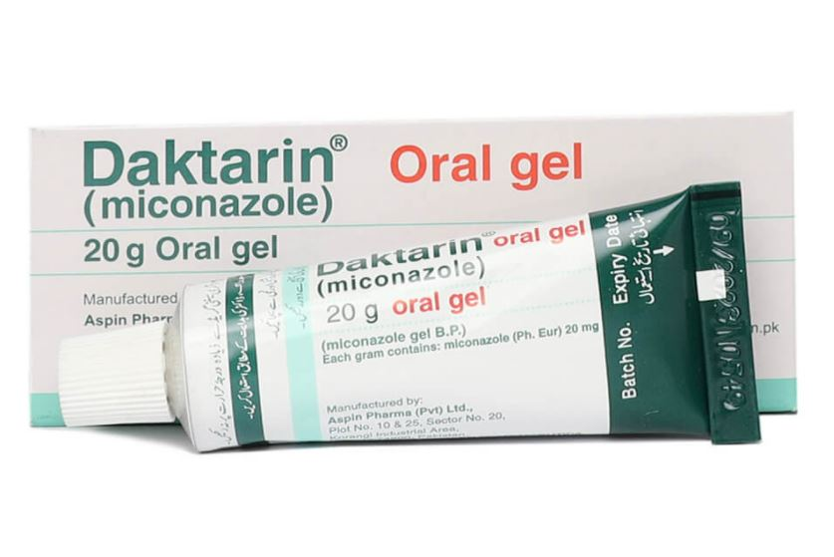
Evidence base for over-the-counter medication
Only Daktarin oral gel (miconazole) is available OTC to treat oral thrush. It has proven efficacy and appears to have clinical cure rates between 80% and 90%.
The dosage of the gel is four times a day in all age groups, although the volume administered varies, depending on the age of the patient. For those aged between 4 and 24 months, 1.25 mL (¼ measuring spoon) of gel should be applied; for adults and children older than 2 years, 2.5 mL (½ measuring spoon) of gel is applied.

Slide 39
Treatment
Miconazole can cause nausea and vomiting, dry mouth and oral discomfort.
In comparative trials, Daktarin appears to have superior cure rates than the prescription-only medication (POM) nystatin.
Topical or systemic antifungal medication for 2 weeks usually produces resolution.
Systemic therapy using fluconazole is usually highly effective.
In most cases, fluconazole given once or twice weekly is highly effective at preventing recurrent infection.

Slide 40

Thank you
Thank you

