Slide 1
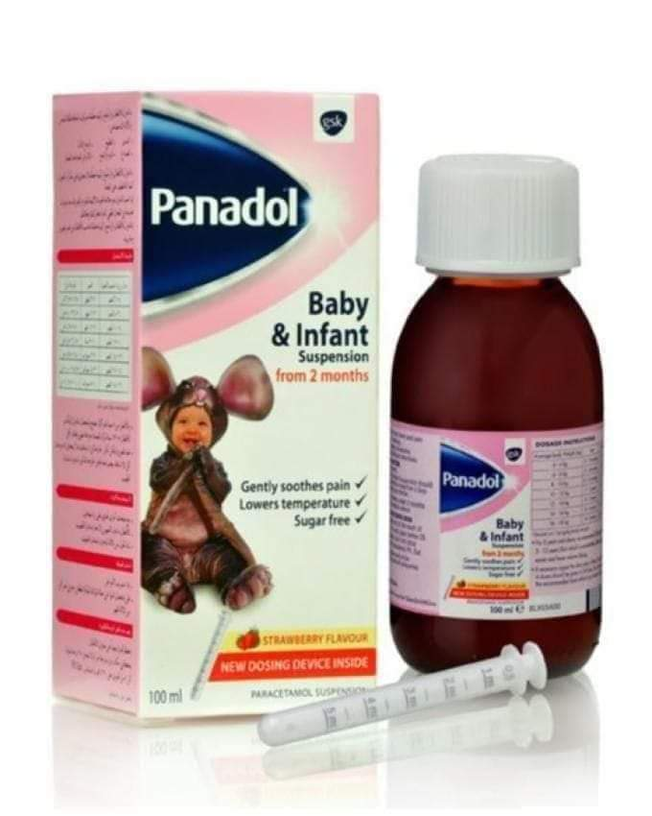
Calculating Doses
Dr. Haider Raheem Mohammad

Slide 2
Pediatric Patients
• Pediatric patients, defined as those younger than 18 years.
• Newborn infants born before 37 weeks of gestational age are termed premature;
• those between 1 day and 1 month of age are neonates (the term neonate is used to describe a newborn infant aged 0–28 days);
• 1 month to 1 year are infants;
• 1 to 11 years are children; The terms child or children are used generically to describe the entire range from infant to adolescent (1 month–17 years). and
• 12 to 17 years are adolescents.

Slide 3
Calculating Doses
• Calculation of doses generally can be performed with dimensional analysis.
• Problems encountered in the pharmacy include calculation of the number of doses, quantities in a dose or total mass/volume, amount of active or inactive ingredients, and size of dose.
• Calculation of children’s doses is commonly performed by the pharmacist.
• Dosage is optimally calculated by using the child’s body weight or mass and the appropriate dose in milligrams per kilogram (mg/kg).

Slide 4
Calculating Doses
• Many children’s doses are standardised by weight (and therefore require multiplying by the body-weight in kilograms to determine the child’s dose); occasionally, the doses have been standardised by body surface area (in m²).
• For most drugs the adult maximum dose should not be exceeded. For example if the dose is stated as 8 mg/kg (max. 300 mg), a child weighing 10 kg should receive 80 mg but a child weighing 40 kg should receive 300 mg (rather than 320 mg).

Slide 5
Calculating Doses
• Since children are more susceptible to the harmful effects of drugs, dosage should be carefully calculated until the age of puberty or a weight of 50 kg is reached.
• Young children may require a higher dose per kilogram than adults because of their higher metabolic rates.
• Other problems need to be considered. For example, calculation by body-weight in the overweight child may result in much higher doses being administered than necessary; in such cases, dose should be calculated from an ideal weight, related to height and age.

Slide 6
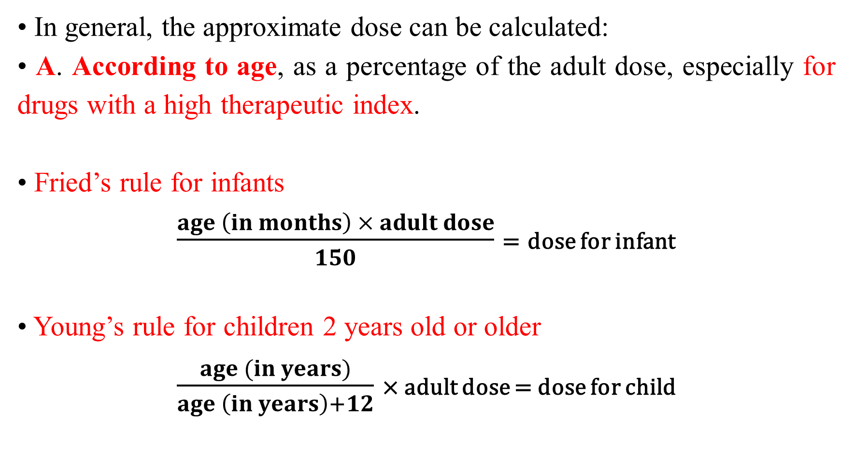
Calculating Doses
• In general, the approximate dose can be calculated:
• A. According to age, as a percentage of the adult dose, especially for drugs with a high therapeutic index.
• Fried’s rule for infants
$\frac{age \left(in months\right) × adult dose}{150}$ = dose for infant
• Young’s rule for children 2 years old or older
$\frac{age (in years)}{age \left(in years\right)+12}$ × adult dose = dose for child
means that a child of 6 years would receive one-third of the adult dose.

Slide 7
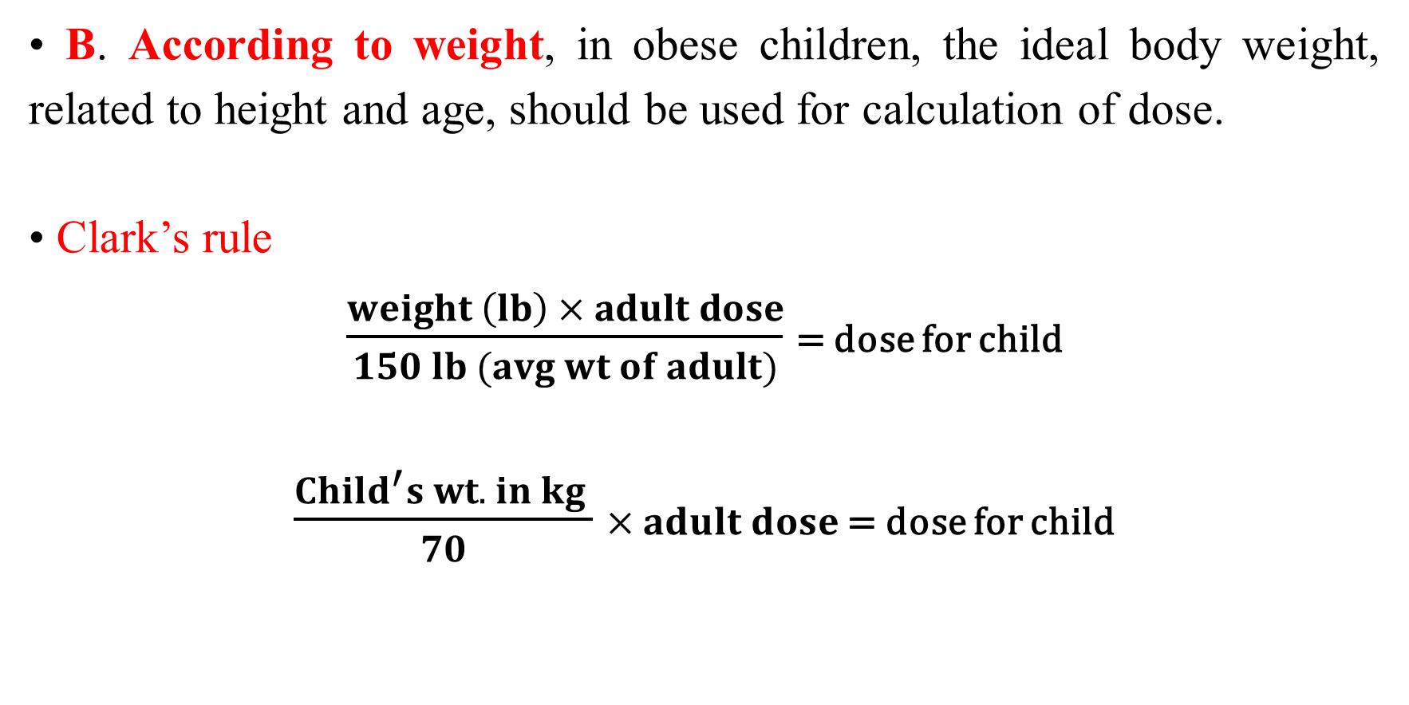
Calculating Doses
• B. According to weight, in obese children, the ideal body weight, related to height and age, should be used for calculation of dose.
• Clark’s rule
$\frac{weight \left(lb\right) × adult dose}{150 lb (avg wt of adult)}$ = dose for child
$\frac{Child^{′}s wt. in kg }{70}$ × 𝐚𝐝𝐮𝐥𝐭 𝐝𝐨𝐬𝐞 = dose for child
1 kilogram (kg) = 2.2 pounds (lbs).

Slide 8
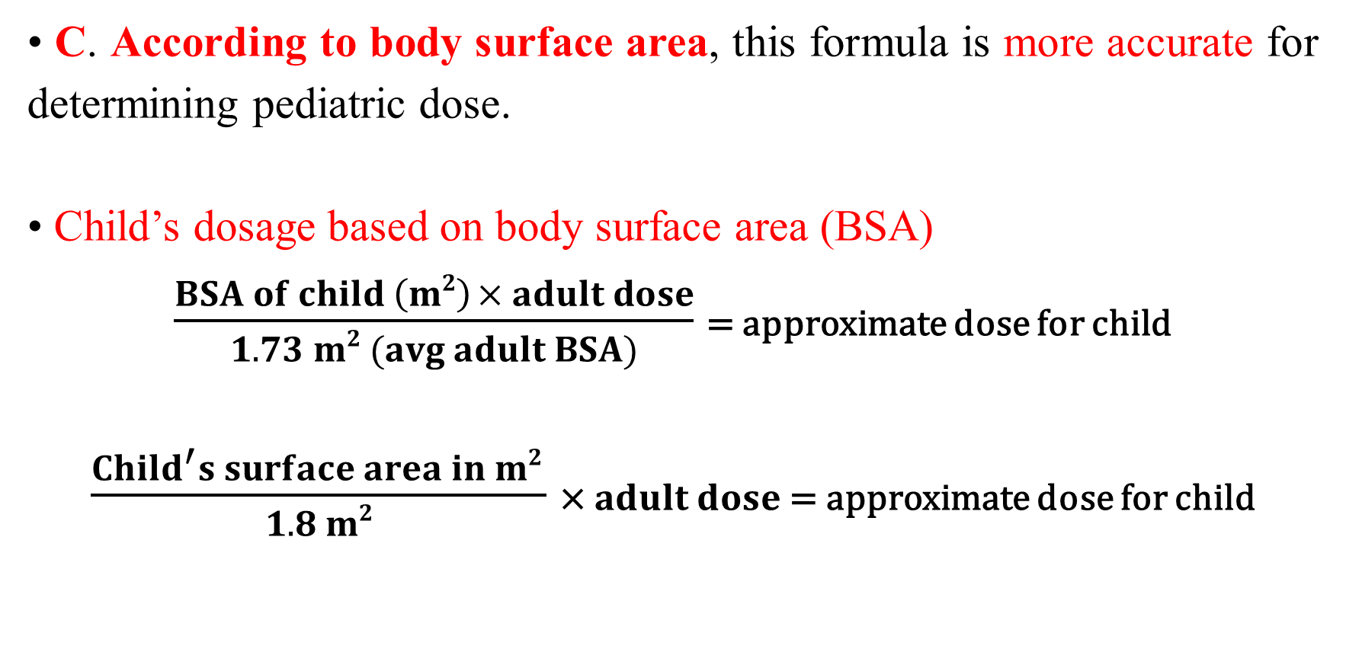
Calculating Doses
• C. According to body surface area, this formula is more accurate for determining pediatric dose.
• Child’s dosage based on body surface area (BSA)
$\frac{BSA of child \left(m2\right) × adult dose}{1.73 m2 (avg adult BSA)}$ = approximate dose for child
$\frac{Child^{′}s surface area in m2 }{1.8 m2}$ × 𝐚𝐝𝐮𝐥𝐭 𝐝𝐨𝐬𝐞 = approximate dose for child

Slide 9
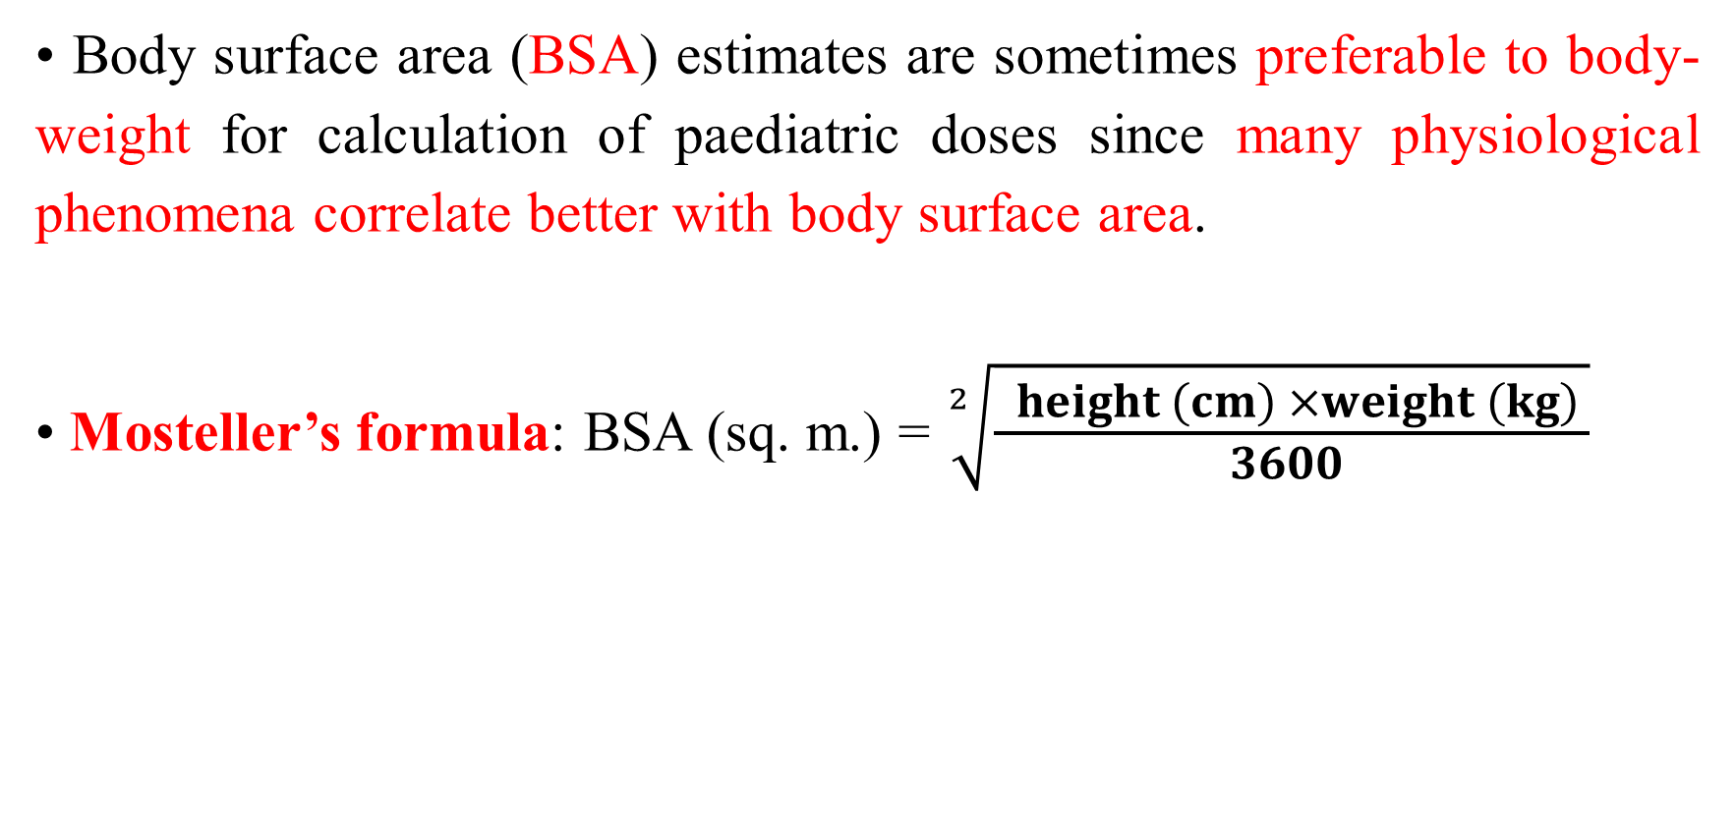
Calculating Doses
• Body surface area (BSA) estimates are sometimes preferable to body-weight for calculation of paediatric doses since many physiological phenomena correlate better with body surface area.
• Mosteller’s formula: BSA (sq. m.) = $\sqrt[2]{\frac{ height \left(cm\right) ×weight \left(kg\right) }{3600 }}$
Which is as accurate to within 2% as more complicated formulae.

Slide 10
Body surface area of children.
BSA for a 15-kg. child, 100 cm. tall = 0.64 M²

Slide 11
Nomogram for the estimation of surface area.
The surface area is indicated where a straight line that connects the height and
weight levels intersects the surface area column, or if the patient is roughly of average size, from the weight alone (enclosed area).

Slide 12
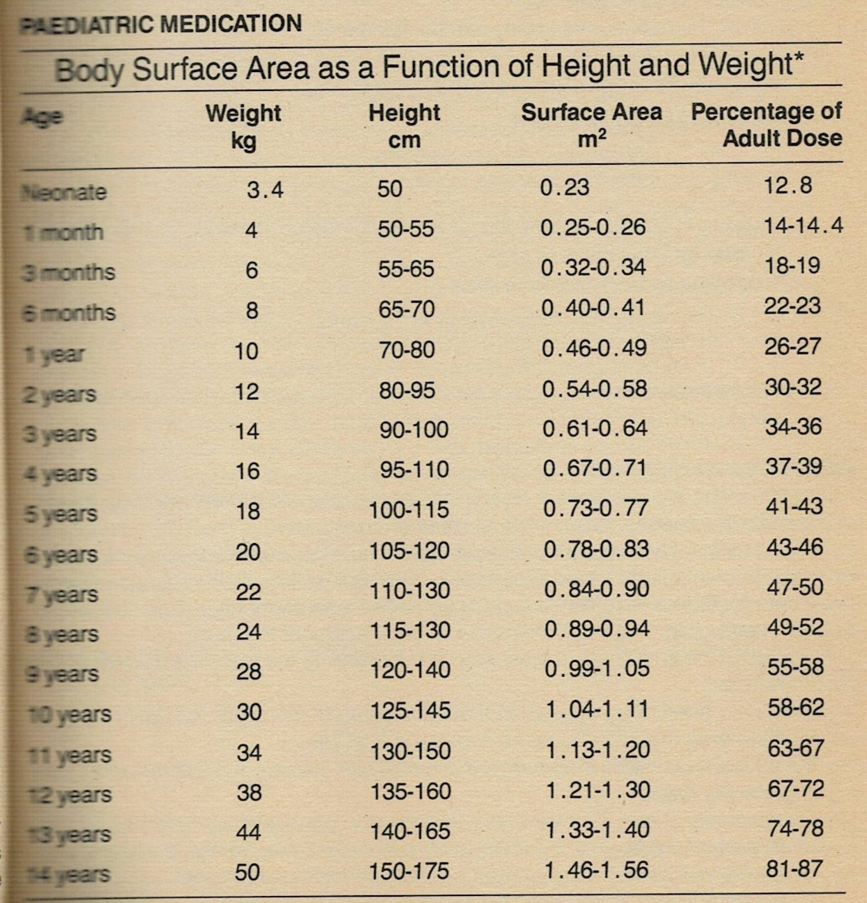

Slide 13
Calculating Doses
• E. Constant rate intravenous infusions
• Some drugs are administered intravenously at a constant (zero-order) rate by using a continuous-drip infusion set or a constant-rate infusion pump.
• The flow rate (volume per unit time) required can be calculated from the volume to be administered and the duration of the infusion.
• The rate of drug administration can be calculated from the concentration of drug in the infused solution and the flow rate of the infusion set or pump.
• Conversion factors may be required to obtain the final answer in the correct units (drops per minute or milliliters per hour).

Slide 14
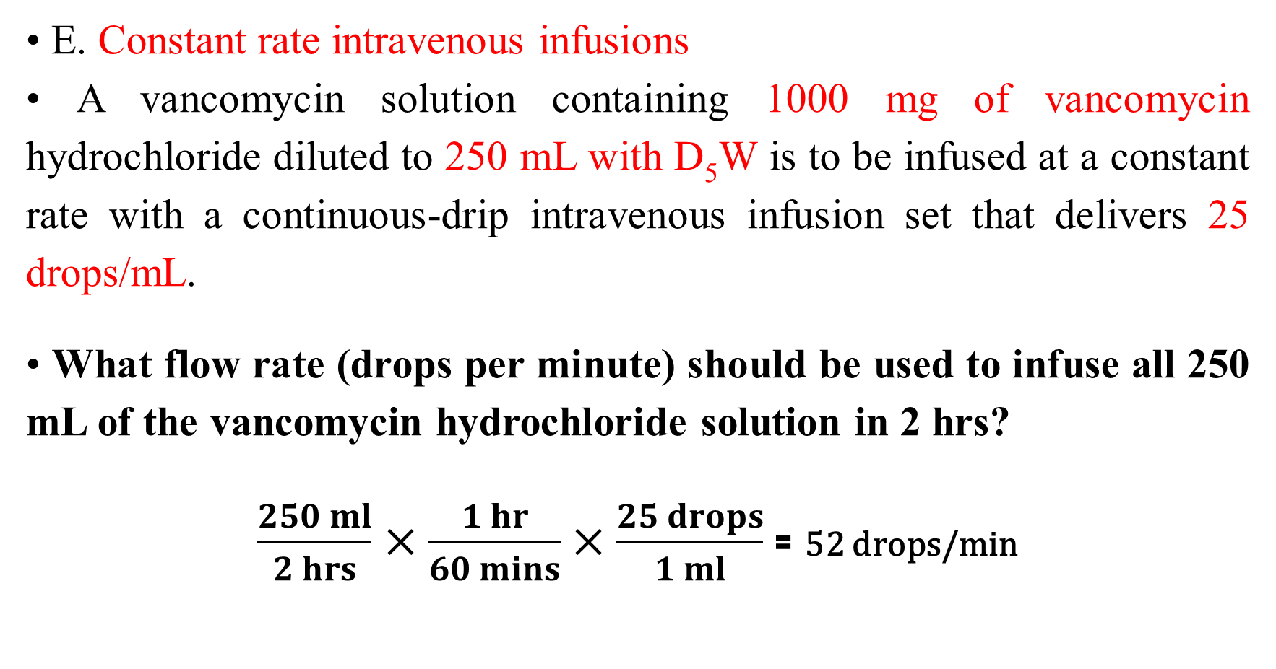
Calculating Doses
• E. Constant rate intravenous infusions
• A vancomycin solution containing 1000 mg of vancomycin hydrochloride diluted to 250 mL with D₅W is to be infused at a constant rate with a continuous-drip intravenous infusion set that delivers 25 drops/mL.
• What flow rate (drops per minute) should be used to infuse all 250 mL of the vancomycin hydrochloride solution in 2 hrs?
$\frac{250 ml}{2 hrs}$ $×\frac{1 hr}{60 mins}×\frac{25 drops}{1 ml}$ = 52 drops/min

Slide 15
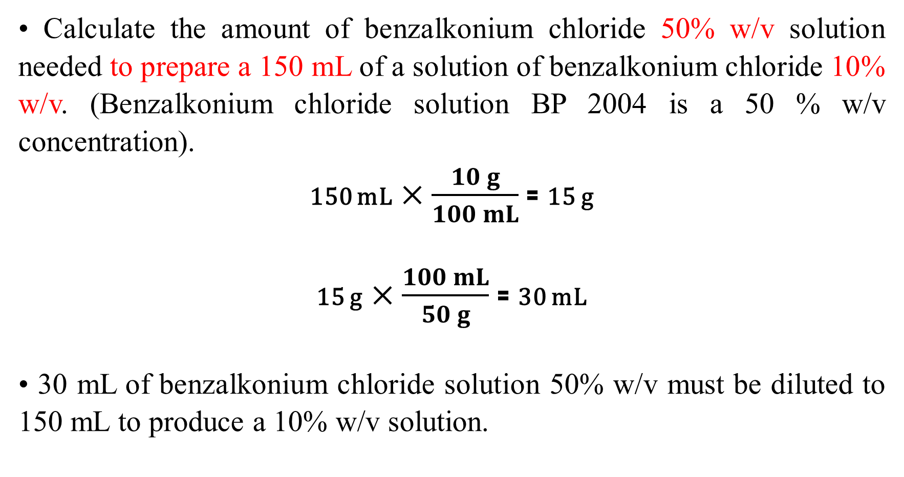
Preparing Dilutions
• Calculate the amount of benzalkonium chloride 50% w/v solution needed to prepare a 150 mL of a solution of benzalkonium chloride 10% w/v. (Benzalkonium chloride solution BP 2004 is a 50 % w/v concentration).
150 mL$×\frac{10 g}{100 mL}$ = 15 g
15 g$×\frac{100 mL}{50 g}$ = 30 mL
• 30 mL of benzalkonium chloride solution 50% w/v must be diluted to 150 mL to produce a 10% w/v solution.

Slide 16
Preparing Dilutions
• Method 2
Product of volume and concentration:
V_{c} × C_{c} = V_{d} × C_{d} where V_{c} = volume of concentrated solution
V_{c} × 50 = 150 x 10 C_{c} = concentration of concentrate
V_{c} = 150/5 V_{d} = volume of diluted solution
V_{c} = 30 mL C_{d} = concentration of diluted solution

Slide 17
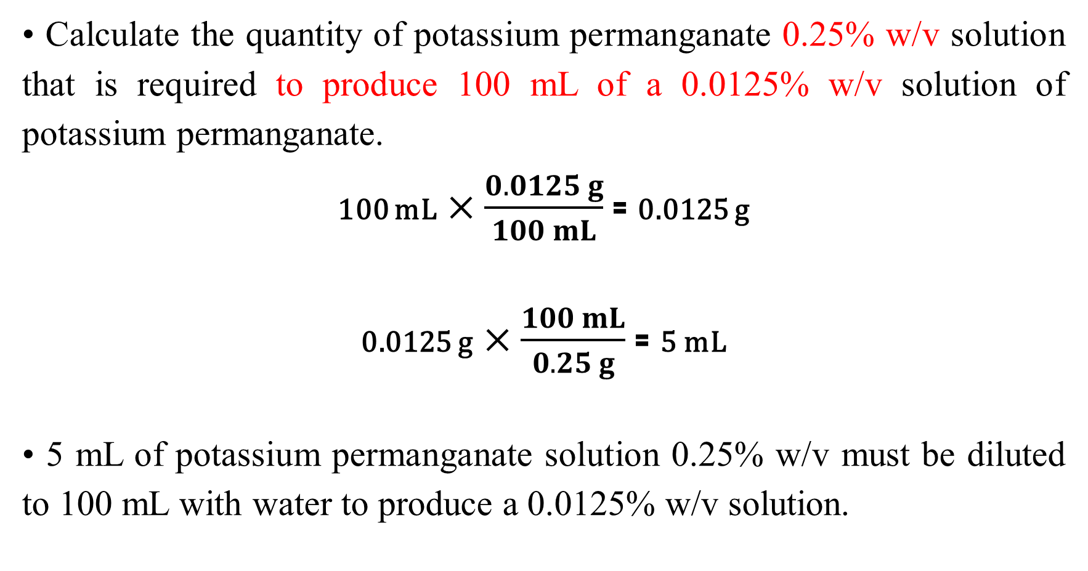
Preparing Dilutions
• Calculate the quantity of potassium permanganate 0.25% w/v solution that is required to produce 100 mL of a 0.0125% w/v solution of potassium permanganate.
100 mL$×\frac{0.0125 g}{100 mL}$ = 0.0125 g
0.0125 g$×\frac{100 mL}{0.25 g}$ = 5 mL
• 5 mL of potassium permanganate solution 0.25% w/v must be diluted to 100 mL with water to produce a 0.0125% w/v solution.

Slide 18
Preparing Dilutions
• Method 2
V_{c} × C_{c} = V_{d} × C_{d}
V_{c} = volume of concentrated solution = unknown
C_{c} = concentration of concentrate = 0.25 %
V_{d} = volume of diluted solution = 100mL
C_{d} = concentration of diluted solution = 0.0125 %
V_{c} × 0.25 % = 100 mL × 0.0125 %
V_{c} = 1.25/0.25
= 5 mL

Slide 19


