Slide 1
Treatment of Cancer Pain – Part II
Dr. Haider Raheem Mohammad

Slide 2
Opioids
• The term opiate refers to compounds structurally related to products found in opium, a word derived from opos, the Greek word for “juice,” natural opiates being derived from the resin of the opium poppy, Papaver somniferum. Opiates include the natural plant alkaloids, such as morphine, codeine, thebaine, and many semisynthetic derivatives.
Papaver somniferum

Slide 3
Opioids
• An opioid is any agent that has the functional and pharmacological properties of an opiate.
• The term endorphin not only is used synonymously with endogenous opioid peptides but also refers to a specific endogenous opioid, β-endorphin.
• The families of endogenous opioid peptides (β-endorphin, enkephalins, and dynorphins) interacting with the three opioid receptor subtypes (μ, δ, κ).

Slide 4
Opioids
• The term narcotic was derived from the Greek word narkotikos, for “benumbing” or “stupor.”
• Although the term narcotic originally referred to any drug that induced narcosis or sleep, the word has become associated with opioids and is often used in a legal context to refer to substances with abuse or addictive potential.

Slide 5
Methadone Dose Calculation
• L.V. has now completed chemoradiation therapy, and the mucositis pain has resolved. He continues to have persistent burning neuropathic pain rated 8 of 10 in the neck and shoulders and is using transdermal fentanyl 100 mcg/hour along with five doses of immediate-release oral morphine 30 mg per day. He is also taking gabapentin 900 mg orally three times a day and using a Lidoderm patch on each shoulder.
• L.V.’s oncologist wants to switch to oral methadone for neuropathic pain management. What is the oral methadone dose L.V. should be started on?

Slide 6
Methadone Dose Calculation
• Unlike short-acting opioids, methadone has a long half-life that ranges from 15 to 60 hours with a duration of action of 6 to 12 hours.
• The conversion to methadone is not proportional like other opioid equianalgesic dose calculations. The most commonly used morphine to methadone conversions are given in Table 5-3.

Slide 7
Table 5-3: Morphine to methadone equianalgesic dose ratio.
Oral Morphine Dose (mg/d) | <100 | 101–300 | 301–600 | 601–800 | 801–1000 | ≥1001
Oral morphine to oral methadone ratio | 3:1 | 5:1 | 10:1 | 12:1 | 15:1 | 20:1
• The dose of oral morphine falls within the dose range of 301 to 600 mg, which corresponds to a 10:1 oral morphine to oral methadone ratio.

Slide 8
Methadone Dose Calculation
• The calculations to convert transdermal fentanyl to oral methadone in L.V. are:
Step 1:
• Determine the 24-hour total of the opioid that will be converted. For L.V., the transdermal fentanyl 100 mcg/hour patch will need to be converted to oral morphine. In addition, L.V. is using 150 mg/day of immediate-release oral morphine.

Slide 9
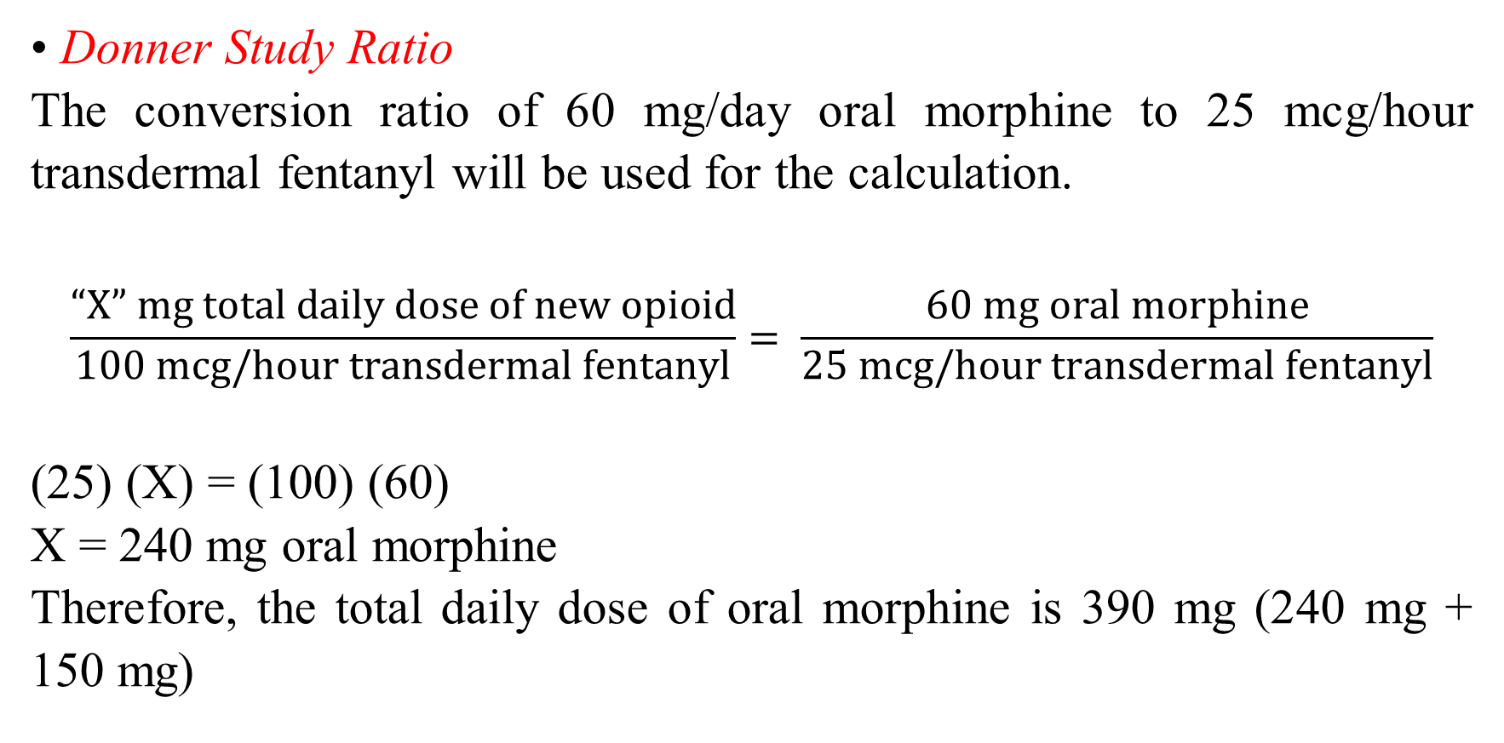
Methadone Dose Calculation
• Donner Study Ratio
The conversion ratio of 60 mg/day oral morphine to 25 mcg/hour transdermal fentanyl will be used for the calculation.
$$\frac{“X” mg total daily dose of new opioid}{100 mcg/hour transdermal fentanyl}= \frac{60 mg oral morphine}{25 mcg/hour transdermal fentanyl}$$
(25) (X) = (100) (60)
X = 240 mg oral morphine
Therefore, the total daily dose of oral morphine is 390 mg (240 mg + 150 mg)

Slide 10
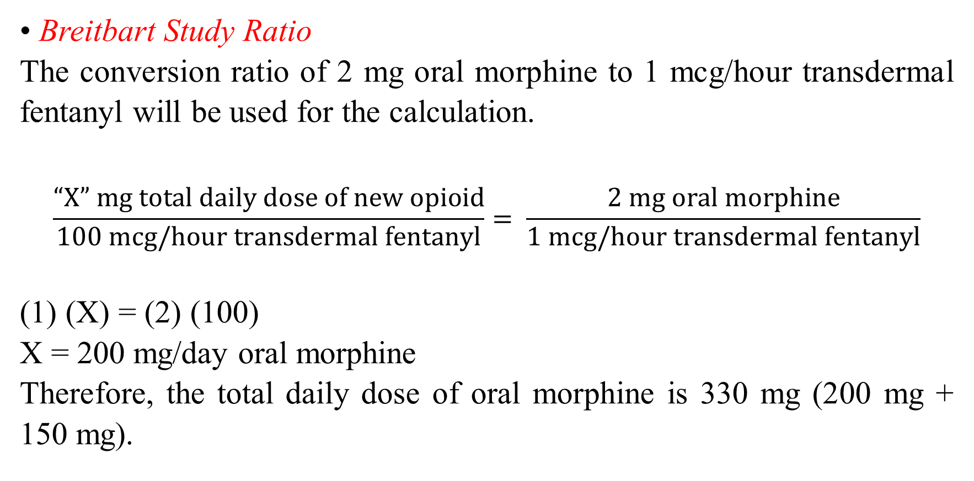
Methadone Dose Calculation
• Breitbart Study Ratio
The conversion ratio of 2 mg oral morphine to 1 mcg/hour transdermal fentanyl will be used for the calculation.
$$\frac{“X” mg total daily dose of new opioid}{100 mcg/hour transdermal fentanyl}= \frac{2 mg oral morphine}{1 mcg/hour transdermal fentanyl}$$
(1) (X) = (2) (100)
X = 200 mg/day oral morphine
Therefore, the total daily dose of oral morphine is 330 mg (200 mg + 150 mg).

Slide 11
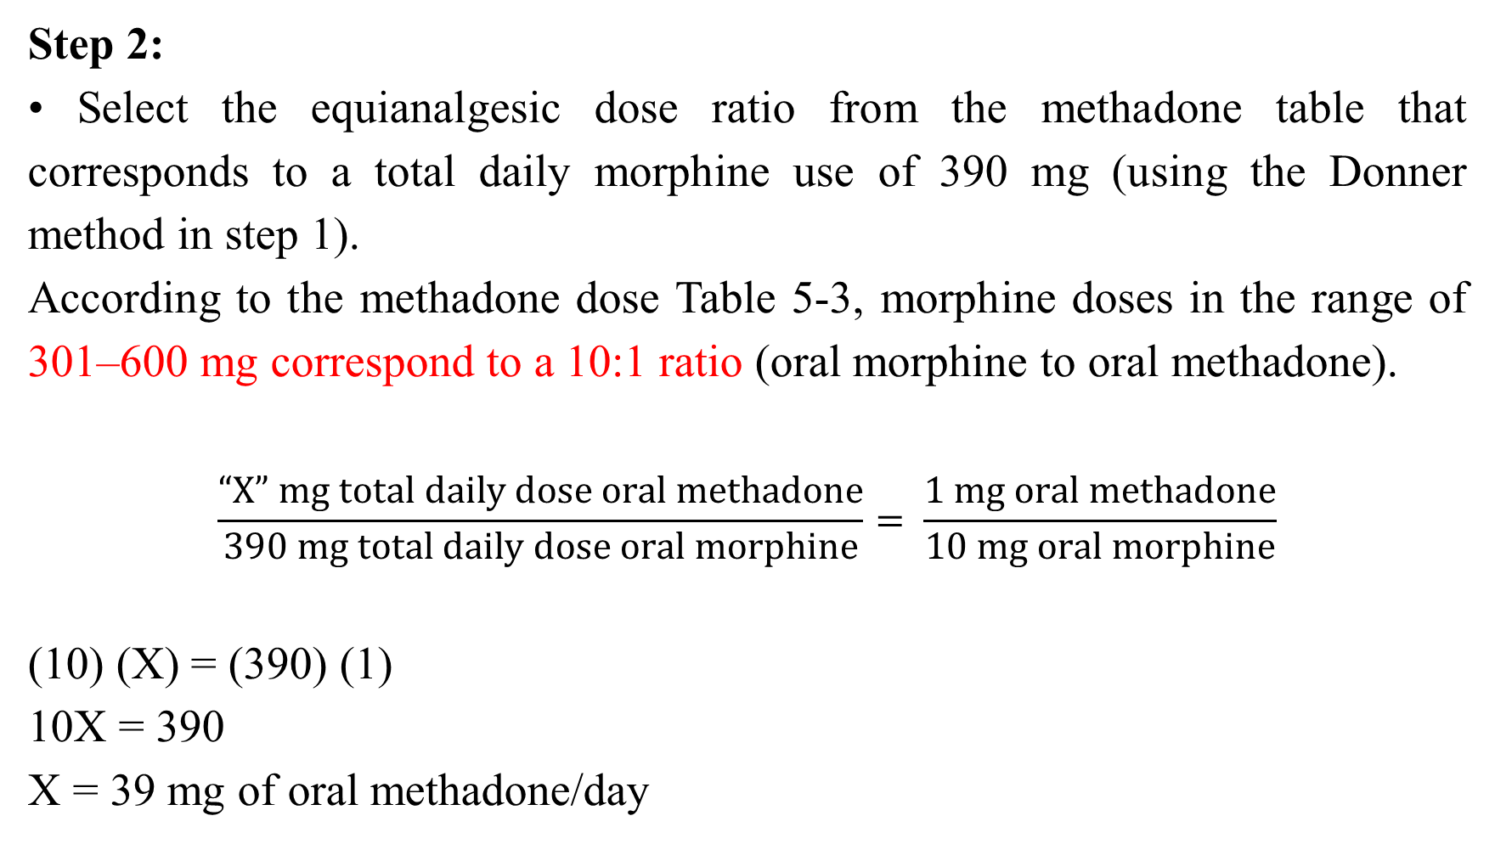
Methadone Dose Calculation
Step 2:
• Select the equianalgesic dose ratio from the methadone table that corresponds to a total daily morphine use of 390 mg (using the Donner method in step 1).
According to the methadone dose Table 5-3, morphine doses in the range of 301–600 mg correspond to a 10:1 ratio (oral morphine to oral methadone).
$$\frac{“X” mg total daily dose oral methadone}{390 mg total daily dose oral morphine}= \frac{1 mg oral methadone}{10 mg oral morphine}$$
(10) (X) = (390) (1)
10X = 390
X = 39 mg of oral methadone/day

Slide 12

Thank you

