Slide 1
Hello, and welcome to my lecture presentation on Pressure Scales.
Today, we will be covering what pressure is, how it is measured, and the different types of pressure scales.
Pressure is the force per unit area that acts on a surface. It is a fundamental concept in physics, engineering, medicine, and many other fields.
Pressure is measured using various devices such as gauges, sensors, and pressure transducers. These instruments provide real-time data on the level of pressure at a particular location.

Slide 2
There are several types of pressure scales, including:
1. absolute pressure: Pressure measured relative to the atmospheric pressure at sea level
it is measured in pascals (Pa) and atmospheres (atm).
2. Gauge pressure: Pressure measured above or below the atmospheric pressure at sea level
it is also measured in (Pa) and (atm.).
3. Vacuum Pressure: Pressure below the atmospheric pressure at sea level. It is measured in Pascals (Pa) or atmospheres ( atm)

Slide 3
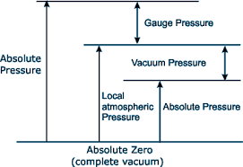
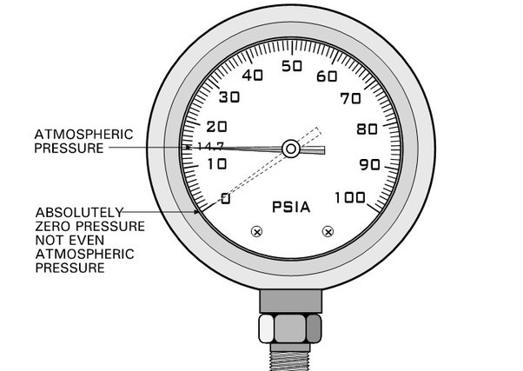
Absolute pressure scale
Absolute pressure is when the pressure is measured using absolutely no pressure as a starting point.
Air, which is a mixture of gases, has weight. The force of gravity attracts the air. At sea-level the ‘standard’ weight of the earth’s atmosphere exerts a pressure of 14.7 PSI Atmospheric pressure. PSI means pounds per square inch
Since we all are subjected to the pressure of the earth’s atmosphere all the time, we may think of it as no pressure at all and consider the pressure of the earth’s atmosphere to be zero. Yet it is a very real pressure. If we move all the air out of a closed chamber, there would be no pressure within the chamber, so the pressure would be absolutely zero.
The absolute pressure scale uses absolute zero pressure as its starting point. Absolute pressure is the complete absence of pressure, even Atmospheric pressure.

Slide 4
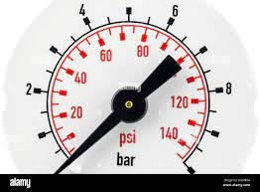
Gauge pressure scale
Gauge pressure is pressure measured using atmospheric pressure as a starting point and calling this pressure ZERO.
Most pressures measured in Gas/ Oil processing are gauge pressures. The gauge pressure uses atmospheric pressure as the starting point for all measurements. This means that the gauge scale starts at zero even though there is still atmospheric pressure on it.

Slide 5
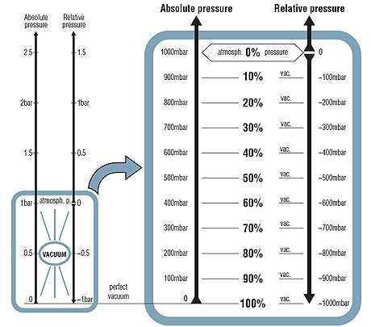
Vacuum pressure scale
A vacuum is a space that contains no air. vacuum means pressure lower than atmospheric pressure. Vacuum pressure is commonly measured in inches of mercury. A reading of zero on the mercury vacuum gauge is equal to atmospheric pressure. The vacuum scale is used to measure pressures in pipes or vessels which are below atmospheric pressures.
An unconnected pressure gauge with a vacuum scale will read zero.

Slide 6
Blood pressure
force originating in the pumping action of the heart, exerted by the blood against the walls of the blood vessels; the stretching of the vessels in response to this force and their subsequent contraction are important in maintaining blood flow through the vascular system.

Slide 7
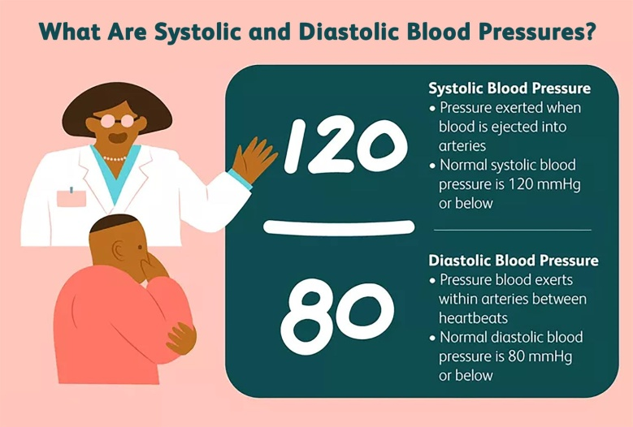
In humans
blood pressure is usually measured indirectly with a special cuff over the brachial artery (in the arm) or the femoral artery (in the leg). There are two pressures measured: (1) the systolic pressure (the higher pressure), which is the force that blood exerts on the artery walls as the heart contracts to pump the blood out to the body into the organs and tissues. It is an indicator to the amount of pressure the heart exert to pump blood in the circulatory system. and (2) the diastolic pressure is the lower level of pressure in arteries when heart is at the rest between beats. It is an indicator to the amount of the resistance to blood flow in the circulatory system.

Slide 8
The standard values
systolic pressure is normally between 90 and 120 millimetres of mercury (mmHg). Diastolic pressure is normally between 60 and 80 mmHg. Hence, in general, a reading of 110/70 mmHg would be considered healthy, whereas 80/50 mmHg would be low and 160/100 mmHg would be high.

Slide 9
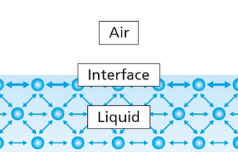
Surface tension
Surface tension pressure: it’s the pressure exerted by a liquid on its surface. (Pa).
Surface tension arises from cohesive forces between the liquid molecules. In the bulk, molecules are interacting equally with each other in all directions. However, at the surface, molecules don't have the same neighbors on all sides. Thus, a net inward force pulls the molecules toward the bulk. This gives rise to a property called surface tension. How high the surface tension is, is dependent on the type of molecular interactions present. For example, the surface tension of water is high, as the water molecules interact with each other through hydrogen bonds which are relatively strong.

Slide 10
Units of surface tension
There are several different units for surface and interfacial tension; typically (N/m and dynes/cm) are used.

