Slide 1
Common cold
Done by:
Assist. Lec. Shaymaa Hasan Abbas

Slide 2
Definition
-It is a self-limiting viral infection of the upper respiratory tract.
- Different types of viruses (200types) can produce symptom of the common cold such as: rhinoviruses (half of the cases), adenoviruses and others.
- Preschool children are more common to suffer from common cold.

Slide 3
Symptoms
Fever and malaise
Rhinorrhea
Nasal congestion
Sore throat
cough

Slide 4
Differential diagnosis
Differential diagnosis:
The pharmacist must try to differentiate between viral infection and conditions that present with similar symptoms ( e.g.; flu, sinusitis, allergic & chronic rhinitis), as well as the complications associated with the common cold.
Differentiating between colds and flu( which required referral for further investigations'^) is needed. Patients often use the word "flu" when describing a common cold.

Slide 5
Differential diagnosis between common cold and flu
Common cold | Flu
Gradual onset of symptoms | Abrupt onset of symptoms
Temp. rarely elevated | Temp. is 38c or higher (37.5 in elderly).
respiratory symptoms ( cough, sore throat, nasal congestion, or rhinorrhoea) is predominant | constitutional symptoms ( headache, malaise, myalgia, sweat, chills ,prostration) is predominant
common cold attack any time of year | more often in winter seasons

Slide 6
Treatment of common cold
-There is usually no reason to see a doctor as a cold will clear up on its own within a week or two, and there is no prescription-only medicine that can cure a cold.
-Symptoms can be treated with over-the-counter medicines and warm drinks.
-Rest, preferably by staying in bed. (flu)
-Drink as much as possible, as large amounts of fluid are lost during a fever.

Slide 7
Treatment
  Antibacterial are not effective or appropriate as both infections are viral.
  The same non-prescription medicines are used to treat the symptoms of both the common cold and influenza.
  over-the-counter preparations often contain a combination of ingredients intended to treat two or more symptoms.

Slide 8
Treatment timescale
Once the pharmacist has recommended treatment, patient should be advised to see the Dr. in 10-14 days if cold has not improved.

Slide 9
A-Non pharmacological measures:
Non -drug therapy include:
1-increased fluid intake which may loosen the mucus and promote drainage.
2-getting adequate rest may help to recover quickly.
3-adequate nutrition.
4-saline solution can soothe the irritated nasal tissue and moisturized nasal mucosa, and it can be given to all age group and during pregnancy.

Slide 10
Fever and malaise
  Paracetamol, aspirin and ibuprofen
  Aspirin is restricted in its use by its pronounced side-effect profile.

Slide 11
rhinorrhoea
(runny nose)
Antihistamines could theoretically reduce some of the symptoms of a cold:
runny nose (rhinorrhoea) and sneezing. These effects are due to the anticholinergic action of antihistamines.
The older drugs (e.g. chlorphenamine (chlor-pheniramine), promethazine) have more pronounced anticholinergic actions than the non-sedating antihistamines (e.g. loratadine, cetirizine, acrivastine).

Slide 12
Nasal congestion and rhinorrhoea
(runny nose)
Sedating antihistamines
  They are usually co-formulated with sympathomimetics to counteract the congestion and the sedation that they tend to cause.

Slide 13
Cautions and contra-indications
caution in prostatic hypertrophy, urinary retention, susceptibility to angle closure glaucoma, and pyloroduodenal obstruction.
Caution may be required in epilepsy.
Children and the elderly are more susceptible to side-effects.
Hepatic impairment
Sedating antihistamines should be avoided in severe liver disease—increased risk of coma.

Slide 14
Side-effects
Drowsiness is a significant side-effect with most of the older antihistamines.
  paradoxical stimulation may occur rarely, especially with high doses or in children and the elderly.
  Drowsiness may diminish after a few days of treatment .
Side-effects that are more common with the older antihistamines include:
  headache, psychomotor impairment, and antimuscarinic effects such as urinary retention, dry mouth, blurred vision, and gastro-intestinal disturbances.

Slide 15
Non-sedating antihistamines
Note: non-sedating antihistamine cause less sedation and psychomotor impairment than the older antihistamines because they penetrate the blood brain barrier only to a slight extent is rare , but the warning that these drugs may affect driving and skilled tasks is still present
excess alcohol should be avoided.
Loratidine, citrizine, telfast.

Slide 16
Pregnancy
Most manufacturers of antihistamines advise avoiding their use during pregnancy; however,
there is no evidence of teratogenicity except for hydroxyzine.
The use of sedating antihistamines in the latter part of the third trimester may cause adverse effects in neonates such as irritability, paradoxical excitability, and tremor.

Slide 17
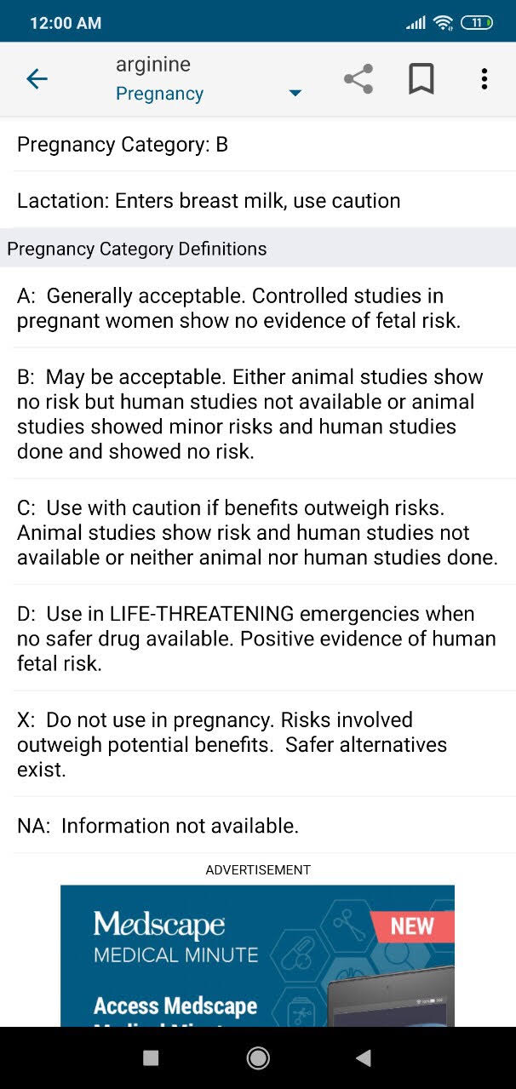

Slide 18
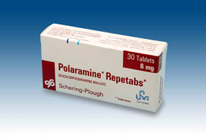
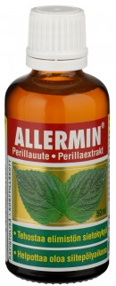

Slide 19
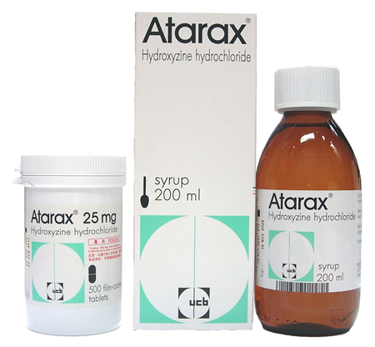
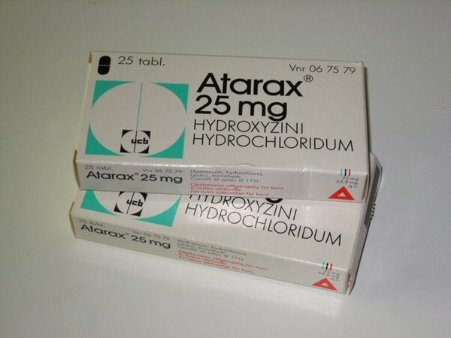

Slide 20
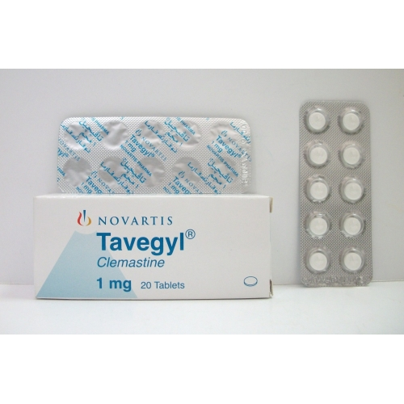

Slide 21
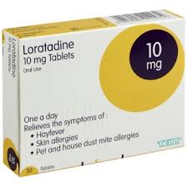
Loratidine

Slide 22
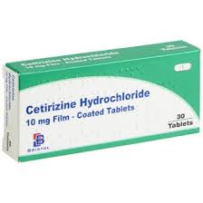
citrizine

Slide 23
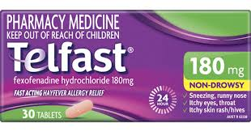
Fexofenadine ( Telfast ®)

Slide 24
Systemic nasal decongestants
Compounds used are sympathomimetic amines: pseudoephedrine, phenylephrine and ephedrine.
Pseudoephedrine is available over the counter; it has few sympathomimetic effects.
Systemic decongestants improve air circulation and mucus drainage.
Nasal decongestants for administration by mouth may not be as effective as preparations for local application but they do not give rise to rebound nasal congestion on withdrawal.

Slide 25
Pseudoephedrine hydrochloride
IMPORTANT SAFETY INFORMATION
MHRA/CHM ADVICE (MARCH 2008 AND FEBRUARY 2009): over the- counter cough and cold medicines for children
Children under 6 years should not be given over-the counter cough and cold medicines containing
pseudoephedrine.

Slide 26
They are central nervous stimulants and should not be taken near bedtime.
Systemic decongestants should be used with caution:
  in diabetes,
  hypertension,
  hyperthyroidism
  susceptibility to angle-closure glaucoma,
  prostatic hypertrophy
  Ischaemic heart disease
  CI/ in patients taking monoamine oxidase inhibitors.
(cause hypertensive crises),

Slide 27
Restrictions on sales of pseudoephedrine and ephedrine
In response to concerns about the possible extraction of pseudoephedrine and ephedrine from OTC products for use in the manufacture of methylam-phetamine (crystal meth), restrictions were introduced in 2007.
The medicines are available only in small pack sizes, with a limit of one pack per customer, and their sale has to be made by a pharmacist or by suitably trained pharmacy staff under the supervision of a pharmacist. When the MHRA reviewed
these arrangements in 2015, they concluded that these measures had made an important contribution to managing the risk of misuse of pseudoephedrine and
ephedrine in the United Kingdom.

Slide 28
Pregnancy
defective closure of the abdominal wall (gastroschisis) reported very rarely in newborns after first trimester exposure.
Breast-feeding
may suppress lactation; avoid if milk production insufficient

Slide 29
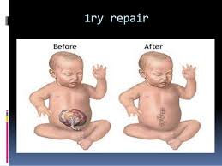

Slide 30
Hepatic impairment
manufacturer advises use with caution in severe impairment.
Renal impairment
use with caution in mild to moderate impairment; manufacturer advises avoid in severe impairment.
Side-effects
nausea, vomiting,
hypertension, tachycardia,
headache, anxiety, restlessness, insomnia; rarely hallucinations, rash;
very rarely angle-closure glaucoma; urinary retention also reported.

Slide 31
Topical nasal decongestants
Inhalation of warm moist air is useful in the treatment of symptoms of acute infective conditions.
The addition of volatile substances such as menthol and eucalyptus may encourage the use of warm moist air

Slide 32
Local decongestants
Sympathomimetic amines exert a rapid and potent vasoconstricting effect, confined to the area of application, when applied directly into the nose in the form of drops or spays.
Compounds used are oxymetazoline, xylometazoline, ephedrine and phenylephrine.

Slide 33
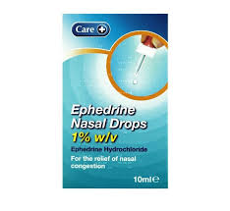
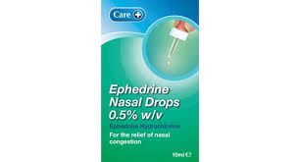
Ephedrine hydrochloride nasal
drops is the safest sympathomimetic preparation and can give relief for several hours.
The more potent sympathomimetic drugs oxymetazoline and xylometazoline hydrochloride are more likely to cause a rebound effect.

Slide 34
  They can be used by patients for whom systemic decongestants are contraindicated, but should be avoided by patients taking monoamine oxidase inhibitors.
  If used for prolonged periods they can cause a rebound effect, with congestion often returning worse than before, and should therefore not be used for more than about 5–7 days.

Slide 35
Xylometazoline hydrochloride
MPORTANT SAFETY INFORMATION
The CHM/MHRA has stated that
non-prescription cough and cold medicines containing oxymetazoline or xylometazoline can be considered for up to 5 days’ treatment in children aged 6–12 years after basic principles of best care have been tried; these medicines
should not be used in children under 6 years of age.

Slide 36
Children under 6 years old
In March 2009, an important statement was issued by the Medicines and Healthcare products Regulatory Agency (MHRA), which says:
The new advice is that parents and careers should no longer use over-the-counter (OTC) cough and cold medicines in children under 6.
  There is no evidence that they work and they can cause side-effects, such as allergic reactions, effects on sleep or hallucinations.
  The risks of side-effects are reduced in older children. This is because they weigh more, get fewer colds and can say if the medicine is doing any good.

Slide 37
Alternatives to cough and cold medicines for infants
Saline nose drops or spray keep nasal passages moist and helps avoid stuffiness.
Acetaminophen or ibuprofen can be used to reduce fever, aches and pains. Parents should carefully read and follow the product’s instructions for use label.
Drinking plenty of liquids will help the child stay well hydrated.

Slide 38
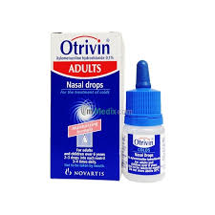
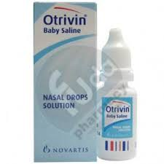
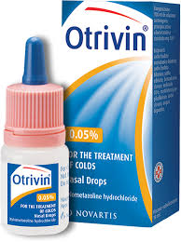

Slide 39
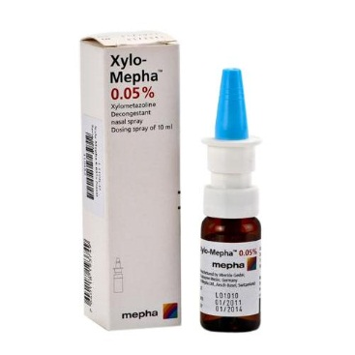
Spray versus drops

Slide 40
Combination products
3-Combination products :sympathomimetics (for congestion) + Antihistamine( for rhinorrhoea and sneezing):
Example of Combination products is :
Actifid® tablet and syrup: which composed of Triprolidine ( sedating antihistamine) and Pseudoephedrine (sympathomimetics). Clarinase (pseduephedrin and loratidin), Panadol cold and flu (night or day)

Slide 41
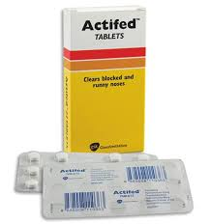

Slide 42
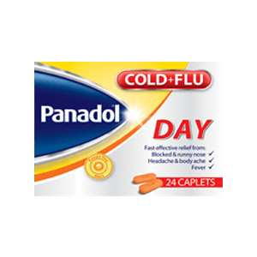

Slide 43
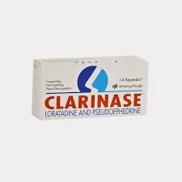

Slide 44
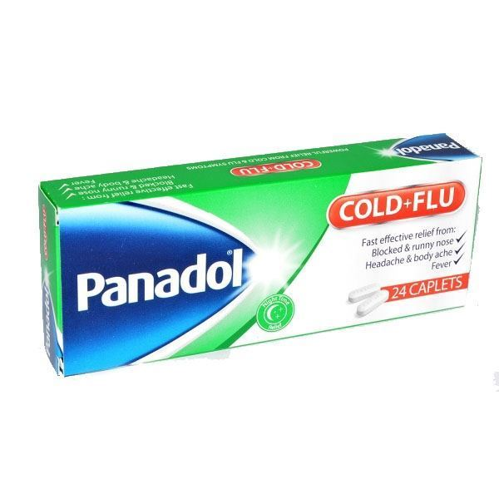

Slide 45
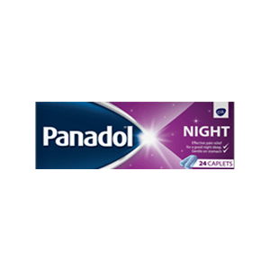

Slide 46
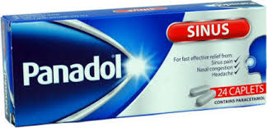

Slide 47
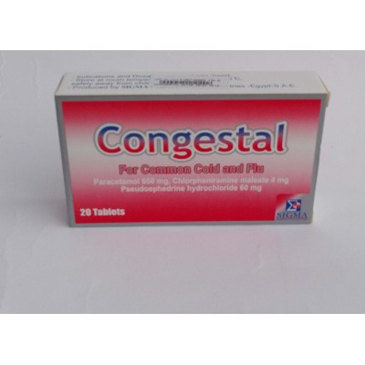
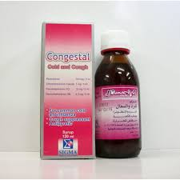

Slide 48
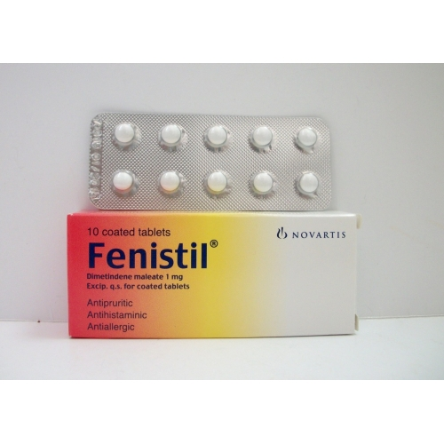
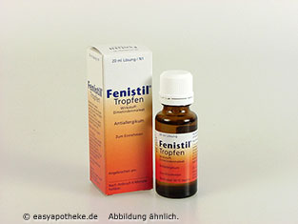

Slide 49
Sore throat
Demulcents
Sucking anything produces saliva, lubricating and soothing inflamed tissues and washing infecting organisms off them.
Any lozenge or pastille, regardless of ingredients, will do this.

Slide 50
glycerin, lemon and honey pastilles may be effective for soothing a sore throat.
Because they contain no medicament they can be used as often as necessary to stop the throat feeling dry, thereby relieving discomfort.
Some products contain ingredients with volatile constituents, e.g. eucalyptus oil and menthol, which produce a sensation of clearing blocked nasal and upper respiratory passages and can be useful in relieving other symptoms of colds.
The main disadvantage of most demulcent throat lozenges and pastilles is their high sugar content.

Slide 51
Antibacterials
The antibacterial compounds used in sore-throat lozenges are unlikely to be effective against the rhinoviruses that are largely responsible for the common cold.
A sore throat complicated by a secondary bacterial infection, such as tonsillitis, would normally be treated with a systemic antibiotic.

Slide 52
  Local anaesthetics Benzocaine is the only local anaesthetic included in sore-throat lozenges;
  benzocaine and lidocaine are used in sore-throat sprays.
  A local anaesthetic may be helpful if swallowing is uncomfortable.
  Local anaesthetics can cause sensitisation in some individuals with prolonged use, so usage should be limited to 5 days.

Slide 53
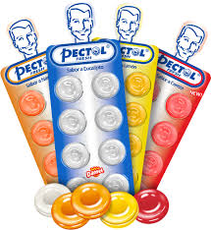
Pectol tablets
Tablet contains Eucalyptus Oil, Glucose and Vitamin C as active ingredients.

Slide 54
The primary active ingredients are dichlorobenzyl alcohol and amylmetacresol, with some formulations containing ascorbic acid (vitamin C).
- Dichlorobenzyl alcohol is a mild antiseptic, able to kill bacteria and viruses associated with mouth and throat infections. It is a common ingredient in throat lozenges such as, Strepsils, Lorsept, and Gorpils. - Amylmetacresol (amc) is an antiseptic used to treat infections of the mouth and throat.
Strepsils

Slide 55
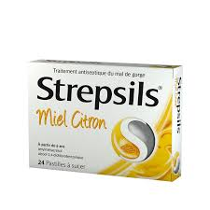

Slide 56
Vitamin C in common cold
Vitamin C does not prevent colds and appears to reduce the duration of symptoms when ingested in large dose (up to 1gm daily)although the response is variable.

Slide 57
Vaccination:
For influenza Prophylaxis, vaccination is recommended
for
  high-risk groups
  all persons over 65 years.

Slide 58
Allergic rhinitis(Hayfever)
Allergic rhinitis, also known as hay fever, is a type of inflammation in the nose which occurs when the immune system overreacts to allergens in the air.
Signs and symptoms include a runny or stuffy nose, sneezing, red, itchy, and watery eyes, and swelling around the eyes. The fluid from the nose is usually clear.

Slide 59
Hayfever
Allergic rhinitis is typically triggered by environmental allergens such as pollen, pet hair, dust, or mold
Histamine is the main chemical mediator responsible for the inflammatory response of hayfever.
All oral formulations for treatment of hayfever are antihistamines and act through competitive antagonism of histamine at the H1 -receptor.

Slide 60
A number of medications may improve symptoms including nasal steroids, antihistamines such as diphenhydramine, cromolyn sodium, and leukotriene receptor antagonists such as montelukast.

Slide 61
Beclometasone, fluticasone and sodium cromoglicate are effective in relieving all nasal symptoms of hayfever.
They take some days to achieve optimum effect, and treatment should ideally be started at least 2 weeks before symptoms are expected.
Patients should be advised that, if symptoms are already present when treatment is started, it could be several days before an effect is noted and several weeks before full relief is obtained.

Slide 62
Beclometasone and fluticasone are presented as aqueous non-aerosol sprays. Absorption from the nasal mucosa is low, and systemic effects are highly unlikely at recommended doses (although pregnant and lactating women are advised to avoid using them unless a doctor regards treatment as essential).
Any local reactions, such as stinging, burning and aftertaste, are mild and transient.

Slide 63
Treatment may need to be maintained throughout the hayfever season, and repeated each year.
The preparations can be used for up to 3 months without consulting a doctor.
Beclometasone and fluticasone are licensed for use in adults of 18 years and over.
They should be avoided if there is infection in the nose or eye.
There are otherwise no significant contraindications or interactions.

Slide 64


